Slide 1
Impact of Weather on Ridership of the Chicago Transit Authority
Dwight Brandt
Colorado State University Global
MIS581 – Capstone: Business Intelligence and Data Analytics
Dr. Kimberly A. Ford
November 7, 2021
Notes:
Impact of Weather on Ridership of the Chicago Transit Authority

Slide 2
Outline
Transit & Weather
Who Is the CTA?
Research Design – Hypotheses & Dataset
Review of the Findings
Recommendations
Resources
Notes:
In this presentation, several topics will be covered. To begin, I will provide a brief introduction on how weather and transit are linked.
Next, some points on the Chicago Transit Authority’s, also referred to as “the CTA” background will be noted. Then, I will dig deeper into the study itself. The first element will involve the research design. This will include the hypotheses developed and the dataset used in the analysis.
After that, I will outline some of the key findings of the research. Lastly, recommendations will be suggested.
At the end, I will provide you with where to find information on the project itself, including the dataset and the research paper.
Let us get started.
(next slide)

Slide 3
Transit & Weather
Mass Transit
Is important in urbanized settings (Farmer & Noonan, 2014)
Provides economic growth of a region (Vajjarapu et al., 2020)
Is often dependent on ridership revenue (Merlin et al., 2021)
Can be impacted by various factors (Kalkstein et al., 2009)
Notes:
Humanity has looked towards transportation as a means to get from one place to another throughout much of history. Over time, the modes have expanded to include such high-volume methods as bus and rail, capable of moving large numbers of people. Referred to as mass transit systems, they play an important role especially in urbanized settings (Farmer & Noonan, 2014) and to general economic growth of a region (Vajjarapu et al., 2020).
One component that is directly related to the success of any mass transit system is ridership, since often a large share of a budget that funds a mass transit system comes directly from those paying for the services in which they ride (Merlin et al., 2021). There are a multitude of factors that can impact ridership including the price of fuel, vehicle ownership, and accessibility to transit centers (Kalkstein et al., 2009).
One major disruptor that has had a large negative impact on travel in general has been the COVID-19 pandemic. Parker et al. (2021) note that results of a survey indicated that 75% of participants stated a reduction in transit usage in the United States since the start of the pandemic. A reduction of this magnitude would likely have a substantial impact on any transit agency reliant on revenue from its riders.
(next slide)

Slide 4
Transit & Weather
Weather Impacts
Well-known by transit agencies as having an impact on ridership (Kalkenstein et al., 2009)
Numerous studies have concluded weather impacts ridership (Ngo, 2019)
This includes precipitation and snowfall (Miao et al., 2019)
Notes:
Weather has been long noted as a factor that impacts transit ridership by those overseeing transit agencies (Kalkstein et al., 2009). There have been numerous studies that have looked at the relationship between transit ridership and weather (Ngo, 2019). For example, riders are not wanting to walk or wait in snow or heavy rain for public transit, and as a result, this can reduce ridership (Miao et al., 2019). The general consensus of these studies concluded that weather can negatively impact transit ridership.
Now, let us go into the topic of this research, the CTA.
(next slide)

Slide 5
The CTA
One of the largest agencies in the United States, ridership and revenue (Tang & Thakuriah, 2012)
Service area around 3.5 million
1.6 million riders on a given weekday
  Rail – “the L”
  Bus
Annual budgets around $1.5 B (operating) and $1.3 B (capital)
Illinois state law dictates at least half of operating budget come from rider revenue
(Chicago Transit Authority [CTA], 2021)
Notes:
Formed in the 1940s, the CTA today is among the largest mass transit agencies in the United States both in revenue and ridership, and it has grown over its existence to include not only the city of Chicago, but also the around three dozen bordering municipalities of the Greater Chicago Area (Tang & Thakuriah, 2012), amounting to a total service population of 3.5 million (Chicago Transit Authority [CTA], 2021). On any given weekday, around 1.6 million riders take the L or a bus on its system, with ridership about evenly split between the two modes.
As an organization, there are close to 10,000 employees on its payroll, positions that are funded through and included in its annual operating budget of over $1.5 billion. In addition, the CTA has an annual capital budget of close to $1.3 billion (CTA, 2021). An Illinois state law requires the CTA to recover a minimum of one half of its operating budget from ridership revenue (CTA, 2021). Such an organization of this size, with its large budgets and number of employees, would likely be impacted by ridership swings, not only from substantial impacts of a pandemic, but perhaps weather-related impacts as well, adding to the constraints of the system.
Now thinking of the CTA, how does weather impact ridership on its system? This is the premise of the research project.
We will now transition in this presentation, to get into the details.
(next slide)

Slide 6
Research Design
Hypotheses
Set of 6 research questions focused around using
  One of two weather variables – precipitation; snow
  One of three transit variables – overall; bus; rail
Example
  RQ 2: Does the amount of precipitation negatively impact total weekday bus ridership?
    H₀ : There is no negative relationship between the amount of precipitation and the total weekday bus ridership
    Ha : A negative relationship exists between the amount of precipitation and the total weekday bus ridership
Notes:
There were a total of six research questions (RQs) developed as part of this project, each with a null and alternative hypothesis. Each RQ was focused on one of the two weather variables, precipitation or snowfall, and one of the three transit variables, overall ridership or bus or rail. The analysis focused in on weekday transit ridership. This is because Li et al. (2018) indicate that past research points to weekday transit ridership as being more concrete and solid during times of increased weather like snow or rain, as opposed to the weekends where behaviors in riders are more determined by leisure activities that include shopping or attending sporting events.
Most of the RQs noted a negative relationship in the hypotheses, save for RQ1 being neutral and RQ3 being positive, the latter of which looked at the relationship between precipitation and rail ridership. The thought here is that with more precipitation, roads could be more congested delaying buses, but not rail service, so there could potentially be more riders using that mode.
Now that we have the sets of hypotheses defined, let’s move on to see how the dataset was developed.
(next slide)

Slide 7
Research Design
Dataset
Transit Ridership Data
  Daily boarding totals
  Source: Chicago Data Portal (City of Chicago, 2021)
Weather Data
  Daily precipitation and snowfall totals of weather station at Chicago O’Hare
  Source: Online Climate Data Portal (National Centers for Environmental Information, n.d.)
Wrangled in Microsoft Power BI using Power Query
  Date range: 1/1/2001 – 12/31/2019
  Weekday data (excludes holidays)
Exported to Microsoft Excel
Notes:
Two data sources were used to create the single dataset used for this project. The transit ridership data was sourced from the Chicago Data Portal (City of Chicago, 2021). This data noted daily boarding totals, reflected as an aggregation of these transactions, going back to 2001. This was broken down by mode in addition to the overall total. The weather data was sourced from the Online Climate Data Portal of the National Centers for Environmental Information (n.d.). A dataset search for daily precipitation and snowfall totals at the weather station for Chicago O’Hare International Airport (ID USW00094846) was conducted for the time period of January 1, 2001 through December 31, 2019. This particular weather station was selected due to its central geographic location in the greater Chicago area.
These separate datasets were then pulled into Microsoft Power BI, and using the Power Query capabilities, were combined into a single dataset. The final dataset reflected a date range to match that of the weather data and excluded weekend and holidays. It was then exported to Microsoft Excel.
(next slide)

Slide 8
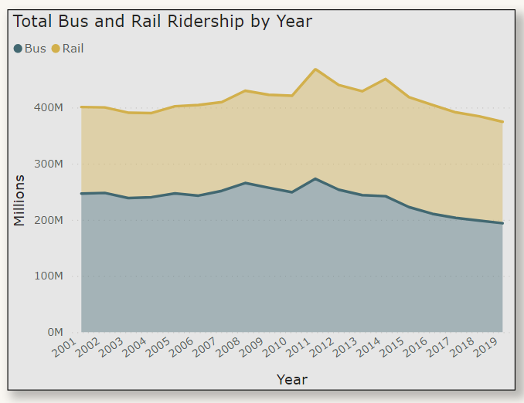
Findings
Data Discovery
Annual ridership numbers fairly steady
Both modes follow same pattern
If operating costs are increasing, how to boost ridership (and thus revenue)?
Figure 1. Screenshot of Ridership by Mode by Year
Notes:
Before we jump into the findings themselves, I would like to call out that I did some initial data discovery to see if there might be anything of interest in the data. On this slide we can see how ridership numbers of each mode are performing annually.
As the graph (Figure 1) shows, the numbers for the most part have held steady since 2001, with a slight downward trend since 2011. Both modes appear to mirror the ups and downs. One thought on this graph is that it is likely operating costs for the CTA have been going up year after year. If ridership numbers are not increasing, what mechanisms could there be to boost ridership, and thus, boost revenue?
(next slide)

Slide 9
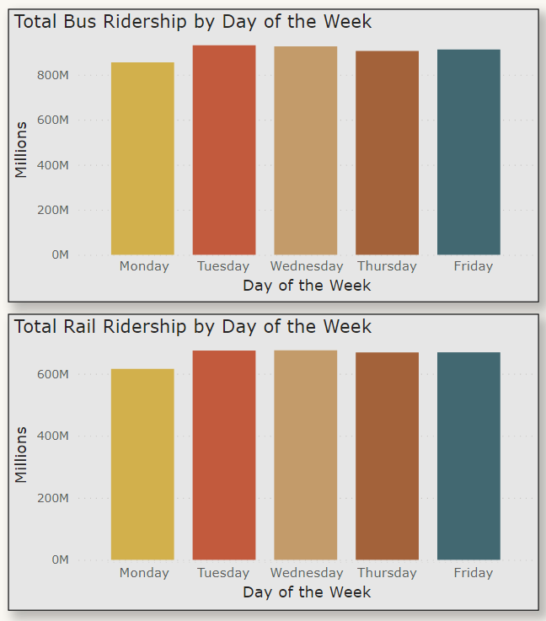
Findings
Data Discovery
Breaking data into days of the week
Fairly consistent
Monday could be lower due to number of holidays falling on that day
Figure 2. Screenshot of Ridership by Mode by Day of Week
Notes:
In addition to looking at the data year over year, another thought that came to mind was whether one day of the week in particular had any more ridership than another. Recall earlier that Li et al. (2018) indicated that past research points to weekday transit ridership as being more concrete and solid.
As we can see, for the most part, ridership numbers are fairly consistent among the days of the week and between the modes of travel taken. Keep in mind that Monday could likely be lower than the rest of the days since many holidays fall on a Monday.
We will now move into the findings on the next slide.
(next slide)

Slide 10
Findings
Methods
Bivariate correlation analysis: Pearson’s correlation coefficient
  Quantitative data
  Continuous data
  Relationship (Field, 2013)
SAS® Studio
  Noted as institutional standard for analysis around statistical tests (O’Leary, 2017)
Notes:
Before we jump into the results of the hypothesis tests, I would like to cover briefly the methods used. The dataset variables are both quantitative and continuous in nature. As the hypotheses focus on a relationship between two variables, Pearson’s correlation coefficient (“Pearson’s r”) was used, as Field (2013) suggests. To conduct these statistical tests, SAS Studio, through the SAS OnDemand for Academics platform, was used. O’Leary (2017) notes SAS as being the institutional standard for analysis around statistical tests.
(next slide)

Slide 11
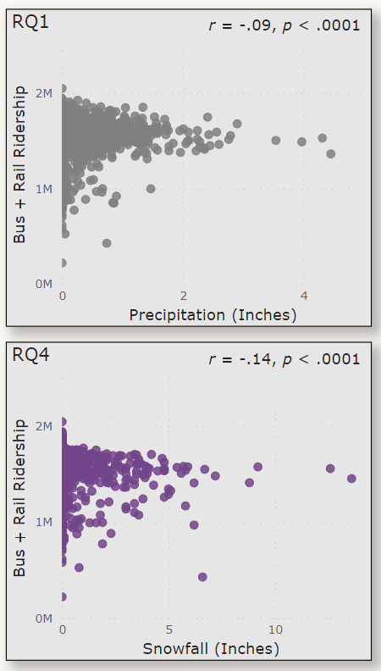
Findings
Overall Ridership
Results of each correlation test show significance
Variables are weakly and negatively correlated
As amount of precipitation/snowfall increases, ridership numbers decrease
Figure 3. Screenshot of Scatterplots for RQ1 and RQ4
Notes:
In looking at the results, we will first look at RQ1 and RQ4, which analyzed the combined bus and rail ridership and each respective weather variable. As the graph (Figure 3) shows, the results indicate that each of the respective weather variables is significantly related to the overall total weekday ridership, though weakly correlated. As the amount of precipitation or snowfall increases, the ridership numbers decrease.
(next slide)

Slide 12
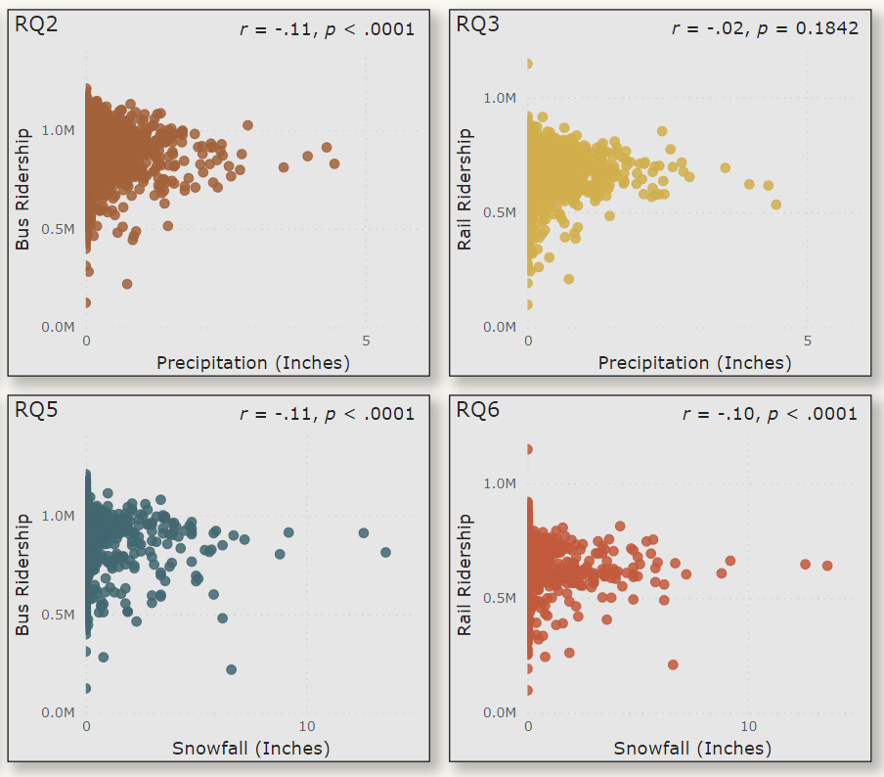
Findings
Ridership by Mode
Results of each correlation test show significance
Variables are weakly and negatively correlated
One exception is RQ3
  Amount of precipitation is not significant in relation to total weekday rail ridership
Figure 4. Screenshot of Scatterplots for RQ2; RQ3; RQ5; RQ6
Notes:
This slide looks at each mode of transit broken out. The graph on this slide (Figure 4) shows the results of each correlation test for the RQ noted. The set here looks at each mode of transit with each type of weather. Like the results of RQ1 and RQ4 that looked at overall ridership regardless of mode, the results shown here also indicate that each of the respective weather variables is significantly related to the weekday ridership numbers of each respective mode, though weakly correlated. And like the results of RQ1 and RQ4, this indicates that as the amount of precipitation or snowfall increases, the ridership numbers decrease.
Now, there is one except to this. If you can cue in on RQ3, which is the top right graph. This correlation test looked precipitation with rail ridership. Here, the amount of precipitation is not significant in relation to the total weekday rail ridership, r = -.02, p = .1842. Because the p-value is not less than the significance level of 0.05, the null hypothesis is not rejected and the alternative hypothesis is not accepted.
(next slide)

Slide 13
Findings
Overall Results
Results of each correlation test show significance
Variables are weakly and negatively correlated
As amount of precipitation/snowfall increases, ridership numbers decrease
One exception is RQ3
  Amount of precipitation is not significant in relation to total weekday rail ridership
RQ | Variables | Relationship Noted in Ha | p-Value | Correlation | H₀ Result
1 | Ridership_Total_All Precipitation_Inches | Neutral | <.0001 | -.09 | Rejected
2 | Ridership_Total_Bus Precipitation_Inches | Negative | <.0001 | -.11 | Rejected
3 | Ridership_Total_Rail Precipitation_Inches | Positive | 0.1842 | -.02 | Not Rejected
4 | Ridership_Total_All Snowfall_Inches | Negative | <.0001 | -.14 | Rejected
5 | Ridership_Total_Bus Snowfall_Inches | Negative | <.0001 | -.11 | Rejected
6 | Ridership_Total_Rail Snowfall_Inches | Negative | <.0001 | -.10 | Rejected
Table 1. RQ Hypothesis Comparison
Notes:
In looking at all the results compiled into a single table (Table 1), we can see that as mentioned on the previous slides that overall, the results of each correlation test show significance and that the variables analyzed are weakly and negatively correlated. This means, that as the amount of precipitation or snowfall increases, ridership numbers decrease. Again, the one exception was RQ3 that tested the relationship between precipitation and rail ridership.
This overarching assessment aligns with past studies that have researched the impact of weather on other mass transit systems across the globe and have generally come to the same conclusion.
So, how can the CTA use this knowledge?
(next slide)

Slide 14
Recommendations
Weak correlation suggests other factors could be at play in influencing transit ridership
  Internal: timeliness of service or fare pricing
  External: socioeconomic and demographic characteristics (Miao et al., 2019)
Consider digging deeper
  Analysis on specific stops or rail lines
  Could weekend, holiday, or specific days of the week have influence
Be mindful of mitigating risk around collecting and protecting personal data (Davis, 2012)
  Ridership data
Notes:
The weak correlation between weather and transit ridership suggests that other factors could be at play that may be influencing ridership numbers. As Miao et al. (2019) points out, there are internal factors such as the timeliness of service and fare pricing, as well other external factors in addition to weather like socioeconomic and demographic characteristics that can influence public transit ridership.
Another consideration may be to dig deeper by conducting analysis at specific stops or on specific rail lines, to better understand whether weather and these additional factors could have a more granular impact. While this study only analyzed weekday ridership data, there may be an opportunity to analyze the entire dataset to understand how weekends, holidays, or specific days of the week have any insight that can be provided.
While there can be absolute value in data to an organization for opportunities like innovation as well as social benefit from the analysis and subsequent reporting of insight, it remains nonetheless important though to value the privacy of information like that of a rider. Thus, the organization should allow for the mitigation of risk around collecting and protecting data (Davis, 2012), including personally identifiable information like that of a rider’s name.
(next slide)

Slide 15
Resources
For additional information…
  github.com/dbrandtCSUG/Capstone
There, you will find
  Research paper
  Dataset
  SAS® Code
  Copy of this presentation
Notes:
Thank you for watching my presentation. I hope you enjoyed it.
For additional information, please visit my GitHub repository, which can be found at the link on the screen (www.github.com/dbrandtCSUG/Capstone.
There you will find all the materials for my Capstone project, including my research paper, the dataset, SAS® code, and a copy of this presentation.
Have a wonderful day!

Slide 16
References
Chicago Transit Authority. (2021). About us. CTA. Retrieved September 15, 2021, from https://www.transitchicago.com/about/
City of Chicago. (2021). CTA – Ridership – Daily Boarding Totals. Chicago Data Portal. https://data.cityofchicago.org/Transportation/CTA-Ridership-Daily-Boarding-Totals/6iiy-9s97
Davis, K. (2012). Ethics of big data. O'Reilly Media, Inc.
Farmer, S., & Noonan, S. (2014). The contradictions of capital and mass transit: Chicago, USA. Science & Society, 78(1), 61-87. https://doi.org/10.1521/siso.2014.78.1.61
Field, A. (2013). Discovering statistics using IBM SPSS statistics (4th ed.). Sage Publishing.
Notes:
References

Slide 17
References
Kalkstein, A. J., Kuby, M., Gerrity, D., & Clancy, J. J. (2009). An analysis of air mass effects on rail ridership in three US cities. Journal of Transport Geography, 17(3), 198–207. https://doi.org/10.1016/j.jtrangeo.2008.07.003
Li, J., Li, X., Chen, D., & Godding, L. (2018). Assessment of metro ridership fluctuation caused by weather conditions in Asian context: Using archived weather and ridership data in Nanjing. Journal of Transport Geography. 66. 356–368. https://doi.org/10.1016/j.jtrangeo.2017.10.023
Merlin, L. A., Singer, M., & Levine, J. (2021). Influences on transit ridership and transit accessibility in US urban areas. Transportation Research Part A: Policy & Practice, 150, 63–73. https://doi.org/10.1016/j.tra.2021.04.014
Miao, Q., Welch, E. W., & Sriraj, P. S. (2019). Extreme weather, public transport ridership and moderating effect of bus stop shelters. Journal of Transport Geography, 74, 125–133. https://doi.org/10.1016/j.jtrangeo.2018.11.007
National Centers for Environmental Information. (n.d.). Climate Data Online Search. NCEI. Retrieved September 16, 2021, from https://www.ncdc.noaa.gov/cdo-web/search
Notes:
References

Slide 18
References
Ngo, N. S. (2019). Urban bus ridership, income, and extreme weather events. Transportation Research Part D, 77, 464–475. https://doi.org/10.1016/j.trd.2019.03.009
O’Leary, Z. (2017). The essential guide to doing your research project. (3rd ed.). Sage Publishing.
Parker, M. E. G., Li, M., Bouzaghrane, M. A., Obeid, H., Hayes, D., Frick, K. T., Rodríguez, D. A., Sengupta, R., Walker, J., & Chatman, D. G. (2021). Public transit use in the United States in the era of COVID-19: Transit riders’ travel behavior in the COVID-19 impact and recovery period. Transport Policy, 111, 53–62. https://doi.org/10.1016/j.tranpol.2021.07.005
Tang, L., & Thakuriah, P. V. (2012). Ridership effects of real-time bus information system: A case study in the City of Chicago. Transportation Research Part C, 22, 146–161. https://doi.org/10.1016/j.trc.2012.01.001
Vajjarapu, H., Verma, A., & Allirani, H. (2020). Evaluating climate change adaptation policies for urban transportation in India. International Journal of Disaster Risk Reduction, 47. https://doi.org/10.1016/j.ijdrr.2020.101528
Notes:
References

