Slide 1
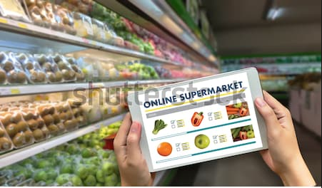



Venolearn supermarket - Python Project
Venolearnsupermarket.com
Daily sales of items of supermarket are stored in MSSQL server and are ingested to windows local as .csv file and the same is sent to sales manager daily using python script

