Slide 1
Classification Logistic Regression
1. Import the class containing the classification method
from sklearn.linear_model import LogisticRegression
2. Create an instance of the class
LRC = LogisticRegression()
3. Fit the instance on the data and then predict the expected value
LRC = LRC.fit(X_train, y_train)
y_predict = LRC.predict(X_test)
4.Import the classification metrics
from sklearn.metrics import accuracy_score , precision_score, recall_score, f1_score, roc_auc_score, confusion_matrix, roc_curve, precision_recall_curve

Slide 2
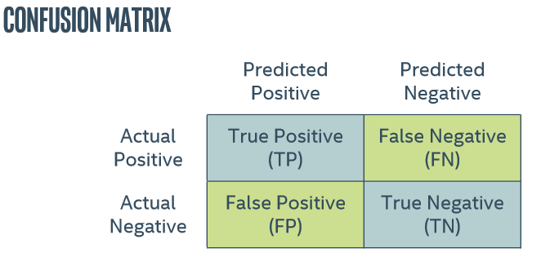

Slide 3
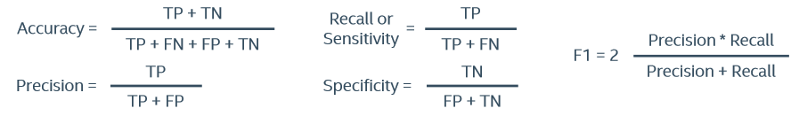

Slide 4



