Slide 1
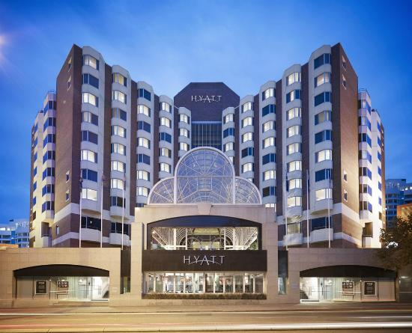
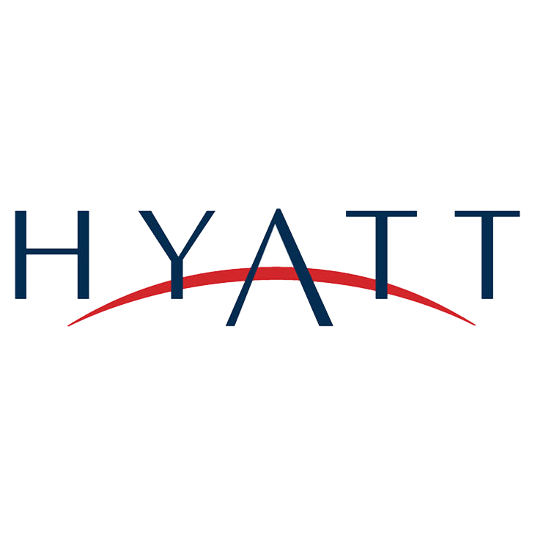
IST687_M002_Group1 Romil Shroff Omkar Mutreja Jeni Adenshia Cordell Hudson
HYATT HOTELS ANALYSIS

Slide 2
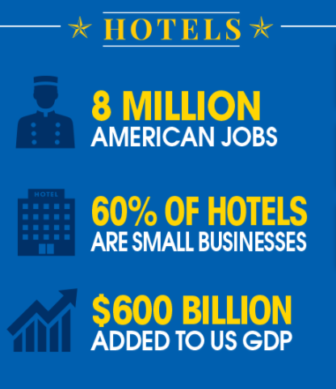
Industry Analysis
The U.S. travel and tourism industry generated over $1.5 a trillion in economic output in 2016
In 2016 travelers spent more than $293 billion on traveler accommodations
This sector supports more than 1.4 million jobs U.S. jobs.

Slide 3
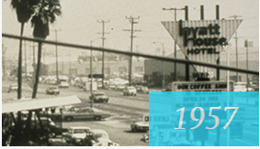
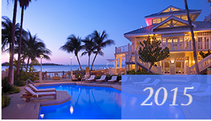
Business Overview
Hyatt was founded by Jay Pritzker in 1957
In 1968, Hyatt International was formed and subsequently became a separate public company
On December 31, 2004, all of the hospitality assets owned by Pritzker family business interests were consolidated under a single entity now Hyatt Hotels Corporation

Slide 4
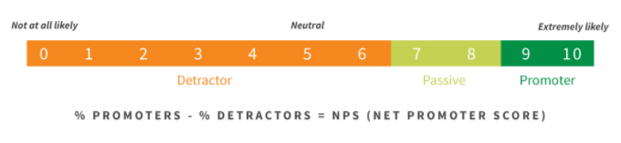
Identify Key Business Metrics
Net Promoter Score
Promoters (score 9-10) are loyal enthusiasts who will keep buying and refer others, fueling growth.
Passives (score 7-8) are satisfied but unenthusiastic customers who are vulnerable to competitive offerings.
Detractors (score 0-6) are unhappy customers who can damage your brand and impede growth through negative word-of-mouth.

Slide 5
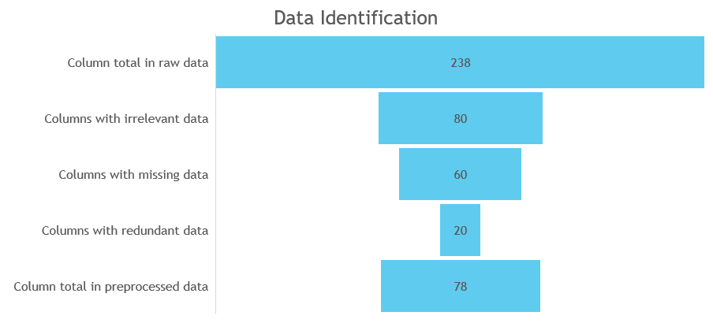
Data Identification

Slide 6
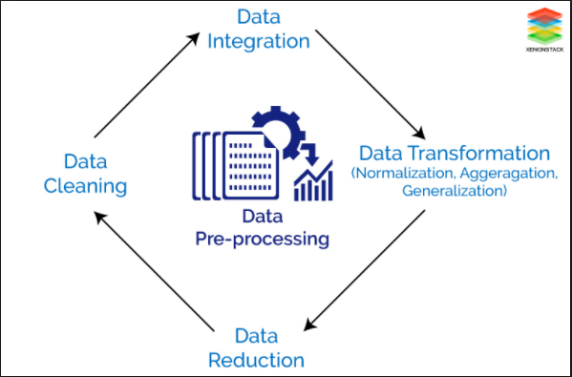
Data Preprocessing
Data Cleaning
Data Transformation
Data Aggregation
Data Filtering
Data Discretization
Resolve Inconsistencies
Data Reduction
Data Integration

Slide 7
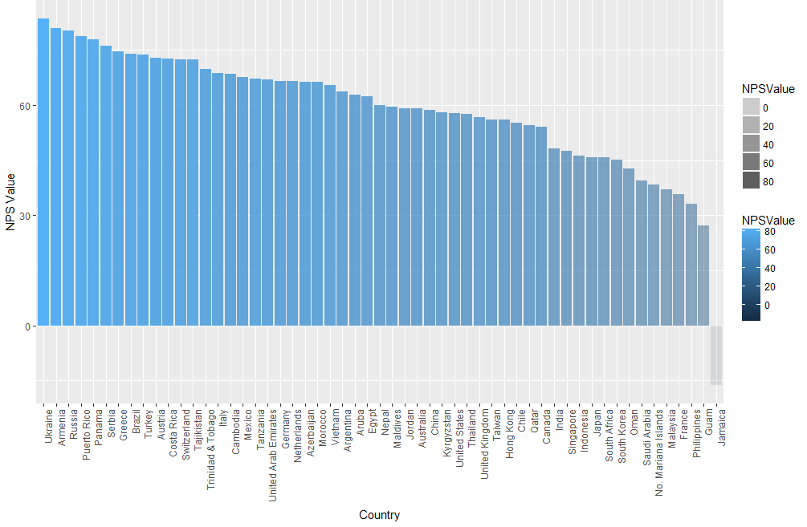
Exploratory Data Analysis
An approach to analyzing data sets to summarize their main characteristics, with visual methods
Bar plot of Country vs NPS

Slide 8
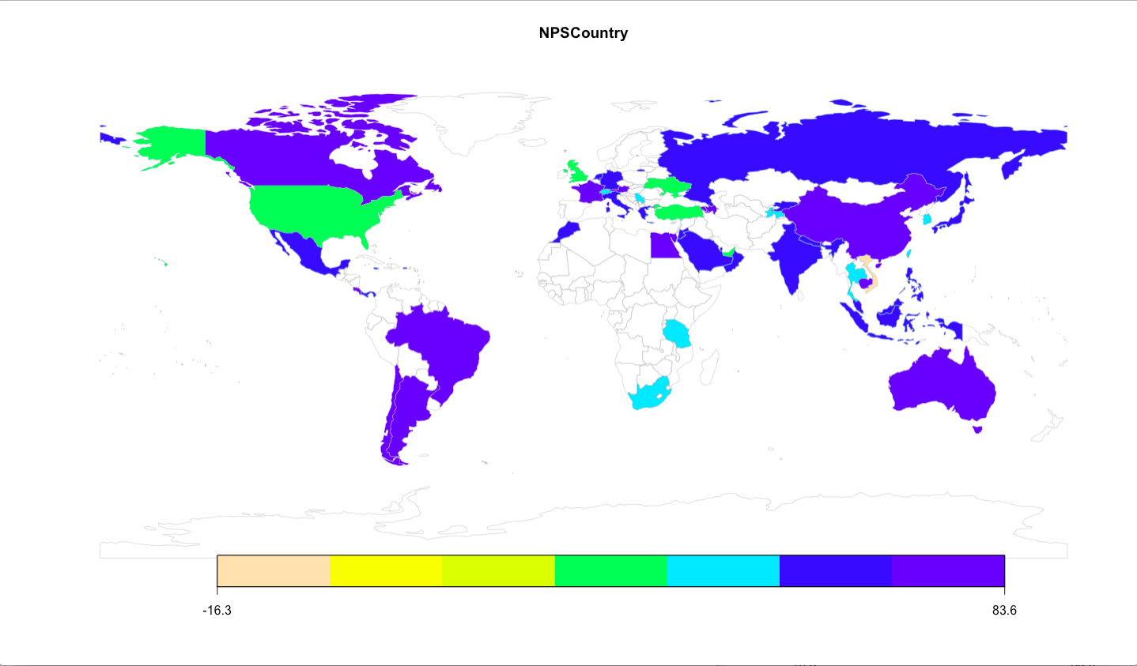
Exploratory Data Analysis
Country wise NPS

Slide 9
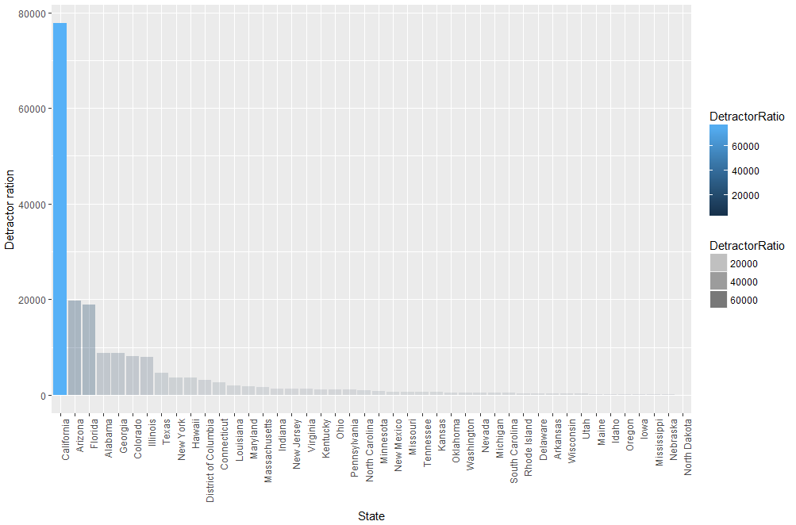
Exploratory Data Analysis
Bar plot of State wise detractor ratio for USA

Slide 10
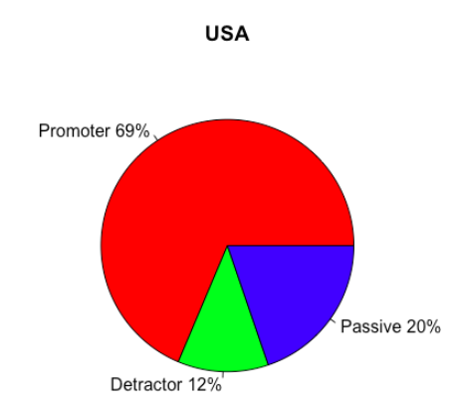
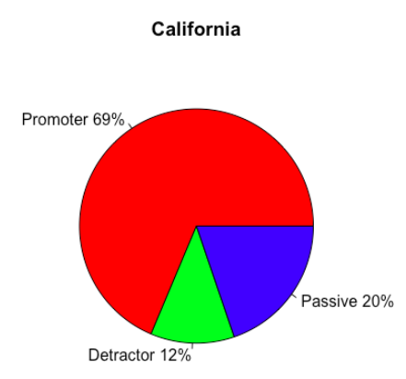
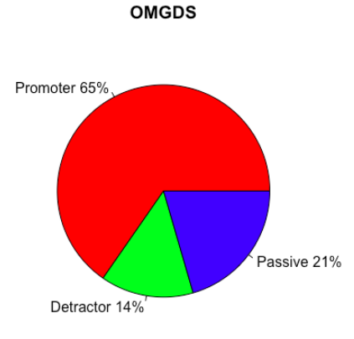
Exploratory Data Analysis
Pie Charts for USA, California, and OMGDS Hotel type(El Segundo City of California)

Slide 11
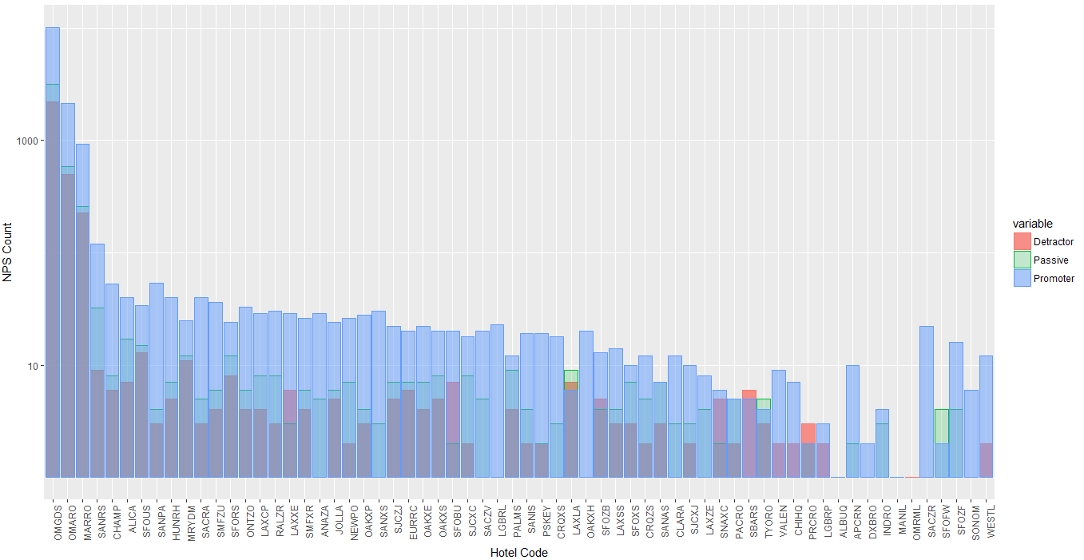
Insights, Trends, and Visual Graphs
Bar Plot of Hotel Wise Detractor Ratio

Slide 12
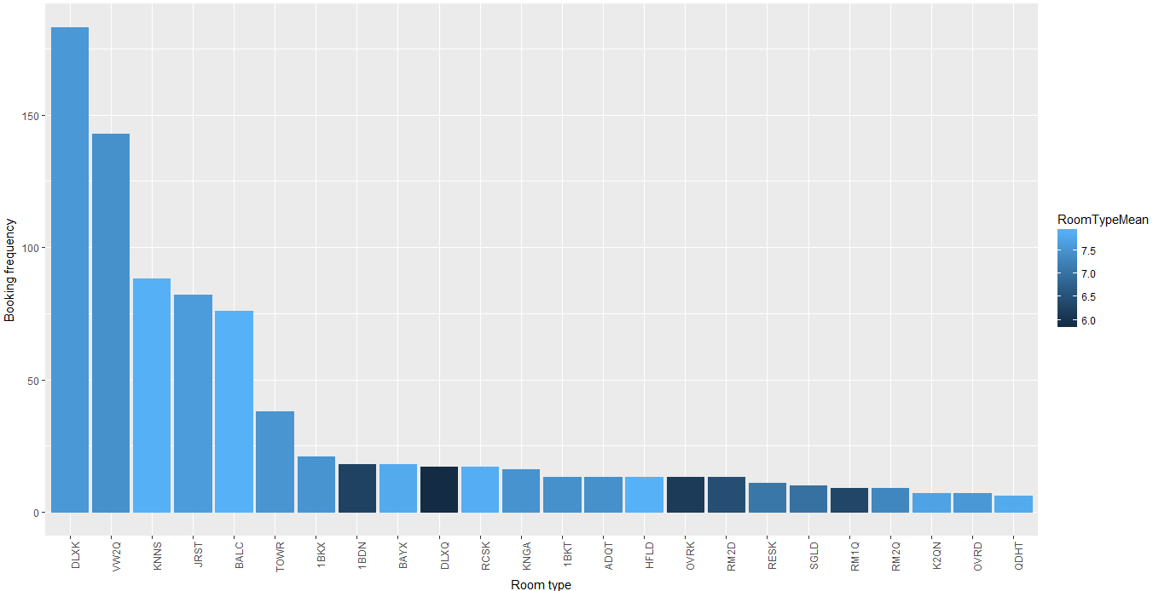
Insights, Trends, and Visual Graphs
Visualization of room type and their feedback

Slide 13

Identify Business Problem and Business Questions
How should HYATT hotels reduce the friction in the customer experience?
Which country has the highest detractor ratio?
Which state within that country is showcasing poor customer feedback?
Which category of hotels is leading the poor customer feedback trend within the specific state?
What services and facilities are driving transformation of customer experience from detractors to passive to promotors?

Slide 14
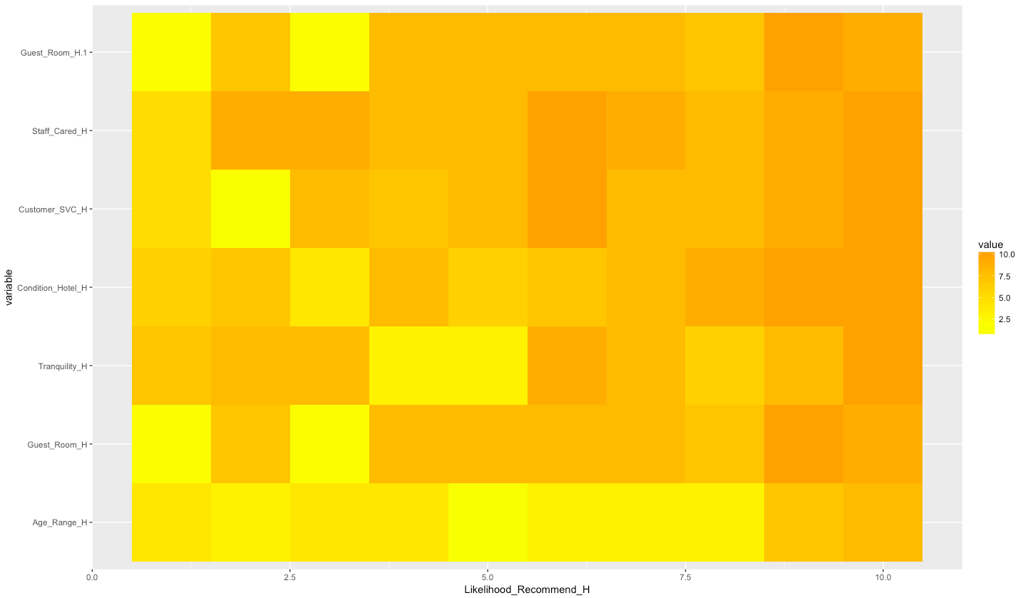
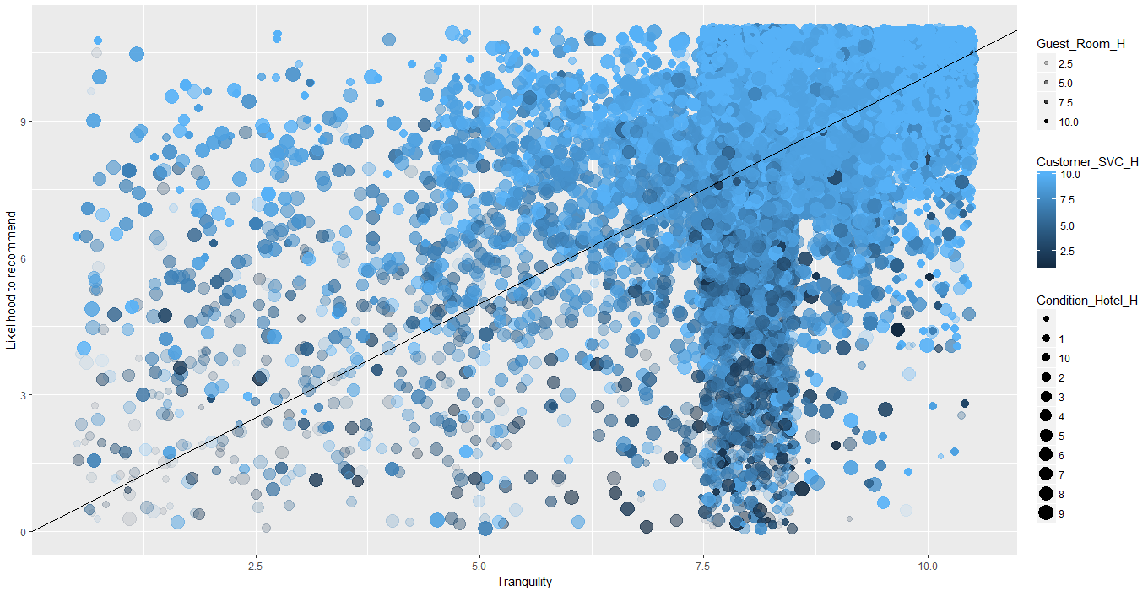
Find Answers to Business Questions using Data Modelling
Linear Modelling to understand and predict the behavior of customers based ‘Likelihood to Recommend’
Key factors which influence ‘Likelihood to Recommend’ are Age Range, Guest Rooms, Tranquility, Hotel Condition, Customer Satisfaction, Staff Cared, and Restaurant

Slide 15
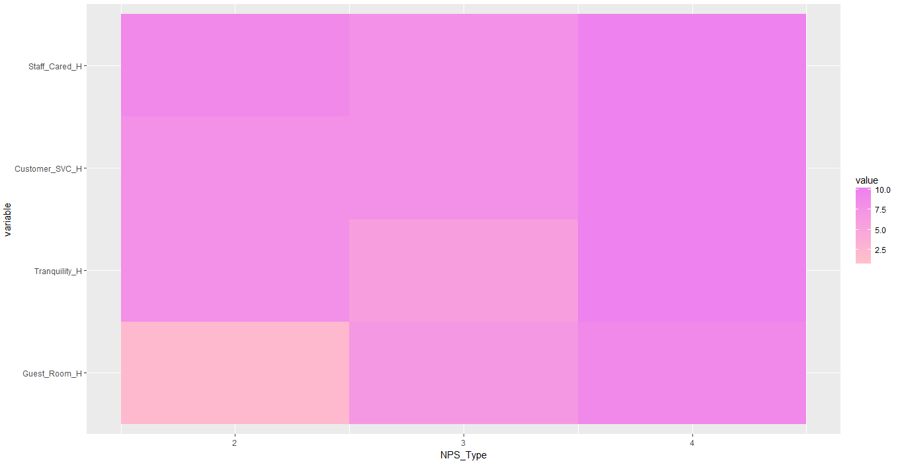
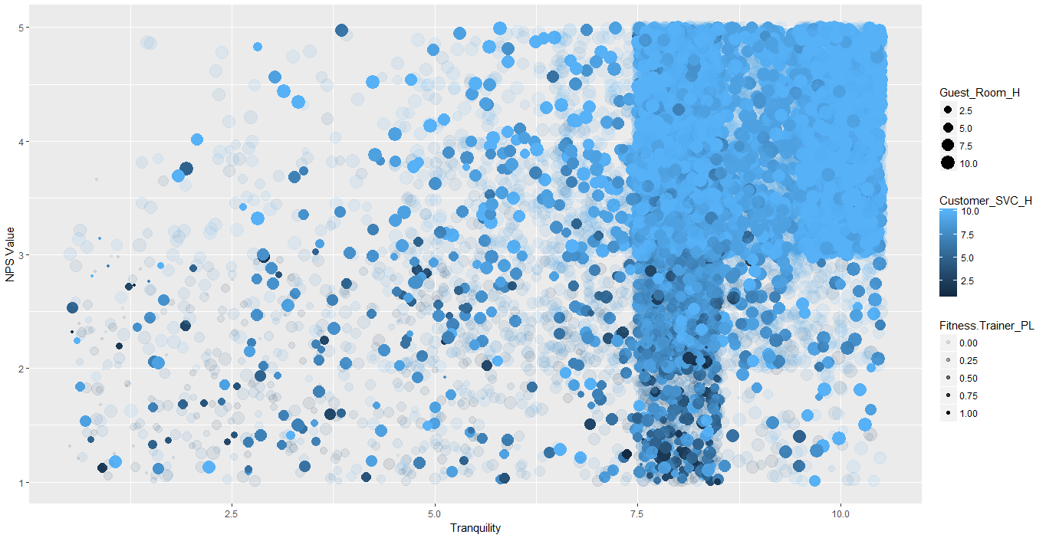
Find Answers to Business Questions using Data Modelling
Linear Modelling to understand and predict the behavior of customers based ‘NPS Type’
Key factors which influence ‘NPS Type’ are Guest Rooms, Tranquility, Fitness Trainer, Customer Satisfaction, and Staff Cared

Slide 16
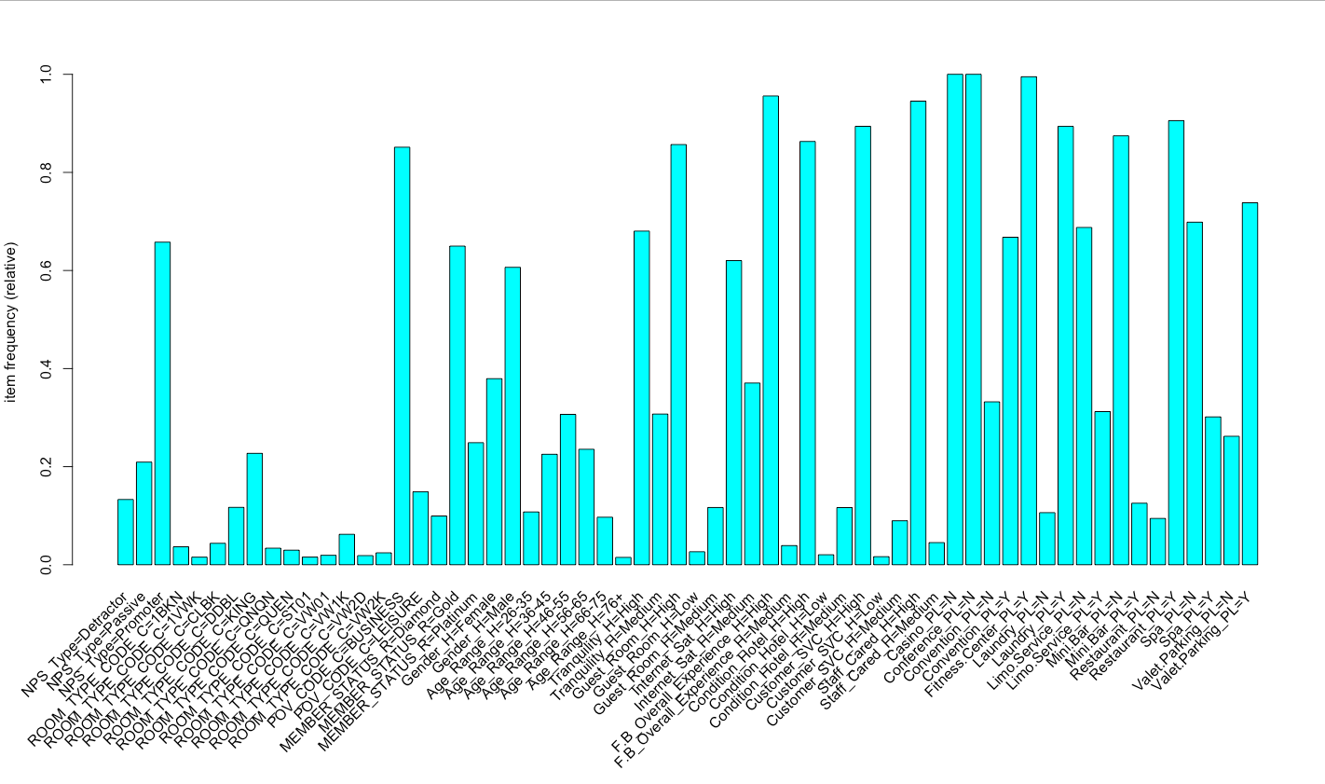
Find Answers to Business Questions using Data Modelling
Apriori Algorithm is a data mining algorithm for mining frequent combination of services and facilities which specifically caters to customer preferences
Item Frequency Plot to determine the frequency of occurrence of services

Slide 17
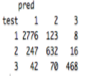
Find Answers to Business Questions using Data Modelling
Using machine learning algorithms like Support Vector Machines (SVM) to implement supervised learning of data for classification and prediction
SVM facilities the identification of a combination of services and facilities which will create a positive, neutral, and negative customer experience
Guest Rooms, Tranquility, Hotel Condition, Customer Satisfaction, Staff cared, and Internet Usage have been identified as crucial parameters to influence customer favorability towards the hotel
Confusion Matrix from the SVM data model clearly indicates a accurate model for classification with elements in the diagonal showcasing precise classifications

Slide 18
Recommendations and Lessons Learned
To improve customer feedback from detractors, the hotel must focus on improving the services and facilities which have been proven to significantly influence customer feedback
Services must be packaged and promoted in a combination of offerings tailored to specific class and category of customers
Hyatt Hotel in El Segundo City of California should make significant improvements by providing better staff services to customers
The Hotel should focus on maintaining a high standard for Hotel Rooms and Hotel Conditions
Room upgrades, premium internet services, and personal staff could be provided to frequent customers with detractor and passive ratings
Restaurants and cafes significantly influence customer feedback towards the hotel; Survey forms and feedback questionnaire could be filled up to customize food and bar menu
Special rules must be set-up to ensure noise free environment and tranquility of customers

Slide 19
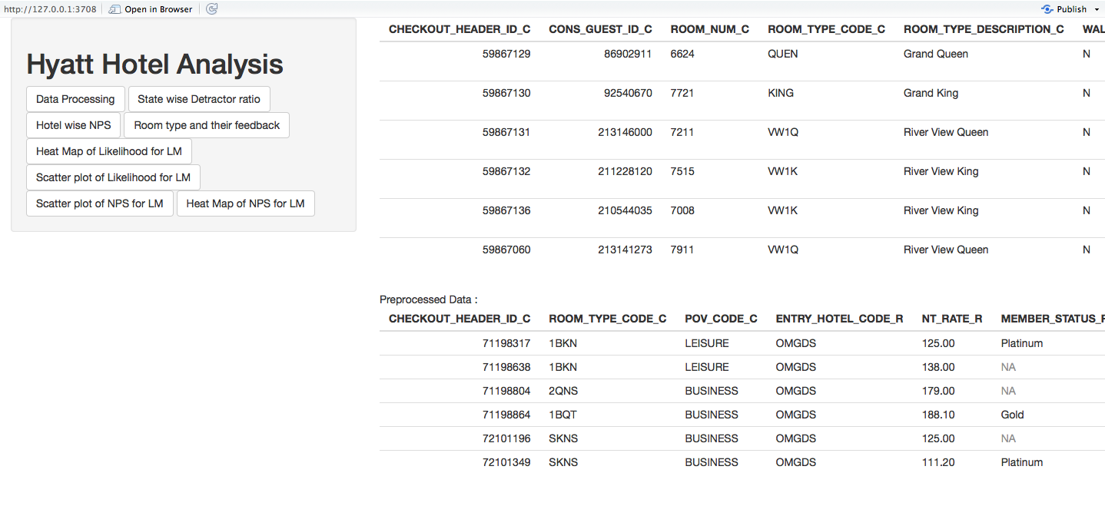
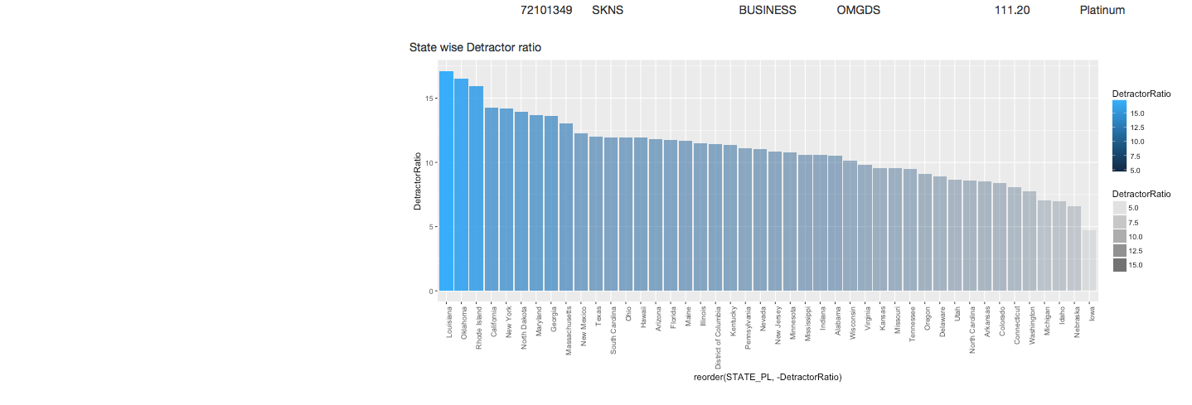
Deployment of Shiny Application for Business Users

Slide 20
Questions?
THANK YOU

