Slide 1

DB Relay
An Introduction

Slide 2
Inspiration

Slide 3
The crux
Database access is
WAY TOO HARD

Slide 4
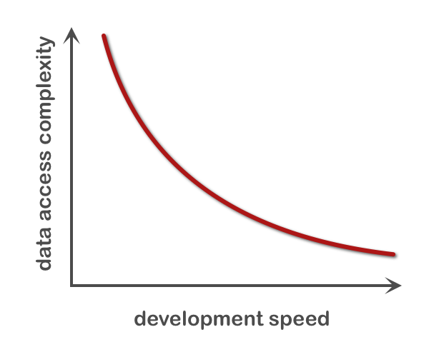
The problem

Slide 5
The vision
Easy access
means getting data
from a database in one or two
language statements

Slide 6
Like that, for example
HTTP POST request:
$ curl \
--data-urlencode sql_server=sqlserver \
--data-urlencode sql_database=AdventureWorks \
--data-urlencode sql_user=demo \
--data-urlencode sql_password=demo \
--data-urlencode "sql=select count(*) as employees from HumanResources.vEmployee" \
"http://dbrelay.net:1433/sql"
JSON over HTTP response:
{"request":{"sql_server":"sqlserver", "sql_user":"demo", "sql_database":"AdventureWorks"}, "data":[{"fields":[{"name":"employees", "sql_type":"int", "length”:4}], "rows":[{"employees":290}], "count":1}], "log":{}}
$

Slide 7
The twist
… even within a
web page

Slide 8
Concept

Slide 9
Achieving simplicity
Little to learn
Protocols and authentication
Query language
Results as data structures
Interface libraries
Simple maintenance and configuration
HTTP, HTTPS
SQL
JSON
Come with a language
Single-file config

Slide 10
Prerequisite: NGiNX
Prerequisite knowledge:
NGiNX (pronounced “engine-X”) is a free, open-source, high-performance HTTP server and then some. NGiNX was released in 2004 by Igor Sysoev. It is now the third or fourth most popular web server and hosts about 6.55% (per Netcraft in May 2010) of all domains worldwide. NGiNX is fast, lightweight, and scales to 10K concurrent requests.
More information about NGiNX is available at:
http://wiki.nginx.org/

Slide 11
Welcome to DB Relay !
DB Relay is an open source project built around the NGiNX web server platform, providing an HTTP/JSON interface to a variety of database servers. It enables database access without drivers and web application development without complex middleware. DB Relay is designed for operational efficiency and easy maintenance.

Slide 12
Architecture

Slide 13
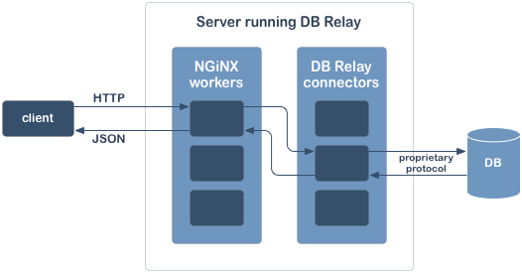
Architecture

Slide 14
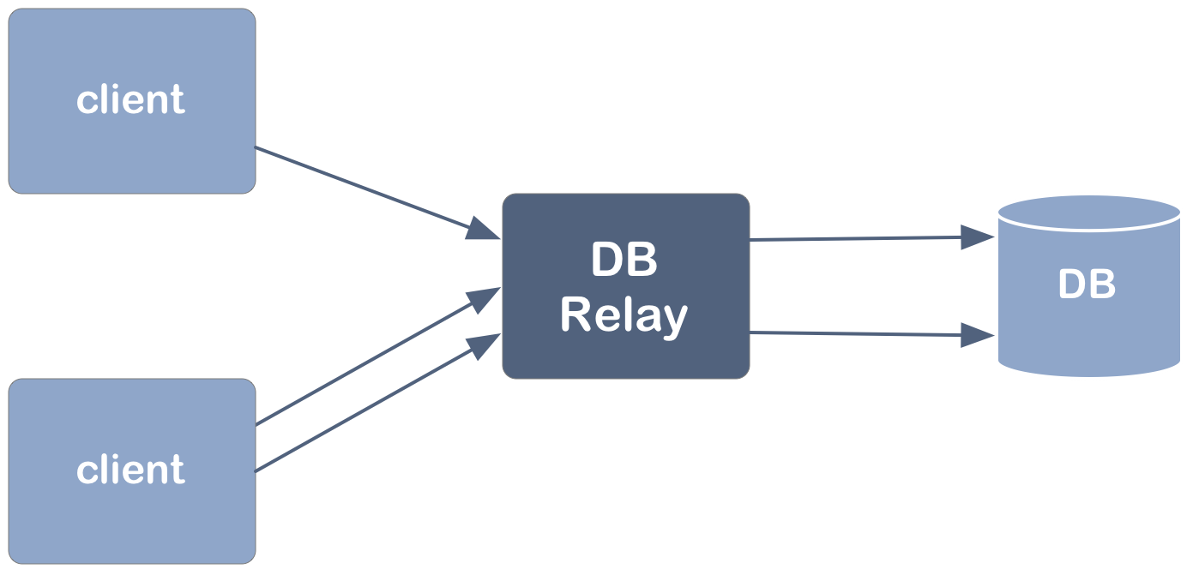
Simple connectivity
In a simple use case one DB Relay instance services one target database with shared or independent DB connections

Slide 15
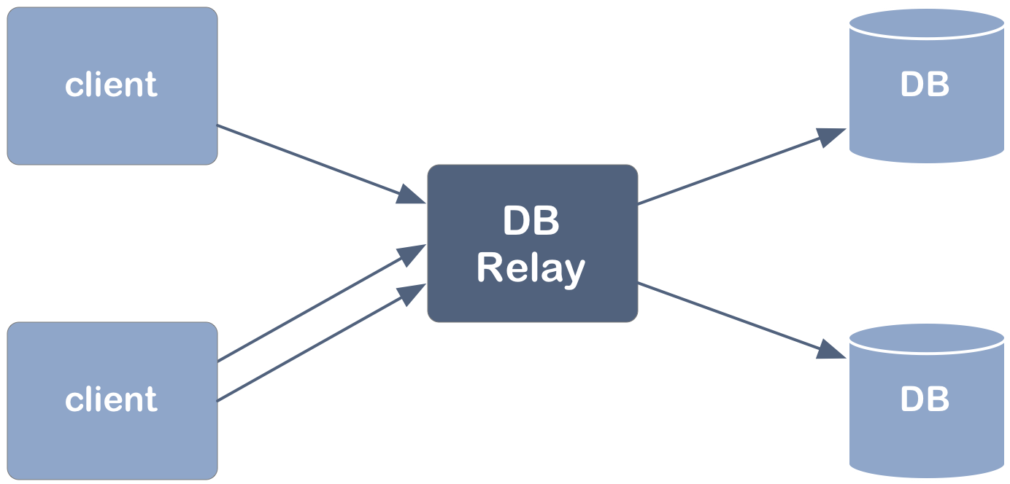
DB Relay view of connectivity
Any DB Relay instance may serve any number of clients and databases

Slide 16
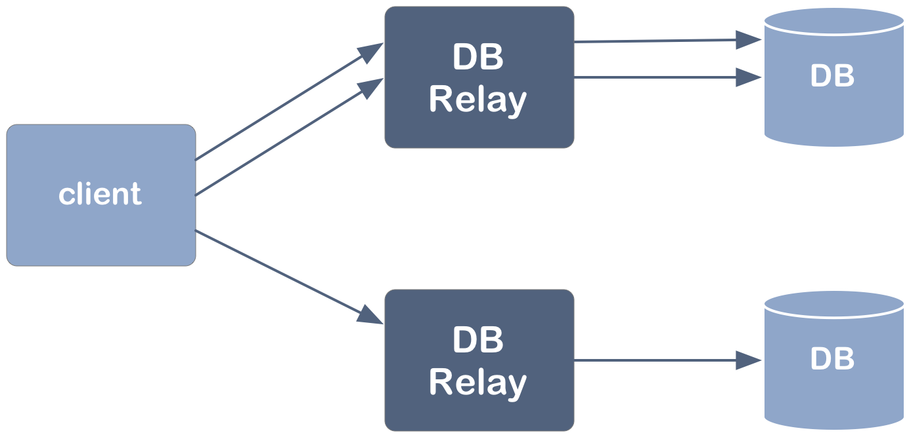
Client view of connectivity
Each client may send requests to any number of DB Relays and databases

Slide 17
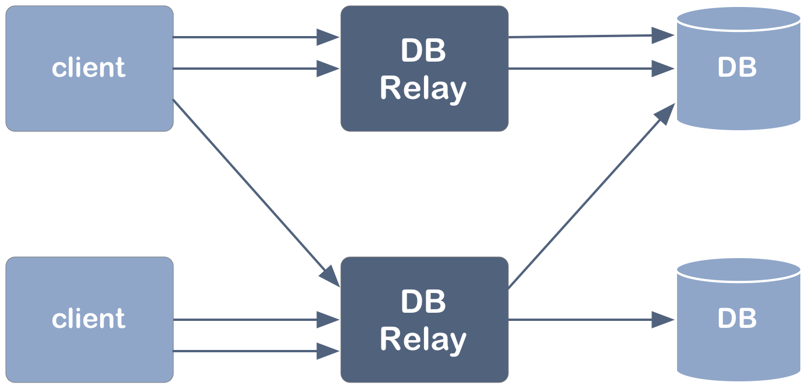
All connectivity options
Any combination of the previous connectivity options is OK

Slide 18
examples

Slide 19
Returned JSON format
Properties of the root object. The “request” property returns some of the original request’s HTTP parameters.
1
2
3
4
5
6
7
8
9
10
11
12
13
14
15
16
17
18
19
20
21
22
23
{
"request": {
"query_tag": ...,
"sql_server": ...,
"sql_user": ...,
"sql_database": ...
},
"data": [
{
"fields": [...],
"rows": [...],
"count": ...
}, {
"fields": [...],
"rows": [...],
"count": ...
}
],
"log": {
"sql": ...,
"error": ...
}
}
Array of row sets.
Example field:
{ "name": "Last", "sql_type": "char", "length": 100 }
Example row:
{ "First": "Garrett”, "Last": "Vargas" }
Optional log entries:
The “sql” property contains the SQL string which was sent to the database server. It is not returned by default. To turn it on, use the “flags” HTTP parameter with value “echosql”.
The “error” property is returned automatically only if there was an error executing the request. In that case the “error” property contains the error message string.

Slide 20
Python example
1
2
3
4
5
6
7
8
9
10
import urllib, urllib2
from pprint import pprint
try:
import simplejson as json
except ImportError:
import json
response = urllib2.urlopen(
url = "http://dbrelay.net:1433/sql",
data = urllib.urlencode({
'connection_name' : 'dbrelay@oscon',
'sql_server' : 'sqlserver',
'sql_user' : 'demo',
'sql_password' : 'demo',
'sql' : 'select count(*) as employees from HumanResources.vEmployee'
}))
parsed = json.load( response )
pprint( parsed )

Slide 21
Python example
1
2
3
4
5
6
7
8
9
10
import urllib, urllib2
from pprint import pprint
try:
import simplejson as json
except ImportError:
import json
response = urllib2.urlopen(
url = "http://dbrelay.net:1433/sql",
data = urllib.urlencode({
'connection_name' : 'dbrelay@oscon',
'sql_server' : 'sqlserver',
'sql_user' : 'demo',
'sql_password' : 'demo',
'sql' : 'select count(*) as employees from HumanResources.vEmployee'
}))
parsed = json.load( response )
pprint( parsed )
Python demonstration

Slide 22
JavaScript example
1
2
3
4
5
6
7
8
9
10
11
<!DOCTYPE html PUBLIC "-//W3C//DTD XHTML 1.0 Strict//EN”
"http://www.w3.org/TR/xhtml1/DTD/xhtml1-strict.dtd">
<html xmlns="http://www.w3.org/1999/xhtml" xml:lang="en" lang="en">
<head>
<script src="/dbrelay/js/jquery/jquery-1.4.2.min.js" ></script>
<script>
jQuery.post( "/sql", {
connection_name : "dbrelay@oscon",
sql_server : "sqlserver",
sql_user : "demo",
sql_password : "demo",
sql : "select count(*) as employees from HumanResources.vEmployee"
}, function( response ) {
jQuery("body").html(
"<p>" + response.data[0].rows[0].employees + " employees</p>”
);
}, "json" );
</script>
</head>
<body></body>
</html>

Slide 23
JavaScript example
1
2
3
4
5
6
7
8
9
10
11
<!DOCTYPE html PUBLIC "-//W3C//DTD XHTML 1.0 Strict//EN”
"http://www.w3.org/TR/xhtml1/DTD/xhtml1-strict.dtd">
<html xmlns="http://www.w3.org/1999/xhtml" xml:lang="en" lang="en">
<head>
<script src="/dbrelay/js/jquery/jquery-1.4.2.min.js" ></script>
<script>
jQuery.post( "/sql", {
connection_name : "dbrelay@oscon",
sql_server : "sqlserver",
sql_user : "demo",
sql_password : "demo",
sql : "select count(*) as employees from HumanResources.vEmployee"
}, function( response ) {
jQuery("body").html(
"<p>" + response.data[0].rows[0].employees + " employees</p>”
);
}, "json" );
</script>
</head>
<body></body>
</html>
JavaScript demonstration

Slide 24
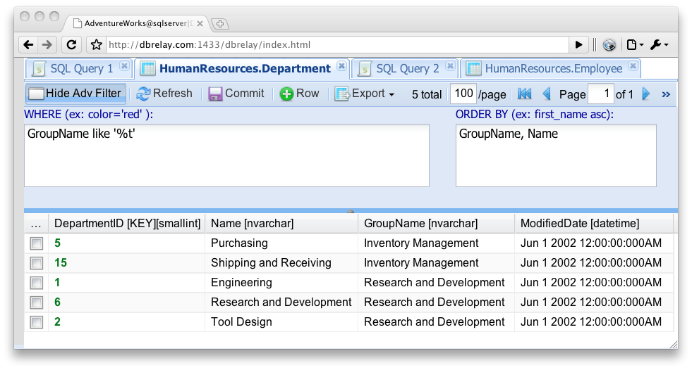
Web UI as example application
The web UI built into DB Relay is an example of building a rich Internet application on the top of DB Relay server using the Sencha (ExtJS) framework. It implements a SQL query UI and table editor (WIP).

Slide 25
Web UI as example application
The web UI built into DB Relay is an example of building a rich Internet application on the top of DB Relay server using the Sencha (ExtJS) framework. It implements a SQL query UI and table editor (WIP).
Web UI demonstration

Slide 26
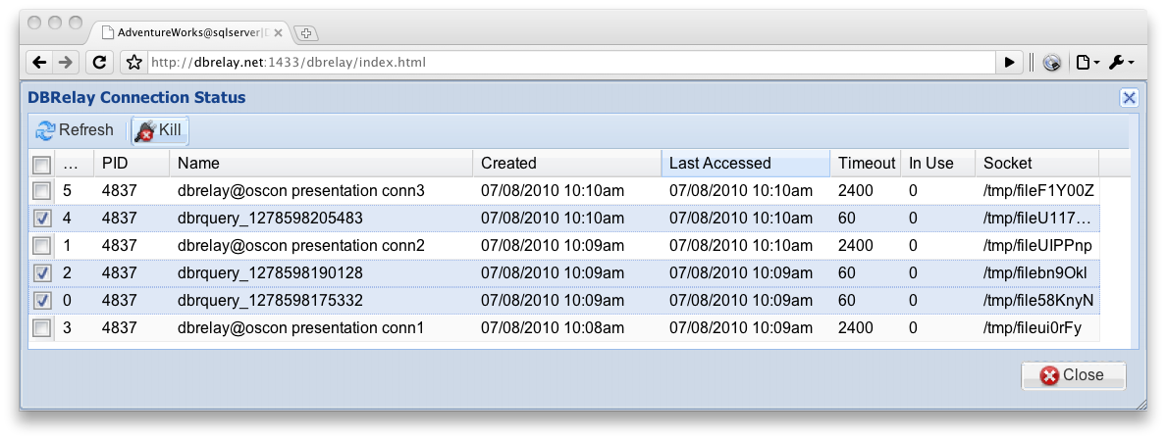
Managing connectors via web UI
As a part of its web UI, DB Relay provides the connector status window, which allows the user to browse active connections. From the same window users can terminate connectors running offending queries.

Slide 27
Managing connectors via web UI
As a part of its web UI, DB Relay provides the connector status window, which allows the user to browse active connections. From the same window users can terminate connectors running offending queries.
Managing
connectors demonstration

Slide 28
Operation

Slide 29

Installation (CentOS 5.2 and OSX 10.5+)
Download and build a DB Relay development instance:
Time:
(measured on a MacBook Pro 2.66 GHz Intel Core Duo)
3 s
15 s
2 s
3 s
7 s
35 s
80 s
15 s
$ mkdir $HOME/dbrelay; cd $HOME/dbrelay
$ git clone git@github.com:dbrelay/dbrelay.git git
$ cd git
$ git submodule init
$ git submodule update
$ ./configure --prefix=$HOME/dbrelay --with-freetds
$ make
$ make install
2 m 20 s
(total time)

Slide 30
Operation on Linux as a service
Installing the init script on CentOS
# cp /home/dbrelay/git/contrib/init \
/etc/init.d/dbrelay
# chmod +x /etc/init.d/dbrelay
# vi /etc/init.d/dbrelay
# chkconfig --add dbrelay
Standard operating commands:
# service dbrelay start
# service dbrelay stop
# service dbrelay restart

Slide 31
Operation on Mac OS X and Linux
Starting DB Relay from its install directory:
$ ./sbin/nginx
$
Stopping DB Relay from its install directory:
$ kill $(cat ./logs/nginx.pid)
$
Logs directory content:
$ ls ./logs/
access.log connector1234.log
error.log nginx.pid

Slide 32
Booth # 520
Maillist : | dbrelay-devel@ list.dbrelay.org
Web site : | http://dbrelay.com/
Brian Bruns : | brian @ dbrelay.com
Vlad Didenko : | vlad @ dbrelay.com

Slide 33
Backup / Overflow Materials

Slide 34
In case of emergency
Shared memory cleaning by DB Relay
$ ./sbin/nginx --clean
Cleaning up old instance(s) shared mem key = 16916987.
$
Shared memory cleaning by root:
# ipcs -sm
------ Shared Memory Segments --------
key shmid owner perms bytes nattch status
0x01030022 0 dbrelay 600 456000 0
------ Semaphore Arrays --------
key semid owner perms nsems
0x01030022 0 dbrelay 600 1
# ipcrm –M 0x01030022; ipcrm –S 0x01030022

Slide 35
Example of DB Relay configuration
1
2
3
4
5
6
7
8
9
10
11
12
13
14
15
16
17
18
19
20
21
22
23
24
25
26
27
28
29
30
31
32
error_log logs/error.log info;
worker_processes 100;
events { worker_connections 256; }
http {
include mime.types;
default_type application/octet-stream;
sendfile on;
keepalive_timeout 65;
server {
listen 1433;
server_name dbrelay;
error_page 500 502 503 504 /50x.html;
location / {
root html;
index index.html index.htm;
}
location /sql { dbrelay; }
location /dbrelay/eg/ { autoindex on; }
location /dbrelay/plugins/ { autoindex on; }
location = /50x.html { root html; }
}
gzip on;
gzip_http_version 1.1;
gzip_vary on;
gzip_comp_level 4;
gzip_proxied any;
gzip_types text/plain text/css text/javascript application/json application/x-javascript;
gzip_buffers 16 8k;
}

Slide 36
Project status
Deployed in production
All dependency libraries are statically compiled into a single executable
Most common (date & time, numeric, string, and UID) types are implemented
Persistent named database connections
Error handling
A single configuration file
Positional SQL parameters in queries
Domain logins
Configurable timeouts
Platform-specific autoconf builds
Administrator HTML interface
Feedback and logging
Legal work to release project as Open Source software
Multiple RDBMS back-ends
Single-file deployment
Handling signals per specification
Full command-line options implementation
Tune the build process to allow for third-party NGiNX modules

Slide 37
Why not MS SQL Server's IIS?
Do not want to enable IIS on each MS SQL Server.
MS SQL Server emits heavy, hard-to parse XML - pain to use in an agile JavaScript or Python.
MS SQL Server's IIS establishes database connection at each request - no intelligent connection persistence.
DB Relay supports other databases in addition to MS SQL Server.
All extra features and plug-ins to NGiNX may be used in the future. For example, NGiNX proxy and cache features used today to cache some of the expensive queries for daily data at the DB Relay level, without hitting the database.

Slide 38
DB Relay

