Slide 1

BENCHMARKING
AI Adoption Across Teams
Are we getting lapped, or right on target?
Product Council | April 2026
Notes:
Welcome everyone. Today I want to tackle a question I know we're all asking: in this Cambrian explosion of AI creativity, where should our teams actually be? I'll share some industry benchmarks, we'll score ourselves live, and I'll propose a framework for the council. Let's start with a quick gut check.

Slide 2
?
My Working Context
QUICK POLL
Darren Brelesky | EVP, Product | CBS Digital
What percentage of
your engineering output
is AI-authored today?
~250 people across Product, Design, Engineering
Pockets of AI adoption — some teams shipping, others experimenting
Feeling the tension: stay energized by possibilities while setting realistic goals
0%
10%
20%
30%
40%
50%+
WHAT I'M WRESTLING WITH
How much of my eng team should focus on AI delivery?
Are we getting lapped or right on target?
Can we benchmark this across the council?
Shout it out. No wrong answers.
Notes:
Quick intro: I'm Darren, EVP Product at CBS Digital. About 250 people across Product, Design, Engineering. We're in pockets of adoption right now. Before I show any data — quick poll: what percentage of your engineering output do you think is AI-authored today? Shout it out. [PAUSE - note the range]. Keep your number in mind. I'm going to show you what 135,000 developers actually measured.

Slide 3
The Numbers
88%
of orgs use AI in at least one function
AI-AUTHORED CODE
22%
Deloitte 2026
82%
of developers use AI tools weekly
of merged code | 135K+ devs surveyed
DX Q4 2025
40%
of enterprise apps will have AI agents by EOY '26
Sweet spot: 25-40%
Above 40% = rising tech debt
Gartner
Leading companies: 41-42% AI code | Avg. dev saves 3.6 hrs/week | 33-36% reduction in dev time
Notes:
Remember your number? The industry average is 22% of merged code is AI-authored, across 135,000 developers. But here's the context: 88% of orgs are using AI somewhere, 82% of developers use AI tools weekly, and Gartner says 40% of enterprise apps will have AI agents by end of year. The leading companies are already at 41-42% AI code. The sweet spot is 25-40% — above that, you start seeing 20-30% rework rates. Average developer saves 3.6 hours a week.

Slide 4
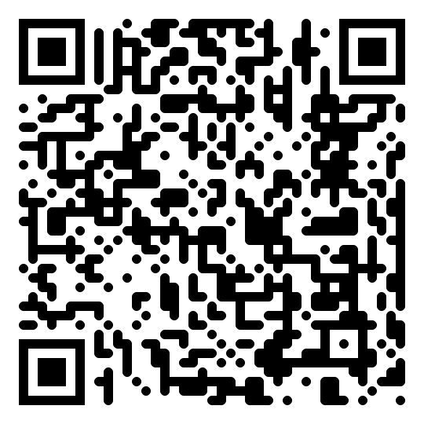




Score Your Organization
Open the poll on your phone. Rate each dimension 1-5 for your org.
ENGINEERING
22-42%
TESTING & QA
89%
of code AI-authored across the industry
Leading orgs at 41-42% | Sweet spot: 25-40%
piloting gen-AI QA workflows
25% avg auto test coverage | Target: 50%+
SCAN TO SCORE
How much of your code is AI-authored?
Is AI embedded in your test pipeline?
CONSUMER INSIGHTS
68%
TALENT & READINESS
20%
of sales/marketing use AI daily
75% of enterprises adopted AI in marketing
of orgs say talent is AI-ready
Skills gap = #1 barrier | Only 60% have tool access
Are AI-powered insights in production?
Is your team trained and ready?
Notes:
This is the interactive moment. I've dropped a link in the chat — open it on your phone. You'll see five dimensions. For each one, score your org 1 to 5. Be honest — this is anonymous. While you're filling it out, let me walk through what the industry benchmarks look like for each dimension. [Walk through each card]. Engineering: 22% average, leaders at 41-42%. Testing: 89% piloting but only 25% auto coverage. Consumer Insights: 68% of marketing teams use AI daily. Talent: only 20% of orgs say they're AI-ready — that's the biggest gap. Take another minute to finish your scores.

Slide 5
Where Should We Be?
PHASE 1
PHASE 2
PHASE 3
Experimenting
Embedding
Scaling
Where most are
Where you should be now
Target by EOY 2026
Individual AI tool use
<15% AI-authored code
Ad-hoc testing with AI
No AI staffing strategy
AI in standard workflows
20-30% AI-authored code
AI in CI/CD pipelines
AI literacy programs live
AI agents in production
30-40% AI-authored code
AI-first test strategy
Dedicated AI roles & budget
Notes:
Based on the data and your scores, here's a maturity model. Phase 1, Experimenting — this is where most companies still are. Individual tool use, low AI code, no strategy. Phase 2, Embedding — this is where I believe we should be RIGHT NOW. AI integrated into workflows, 20-30% AI code, AI in pipelines, literacy programs running. Phase 3, Scaling — our target by end of 2026. Agents in production, 30-40% code, AI-first test strategy, dedicated roles and budget. Where did your scores land? That tells you which phase you're in.

Slide 6

Proposed: Council-Wide Benchmark
You just took the first version. Let's formalize it.
Code & Delivery
% AI-authored code, CI/CD integration, agent deployment
25%
Quality & Testing
AI in test automation, coverage %, defect prediction
20%
Consumer Intelligence
AI-powered insights in prod, personalization, analytics
20%
Talent & Culture
Training coverage, AI literacy, dedicated AI roles
20%
Governance & Scale
Governance maturity, vendor strategy, risk management
15%
Score 1-5 | Quarterly self-assessment | Anonymous council comparison
Notes:
You just took the first version of this assessment. Here's the formal proposal: five dimensions, weighted, scored 1 to 5. Code & Delivery at 25%, Quality & Testing at 20%, Consumer Intelligence at 20%, Talent & Culture at 20% — because the data shows this is where most of us are weakest — and Governance at 15%. The idea: do this quarterly, share scores anonymously across the council, and use the comparison to learn from each other. This doesn't have to be heavy — it's the scorecard you just filled out, done every quarter.

Slide 7
Let's Discuss
1 Where did your scores surprise you?
2 Is a council-wide benchmark something we'd commit to?
3 What dimensions are we missing?
4 How do we stay accountable without it becoming performative?
SCAN TO SCORE
Notes:
I updated the first discussion question based on the live poll — 'where did your scores surprise you?' is more specific and personal than 'where does your org fall.' The rest: would we commit to a shared benchmark? What dimensions am I missing? And the hardest one — how do we hold each other accountable without it becoming a box-checking exercise? I need three volunteers willing to fill out the full scorecard for next quarter so we have real data to compare. Who's in?

