Slide 1
Oracle Management Cloud Workshop
Dan Brett
April, 2019

Slide 2
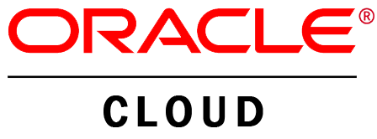

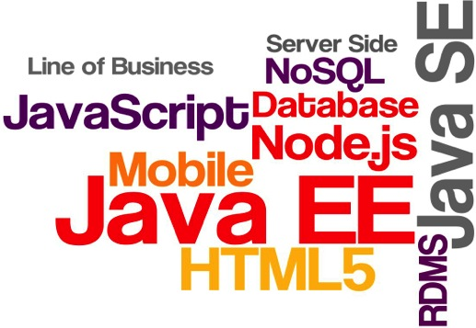


Today’s Application and Infrastructure Topologies
How do you manage an application in a loosely-coupled architecture?
Micro-Services
Multiple Clouds
Continuous Delivery
Polyglot Languages
Integration
Containers
On Premise
Notes:
Across the globe, companies have embraced cloud computing and the agility it provides.
By constantly recombining technology and cloud solutions, enterprises are able to provide an ongoing stream of updated services to engage their users.
This new environment is great for end-users and developers, but very challenging for management since things are constantly changing.

Slide 3














There is a better way.. Unify the data, use powerful analysis
Powered by Machine Learning
Unified Data Operation

Slide 4
IT Organizations are Drowning in Data Age-old “Manual” Troubleshooting techniques no longer suffice
END USER
EXPERIENCE / ACTIVITY
Global threat feeds
Cloud access
Identity
Too many separate tools
APPLICATION
Real users
Synthetic users
App metrics
Transactions
MIDDLE TIER
Too much human effort
Server metrics
Diagnostics logs
DATA TIER
Host metrics
VM metrics
Container metrics
VIRTUALIZATION TIER
Not enough insight
Configuration
Compliance
Tickets & Alerts
Security & Network events
INFRASTRUCTURE TIER
Notes:
What is OMC?
An integrated suite of capabilities that allows you to (a) easily monitor your application – end to end – reduce false alerts, give heads up where possible
(b) quickly troubleshoot if there are any issues – bring you all the data you need to solve that problem at that time - metrics, logs, topology
(c) help you keep your applications secure and compliant
(d) auto remediate the most common problems whether they are security or management events
(e) analyze your data over a longer period of time to spot trends/issues
Regardless of whether your application is running on-prem, our cloud or anybody else’s cloud and on any technology stack
You can use pieces of these individually or use them all together
The unified platform enables us to bring in a rich set of potentially inter-related data to a single place that allows us to get a 360 view - entity and topology

Slide 5








What is OMC ?
Integrated Systems and Security Management Services
Application Performance Monitoring
Easily Monitor your Application
InfraStructure Monitoring
LOG ANALYTICS
Quickly Troubleshoot Issues
IT Analytics
Keep Applications Secure and Compliant
Orchestration
Auto-remediate common problems
Configuration & Compliance
Unified Platform
Analyze issues over longer periods of time
Security Monitoring and ANalytics
Notes:
Our Intelligent, Unified Platform unifies the data from the tens or hundreds of siloed, unconnected tools used by customers today and applies advanced machine learning and anomaly detection techniques against that data, allowing organizations to Increase IT Efficiency, prevent outages and increase their DevOps agility.
The secret sauce of OMC is its application of real-time machine learning to the vast operational data set. Anomaly detection algorithms identify normal and abnormal behavior, providing early warning of problems. Clustering algorithms use pattern recognition to reduce noise and get to the right information quickly. Prediction algorithms use historical data to provide what-if analysis and identify trends that require attention. Correlation algorithms discover dependencies, topologies and relationships among the IT estate, no matter how often and quickly it changes.
And, since OMC is delivered as a SaaS offering, customers can start using it in minutes.

Slide 6
OMC Key Use cases
Unified Monitoring
Log Management
Analytics
Remediation
Security
Application & Infrastructure Monitoring
Complete Transaction Visibility
Real, Mobile & Synthetic Users
Monitor, aggregate, and analyze
Topology-Aware log exploration
Deep support for Oracle
Out-of-the-box ML
IT Analytics
Pre-built dashboards
Data Explorer
Automated actions and runbook
Simple & complex workflows
Integrations with 3p systems
Security Monitoring
User Behavior
Incident Response
Config. & Compliance

Slide 7
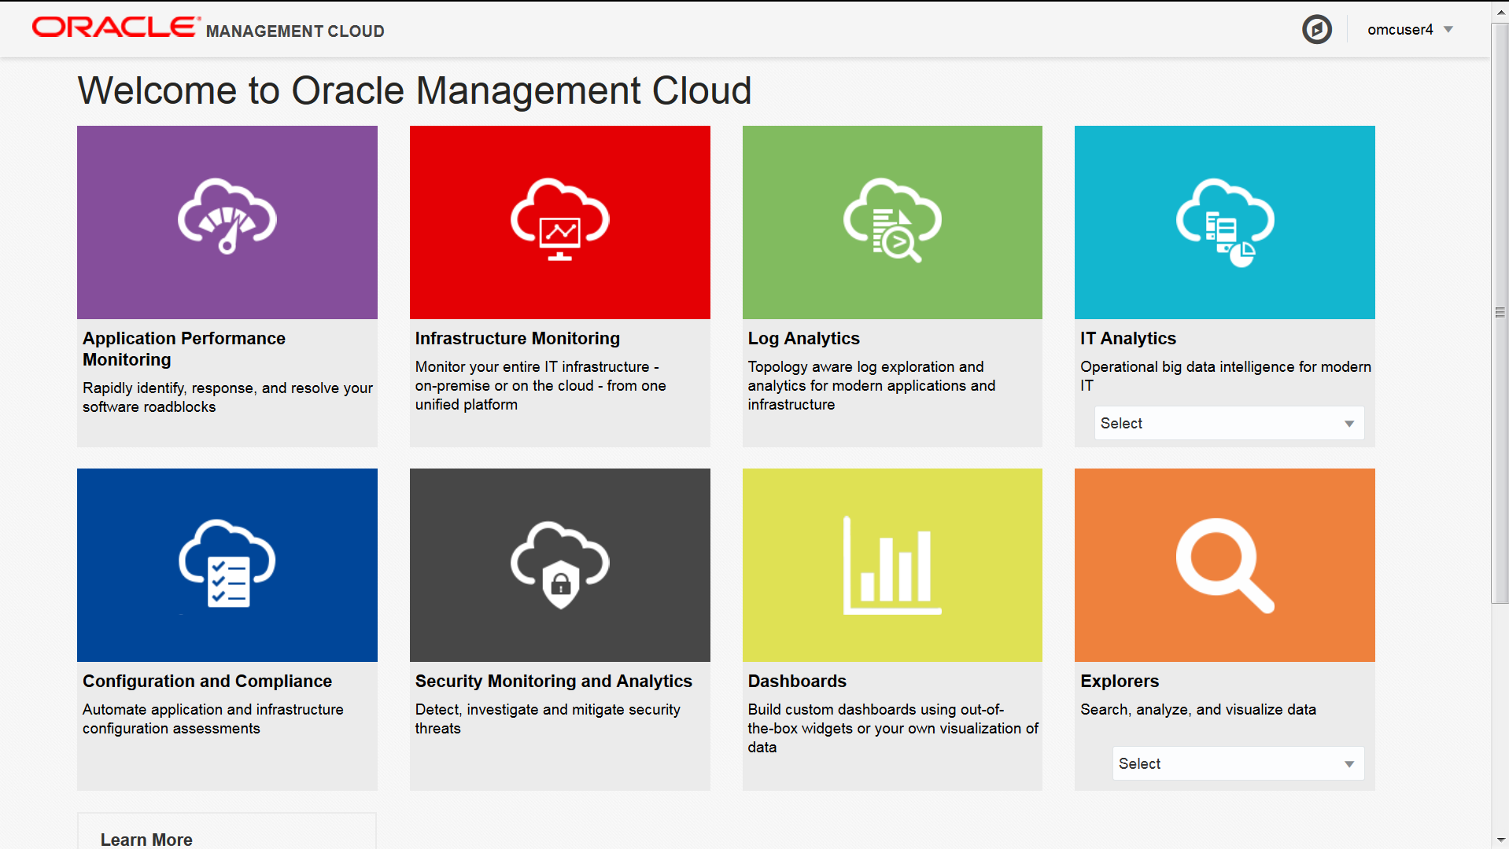

Slide 8
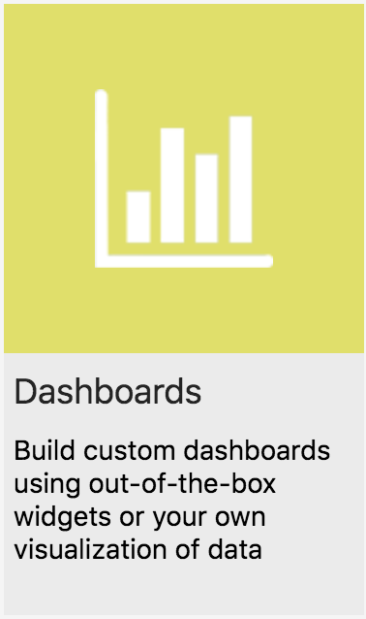
Dashboards Overview
Quick access to multiple data analysis
No configuration required
30 Out of the box Dashboards
Enterprise Health
Database Security
Host Operations
Ability to create custom dashboards & visualizations
Custom Log Parsers & Sources
Easily Visualize Data in Console

Slide 9
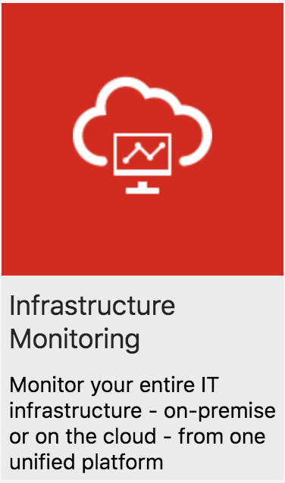
Infrastructure Monitoring Overview
Provides Proactive Monitoring for Entire IT Infrastructure
Perform Health Status Checks Across Tiers
Troubleshoot Issues before they affect users
View Performance Charts
CPU Utilization
I/O Per Second
Availability
Customizable
View Alerts
Grouped by severity
Warning – Fatal

Slide 10
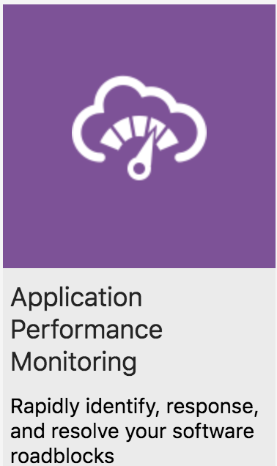
Application Performance Monitoring Overview
Isolate Application Performance Issues
Server Availability
Memory Usage
Garbage Collection
CPU Time
Drill down to related logs
Use Log Explorer to inspect specific log records related to underlying issue
Monitor end-user experience
Session Health & Apdex Score
Trace user’s activity

Slide 11
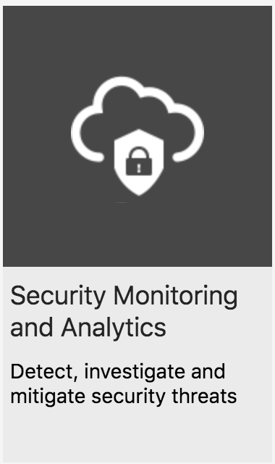
Security Monitoring & Analytics Overview
Investigate Unusual User Activity
Web Access Anomalies
Brute Force Attacks
Targeted Account Attacks
Mitigate Threats & Harden Assets
Orchestration Engine
Configuration & Compliance Rulesets
Leverage Breadth of Security Resources
Identity Context
CASB
Log Analytics

