Slide 1
CakePHP
By David Browder, Anthony Morrison, Joshua Larsen, and Branden Zame

Slide 2
What is CakePHP?
PHP 7 framework
Flexible database access layer
Scaffolding system
Builds small and complex systems
easier, faster, and “tastier” to make.
CakePHP 3.7 Version (Red Velvet)
Most recent version
Simple and fast on building web applications
Less code required
API Documentation
References to Cake namespaces and summaries
Heavy use of GIT to access Cake repositories.

Slide 3
Why is it useful?
CakePHP is fast and adaptable
No need to reinvent the wheel
Integrated CRUD (Create Read update and Delete) for database interaction
Works from any kind of web site directory site, with little to no Apache setup involved.
Conventions over configuration
Model View and Controller Layer’s

Slide 4
Bake Code Generation
The Bake script generates controllers, models and template files for applications
List of commands to help the user navigate and accomplish their goal
Bake guides the user through the class creation process when run with no command line arguments
Different themes for template
Can create your own theme

Slide 5
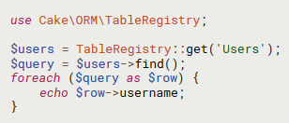
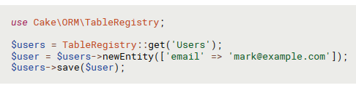
The Model Layer
Implements Business Logic
Responsible for Data Retreival and conversion
Includes processing, validating, associating, and other tasks related to data
Code below shows how to find users as well as add a user

Slide 6
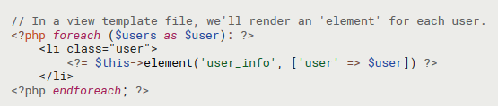
View Layer
Renders A presentation of Model data
Responsible for using the information to produce a presentational interface
Can use Model Data to render an HTML View Template or an XML formatted Result

Slide 7
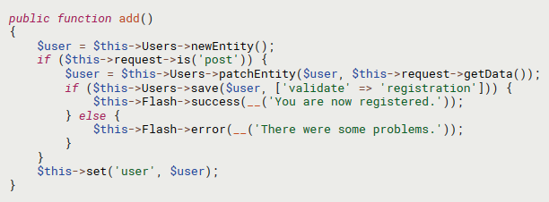
Controller Layer
Handles Requests from users
A Manager that ensures all resources needed for a task are delegated to proper Workers.
Below is an example of a user registration controller

Slide 8
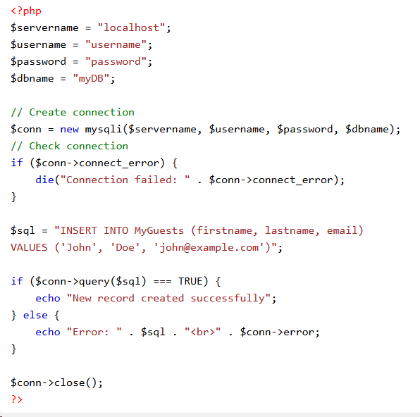
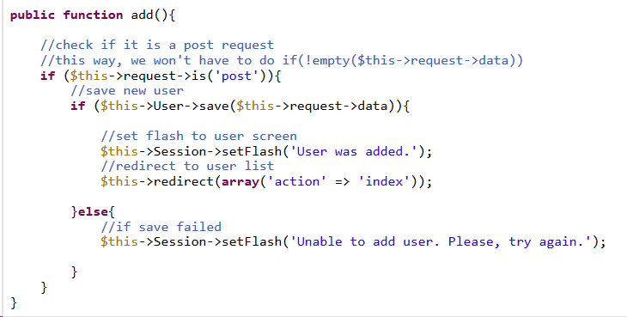
Comparison Of Code Cake VS Dough
Cake Dough(regular PHP)

Slide 9
Solutions
CakePHP can be used anywhere regular PHP is used.
Some business who have used CakePHP include:
Printivo
Blendtec
Sainsbury’s Bank
Videoo

Slide 10
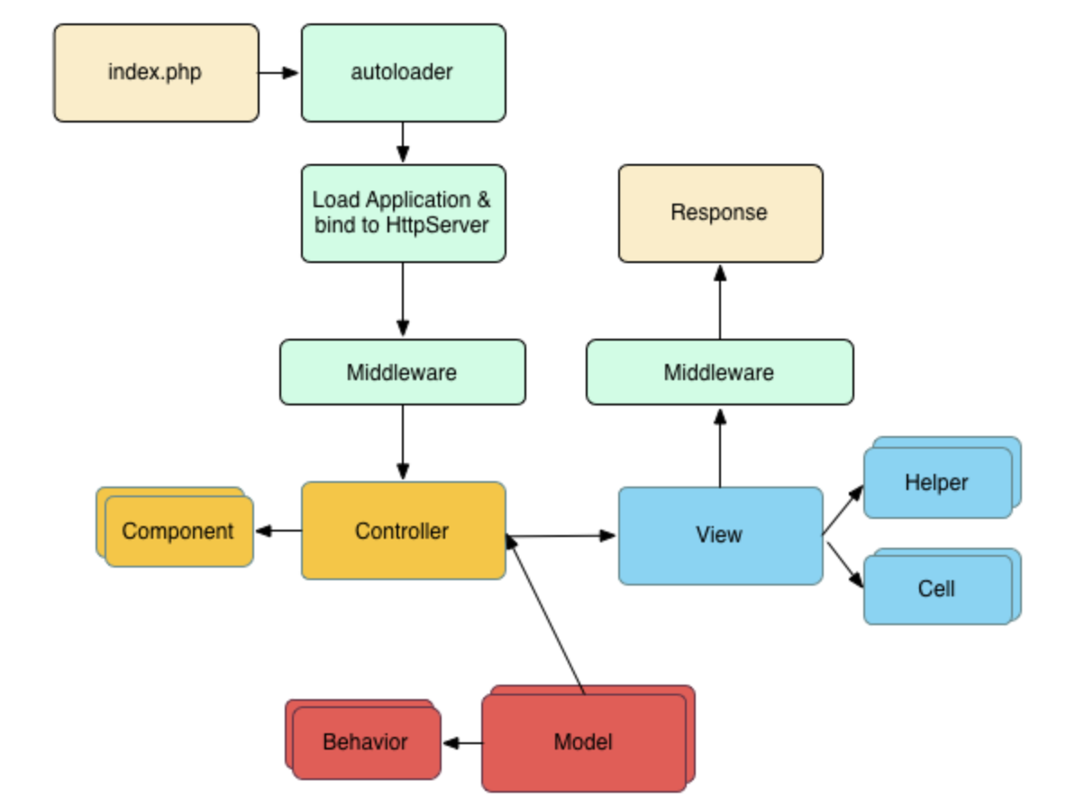
CakePHP Request Cycle
User requires a page or resource of the application.
High-level steps

Slide 11
Community
CakeFest
Yearly conference with workshops and presentations
Promotes the community of people to help each other
Even offers a link to a web based ICR for people
Open source project
People contribute fixes to bugs
GitHub fork
The community will translate the Cookbook

Slide 12
References
https://cakephp.org/
https://book.cakephp.org/3.0/en/intro.html
https://www.w3schools.com/php/php_mysql_insert.asp
https://www.codeofaninja.com/2012/04/cakephp-2x-crud-tutorial.html

Slide 13
Q&A
Any questions?

