Slide 1

CMPE 257 Machine Learning Semester Project Presentation Stock Market Behavior Prediction with Deep Neural Networks
Arun Tej Chennadi
Deepanshu Saini
Sunil Garg
December 5, 2017
Department of Computer Engineering

Slide 2
Background
Problem Statement
Amount of Money in the US Stock Market US$21.3 trillion
US $170 Billion value worth of stocks are traded every day
3,058 companies trading on the NASDAQ and 2,400 on the NYSE
Stock prices and Indexes are influenced by factors like Quarterly reports, Elections, Interest rates, Oil Prices and an incalculable number of other factors
Can we predict how the markets would react to changes in these factors?
With a fund of 1 Million dollars and 1 year of time, maximise profit while trading on the Dow Jones Index using Machine Learning techniques
Compare the profits obtained using different machine learning methods with a savings account
Notes:
Being able to predict which of these stocks will be successful based on a previous week’s data, even at margins slightly above 50%, could prove to be incredibly lucrative

Slide 3
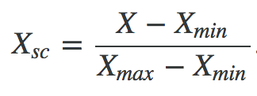
Data Source
The Dow Jones Industrial Average (DJIA) is a collection of 30 publicly traded stocks and it comprises some of the largest and most successful publicly traded stocks in the United States (e.g. Microsoft, Apple)
We used 5 year historic Dow Jones data retrieved from Yahoo! Finance for training and testing our models
Data Analysis and Preprocessing
Our dataset consists of 1250 days closing price data of the DJI
1000 days data is used for training and 250 days for testing
We use last 5 days closing prices as our features
We use MinMax scaling to transform Close price data to a 0 to 1 scale

Slide 4
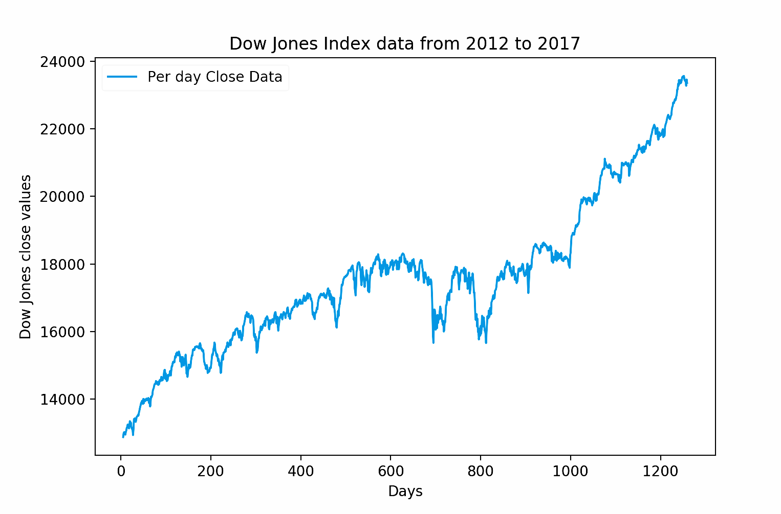

Slide 5



Tools Used
Prediction Logic
Google tensorflow v1.4.0 - Deep learning ANN and LSTM models
Scikit-learn v0.19.0 - Multi-variable Linear Regression and scaling
Matplotlib v2.0.2 - Graphs
Numpy v1.13.3 - Matrix algebra and N-d arrays
Pandas v0.20.3 - Data preprocessing
For each model input label is last 5 day closing price, output label is next day’s predicted stock price
If next day predicted price is higher than last day predicted price we buy stock other wise we sell everything

Slide 6

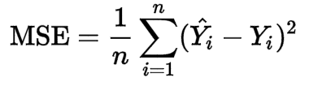

Technical Approach: Linear Regression
A baseline model which assumes the relation between the output variable y and dependent variables x₀ to x_{n} is linear
We used mean squared error to fit the intercept for our model. Multivariable linear regression is an excellent model when you are working with less data.
The computation of the intercept is instantaneous using the pseudo-inverse formula

Slide 7
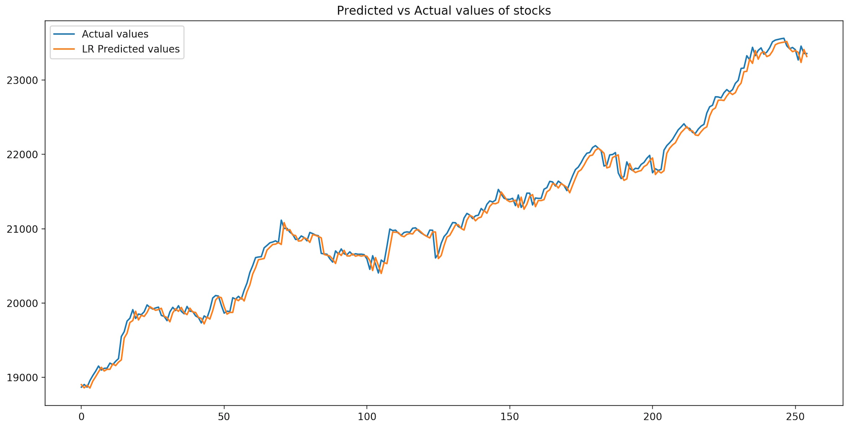
Results - Linear Regression
Root Mean Squared error = 97.07, Profit earned = $152,000 for input fund of $1,000,000
Predicted values lag behind the actual values. Not a true prediction.
Model weights calculation is exponentially faster compared to the other models

Slide 8
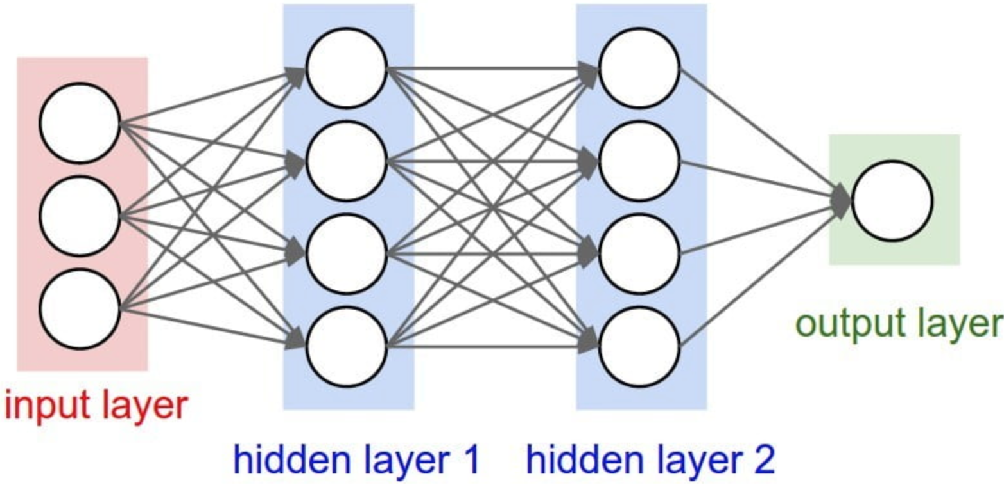
Artificial Neural Network (ANN)
ANN is a computational model based on the structure and functions of biological neural networks.
Our network is a 2 layer feed-forward network with backpropagation.
We use tf.train.AdamOptimizer to control our learning rate. It uses moving averages of the parameters which allow it to have a larger step size.

Slide 9
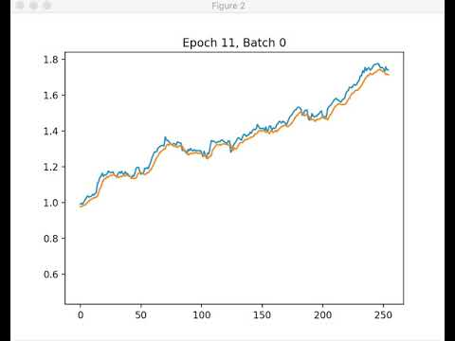
Results - ANN
Root Mean Squared Error = 615, Profit = $ 150,000
Model computation time is slower than Linear regression and faster than LSTM
Predicted values follow actual values accurately rather than lag behind
Model loses accuracy towards the end of the testing period

Slide 10
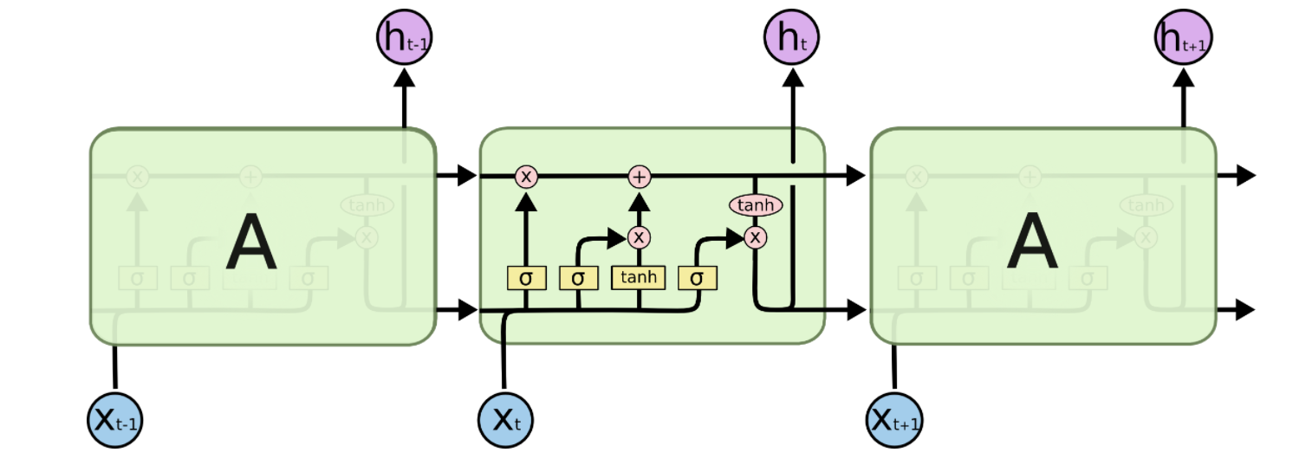
Long Short Term Memory Network (LSTM)
LSTMs are a special kind of RNN designed for remembering information for long periods of time. Gated cells are used to maintain and modify memory.
In our model we use a single layer RNN with 32 LSTM cells.
We employ a high dropout rate to ensure our network does not overfit.
We use tf.learn.AdamOptimizer here as well to compute and minimise loss while dynamically varying the learning rate

Slide 11
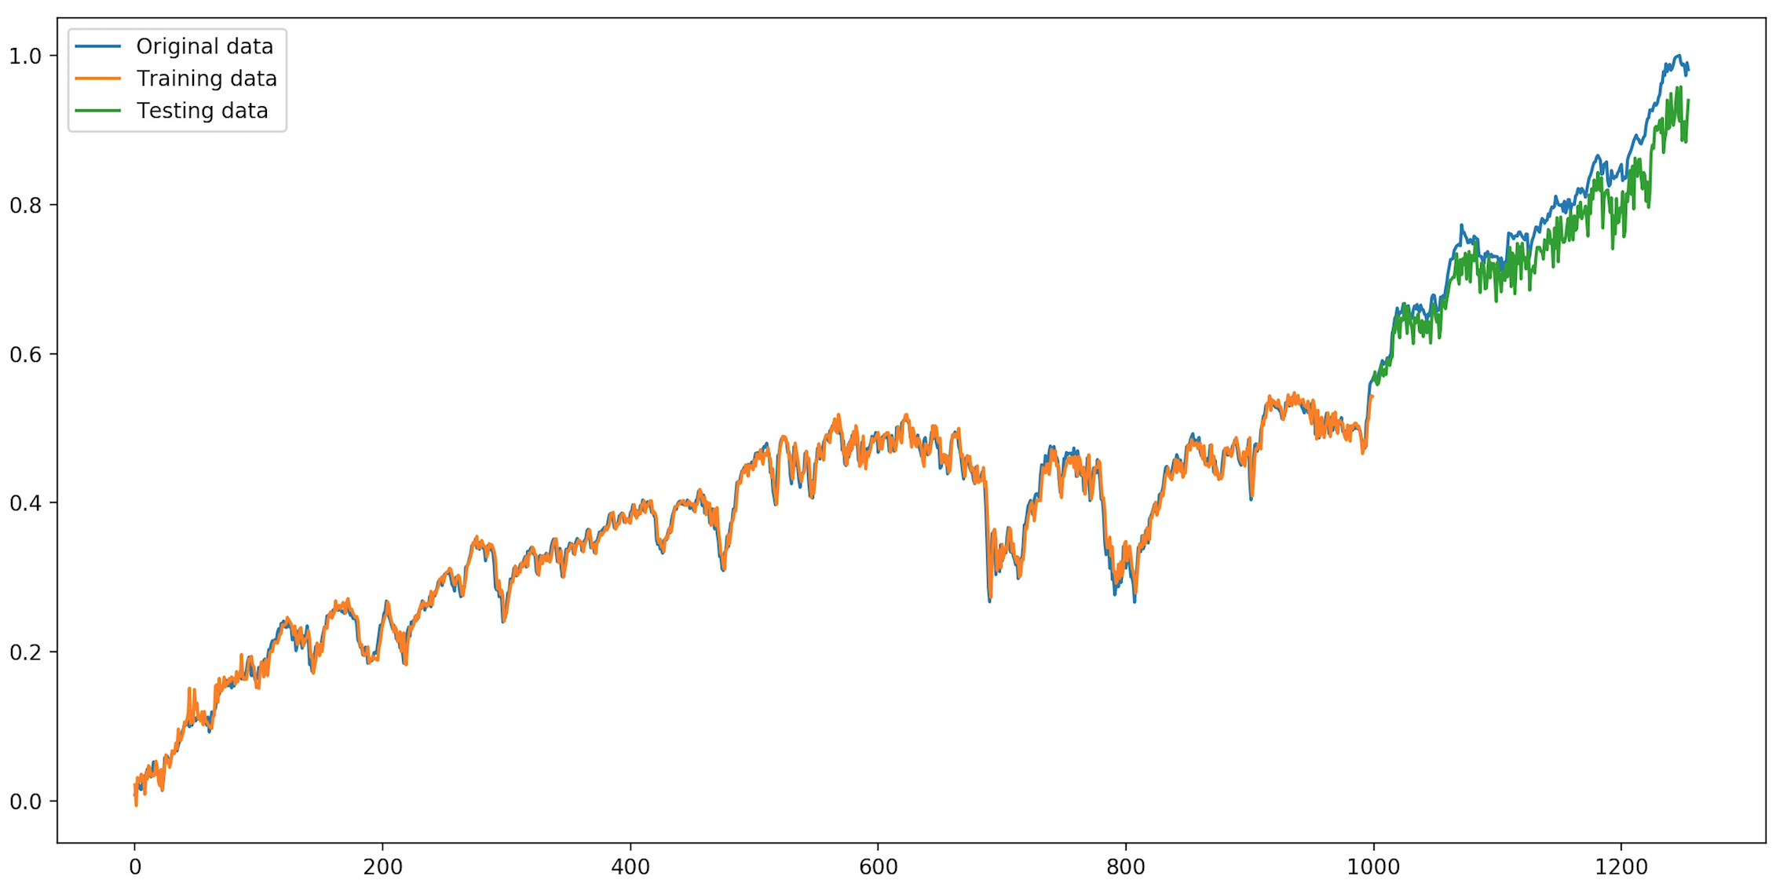
Results - LSTM
Root Mean Squared Error = 800, Profit = $ 210,000, Slowest Model to compute
Predicted values are accurate for the first 30%, model slowly loses accuracy after that
Need to retrain model often to maintain accuracy
Longer memory is actually a negative as data older than a few weeks is not relevant

Slide 12
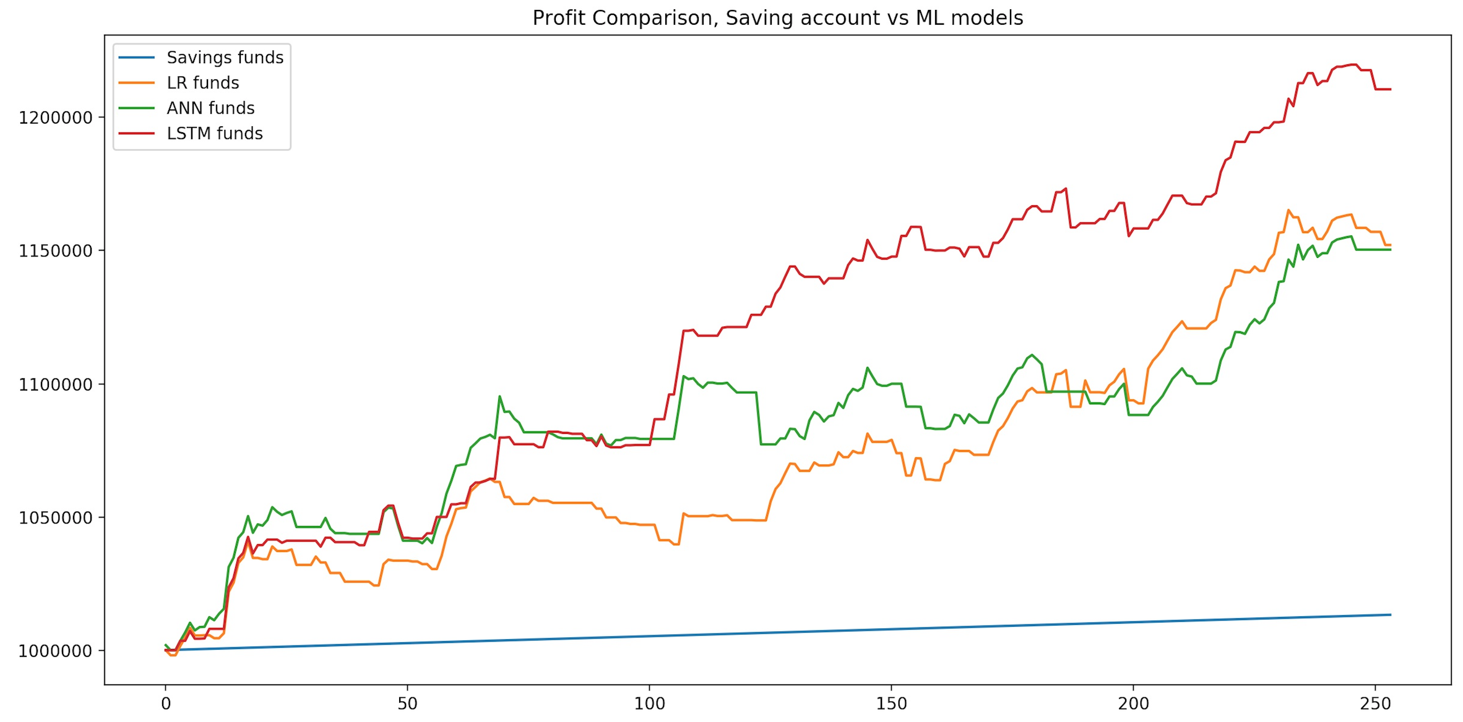
Results - Funds Comparison per Model

Slide 13
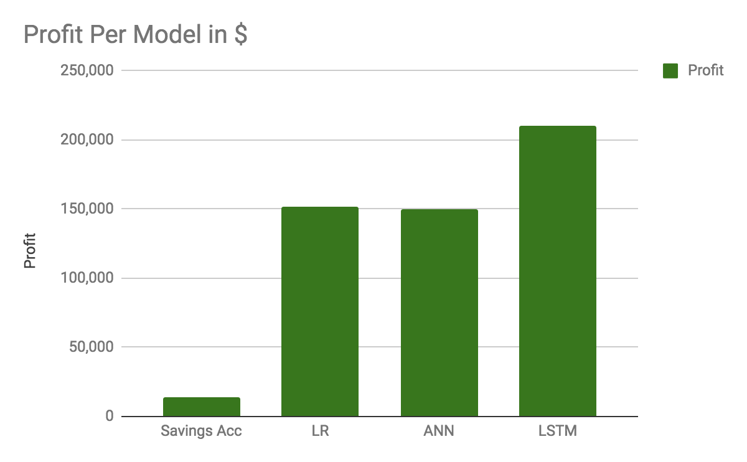
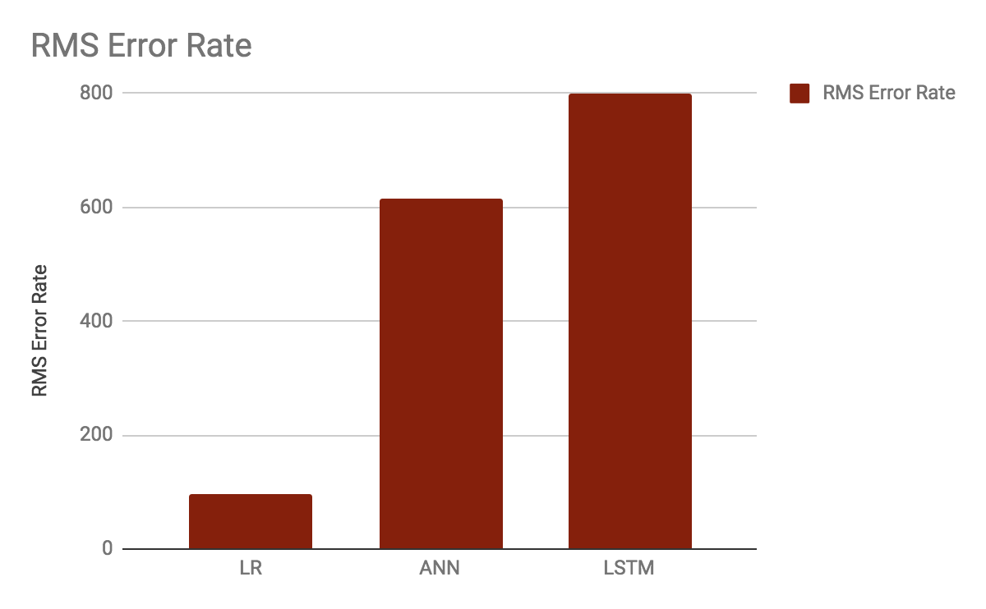
Results - Error and Profit Comparison
 | Savings Acc | LR | ANN | LSTM
Profit for $1,000,000 fund | $13,500 | $152,000 | $ 150,000 | $ 210,000
RMS Error Rate | NA | 97 | 615 | 800

Slide 14
Discussion: Lessons Learned
Stock Prices can be predicted to some extent using Machine Learning!
A simple approach like Linear Regression is useful for validation
Deep Learning Models can predict price trends accurately compared to actual stock value
Accuracy loss in later half of testing set is due to testing data being far away datewise from training data
90% of time is spent in data preprocessing and tuning hyperparameters
Past week data has more impact on prediction compared to months of older data
Models have to be periodically re-trained with updated data to maintain accuracy

Slide 15
Other paths
Future Scope
Logistic Regression could have been used as a baseline approach had we needed a classifier instead of a regressor
Recent stock data was much more useful compared to older data. Simple RNN could be used instead of LSTM
Individual stocks could have been easier to predict instead of an Index which depends on its constituent stocks
Better features like variance in recent data, constituent stock data and clubbing together similar types of constituents
Minutely data instead of per day data
DNNs and LSTMs with more neurons and GPUs to train them

Slide 16
Thank You!

