Slide 1


Python and Julia
Why do we need another language?
Dwight J. Browne
PyGotham 2014
Twitter: @dwightb2
GitHub: https://github.com/dbrowne/Presentations

Slide 2

History
The olden days: The Honeymooners - Oprah
Slow computers required efficient languages
FORTRAN, C
Required efficient and diligent coding
strncpy(tooSmall,tooBig,sizeof(tooBig) =

Slide 3
More History
Seinfeld, Friends
Compressed delivery time
Enterprise apps bloat
C#, Java, Perl
*nix or Win
Computers kept getting faster

Slide 4
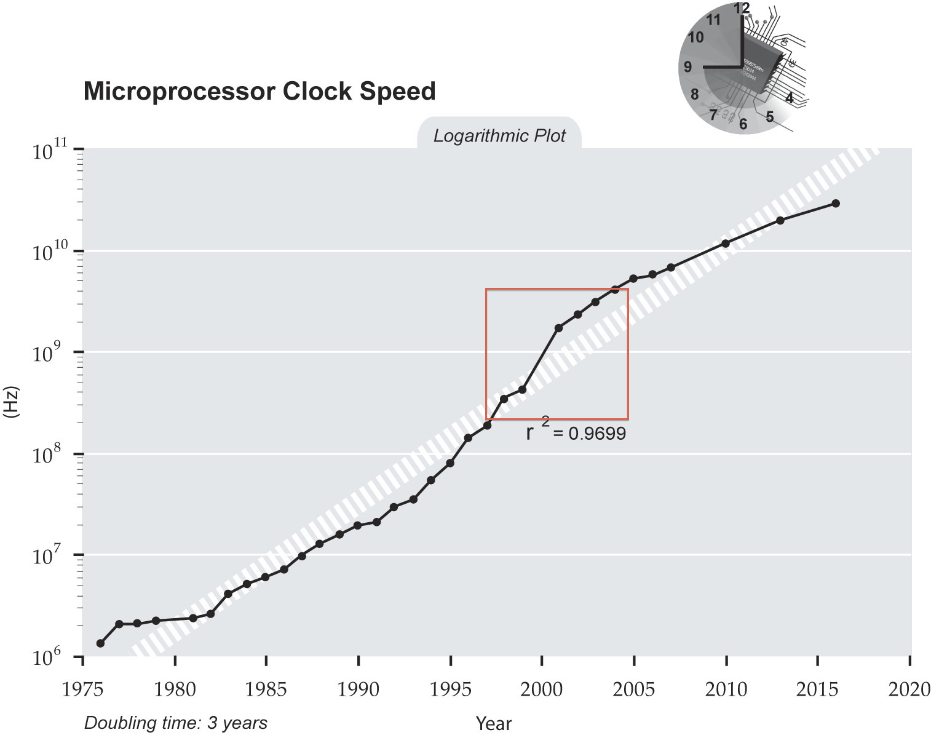
A Brief Diversion

Slide 5
The Dark Ages
Reality TV
GOOD ENOUGH

Slide 6
Some Problems
500 Channels and Nothing to Watch
Big applications
Complex dependencies
Cut and paste code
Technical debt

Slide 7
The Big Problem
The Notorious E.C.L.E
E.C.L.E. - Edit Compile Link Execute
More data. Finite time
Processing speeds are increasing slowly
Need a better way

Slide 8
The Need For Speed
Fast and Furious
High performance = C or FORTRAN
Using BLAS, LAPACK = FORTRAN
Still hindered by E.C.L.E.
A use case for a dynamic language

Slide 9
Python
The Sopranos and Breaking Bad
Multi Paradigm
REPL and IPython save person years
Less TIMTOWDI = Less wasted time
Slowness will be forgiven for fast delivery
But not always

Slide 10
Julia
Julia? Where did this come from?
Fast C like performance
Incredibly young language = Immature library base
C interoperability = Python interoperability
Multiple dispatch
Focus on methods not methods of classes

Slide 11
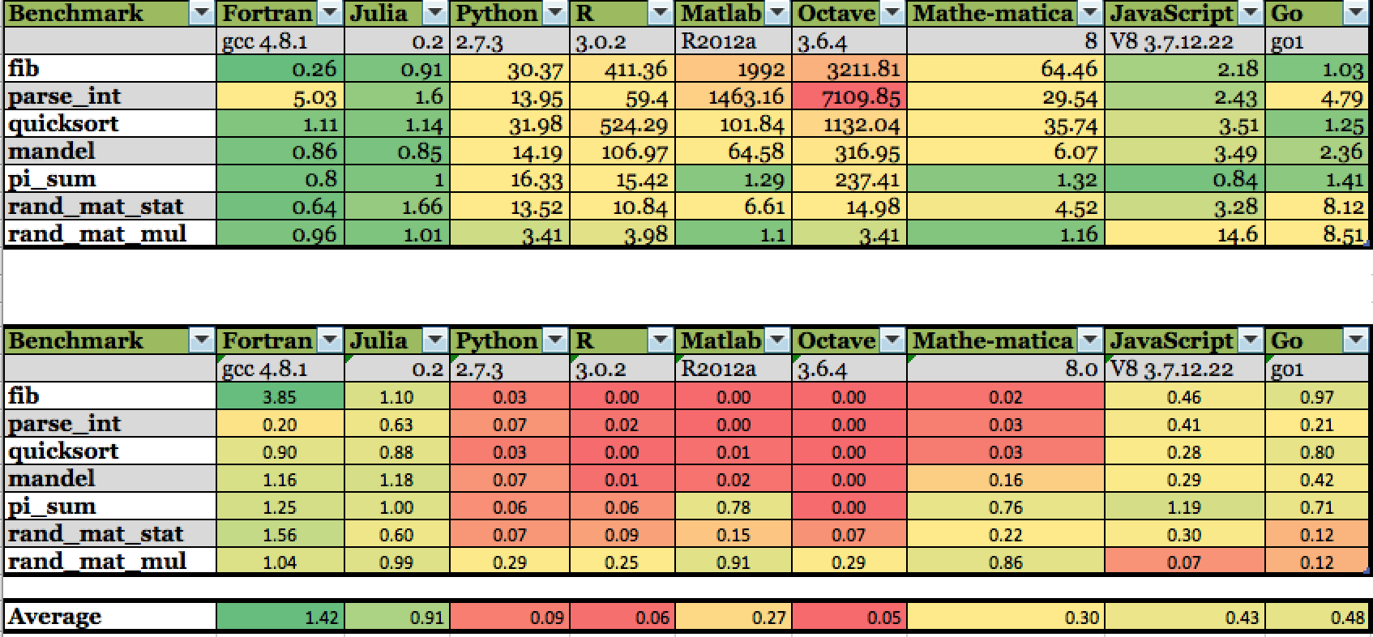
But How Fast is It?
Professional driver on closed course

Slide 12
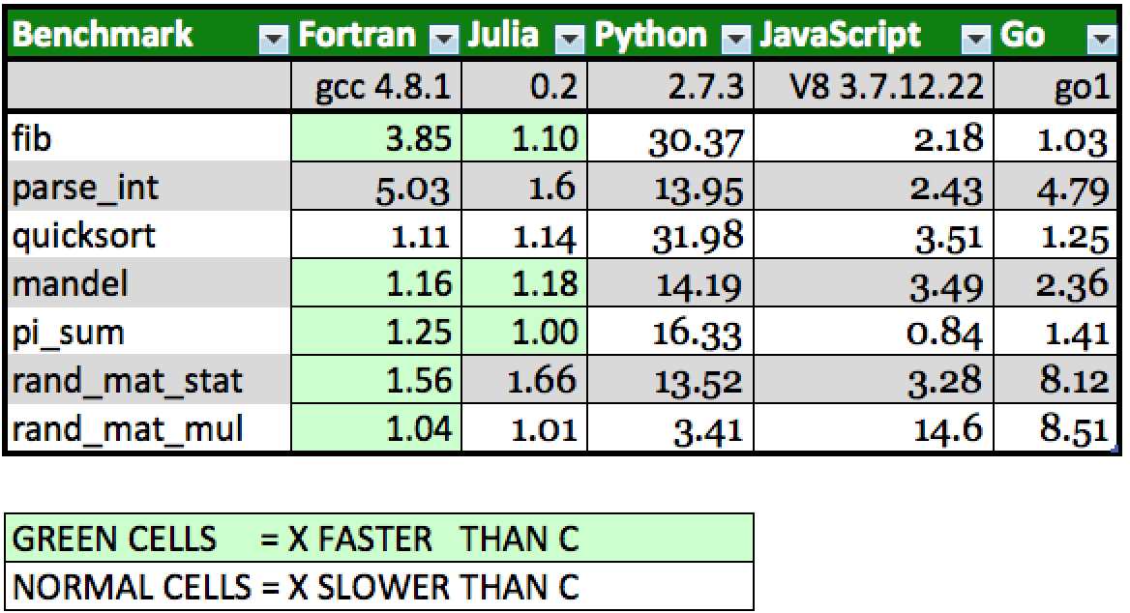
It’s Really That Fast?
Your mileage may vary

Slide 13
What is this Witchcraft?
How does it work?
Python PyObject:
object.h, methodobject.h
descrobject.h
Julia PyObject:
PyCall.jl, pytype.jl
PyPlot.jl for Matplotlib
ccall to call external C libraries

Slide 14
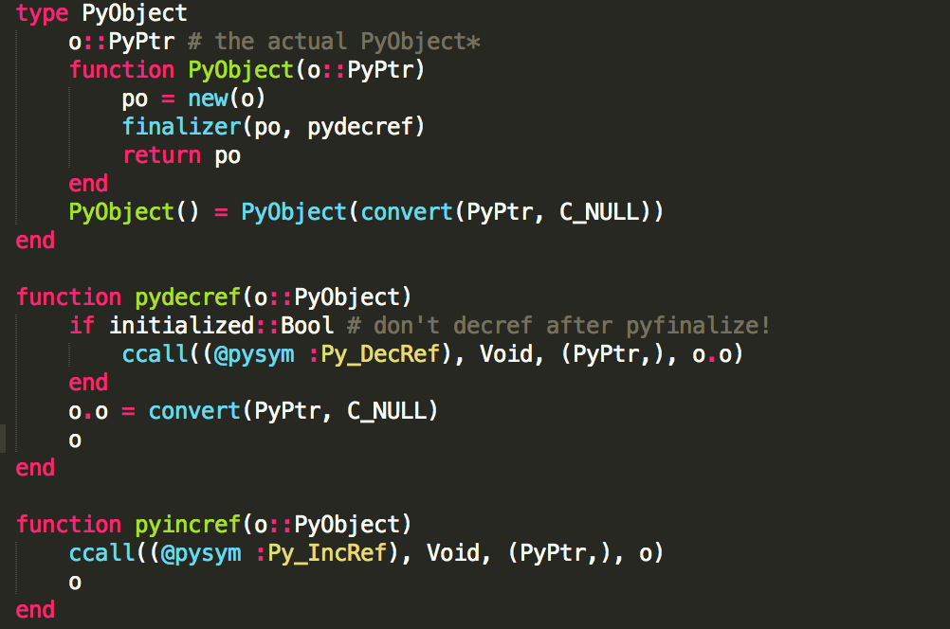
Julia PyObject

Slide 15
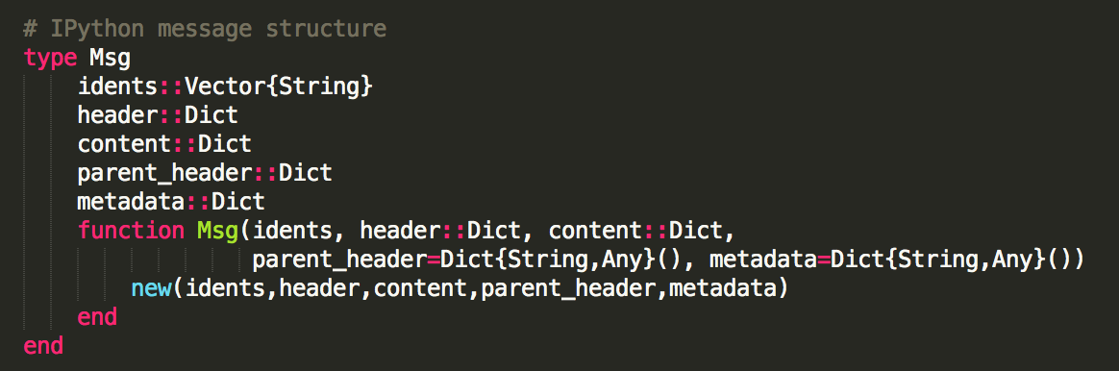
IPython and Julia
Yes. You can have your cake and eat it too!
Ijulia/src/msg.jl
IPython/kernel/zmqIPython/kernel/zmq/session.py

Slide 16

That’s All Folks!

Slide 17
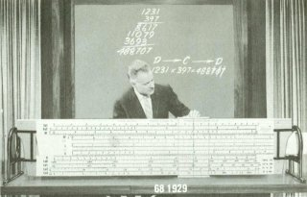
Is that it?
Demonstration

