Slide 1
Chicago Coalition for the Homeless:
Pseudo-Homelessness Simulator
Mitchell Jones, Dylan Brunelle, Dua’a Hussein, Daniel Kim
Development Project Description
Notes:
https://www.cs.uic.edu/~i440/CS_440_Presentation_Evaluation_Form.pdf

Slide 2
Base Foundation: Overview
The project that the team proposes is a detailed simulation that demonstrates what it is like to be homeless based on interviews and experiences from people who have been homeless or are currently experiencing homelessness. The goal of the simulation would be to survive as long as possible despite hazards presented to the user.
Hazards that those who experience homelessness have to be wary of on a daily basis will be the core of the simulation.

Slide 3

Purpose - Helping the CCH’s Mission
The Chicago Coalition for the Homeless (CCH) is a nonprofit organization dedicated to helping the homeless and the homelessness simulation is intended to be used to demonstrate how it is like to be homeless and how stressful it can be, and hopefully change the perception of homelessness from being one of ridicule to one of sympathy
Considerations to must be taken in regards to the simulation is the gravitas surrounding homelessness, and to be very careful with how homelessness is portrayed while still remaining accurate to the experience.

Slide 4
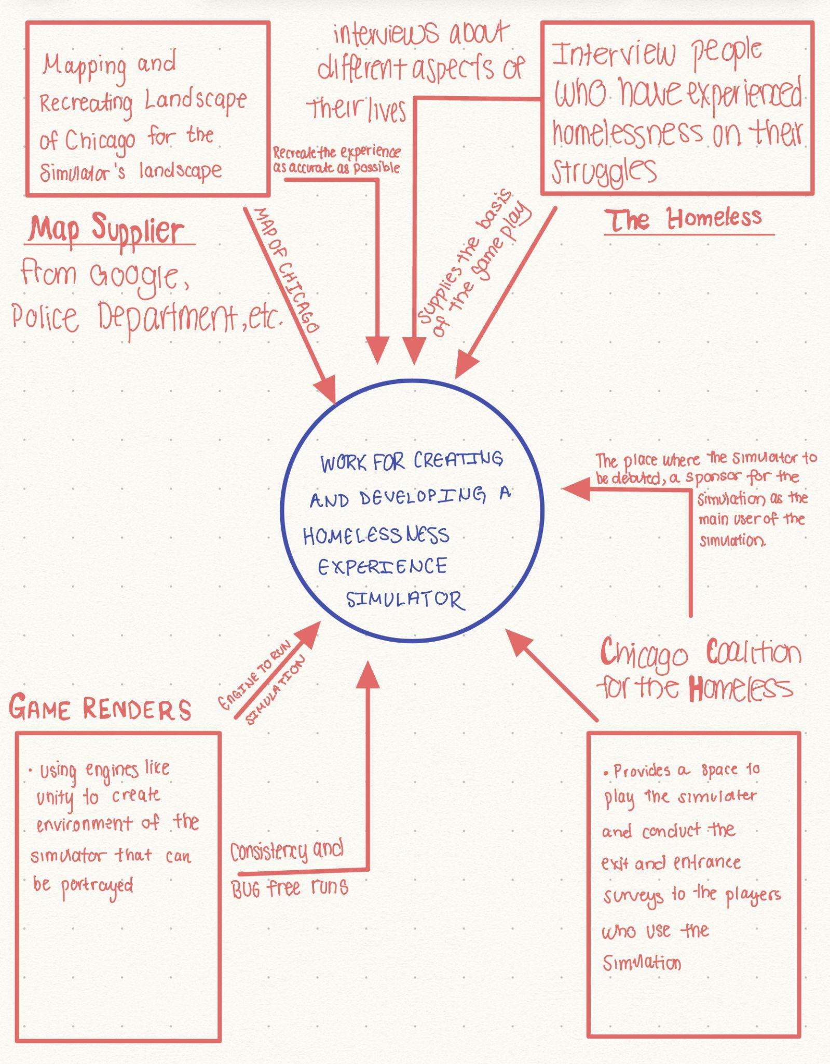
Scope of the Work
Currently very few interactive resources about homelessness available. (Hobson’s Choice)
The Context of the Work will involve combining real locations with stories from those experiencing homelessness, rendered onto an interactive environment.

Slide 5
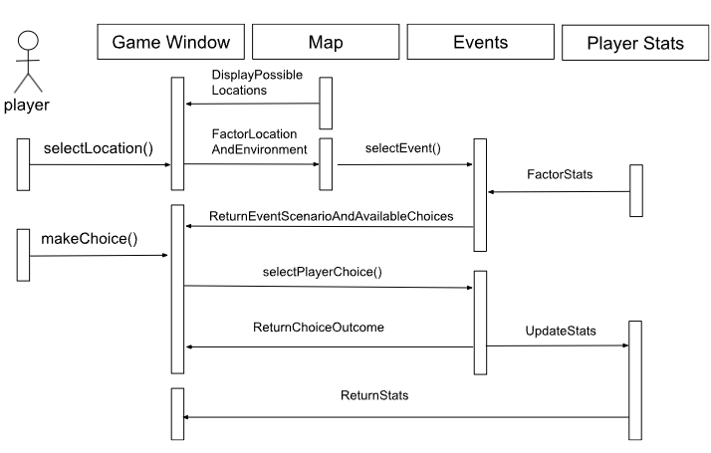
Scope of the Product
Simulation features:
Dynamic Environment-Weather and time of day
Unpredictable Dilemas-Realistic scenarios that can occur outside the player’s will.
Difficult Choices-Thought provoking decisions that real people have had to make while living on the streets

Slide 6
Stakeholders
Client & Customer: Chicago Coalition for the Homeless (CCH)
Hands-On Users:
Organizations combating homelessness (includes client)
Interested in using the product to spread awareness about homelessness
Non-homeless US population
Client makes simulation available to these users
Target users: client hopes to change these users’ perceptions of homelessness
Other Stakeholders: Homeless Individuals
First-hand accounts/insight is valuable in identifying various struggles and hardships homeless people go through (especially less common ones)
Asked to test the simulation, their feedback is extremely valuable as simulation is meant to accurately simulate their experiences

Slide 7




Mandated Constraints
Solution Constraints/Implementation Environment:
Windows 10+
Ideal OS given its vast popularity and market share
Low system requirements
Not everyone has high-end machines with powerful hardware
Off-The-Shelf Software:
Game Engine Software Packages
Unity, Unreal Engine
Provide framework for simulator (physics, graphics, AI)
Schedule Constraints:
Prototype done in six months
Beta version done in 1 year
Final product done in 2 years
Budget Constraints:
Strict budget of $250,000

Slide 8

Naming Conventions and Definitions
Following UML 2.0 specified by Object Management Group
Hunger: Feeling of weakness/discomfort due to insufficient food intake
Not used in general form to express desire
Homeless: Describes a person without a home, living on the streets
Simulator focuses on hazards of living on the streets
Does not focus on individuals who are homeless but have shelter (e.g.: living in car, couch surfing)

Slide 9

Relevant Facts and Assumptions
Windows is the most popular desktop OS
Around 69% market share
Assumed user has a computer running Windows 10+
Over 95% running at least Windows 10
Assumed user is able to use a computer
Assumed user has no prior game or simulator experience
Assumed hardware configuration of user pool varies

