Slide 1

ILLUSION D’OPTIQUE
1.- Tilt your head onto your right shoulder.
2.- Move your face about 2 feet in front of the screen (about 24 in.) and look closely.
3.It should take about 30 seconds for your eyes to focus.
====]]\\\\\///////*****<<<<<<<{}{}{}{}{}{}{}{}{}%%%%~~~~~~~~
////////^^!~~~~~::---))))*****+++@@@@@@@@<%||||||@@@@@444
+=+=****&^"""""""}}}}}}}]]]]]]]<<<<<<<%%{{{{{{===**++++**
***++++++++++++++?????????????/////////////%||||||@@@@@444+=+=
****&^"""""""}}}}}}}]]]]]]]<<<<<<<%%////////^^!~~~~~::---))))*****
+++@@@@@@@@<%||||||@@@@@444+=+=****&^"""""""}}}}}}
}]]]]]]]<<<<<<<%%////////^^!~~~~~::---))))*****+++@@@@@@@@
<%/%||||||@@@@@444+=+=****&^"""""""}}}}}}}]]]]]]]<<<<<<<%
%{{{{{{===**++++*****++++++++++++++?????????????/////////////
====]]\\\\\///////*****<<<<<<<{}{}{}{}{}{}{}{}{}%%%%~~~~~~~~
////////^^!~~~~~::---))))*****+++@@@@@@@@<%||||||@@@@@444
+=+=****&^"""""""}}}}}}}]]]]]]]<<<<<<<%%{{{{{{===**++++**
***++++++++++++++?????????????/////////////%||||||@@@@@444+=+=
****&^"""""""}}}}}}}]]]]]]]<<<<<<<%%////////^^!~~~~~::---))))*****
+++@@@@@@@@<%||||||@@@@@444+=+=****&^"""""""}}}}}}
}]]]]]]]<<<<<<<%%////////^^!~~~~~::---))))*****+++@@@@@@@@
<%/%||||||@@@@@444+=+=****&^"""""""}}}}}}}]]]]]]]<<<<<<<%
%{{{{{{===**++++*****++++++++++++++?????????????/////////////

Slide 2
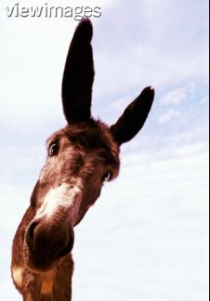
STOP LOOKING LIKE A JACKASS & GET BACK TO WORK …!

