Slide 1

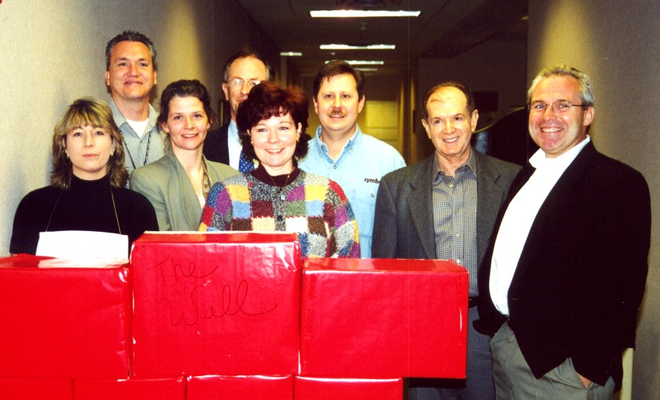

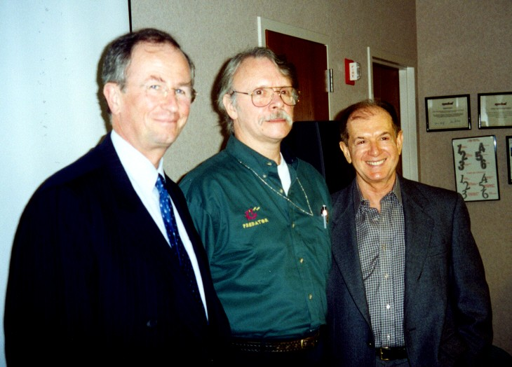



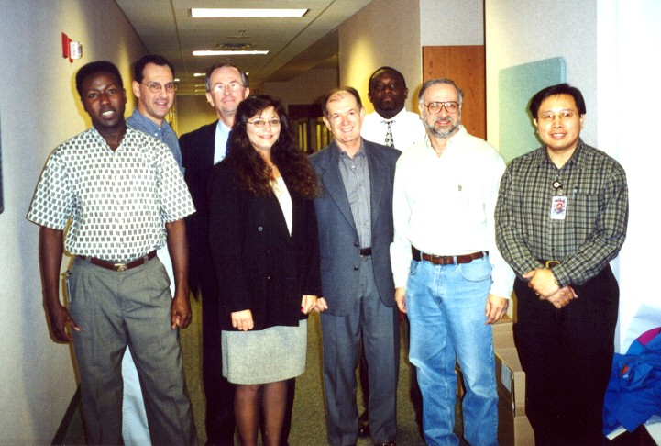
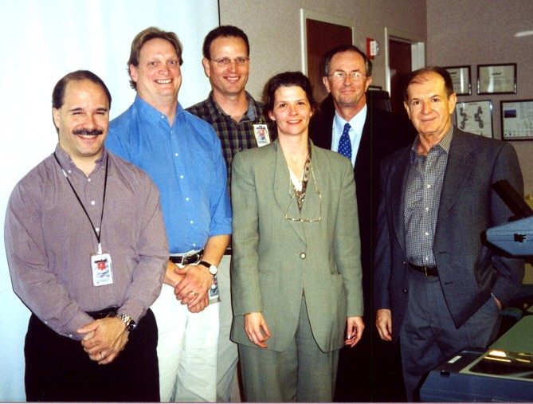

Congratulations to the winners of the
2000 Celebration of Excellence
President’s Award - QI Story
New Products Release Team
Leader : Linda Garnett
President’s Award – Poka-Yoke / AIP
MMCX Connector Extractor
Charles Rankin
Runner-up - QI Story
Diamond DOA PDT75xx Team
Leader : Basil Watson
Runner-up – Poka-Yoke / AIP
Software Nomenclature
Suzanne Wenz, Tony D’Agostino, Carl Barkley,
Bill Leonard, Ken Knizek

Slide 2
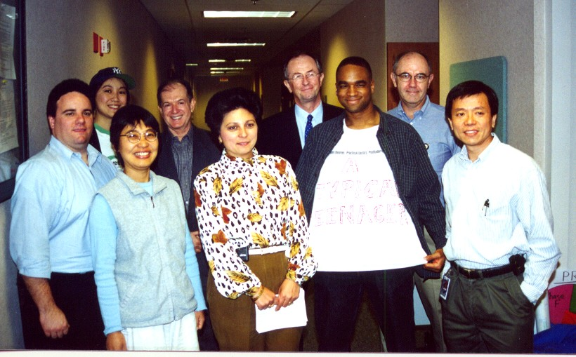
Mechanical Durability Improvement Team

Slide 3
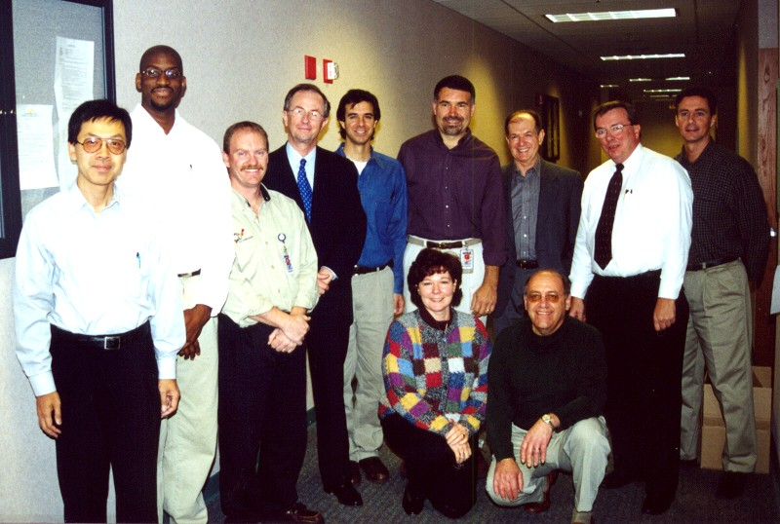
Requalification Team

Slide 4
New Products Release Team

Slide 5
Diamond DOA PDT75xx Team

Slide 6
Charles Rankin – MMCX Connector Extractor

Slide 7
Suzanne Wenz, Tony D’Agostino, Carl Barkley, Bill Leonard, Ken Knizek –
Software Nomenclature

Slide 8
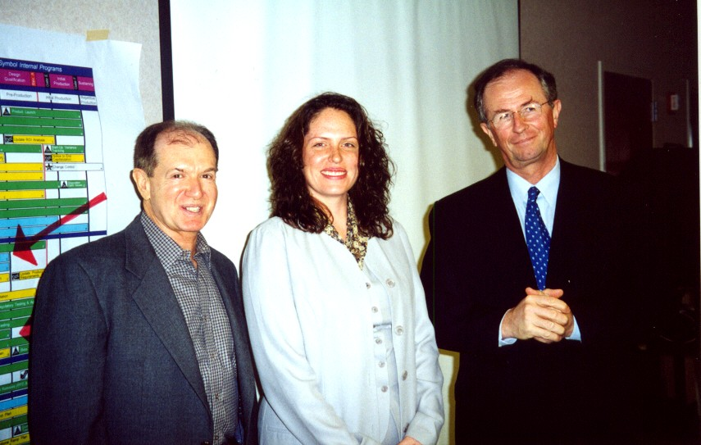
Sandra Borgo –
DDC Administration Groupwise Mailbox

Slide 9
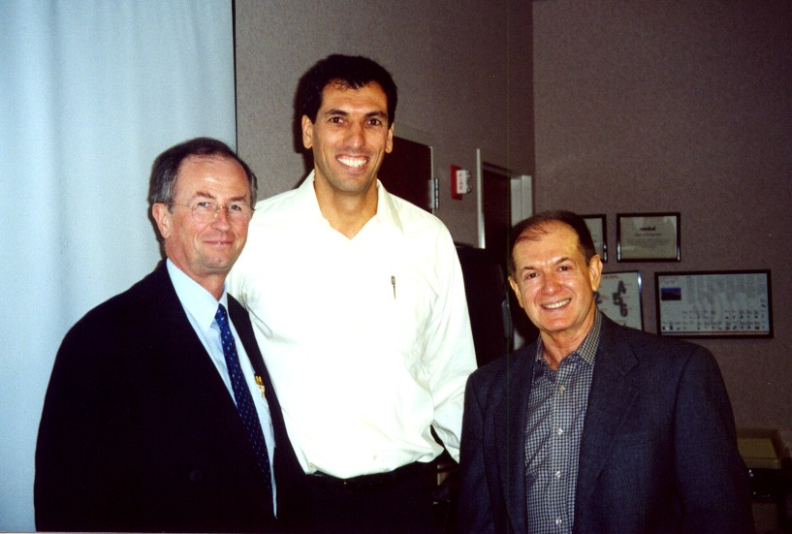
John Cavalieri, Tom Krasner –
Proton/Palm Coil Clip

