Slide 1
Do long reads help classify pathogenic SVs?
• Matched simulation: same SV, same genome, two technologies
• Arm A short only vs Arm B short + long vs Oracle
• Primary metric: AUPRC with cluster-bootstrap CI
• Result: no gain once an SV is detected; gain is in detection

Slide 2
Why simulate
• Pathogenic SVs have no reads
• Real benign short and long reads come from different material
• Plant every SV (both classes) into a GRCh38 window; simulate both read types with identical label-blind code
• Cost: result depends on simulator realism (checked on HG002)

Slide 3
Data: 4,030 SVs, 2,015 per class
• ClinVar P/LP vs B/LB (>=1 star) + gnomAD-SV v4.1 common PASS
• Conflicts and near-duplicates removed; local-density cap
• Matched on type x size bins (KS p = 0.42)
• Size, type, chromosome, position baselines: AUROC 0.48-0.53

Slide 4
Pipeline
• ART 2x150 + in-house HiFi, 30x, het SV, background variants
• bwa-mem / minimap2 to full GRCh38
• Manta+Delly | Sniffles2+cuteSV
• Detection 0.916 short, 0.945 HiFi; median breakpoint error 1 bp both
• 29 pseudo-sample batches; CPU for genomics, GPU for models

Slide 5
Leakage audit: pipeline is label-blind
• Nuisance-only, shuffle, adversarial, shortcut models: AUROC 0.49-0.55
• Source swap (gnomAD-benign -> ClinVar-benign): AUROC 0.89 / 0.96
• Simulation parameters identical across classes (KS p > 0.27)
• High AUPRC (~0.98) comes from gene context, not leakage

Slide 6
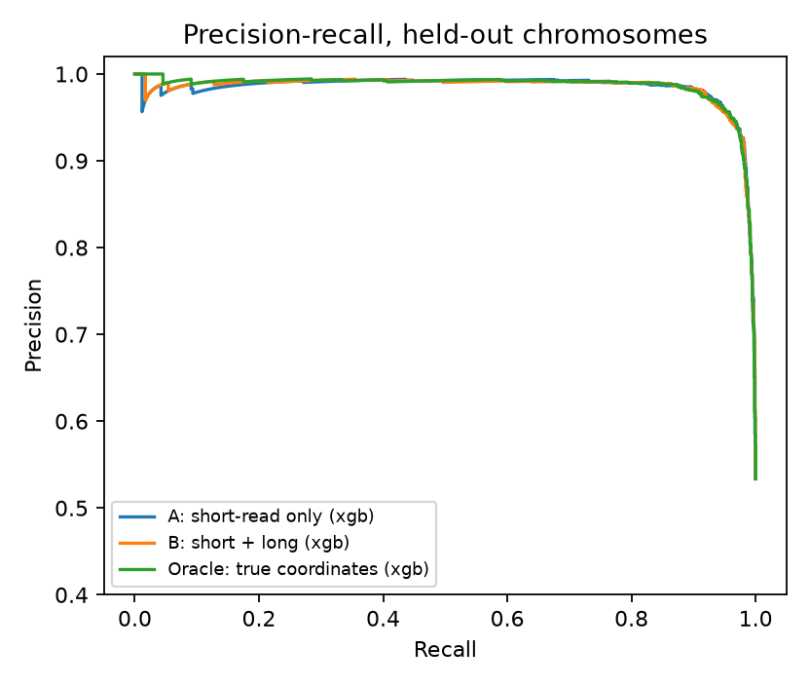
Main result
• XGBoost AUPRC: A 0.984, B 0.985, Oracle 0.986
• B - A = +0.0004 [-0.0021, +0.0038]
• LR, RF, MLP agree
• Exon-overlap status changed in 0/3,510 SVs between A and B coordinates

Slide 7
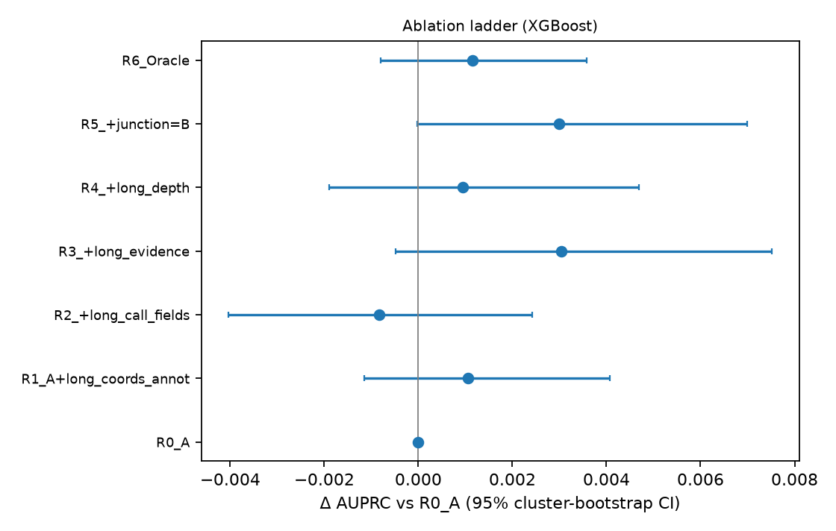
Where would a gain be? Ladder and controls
• Ladder steps all within CI of 0
• Leave-one-family-out: max drop 0.005
• All SVs incl. undetected: +0.0036 [+0.0021, +0.0054]
• Exon-hit only: +0.0019 [+0.0004, +0.0035] (exploratory)

Slide 8
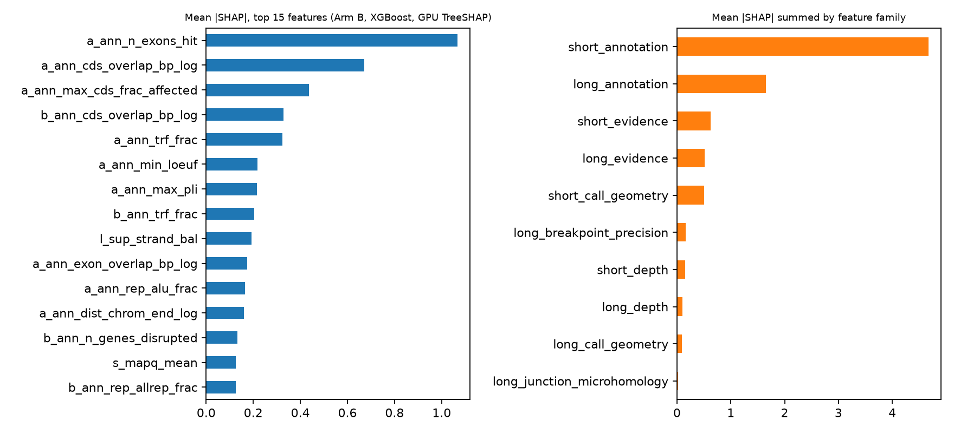
Why: SHAP and feature families
• Annotation dominates (exons hit, CDS overlap, LOEUF)
• Long-read evidence adds redundant information
• GPU TreeSHAP on XGBoost

Slide 9
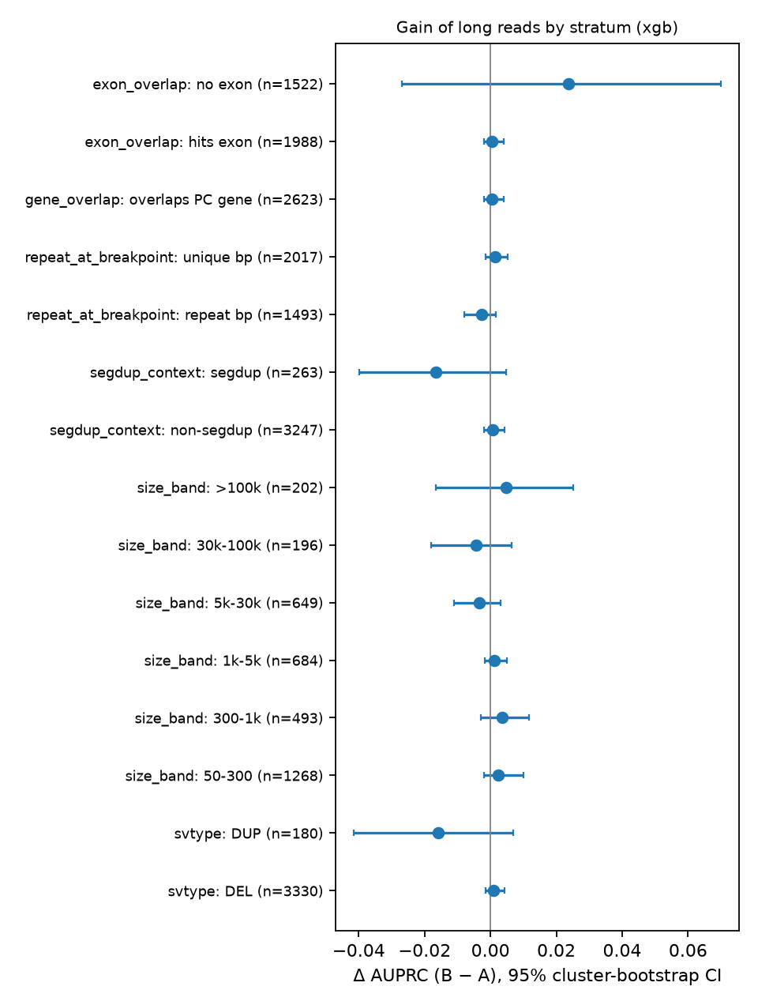
Stratified gain
• No stratum excludes 0
• Small SVs: +0.002 [-0.002, +0.010]
• Segdup: -0.017 [-0.040, +0.005] (n = 263)
• Power: MDE ~0.02 for ~250 SVs

Slide 10
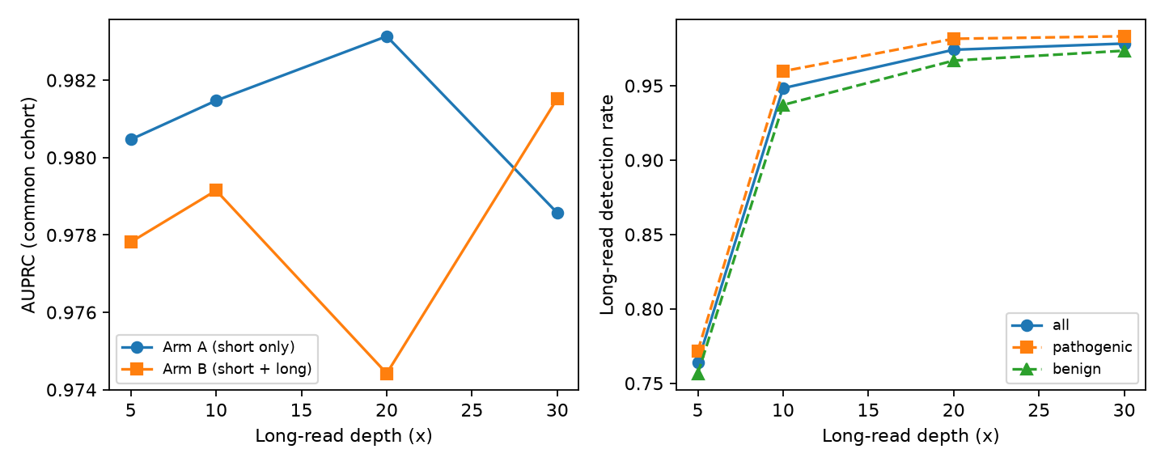
Depth sweep
• Long detection 97.8 / 97.4 / 94.8 / 76.4 % at 30/20/10/5x
• Classifier AUPRC flat
• Detection benefit plateaus at ~10-20x
• 60x short: detection 92.9 % vs HiFi 97.8 %

Slide 11
Real-data check (HG002)
• 104 GIAB deletions through the same code
• Adversarial real-vs-sim AUROC 0.97 / 0.98
• Real HiFi breakpoint dispersion 5-10 bp vs 0 in simulation
• Real detection: short(Delly) 0.11, HiFi 0.64
• Simulation is too clean -> optimistic for breakpoints

Slide 12
Limitations
• Simulated errors; one DUP model; het only; DEL-dominant
• Benign mostly gnomAD; easy benchmark (gene context)
• No ONT, INS/INV, phasing, 60x short arm; one replicate
• No real pathogenic reads

Slide 13
Conclusion
• After detection, long reads add no measurable classification value here (CI +/-0.004)
• Their value is detecting SVs short reads miss (94.5 vs 91.6 %)
• Next: real long-read call sets with real breakpoint noise

