Slide 1

22PHY106 – COMPUTATIONAL PHYSICS
SMART VACUUM
CLEANER ROBOT
GROUP - 9
TEAM MEMBERS:
DEV BALA SARAGESH – 23022
GHANASREE S – 23028
HARI HEMAN V K – 23029
RAGHAV N - 23059

Slide 2
INTRODUCTION:
PROBLEM DEFINITION:
The problem lies in the inefficiency and time-consuming nature of traditional vacuuming methods.

Slide 3
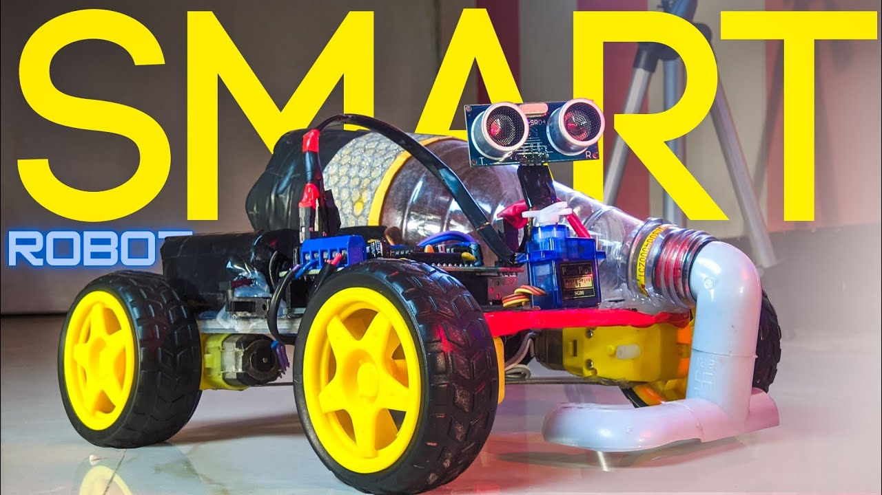
MOTIVATION:
The motivation comes from the need for an automated, efficient, and adaptable solution to keep spaces clean without constant human intervention. ​

Slide 4
OBJECTIVES TO SOLVE:
Efficiency: To Develop a robot capable of effectively cleaning in lesser time.​
Adaptability: Ensure the robot can navigate various environments and adjust cleaning modes accordingly.​
Automation: Create a system that operates autonomously without constant human intervention.​
Safety Features: Implement safety protocols to prevent collisions, falls, and damage to furniture or itself.​

Slide 5
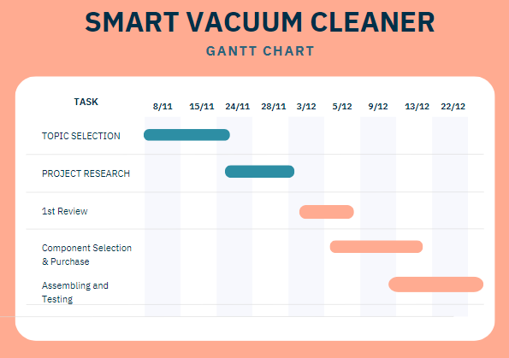
GANTT CHART

Slide 6
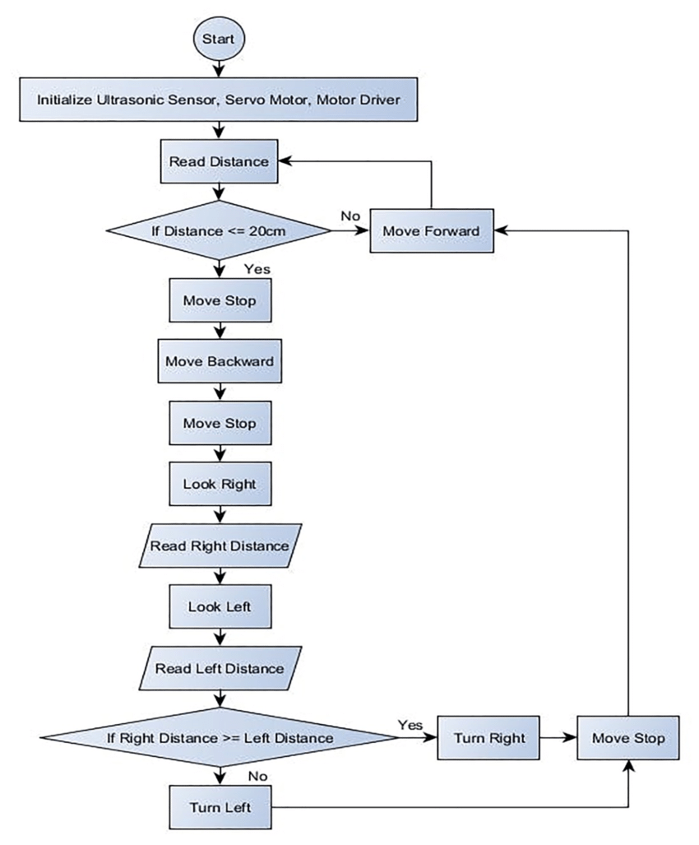
FLOW CHART :

Slide 7
PROPOSED METHODOLOGY:
HARDWARE SELECTION:
Arduino
UNO
Servo
Motor
Gear
Motor
AF Motor
Shield
Ultrasonic
Sensor

Slide 8
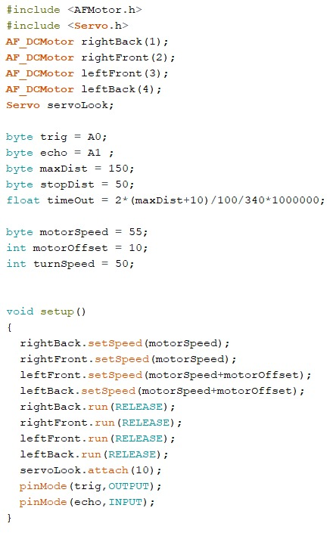
CODE IMPLEMENTATION
Code for obstacle avoiding is implemented in arduino IDE.
CODE SCREENSHOTS:

Slide 9
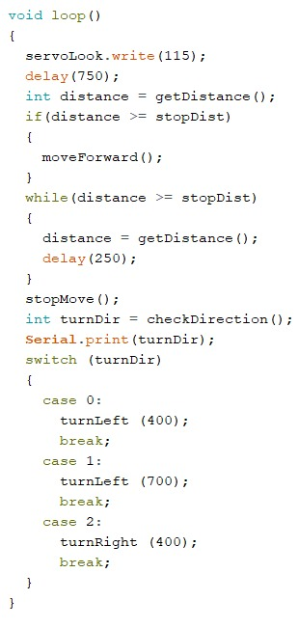
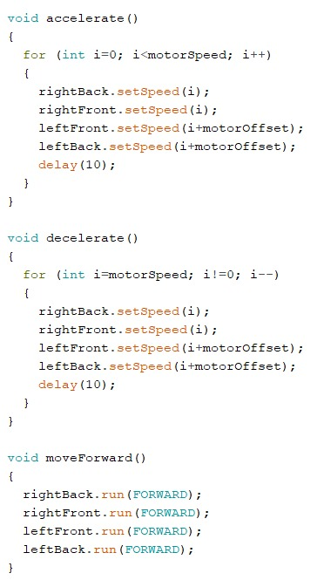

Slide 10
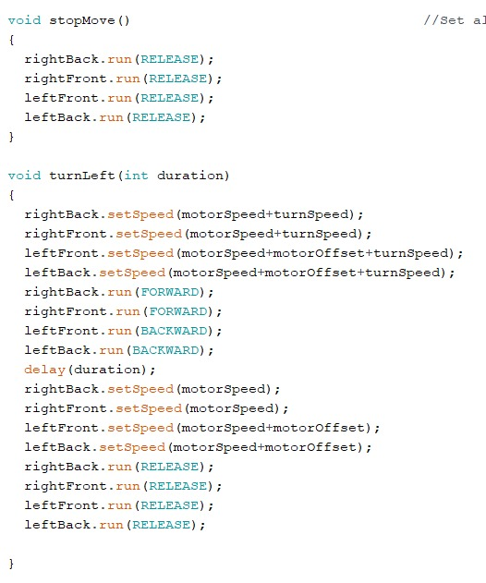

Slide 11
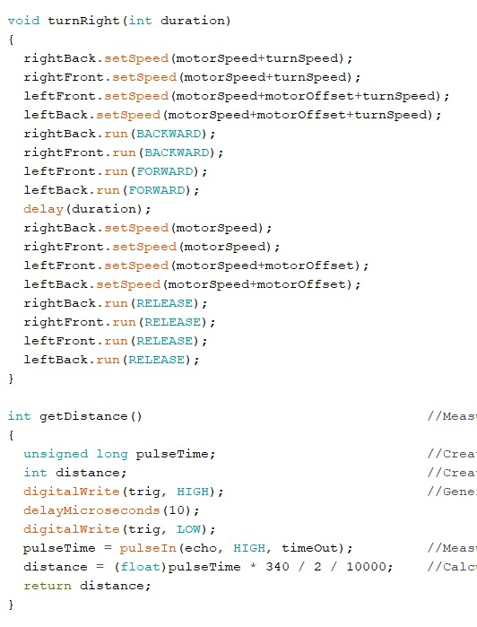

Slide 12
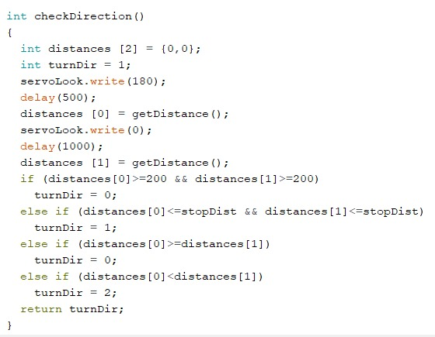

Slide 13
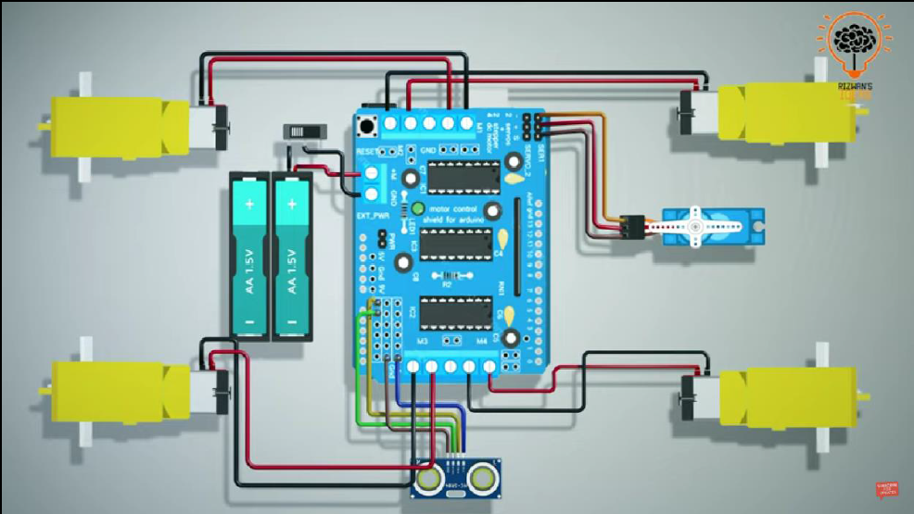
CIRCUIT DIAGRAM:

Slide 14
WORKING OF MODEL
At the starting, the ultrasonic sensor checks the distance ahead and if the there are no obstacle, then the robot starts to move.
It slowly accelerates from 0 to max speed assigned.
After the acceleration the robot continuously checks the for any obstacle ahead, if it encounters one the robot slowly decelerates from max speed to 0.
With the help of the servo motor, ultrasonic sensor reads the obstacle distances in both the directions, and depending on the readings the robot turns the wheels.
After turning the same process repeats from step 1.
All through the processes the robot continues to suck the dust and impurities from the floor simultaneously.

Slide 15
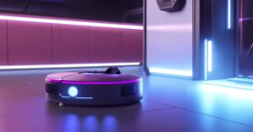
FUTURE SCOPE:
AI Integration: Enhance the robot's intelligence using machine learning for better adaptability and efficiency.​
Smart Home Integration: Enable compatibility with smart home systems for seamless operation.​
Environmental Adaptation: Develop capabilities to clean specific surfaces or handle diverse obstacles.​
Enhanced Battery Life: Improve battery efficiency for extended cleaning periods.

Slide 16
CONCLUSION:
In conclusion, the smart vacuum cleaner robot project represents a leap forward in home automation, offering users a hassle-free and efficient way to keep their living spaces clean. With advanced technology and user-friendly features, these robots simplify household chores, contributing to a more convenient and modern lifestyle.

Slide 17
REFERENCES:
[1] Wolfdieter Richter" Automatic guidance apparatus US patent US7079923B2
[2] Joseph L. Jones" Robot obstacle detection US7155308B2
[3] Joseph Jones, Newton Mack, David Nudget" Autonomous floor-cleaning robot
[4] David Kisela, Robert Vistricle, Wallace Tiller" Autonomous vacuum cleaner
[5] Hwi-Chan Jang, Shin Kim" autonomous cleaner US75235676B2
[6] Spyros G. Tzafestas"Mobile Robot Path," Introduction To Mobile Robot Control
[7] https://www.scribd.com/document/359870444/automatic-vacuum-cleaner-pdf
[8] https://www.instructables.com/id/Floor-vacuum-cleaner-robot-controlled-by-Arduino-w/
[9] http://www.intorobotics.com/build-diy-roomba-style-robot-vacuum-cleaner/
[10] https://web.stevens.edu/ses/me/fileadmin/me/senior_design/2007/group01 /DesignFinal.pdf
[11] https://www.robotshop.com/community/robots/show/robot-vacuum-cleaner
[12] Shalom Levin, Shai Abramson, " an autonomous robot "
[13] Jeremy F. Knopow, David Curtis and Everett F. Carter, JR "Floor cleaning device"

Slide 18
THANK YOU !

