Slide 1

BadgerBOTS
Extracurricular Volunteer Event for Enterprise Java – Nov 14, 2015.

Slide 2
What is BadgerB.O.T.S ?
http://www.badgerbots.org/about/
“Building On Talented Students”
Mission
BadgerBOTS Robotics Corporation’s mission is to promote science, technology, engineering and mathematics (STEM) in Dane County by engaging students in exciting hands-on, mentor-based programs that BUILD self-confidence, DEVELOP communication and leadership skills, and CREATE opportunities to explore STEM so students will SUCCEED in the 21st century.
BadgerBOTS is part of a National Program, FIRST
(For Inspiration and Recognition of Science and Technology)
This weekend they hosted a tournament. “TrashTrek” = Volunteer Opportunities !!!
Automated background check easy and quick using: http://verifiedvolunteers.com/

Slide 3
“TrashTrek” - Wisconsin FIRST LEGO League (regional tournament, JMM High School)
A few quick snaps from Saturday...
A brief interview with Zach – Java and Android Phones are the future at his level for programming bots
The promo for BadgerBOTS explains it best

Slide 4
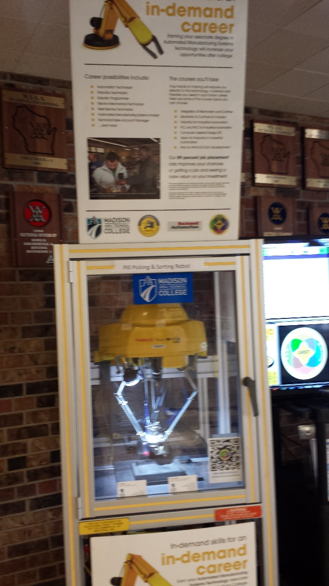
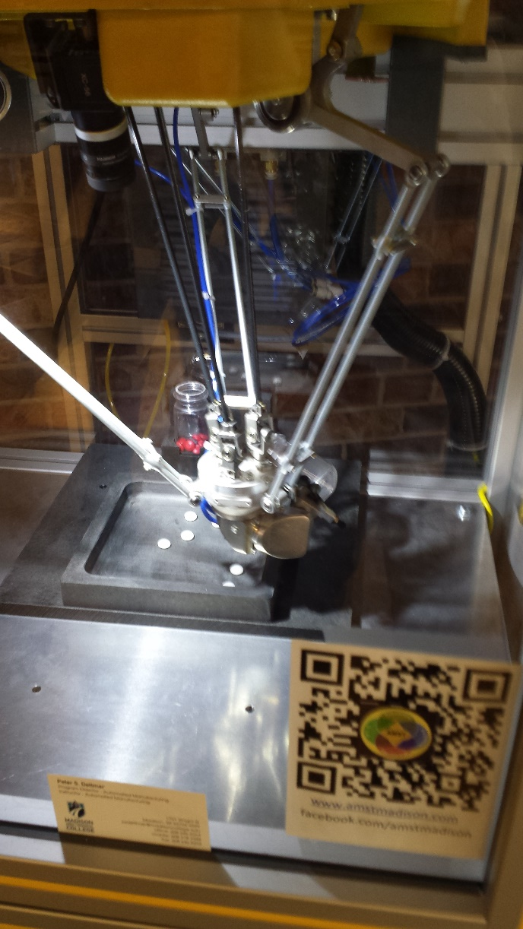
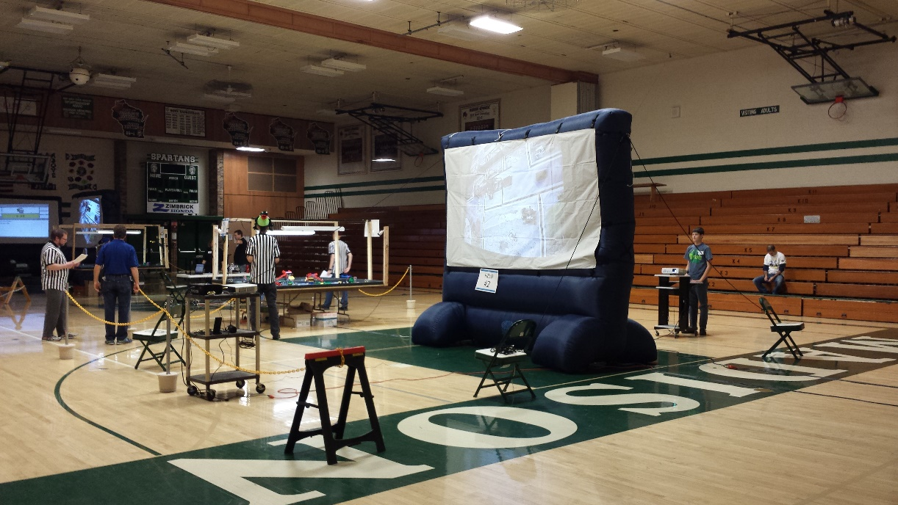
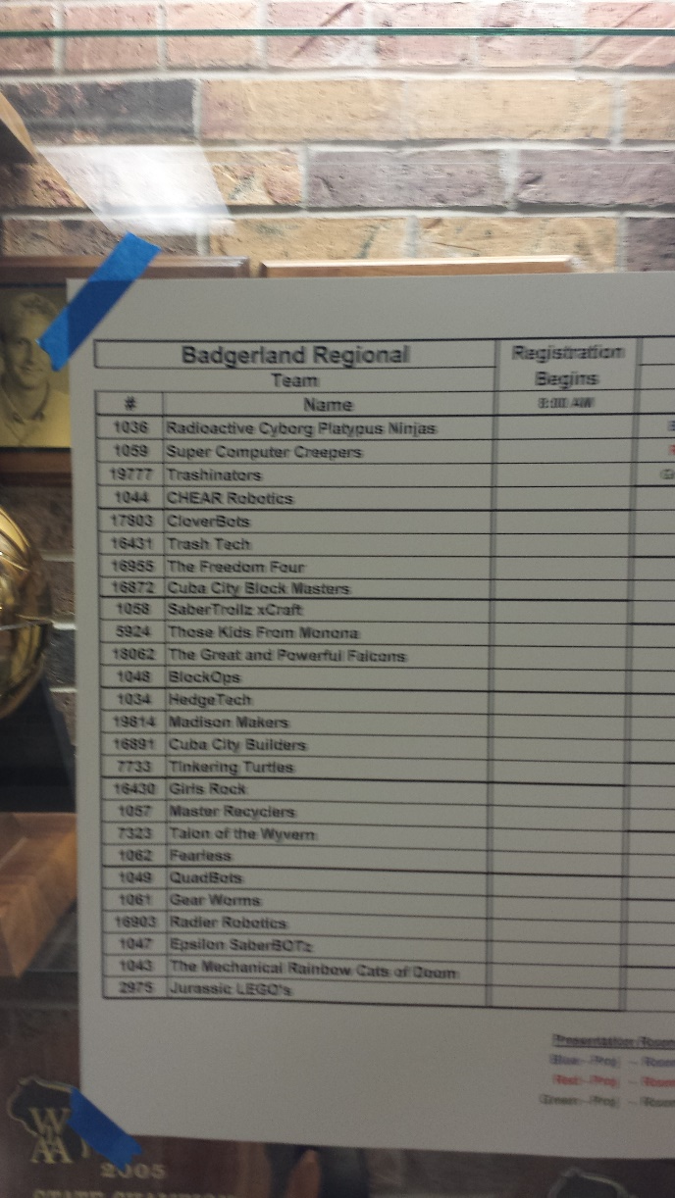

Slide 5
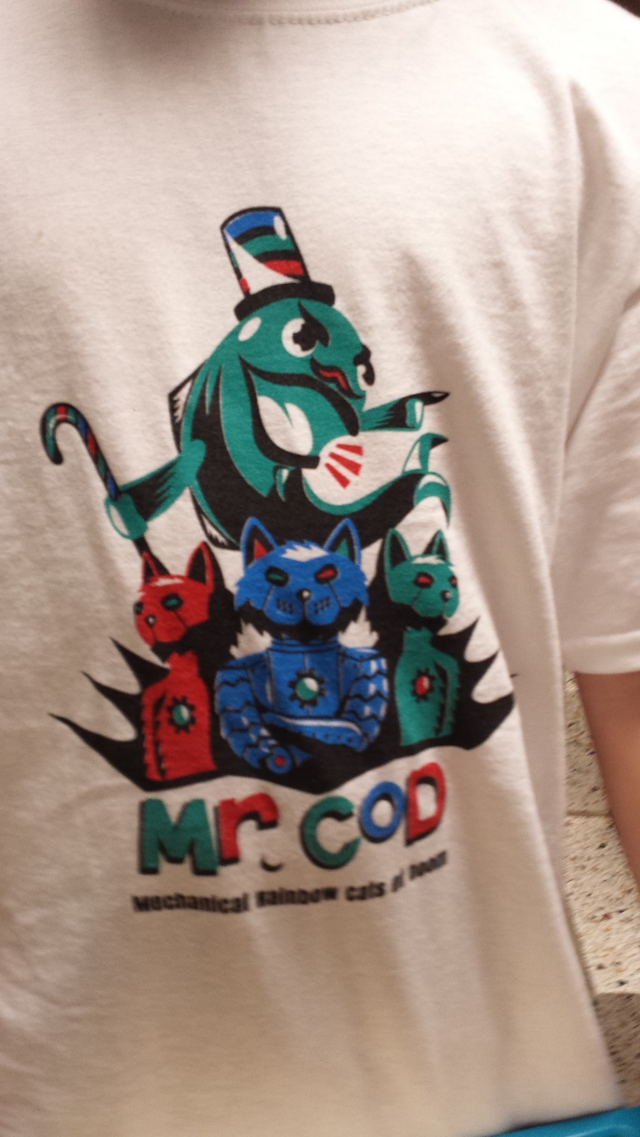
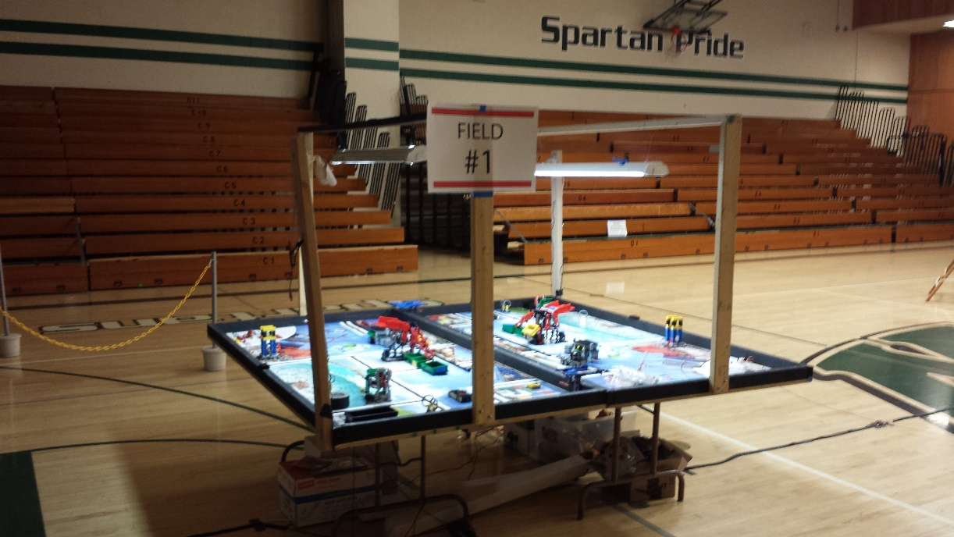
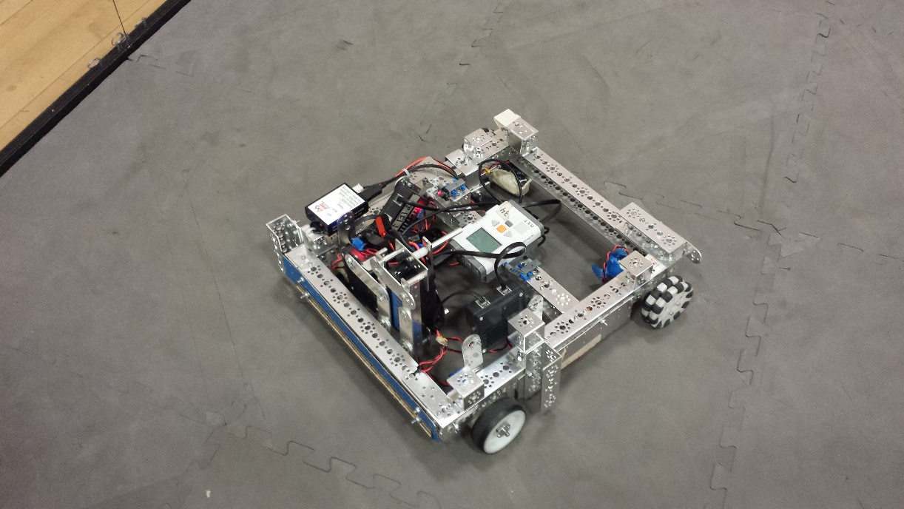
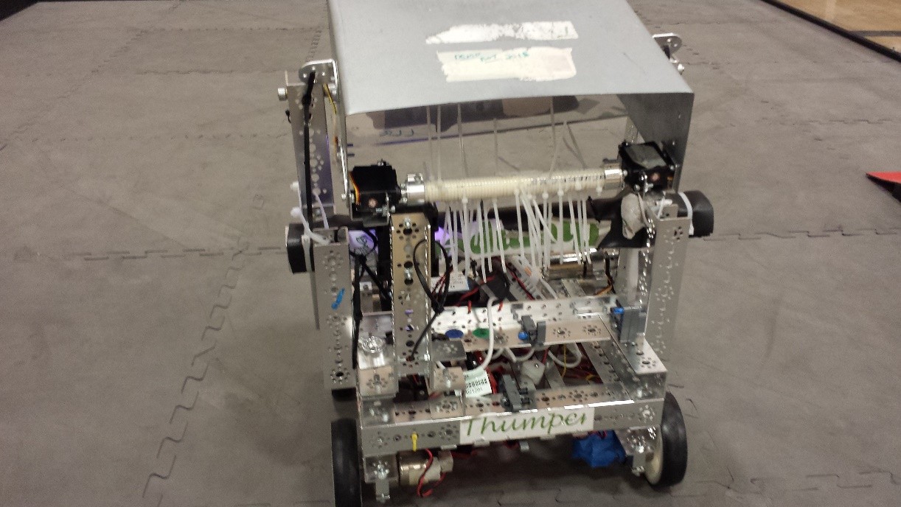

Slide 6
FIRST LEGO League (FLL) , what it is ( video 1 thru 2:20)
http://www.badgerbots.org/programs-2/fll/
The Tournament Experience, very much the “TrashTrek” experience (the second video)

Slide 7
The robots are Programmed differently for the levels and per the objectives
EV3 icon based IDE for the EV3 P-brick for the First LEGO League level. Autonomous behavior objectives; recognizing obstacles, recycled colored materials for separation, etc. However, leJOS EV3 is the java library of firmware available for programming Lego Mindstorms.
http://www.lego.com/en-us/mindstorms/learn-to-program
Java and Android cell controller/receiver for the interactive, sport-based objective of the HS level, BadgerBOTS FTC, FIRST Tech Challenge. The robot kit is reusable from year-to-year and is programmed using a variety of languages.
Here is a simple leJOS program:
import lejos.nxt.Motor;
import lejos.nxt.Button;
public class Example {
public static void main(String[] args) {
Motor.A.forward();
Button.waitForPress();
Motor.A.backward();
Button.waitForPress();
System.exit(1); } }

