Slide 1
Project 25 – Bioprospecting Use Case
Anil (Neil) Wipat

Slide 2
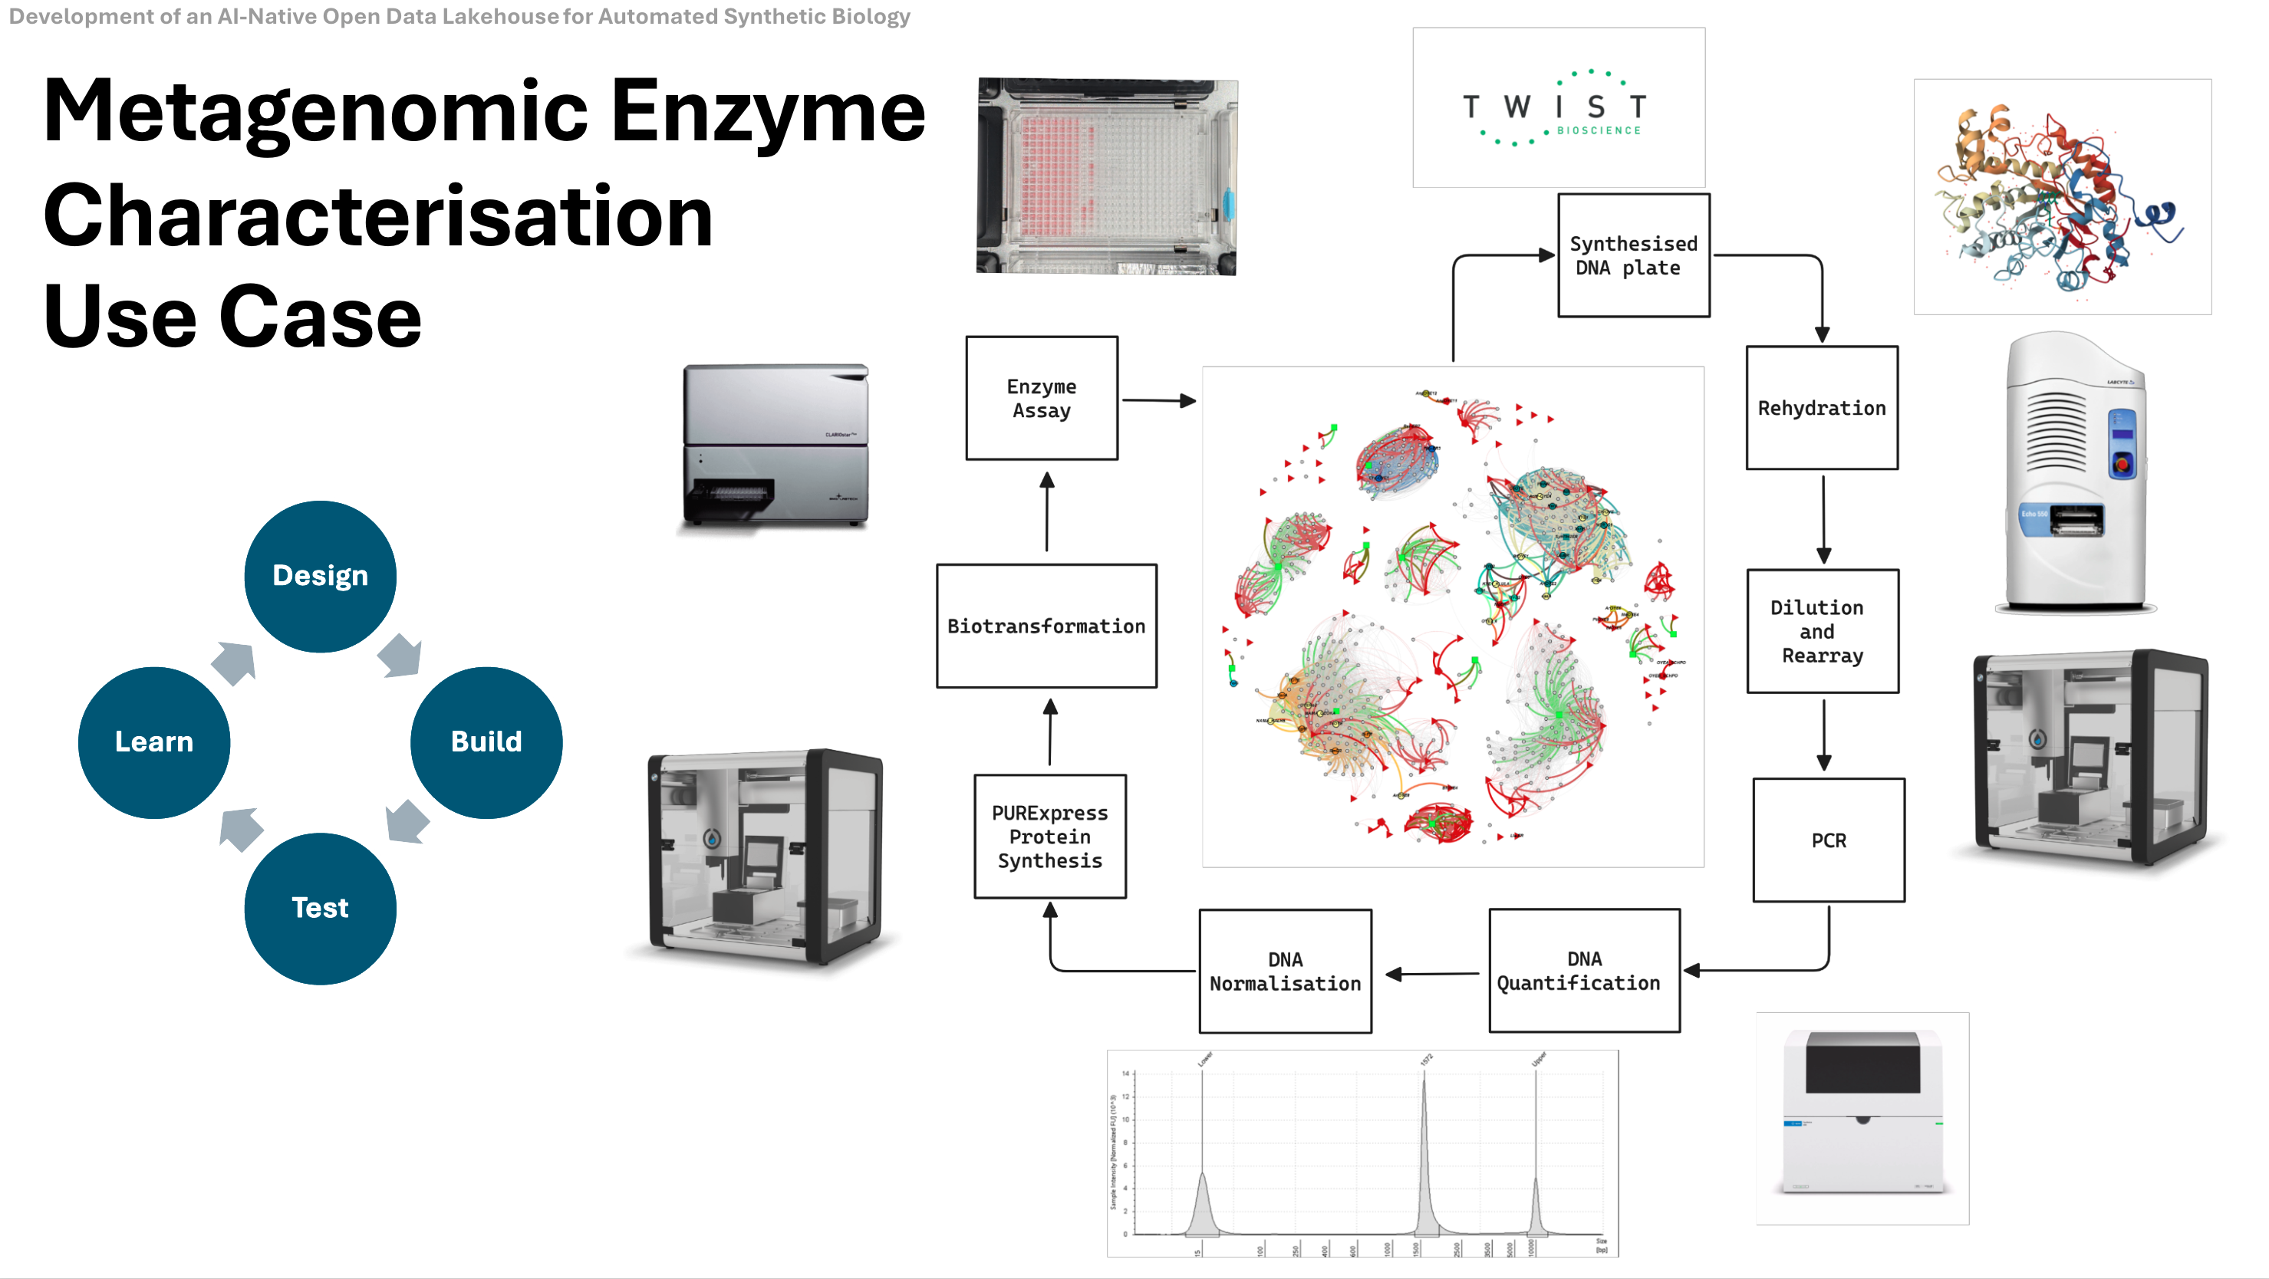

Slide 3
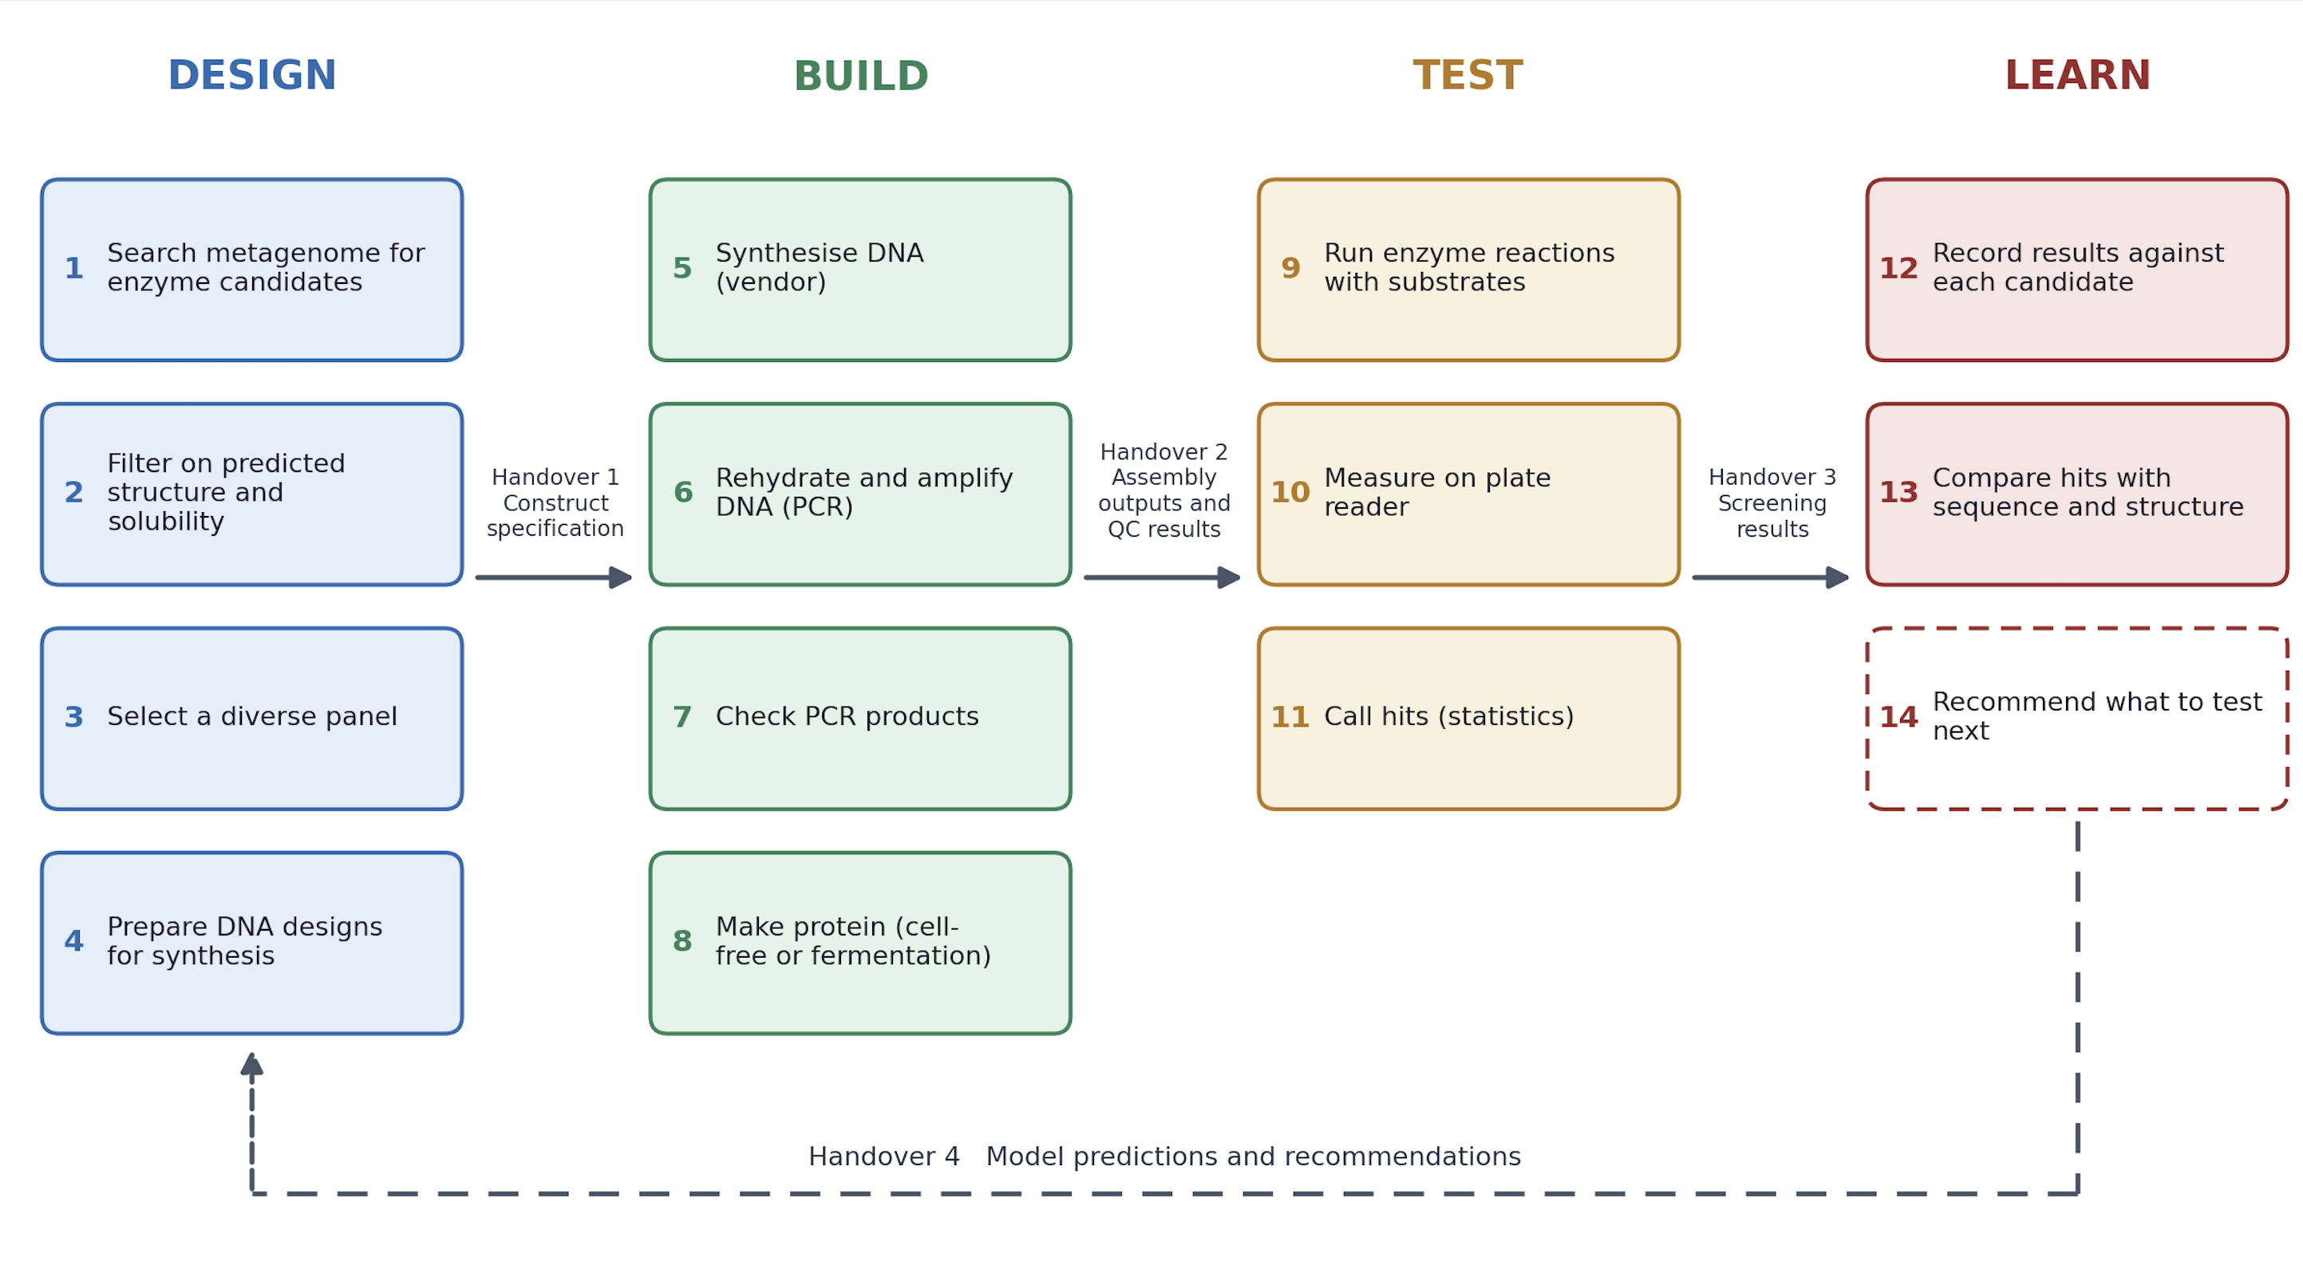

Slide 4
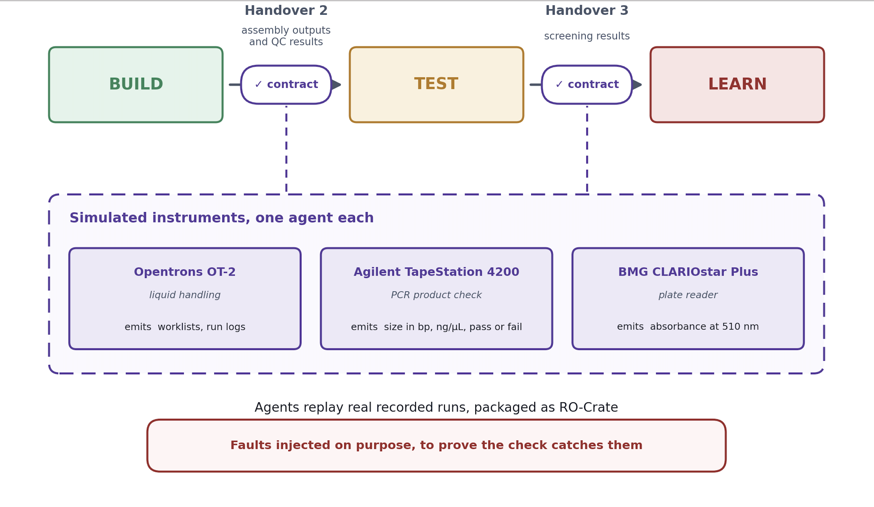

Slide 5
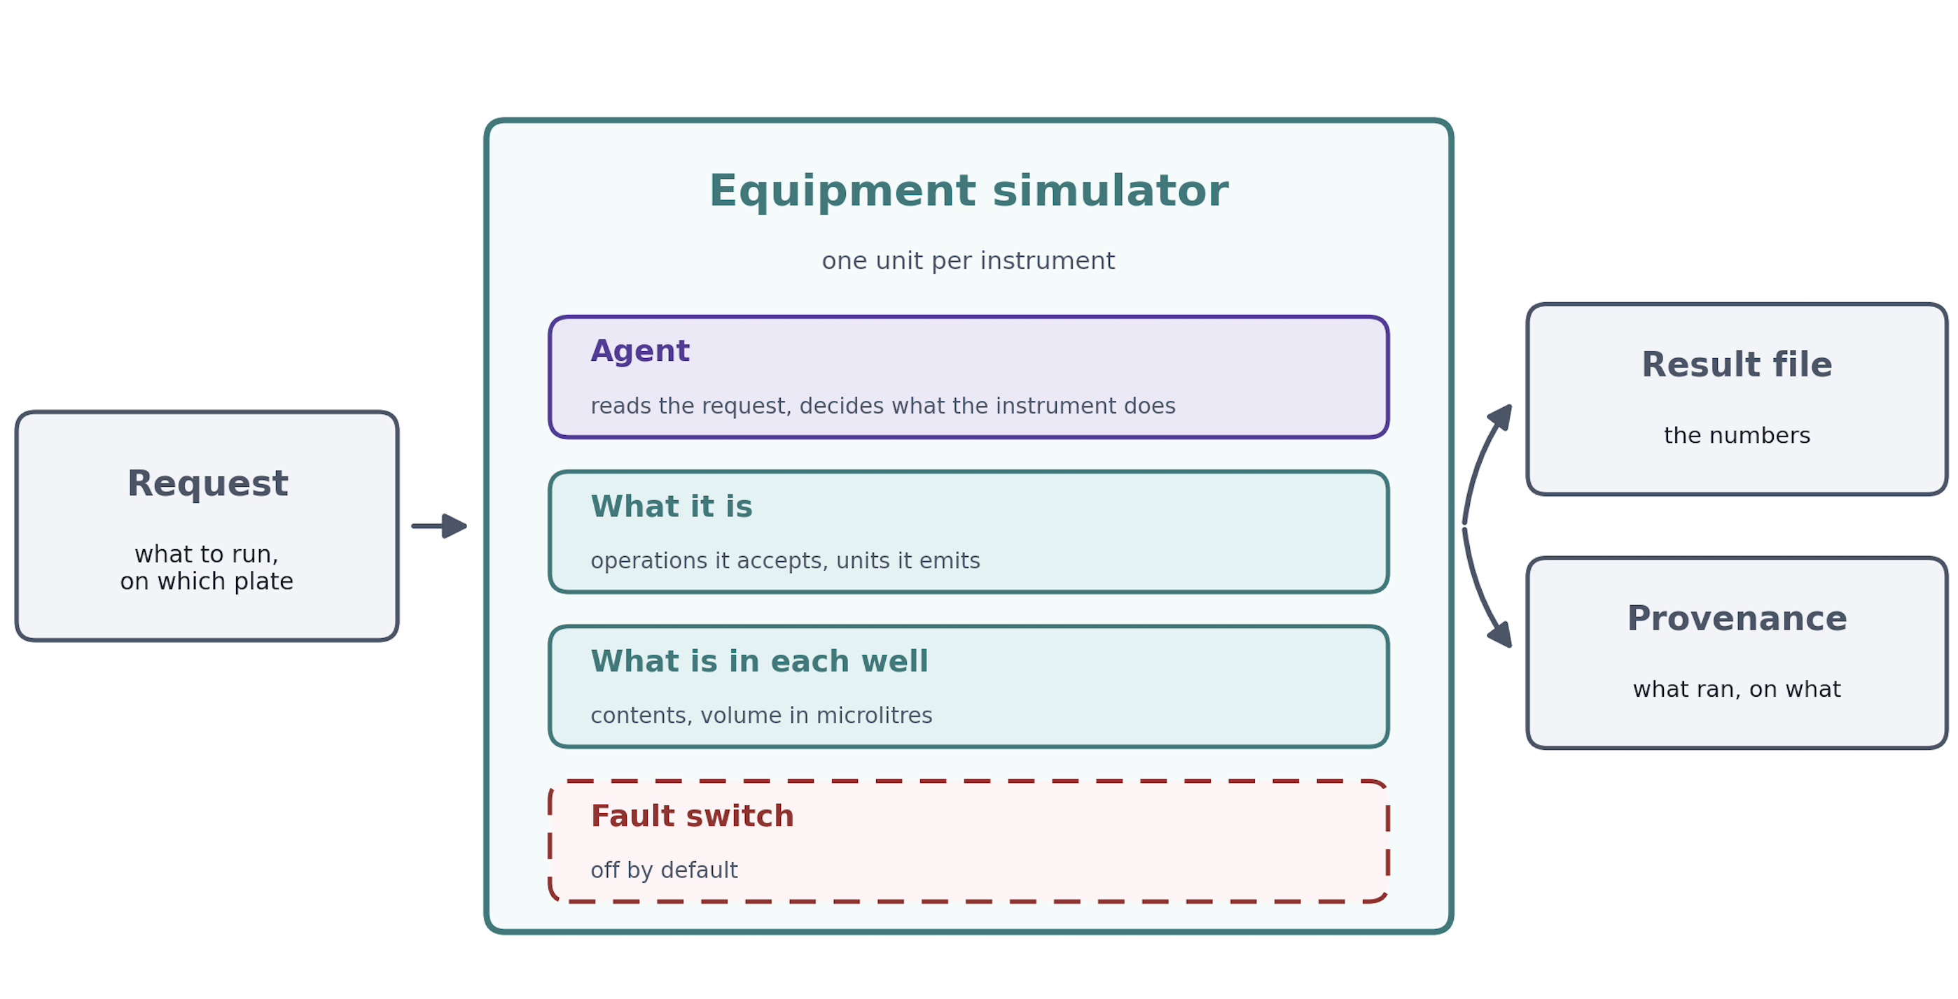

Slide 6

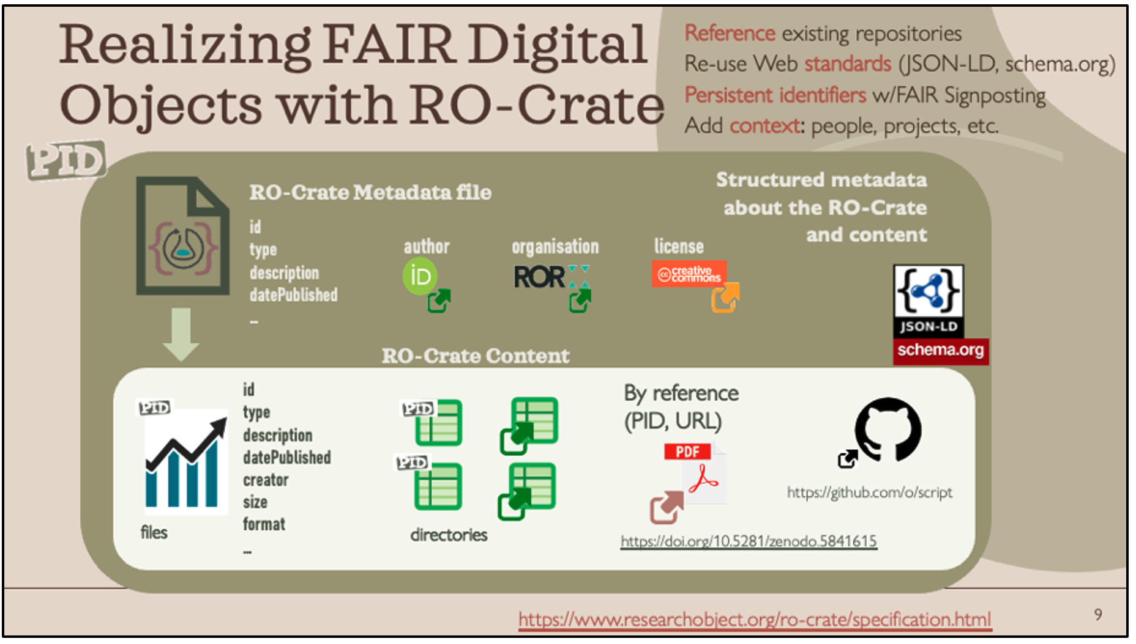
RO-Crate (Research Object Crate)

