Slide 1
Disaster Messaging System with Privacy Enhancements
MQTT Presentation
Presented by: Derrick Buabeng
Notes:
Hello everyone, my name is Derrick Addai. Today, I will present my final project titled Disaster Messaging System with Privacy Enhancements. In this project, I designed a real-time communication system to protect victim privacy during disaster situations.

Slide 2
Introduction & Motivation
The Rise of MQTT in IoT
Why Privacy Now?
What You’ll Learn

Slide 3
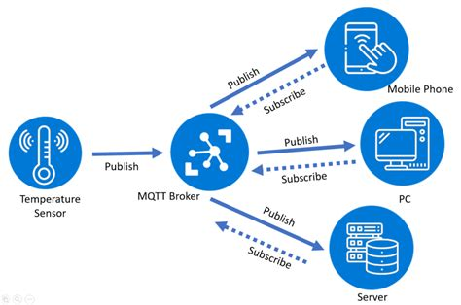
MQTT Architecture
MQTT Architecture has you have three main roles:
The Publisher
The Subscriber
The Broker
Why MQTT is so Widely Used?
Where Privacy Risks Begin?

Slide 4
Threat Model (LINDDUN Framework)
Linkability
Identifiability
Non-repudiation
Detectability
Unawareness
Non-compliance
Notes:
Using the LINDDUN privacy threat model, I identified several major risks. Linkability means multiple messages could be linked to the same victim. Identifiability could expose who the victim is. Non-repudiation ties the victim permanently to their messages. Detectability means attackers could observe communication activity. Disclosure leaks sensitive information like locations. Victims might be unaware that they are leaking data. And finally, non-compliance could violate data protection laws.

Slide 5
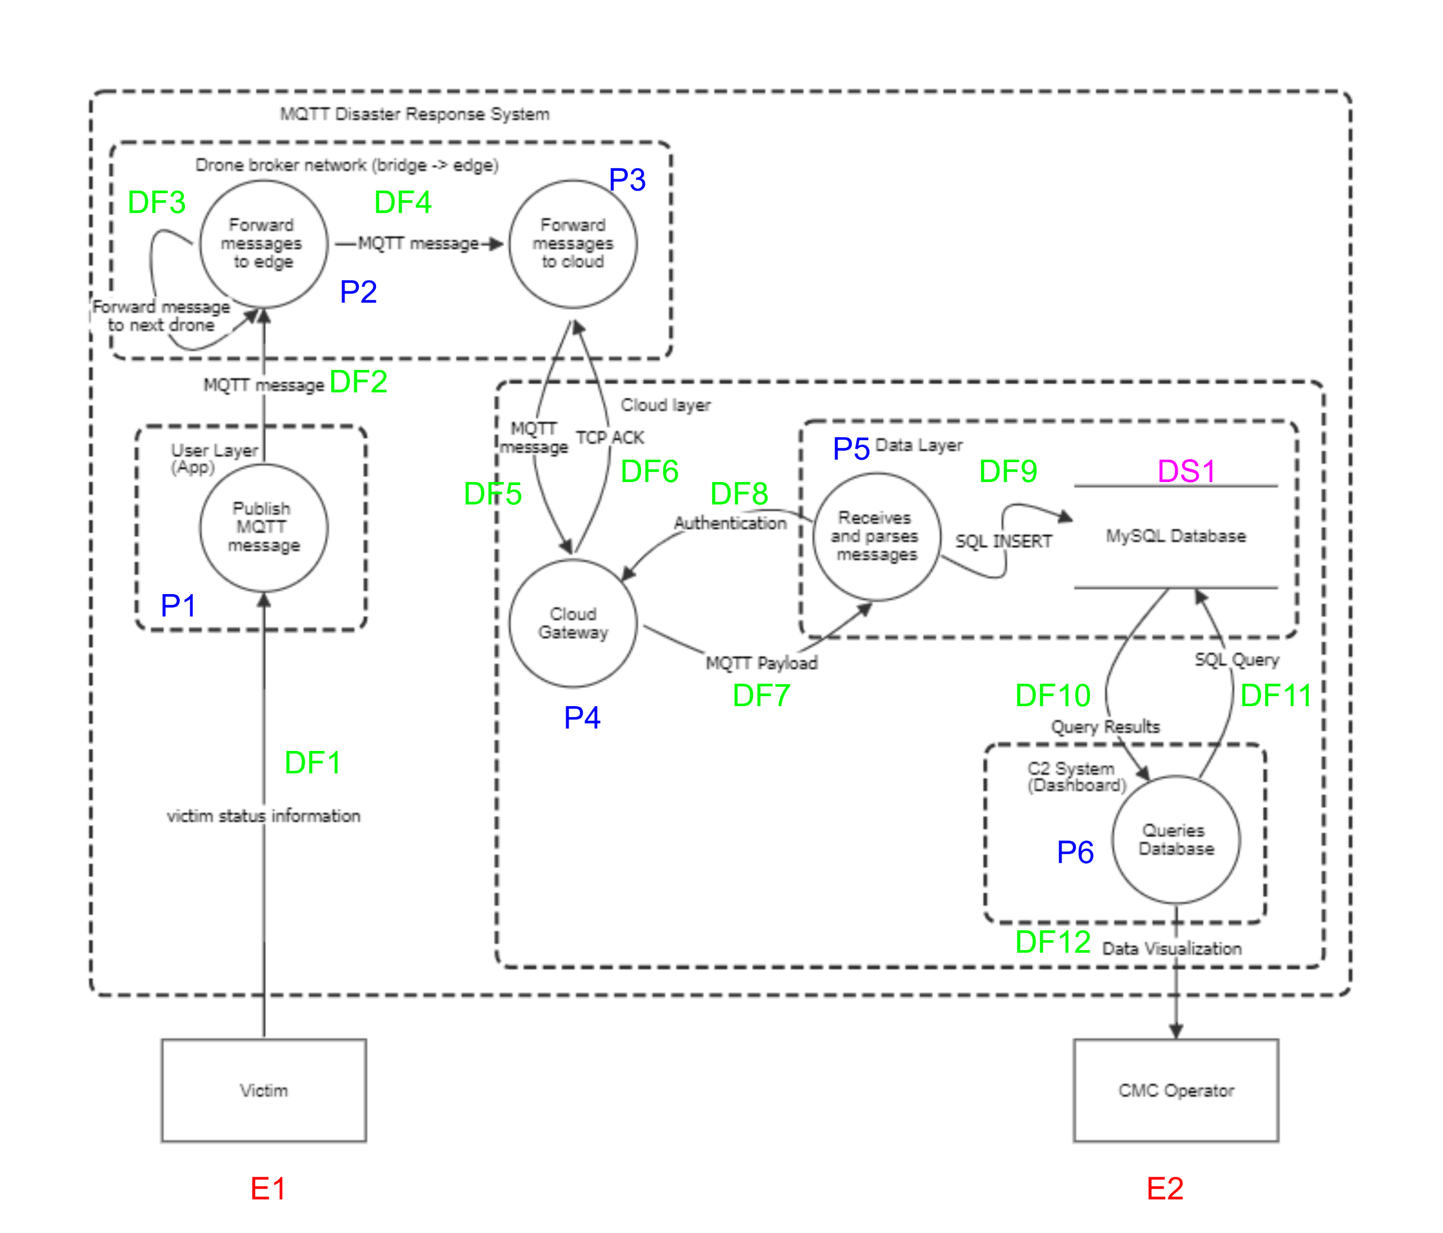
Data Flow Diagram (DFD) of a disaster relief system using MQTT

Slide 6
Vulnerabilities analysis of Exploitation
Label | Element | Description | Potential Vulnerability | LINDDUN Category | Mitigation
E1 | Victim | Provides sensitive info like location, health, distress status | Unauthorized collection or use of PII | Identifiability, Unawareness | Consent management, data minimization, privacy notices
P1 | User App | Publishes MQTT messages with victim data | Hardcoded credentials, lack of encryption | Linkability, Detectability | App-level TLS, dynamic client IDs
DF1 | Victim to App | Sends victim data to app | Unencrypted transmission | Identifiability | Encrypt at source or secure channel (HTTPS)
DF2 / DF3 / DF4 | Drone broker network | Relays messages to edge/cloud | Broker spoofing, bridge message leakage | Linkability, Non-compliance | Use TLS/SSL, authenticate brokers
P2 / P3 | Broker Forwarders | Route messages to cloud | MQTT topic leakage, no ACLs | Linkability, Detectability | Enforce topic-level ACLs, broker auth
DF5 / DF6 | Message to Gateway | MQTT over TCP | Lack of message integrity or replay protection | Detectability | Use HMAC, timestamps, TLS
P4 | Cloud Gateway | Entry point to cloud layer | Cloud misconfigurations, weak auth | Non-compliance, Identifiability | OAuth2, federated identity, rate limiting
DF7 | MQTT Payload | Message forwarded to data layer | Payload in plaintext, possible data inference | Identifiability | Encrypt payload (AES over MQTT)
DF8 | Authentication | Auth before DB insert | Weak credentials, brute-force login | Non-repudiation | Multi-factor auth, rate limiting
P5 | Message Parser | Processes incoming payload | Poor input validation, injection risk | Non-compliance | Validate/sanitize data before DB insertion
DF9 | SQL INSERT | Writes to MySQL DB | SQL Injection, logging sensitive info | Non-repudiation | Prepared statements, encryption-at-rest
DS1 | MySQL Database | Stores mission-critical data | Data breach, poor access control | Non-compliance, Identifiability | Column-level encryption, access logs
DF10 / DF11 | Query to DB and results | Dashboard queries | Inference via pattern queries | Linkability, Detectability | Limit user roles, anonymized query results
P6 | C2 Dashboard | Queries and visualizes | Overexposure to operators, session hijack | Unawareness, Non-compliance | RBAC, secure sessions
DF12 | Visualization to CMC | Visual output to operator | Shoulder-surfing, unauthorized viewing | Detectability, Identifiability | Redact sensitive fields, audit logs
E2 | CMC Operator | Interacts with dashboard | Misuse of data, privacy violations | Unawareness, Non-compliance | Training, privacy policies

Slide 7
Problem Description
Securing Victim Communication via MQTT.
Drones act as mobile brokers.
Risk of interception and exposure.
Goal: Build a secure MQTT-based communication system.
Notes:
In a disaster, victims need to send location and help messages quickly. Drones collect these messages and forward them to the C2 system.
But without protection, these messages could be intercepted, leaking sensitive data.
So, the goal was to build a secure communication system based on MQTT that protects privacy even during emergencies.

Slide 8
Privacy Enhancements Implemented
Tokenization: Random UUIDs instead of real names.
Encryption: Entire message encrypted with Fernet.
Achieved unlinkability, anonymity, confidentiality.
Notes:
To address the risks, I implemented two privacy-enhancing technologies. First, Tokenization: Real victim names were replaced by random UUID tokens.
Second, Encryption: The entire message was encrypted using symmetric encryption (Fernet). This ensures that even if someone captures the message, they cannot read it without the key.

Slide 9
System Without PETs (Original Risk)
Real names like "Victim1" visible.
Messages sent in plain text.
Easy interception and tracking.
High privacy risk.
Notes:
Without applying PETs, messages would have been sent with real names in plain text. Attackers could easily intercept these messages, read sensitive information, and even track victims.

Slide 10
System With PETs (Enhanced Security)
Random UUID tokens used.
Full encryption applied.
Even intercepted messages stay unreadable.
Strong privacy protections enforced.
Notes:
After implementing Tokenization and Encryption, real names were replaced by random tokens. Full encryption ensured that even if someone captured the messages, they could not read the content. This approach dramatically improved privacy and compliance.

Slide 11
Before and After Comparison
Aspect | Before PETs | After PETs
Victim Identifier | Clear names like "Victim1" | Random token like 4ff9d258-...
Message Content | Plain text, easily readable | Fully encrypted & unreadable without the key
Attack Risk | High chance of data leak | Very low risk
Regulatory Compliance | Not privacy-compliant | Strongly aligned with privacy principles
Notes:
This table summarizes the improvement after applying PETs.
Before PETs, victim names and message content were openly visible.
After PETs, identifiers were randomized and messages were fully encrypted, greatly reducing the risk of attacks and improving compliance.

Slide 12
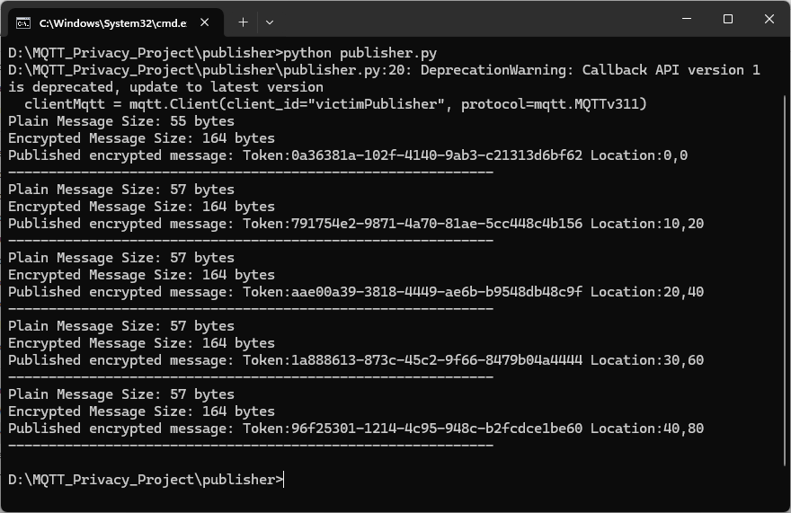
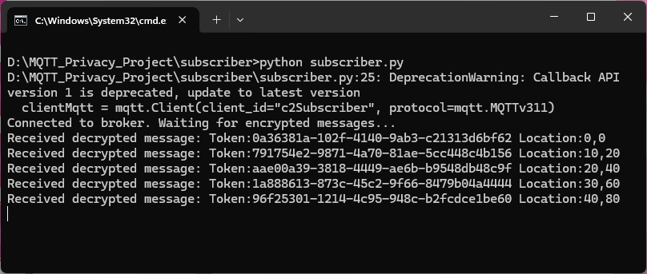
Execution on Local System
Notes:
I ran both python programs on Local system and screenshots are included.
First, I started the subscriber to listen for messages. Then, I ran the publisher.

Slide 13
Live Demo Overview
Start Subscriber: Listen for incoming messages.
Start Publisher: Send encrypted tokenized messages.
Subscriber decrypts and displays secure information.
No real names or plain text visible.
Notes:
I demonstrated the live working system. First, I started the subscriber to listen for messages.
Then, I ran the publisher, which sends encrypted, tokenized messages. On the subscriber side, we see decrypted messages, showing that privacy enhancements are functioning correctly.

Slide 14
System Setup and Experiment
Tools Used: Python, paho-mqtt, cryptography (Fernet), Mosquitto Broker.
Publisher: Sends encrypted, tokenized messages.
Subscriber: Receives and decrypts messages.
Encryption key manually generated and shared securely.
Notes:
The system was built using Python 3.12.2 with paho-mqtt and cryptography libraries.
I installed Mosquitto Broker on Windows 11. Then I manually generated a symmetric encryption key, which was used by both the publisher and subscriber. In testing, encrypted, tokenized messages were successfully transmitted and decrypted.

Slide 15
Final Reflections
Privacy risks are real even during emergencies.
Tokenization and encryption provide strong protections.
Simple solutions can significantly improve security.
Balanced privacy and usability successfully achieved.
Notes:
This project taught me that privacy should never be an afterthought, even during emergencies.
Simple, well chosen techniques like tokenization and encryption can provide strong protections.
We can build systems that are both usable and secure by integrating privacy principles from the beginning.
Thank you..

