Slide 1
PCA
Implementation

Slide 2
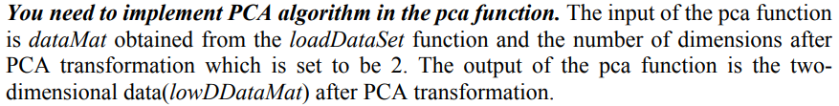
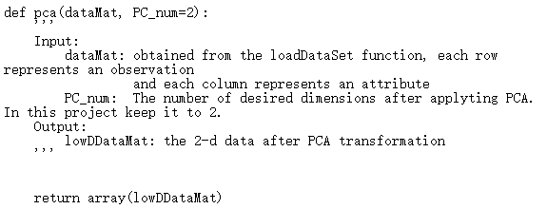
PCA Template

Slide 3
Example
Iris dataset
4 features
Label: 1,2,3
Function loadDataSet is already implemented in the template
Here, we only show the first 10 samples in the ‘iris_with_cluster.csv’ file
X1 | X2 | X3 | X4 | Label
5.4 | 3.9 | 1.7 | 0.4 | 1
6.4 | 3.1 | 5.5 | 1.8 | 2
4.6 | 3.6 | 1 | 0.2 | 1
5.5 | 4.2 | 1.4 | 0.2 | 1
5.1 | 3.5 | 1.4 | 0.2 | 1
4.3 | 3 | 1.1 | 0.1 | 1
7.7 | 2.6 | 6.9 | 2.3 | 2
6.4 | 2.7 | 5.3 | 1.9 | 2
6 | 2.9 | 4.5 | 1.5 | 3
6.7 | 3.1 | 4.4 | 1.4 | 3

Slide 4
Example
Numpy array in Python
from numpy import *
A = array([[1, 2, 3], [4, 5, 6]])
Get a row/column
A[0,:]
A[:,0]
1 | 2 | 3
4 | 5 | 6
A is a 2 X 3 matrix
1 | 2 | 3
1
4

Slide 5
Example
Matrix Operations
Addition
a+b
Multiplication
numpy.dot(a,b): matrix multiplication
a*b: array multiplication (multiplication of corresponding elements of two arrays)
Transpose of a Matrix
numpy.transpose
https://numpy.org/doc/stable/user/basics.html

Slide 6
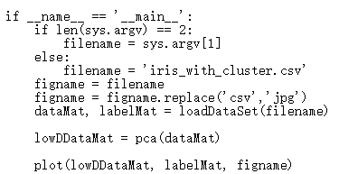
PCA Template
Read dataset
Run PCA algorithm
Plot the reduced data points

Slide 7
Example
Input data
4
X1 | X2 | X3 | X4
5.4 | 3.9 | 1.7 | 0.4
6.4 | 3.1 | 5.5 | 1.8
4.6 | 3.6 | 1 | 0.2
5.5 | 4.2 | 1.4 | 0.2
5.1 | 3.5 | 1.4 | 0.2
4.3 | 3 | 1.1 | 0.1
7.7 | 2.6 | 6.9 | 2.3
6.4 | 2.7 | 5.3 | 1.9
6 | 2.9 | 4.5 | 1.5
6.7 | 3.1 | 4.4 | 1.4
Label
1
2
1
1
1
1
2
2
3
3
N
N
Input of pca function, N X 4 Matrix
1-D array

Slide 8
Example
X1 | X2 | X3 | X4
5.4 | 3.9 | 1.7 | 0.4
6.4 | 3.1 | 5.5 | 1.8
4.6 | 3.6 | 1 | 0.2
5.5 | 4.2 | 1.4 | 0.2
5.1 | 3.5 | 1.4 | 0.2
4.3 | 3 | 1.1 | 0.1
7.7 | 2.6 | 6.9 | 2.3
6.4 | 2.7 | 5.3 | 1.9
6 | 2.9 | 4.5 | 1.5
6.7 | 3.1 | 4.4 | 1.4
X1’ | X2’ | X3’ | X4’
-0.41 | 0.64 | -1.62 | -0.6
0.59 | -0.16 | 2.18 | 0.8
-1.21 | 0.34 | -2.32 | -0.8
-0.31 | 0.94 | -1.92 | -0.8
-0.71 | 0.24 | -1.92 | -0.8
-1.51 | -0.26 | -2.22 | -0.9
1.89 | -0.66 | 3.58 | 1.3
0.59 | -0.56 | 1.98 | 0.9
0.19 | -0.36 | 1.18 | 0.5
0.89 | -0.16 | 1.08 | 0.4
X
Adjust the original data by the mean
X’ = X –
Mean X1 | Mean X2 | Mean X3 | Mean X4
5.81 | 3.26 | 3.32 | 1
You can use numpy.mean to calculate

Slide 9

Example
Compute the covariance matrix S of adjusted X:
$S=\frac{1}{N−1}{X′}^{T}X$’
X1’ | X2’ | X3’ | X4’
-0.41 | 0.64 | -1.62 | -0.6
0.59 | -0.16 | 2.18 | 0.8
-1.21 | 0.34 | -2.32 | -0.8
-0.31 | 0.94 | -1.92 | -0.8
-0.71 | 0.24 | -1.92 | -0.8
-1.51 | -0.26 | -2.22 | -0.9
1.89 | -0.66 | 3.58 | 1.3
0.59 | -0.56 | 1.98 | 0.9
0.19 | -0.36 | 1.18 | 0.5
0.89 | -0.16 | 1.08 | 0.4
1.07 | -0.29 | 2.13 | 0.81
-0.29 | 0.27 | 0.88 | -0.34
-2.13 | 0.88 | 4.93 | 1.9
0.81 | -0.34 | 1.9 | 0.74
S is a 4 X 4 Matrix
X’ = X –

Slide 10
Example
Compute and sort the eigenvectors and eigenvalues of S.
Select the largest two eigenvalues and corresponded eigenvectors
Numpy.linalg.eig
numpy.argsort
large
small
eigenvalues
6.752 | 0.215 | 0.034 | 0.004
0.37 | -0.70 | -0.60 | 0.10
-0.15 | 0.69 | 0.71 | -0.04
0.85 | 0.14 | 0.29 | -0.40
0.33 | 0.11 | 0.23 | 0.91
eigenvectors
IMPORTANT: the column v[:,i] is the eigenvector corresponding to the eigenvalue w[i].

Slide 11
Example
Transform data into new dimensions
X1’ | X2’ | X3’ | X4’
-0.41 | 0.64 | -1.62 | -0.6
0.59 | -0.16 | 2.18 | 0.8
-1.21 | 0.34 | -2.32 | -0.8
-0.31 | 0.94 | -1.92 | -0.8
-0.71 | 0.24 | -1.92 | -0.8
-1.51 | -0.26 | -2.22 | -0.9
1.89 | -0.66 | 3.58 | 1.3
0.59 | -0.56 | 1.98 | 0.9
0.19 | -0.36 | 1.18 | 0.5
0.89 | -0.16 | 1.08 | 0.4
0.37 | -0.70
-0.15 | 0.69
0.85 | 0.14
0.33 | 0.11
×
matrix multiplication
Largest two eigenvectors,
Should be a 4 X 2 matrix
Use X’ instead of X to ‘center’ the data points

Slide 12
Example
Plot the points
X axis | Y axis
-1.83 | -0.45
2.37 | 1.00
-2.75 | 0.19
-2.15 | -0.79
2.20 | -0.03
-2.72 | 0.82
4.29 | -0.21
2.29 | 0.36
1.30 | 0.34
1.42 | -0.31
Label/color
1
2
1
1
1
1
2
2
3
3
Should be a N X 2 matrix
1-D array

Slide 13
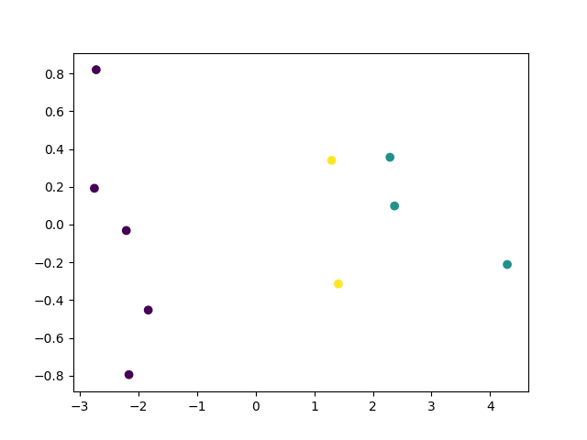
Result
Only 10 data points as an example.
You should have more than that.

