Slide 1
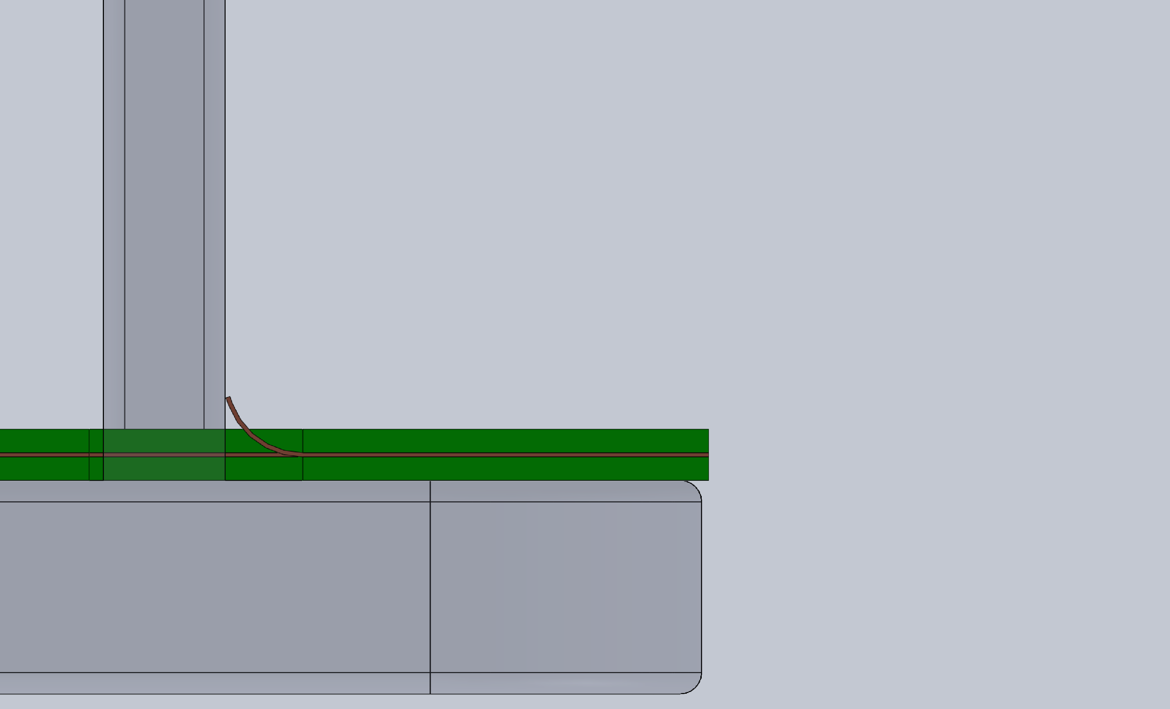
0.002”
0.025”

