Slide 1
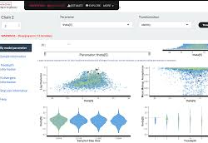
Introduction to Bayesian Analyses Part II
Dan Buonaiuto, Ben Taylor
OEB 137
Fall 2020

Slide 2
Overview
What is Bayesian analysis?
Why Bayesian?
How to run and/ interpret Bayesian models in R
Notes:
People have a vague idea of Bayesian. What is it?

Slide 3
Bayesian work flow
If using stan: Write model. (start at 2 or 3 if using rstanarm, or brms)
Test model on fake data
Choose priors:
Previous work
Biologically reasonable assumptions
Prior predictive checks
Run Model
Evaluate model
Rinse and repeat

Slide 4
https://cran.r-project.org/web/packages/bayesplot/vignettes/visual-mcmc-diagnostics.html#effective-sample-size
https://mc-stan.org/docs/2_19/reference-manual/divergent-transitions

