Slide 1
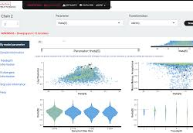
Introduction to Bayesian Analyses Part I
Dan Buonaiuto, Ben Taylor
OEB 137
Fall 2020

Slide 2
Overview
What is Bayesian analysis?
Why Bayesian?
How to run and/ interpret Bayesian models in R
Notes:
People have a vague idea of Bayesian. What is it?

Slide 3
Bayesian Model consists of 3 components
Prior Distribution
Likelihood Function
Posterior Distribution

Slide 4
Toy model I
You have 4 model in a bag. Marbles can be either blue or white.
What are the possible combinations?
You pull out a sequence of 3 marbles, replacing the one you pick each time, and shaking the bag well between draws.. Here’s the sequence:

Slide 5
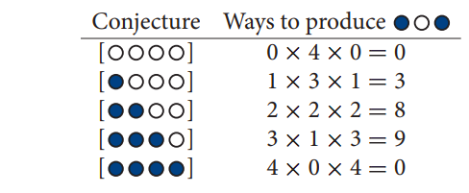

Slide 6
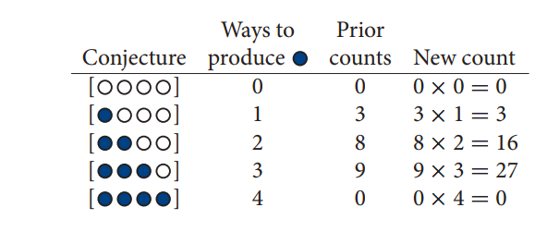
Draw another marble…..
Option 1: You could re-calculate the likelihood of
Option 2: Take the “prior” counts and update conjectures in light of new observation

Slide 7
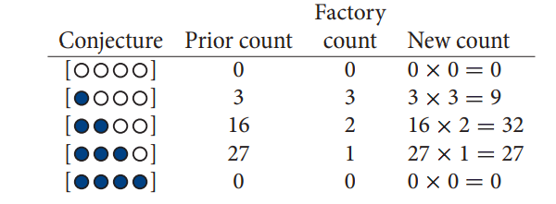
Priors come in many forms
Suppose you have a connection at a marble factory, and they tell you blue marble are extremely rare, but the factory makes sure all bags contain at least one blue and one white marble. They also tell you about their production sequences:
Notes:
From counts to probability

Slide 8
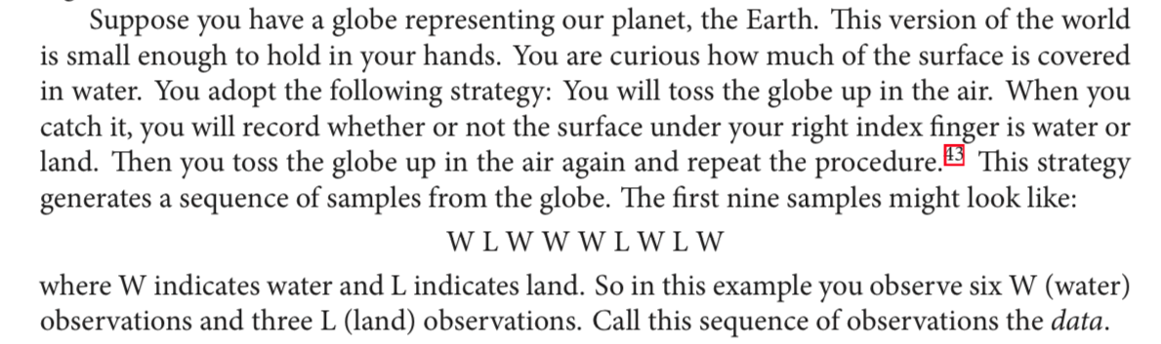
Toy Model II

Slide 9
What we know
Based on the true ratio of water to land there is probability (p) of your right index figure landing on water and p-1 it will land on land. We don’t know p.
Your right index finger can only land on water or land (0,1). Each flip is independent.
Notes:
What distribution does this sounds like

Slide 10
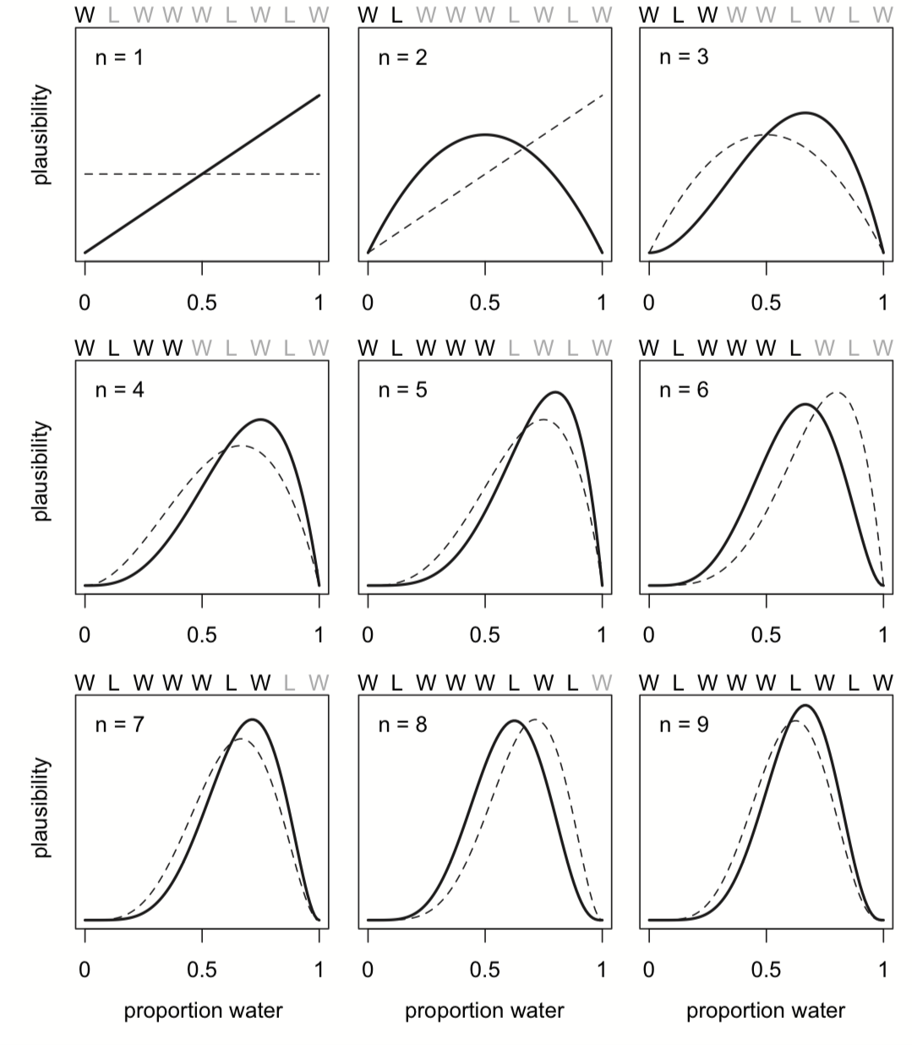
Bayesian updating

Slide 11
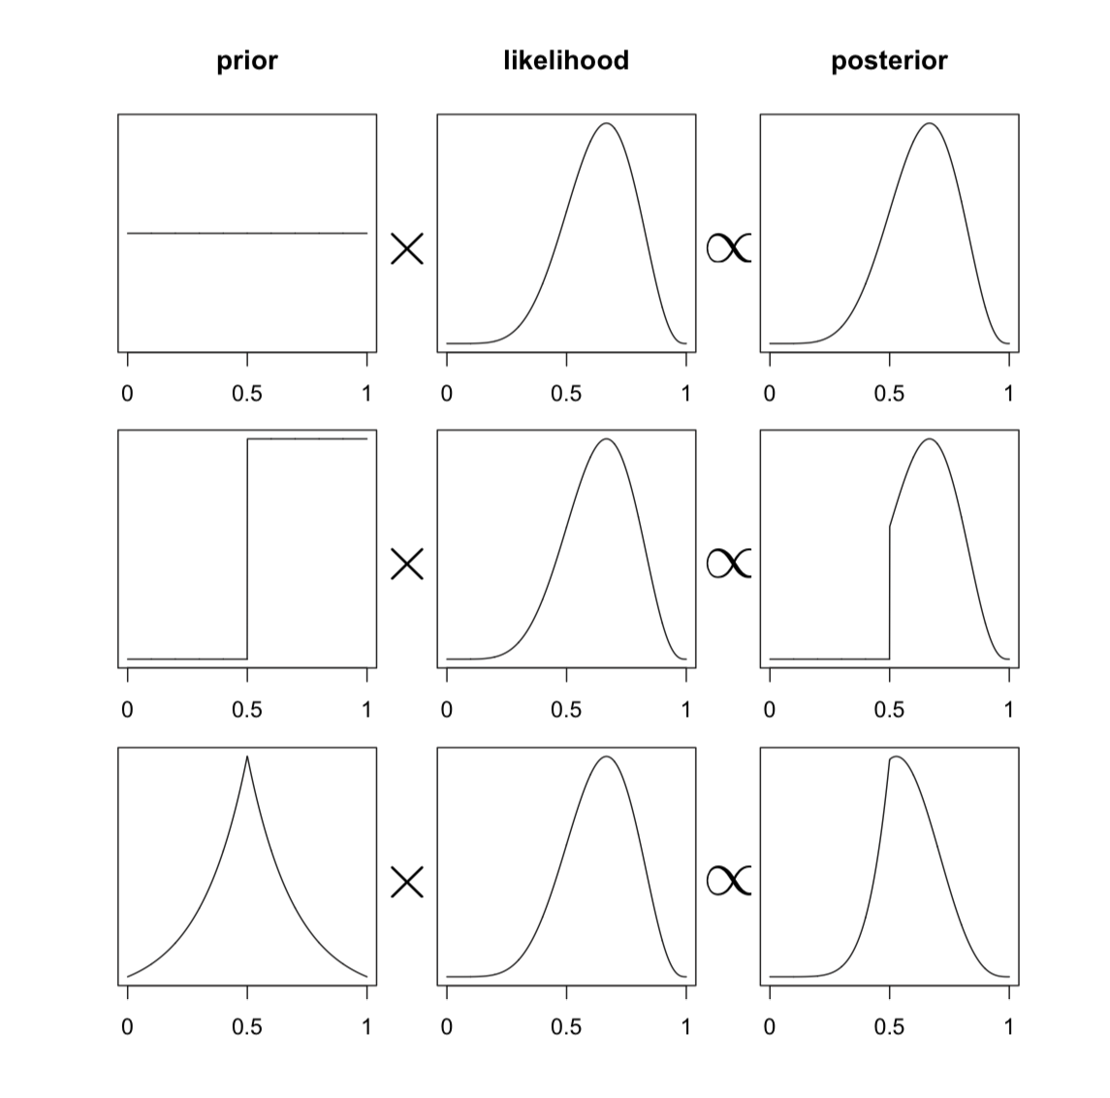
How it fits
General notes:
Opponents to Bayes don’t like priors. But we all sort of have them.
Posterior estimates can be reported sort of like frequentist values.
Bayes theorem: Posterior=(probability of data x prior)/ average probability of the data
Notes:
Goal is weakly informative priors, but Also, it is much easier to make data “lie” data using likelihood function than priors, and all models use likelihood.
Model is an engine. Generating the posterior distribution is task of Bayes theorem.
Bayes theorem Posterior=(probability of data x prior)/ average probability of the data
Bayesian isn’t about Bayes theorem. Inference under any probability concept will eventually make use of Bayes theorem. Since all elements of the calculation are frequencies of the observations non-Bayesian analyses would do the same thing. Bayesian analysis uses Bayes theorem more generally to quantify uncertainty about theoretical entities that can be observed (ie model paramenters)
Several motors approximate this math grid approximation, Quadratic, or (Hamiltonian) MCMC Markov Chain Monte Carlo

Slide 12
Pros and cons of Bayesian
Bayes theorem doesn’t have a minimum sample size. (Small samples will just rely more heavily on priors).
Priors.
Flexible.
Intuitive reporting of results. Rather than “rejects the null hypothesis” “there is a 95% likelihood that the answer falls in this range”.
Better representation of uncertainty (compared to least squares of maximum likelihood).
Computationally intensive
Notes:
Critiques Priors and computationally intense.

Slide 13
Bayesian in R
Stan is the major programming language for Bayesian statistics. You code it in R using the package rstan. But it has its own syntax.
Several newer packages translate stan code into familiar R syntax (like lme4). rstanarm, brms, rethinking. And there are special packages for visualizing Bayesian outputs (eg shinystan, tideybayes).

Slide 14
Work flow
Write model and apply to fake data.
Choosing priors for real data
Previous work
Biologically reasonable assumptions
Prior predictive checks
Run Model
Evaluate model

