Slide 1
Germination Update
30-January-2019

Slide 2
GOALS:
Select species for competition trial
Quantify sensitivity to winter temperature for a suite of temperate herbs

Slide 3
Seasonal Priority Effects and phenological sensitivity
T_{b(i)}
T_{b}
T_{b(j)}
Stratification time
Notes:
Assume same thermal time requirement for simplicity
Species with lower Tb will germinate first. If the they have differential sensitivity to stratification that might shift

Slide 4
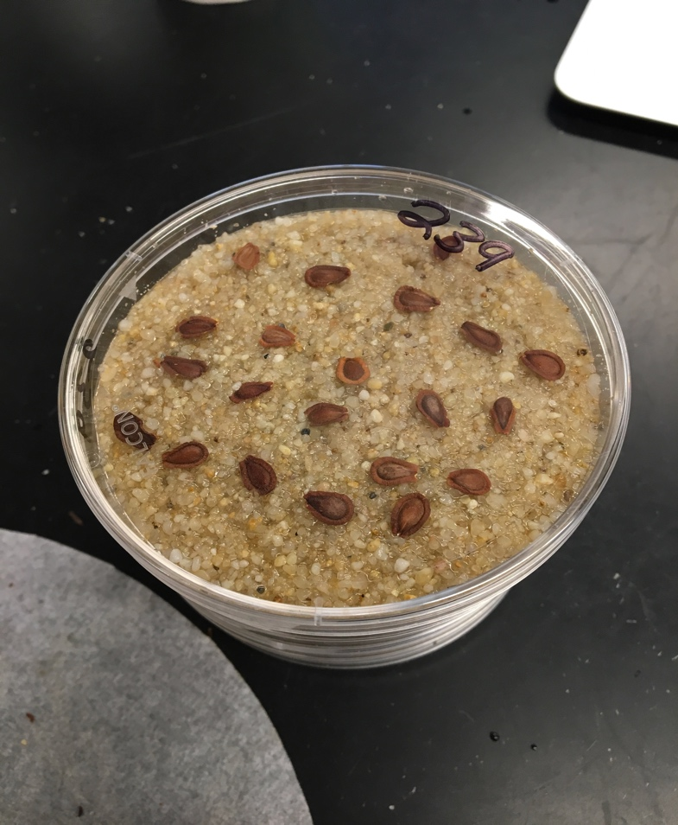
Notes:
Describe experiment here

Slide 5
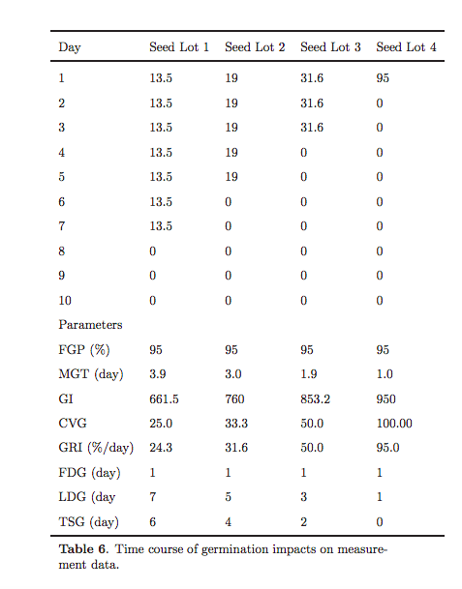
Germination %
Time
Kader 2005

Slide 6
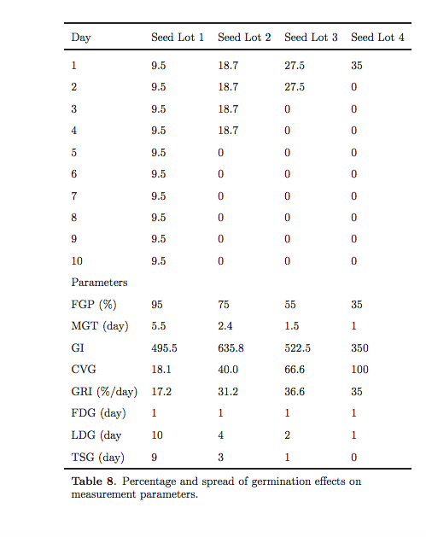

Slide 7
% will germination in pre-treatment (left censor)
% will germinate in the trial (yay)
% will die during the trial (mold…ewww)
% will not germinate (right censor…or is it?)

Slide 8
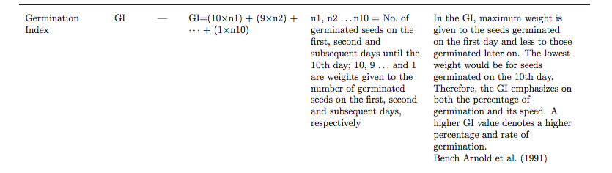
Baskin and Baskin suggest reporting:
Final germination percentage
A measure of germination speed (ie mean germination time, T50)
A measure of germination synchrony
Modeling option 1:
Each of the above~ stratification duration * incubation temp |species
Seems hard to make direct interspecific comparison
1a. Add a germination index
Notes:
GI also can handle pre-germ and moldiness, though not explicitly

Slide 9
More complicated….
2. Tradition nonlinear modeling:
Uses cumulative distribution counts
Violates assumptions of independence at each observation
Is there a repeat measure type analysis for nonlinear models?
3. Time to event analysis:
Survival models and dose-response curves
Assume all seeds can germinate
Estimates right censoring (maybe inappropriate for seeds with dormancy)
The typical distributions used for germination can’t handle negative time values (some survival analysis can).
DRC-rigid packages, doesn’t play well with others, hard to diagnose problems
4. Some sort of four part hierarchical:
A: moldy seed # ~(chilling time, temp) + |species
B: Cold germ~ chilling time
C: germination model (drc or survival)
D*: Cure model- how many right censored will germination
Notes:
Germination index is hard to think of in real tems

Slide 10
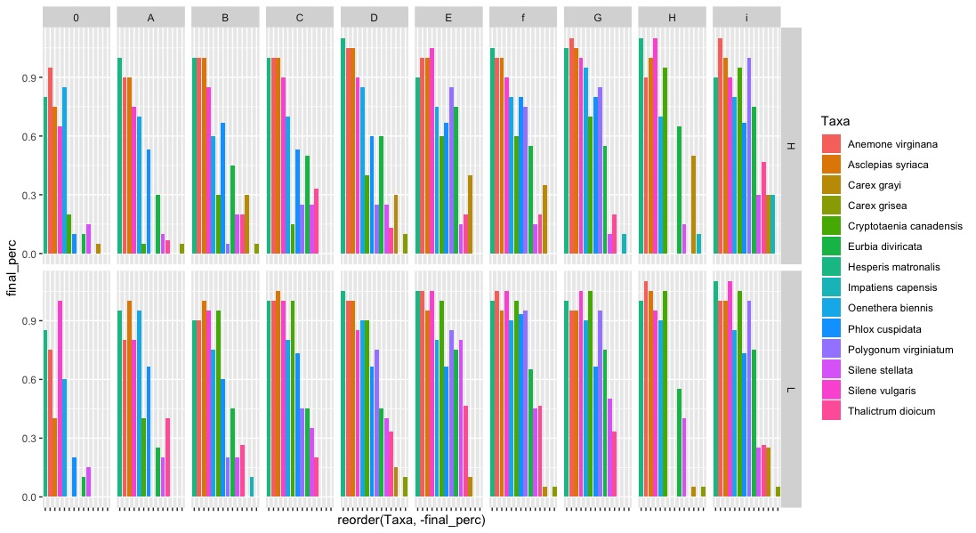

Slide 11
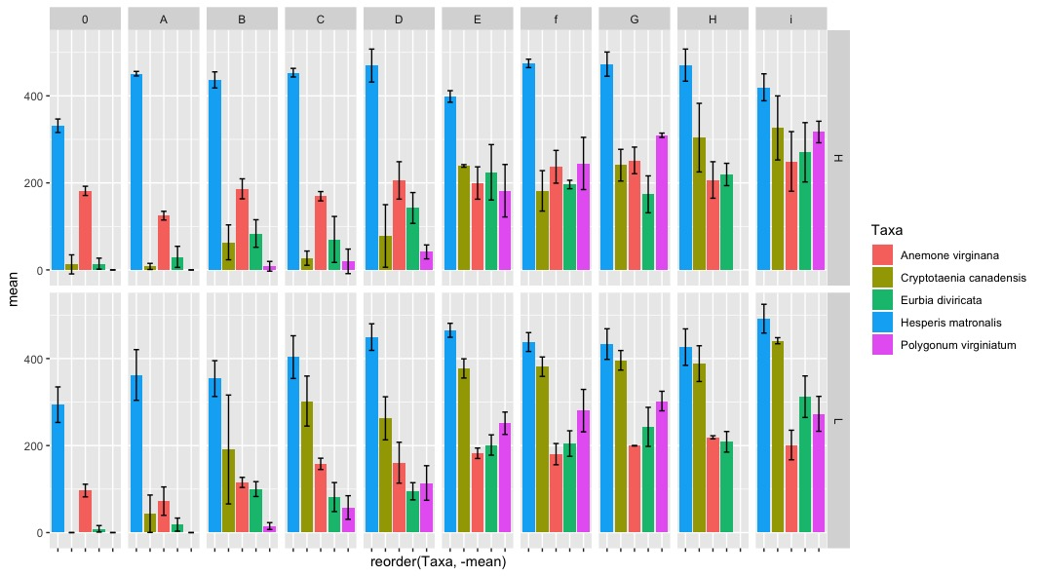

Slide 12
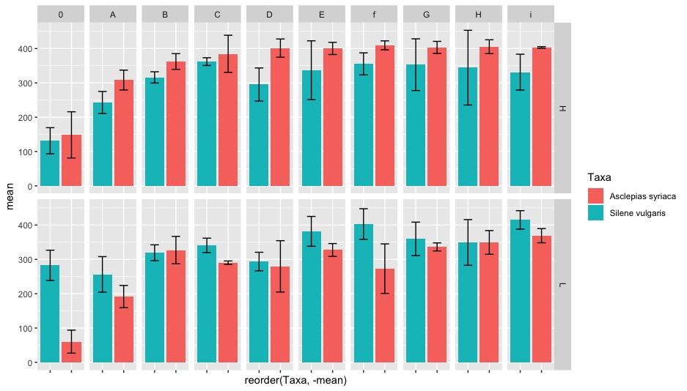

Slide 13
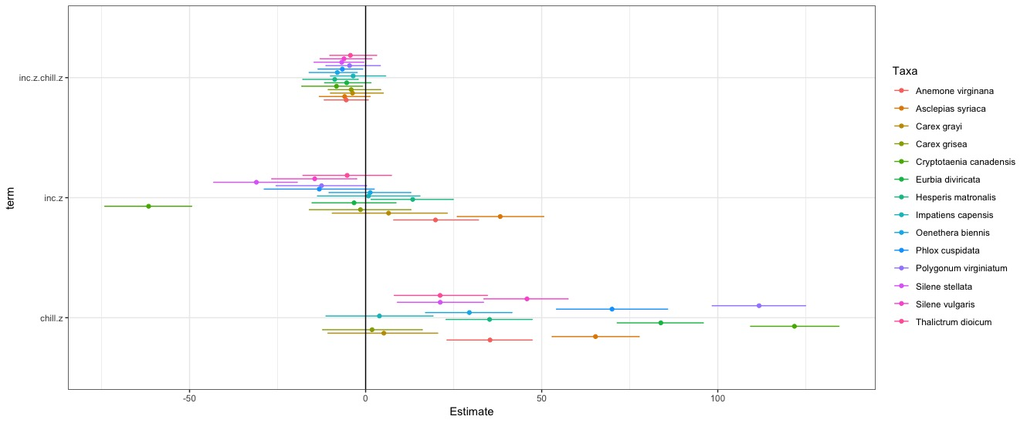

Slide 14
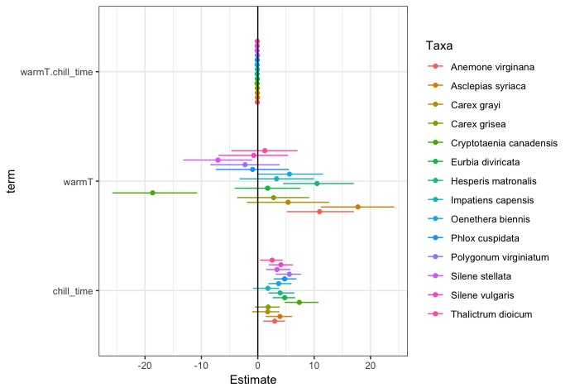
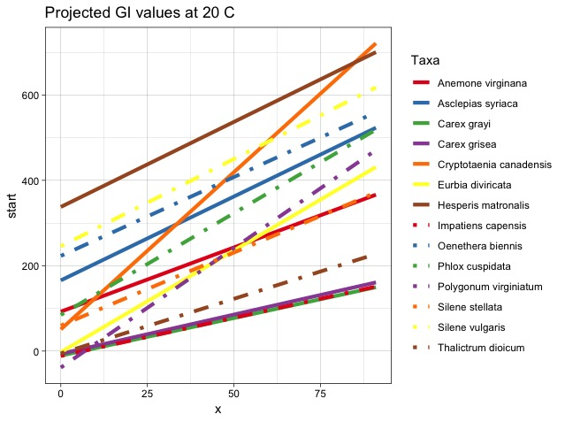

Slide 15
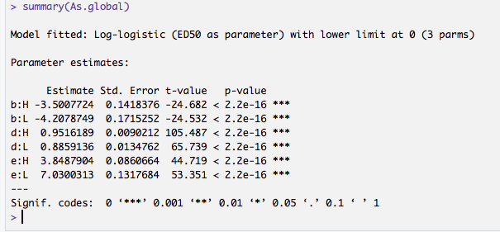
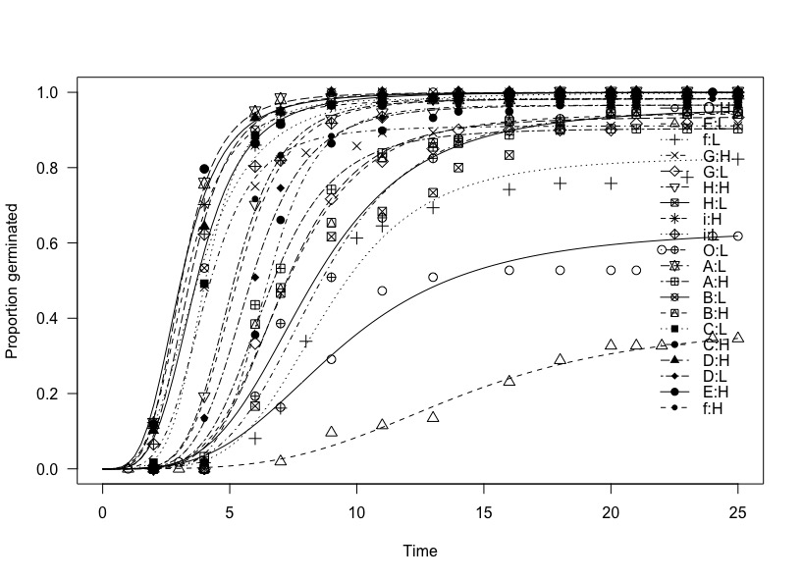
Notes:
Hard to trouble shoot why some treatments won’t converge.

Slide 16
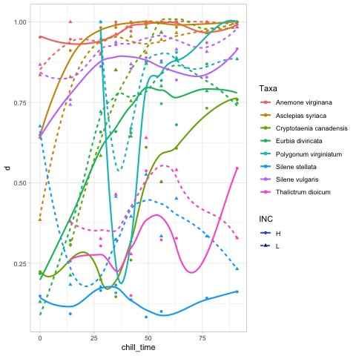
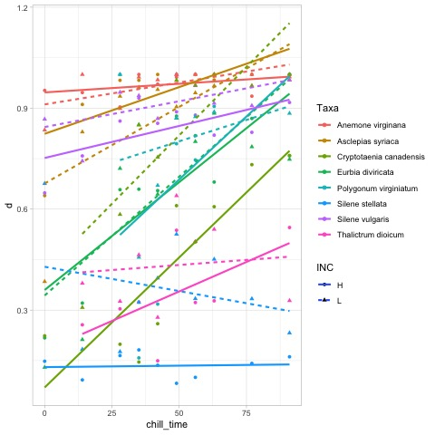

Slide 17
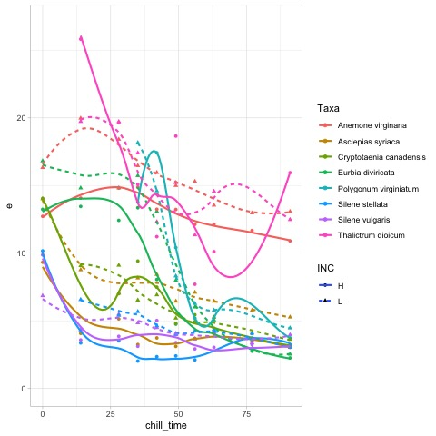
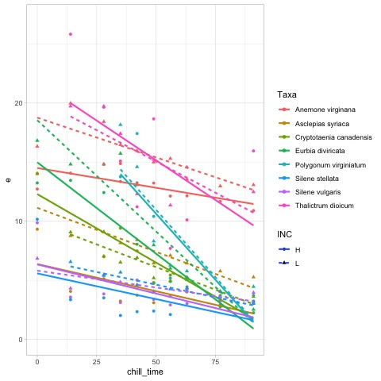

Slide 18
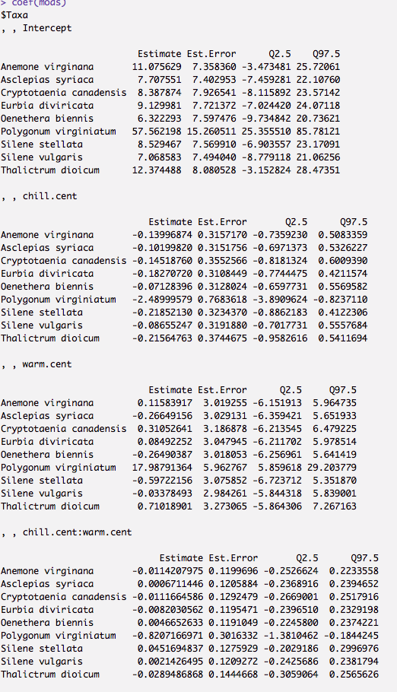
This is a model for how T50 (e) is affected by treatments.
As you can see, it seem like not really, but I think that because of the covariance of d (upper limit), and e

Slide 19
Other concerns:
Usefulness of/methods for chilling thresh holds?

