Slide 1
Germination Update

Slide 2
GOALS:
Species selection for competition trial
Quantify sensitivity to winter temperature for a suite of temperate herbs

Slide 3
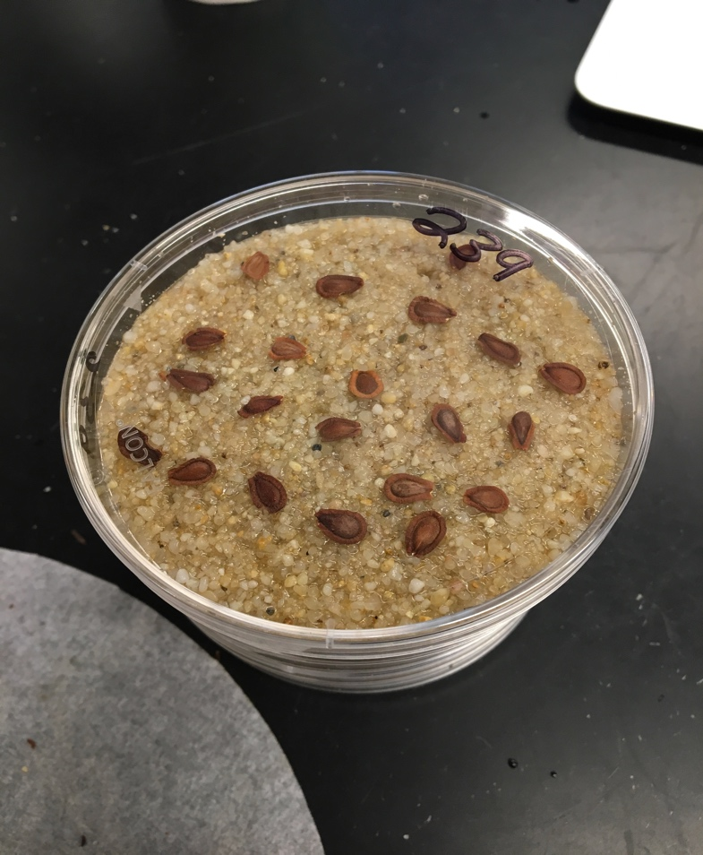

Slide 4
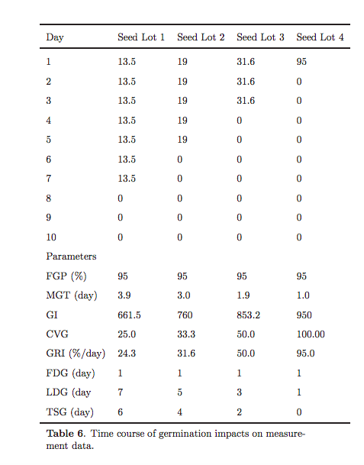
Germination %
Time
Kader 2005

Slide 5
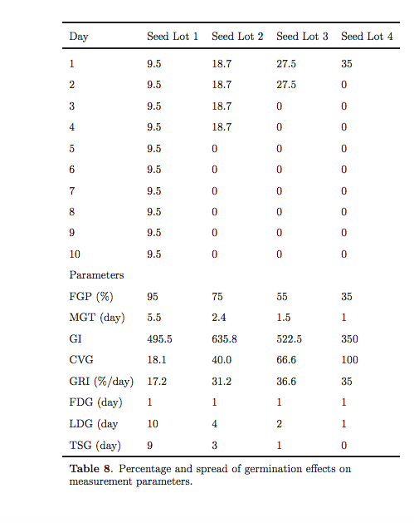

Slide 6
% will germination in pre-treatment (left censor)
% will germinate in the trial (yay)
% will die during the trial (mold…ewww)
% will not germinate (right censor…or is it?)

Slide 7
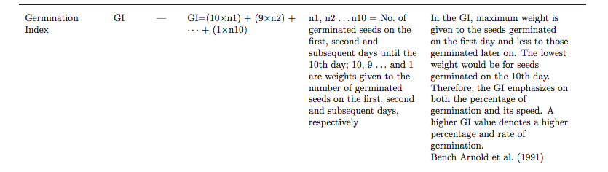
Tradition nonlinear modeling:
Uses cumulative distribution counts
Violates assumptions of independence at each observation
Time to event analysis:
Survival models and dose-response curves
Assume all seeds can germinate
Estimates right censoring (maybe inappropriate for seeds with dormancy)
The typical distributions used for germination can’t handle negative time values
Other metrics
Hybrid:
A: moldy seed # ~(chilling time, temp) + |species
B: Cold germ~ chilling time
C: germination model (drc or survival)
D*: Cure model- how many right censored will germination
Notes:
Germination index is hard to think of in real tems

Slide 8
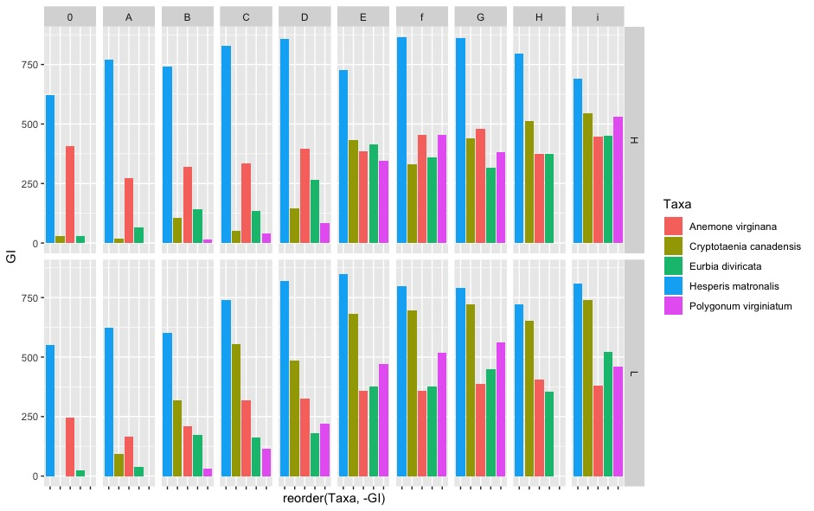

Slide 9
