Slide 2
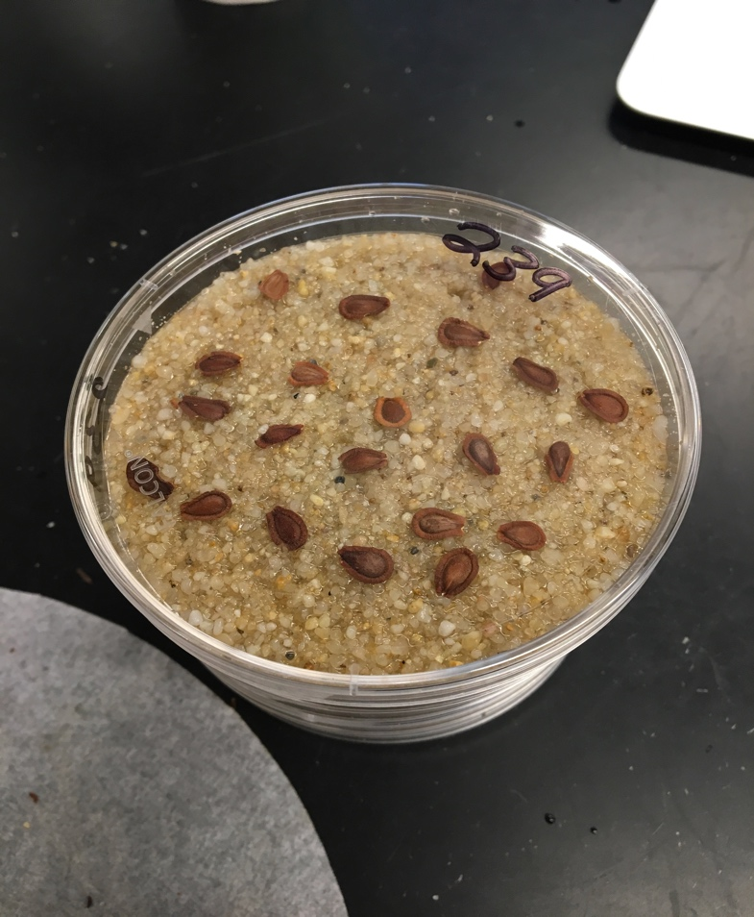
Germination %
Time

Slide 3
% will germination in pre-treatment (left censor)
% will germinate in the trial (yay)
% will die during the trial (mold…ewww)
% will not germinate (right censor…or is it?)

Slide 4
Time to event analysis
A mix of biological and coding interaction

Slide 5
Paremetric survival models and DRC’s….
3 parameters:
e T50 (that what I want)
b Slope @ T50
d Upper limit (can fix, or estimate)
(could also estimate lower limit)
Problem I : e changes with d
Biologically wrong (I think) to project d to 100%.
These distributions (lognormal, log) can’t handle negative or 0 time values. So… left censoring

Slide 6
DRC vs Survival (They are related)
Takes cohort level and under the hood transforms it
Takes data at individual seed level

