Slide 1
A budding project on buds or An emerging project on leaf emergence

Slide 2
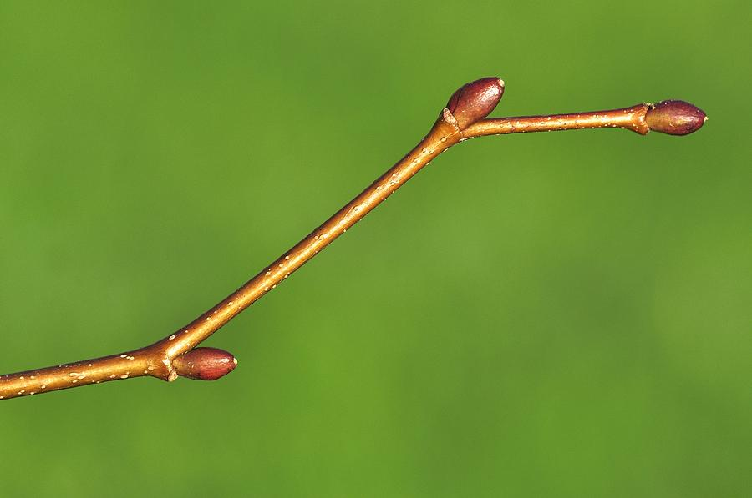
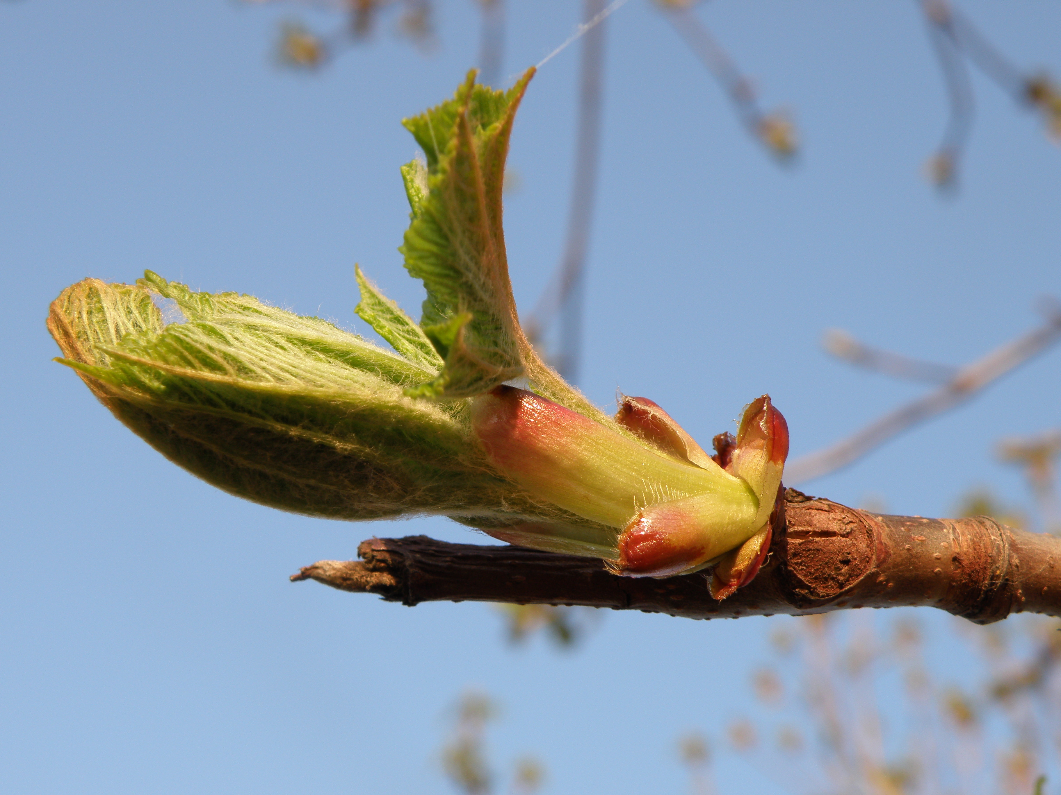
Data set 1:
6467 rows of bud volume
27 species (6 reps/species)
2 sites
(bud level)
Data set 2:
2136 rows phenological observations
12 experimental treatments
(twig level)
Does bud size predict phenological rank?
Inter and intra-species differences

Slide 4
bday∼av.bud.vol+(1|treatment)+(1|species)+(1|site)
Should I vary the slope by species?

Slide 5
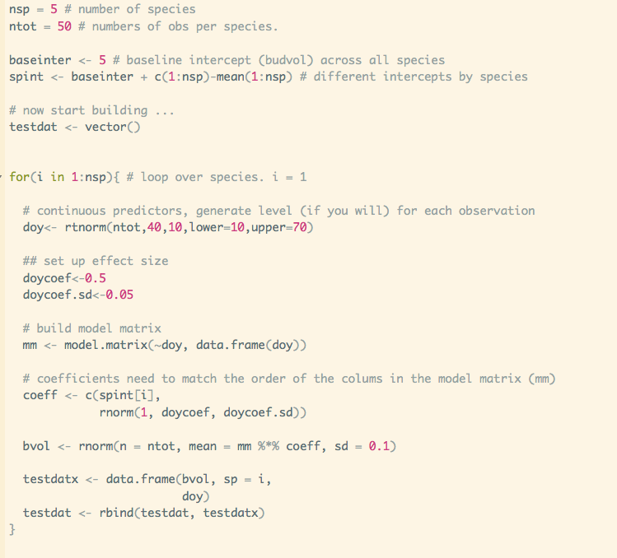
Fake data:

Slide 6
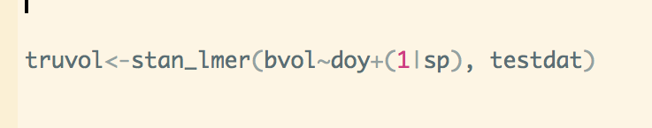

Slide 7
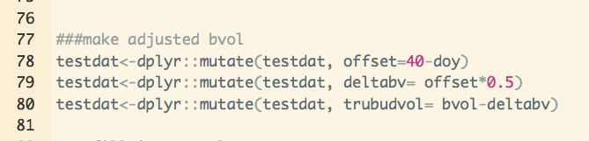
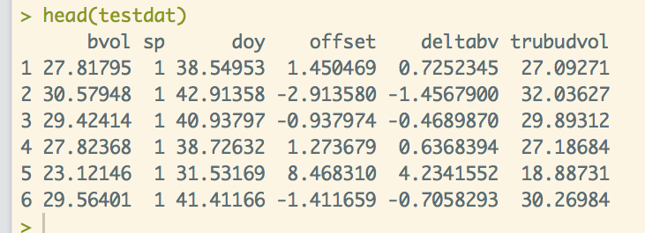
Bias correction
Notes:
Is there a less hacky way to do this?

