Slide 1
A budding project on buds or An emerging project on leaf emergence Dan Buonaiuto OEB 201

Slide 2
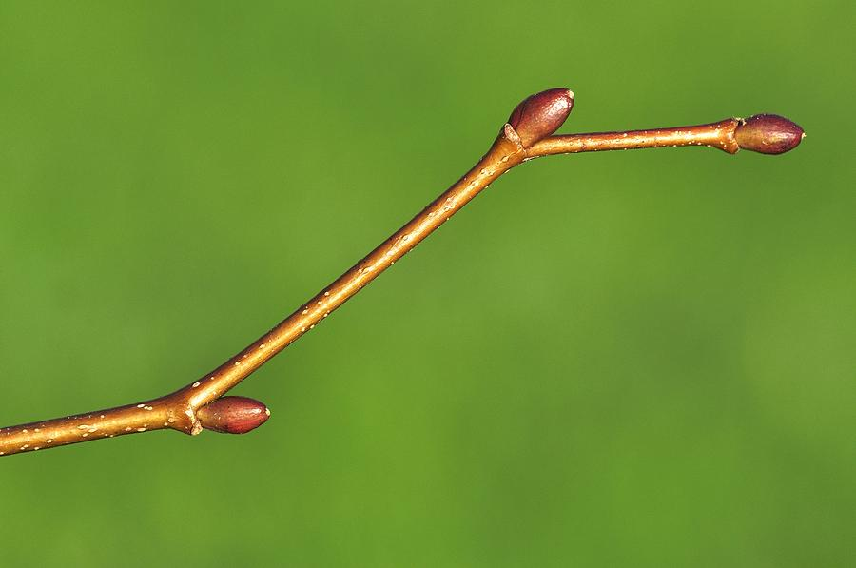
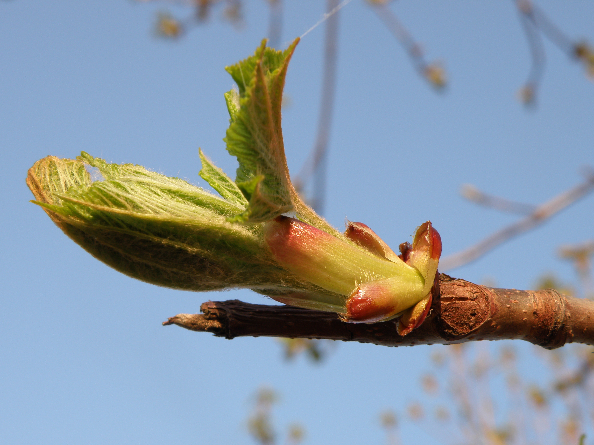
Data set 1:
6467 rows of bud volume
27 species (6 reps/species)
2 sites
(bud level)
Data set 2:
2136 rows phenological observations
12 experimental treatments
(twig level)
Does bud size predict phenological patterns?
Inter and intra-species differences

Slide 4
bday∼true.av.bud.vol+(1|treatment)+(1|species)+(1|site)
budvol~doy+(1+doy|sp)
trubudvol=measured.bv+coef(DOY-Constant )

Slide 5
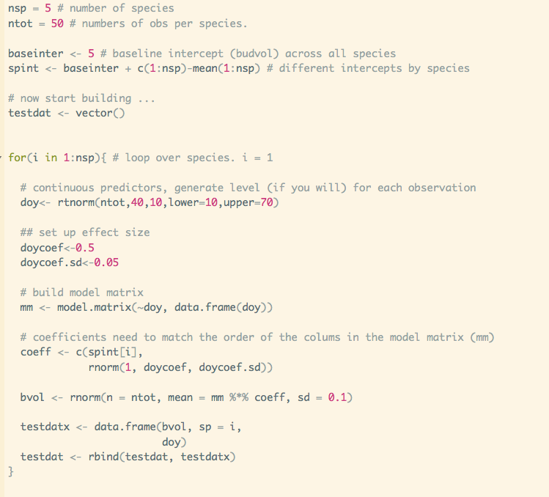
Fake data: Varying intercept

Slide 6
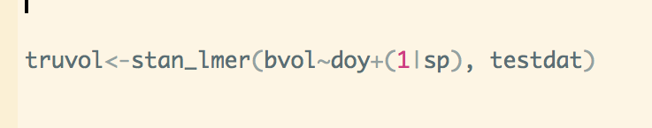

Slide 7
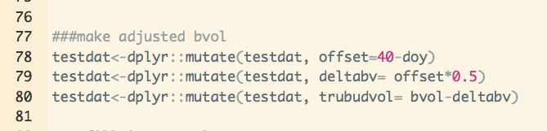
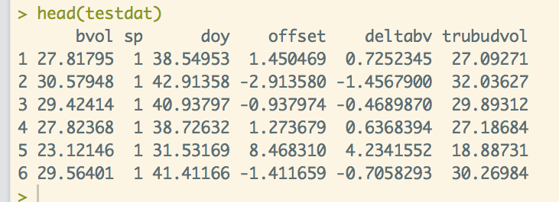
Bias correction
How to account for error on coefficient?
Is there a less hacky way to do this?
Notes:
Is there a less hacky way to do this?

Slide 8
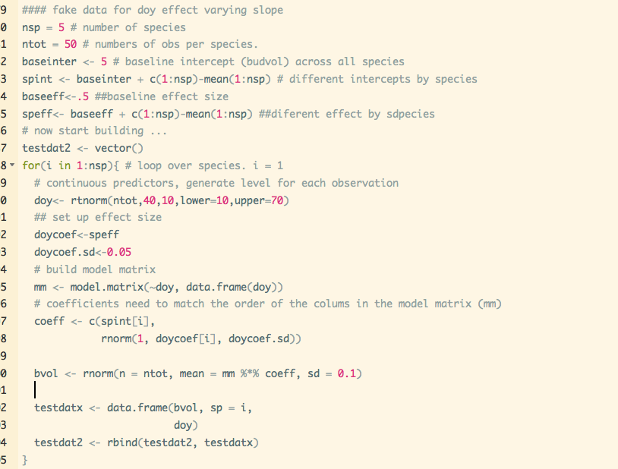
Fake Data: Varying slope & intercept

Slide 9


Slide 10
Real data

Slide 11
Next steps
Improve fake data
Better method/script for bias correct?
What’s the deal with real data???
rough model to predict phenology from tru.bud.vol

