Slide 1
Railcar Dwell Times at Rumford Station

Slide 2
The Problem
Problem:
Railcars bound for other locations can dwell at this dead end station and cost railroads more in car hire fees and delay shipments
Goal:
Predict the car idle/dwell times at Rumford Station based on data available upon arrival of the car
More accurately estimate customer arrival times
More accurately estimate the rail company’s cost to send cars to RUM
Hypothesis:
Due to the manual process of train assembly, car loading and unloading, factors that influence ease of employee work flow such as railcar type and track location will most strongly influence railcar dwell times

Slide 3
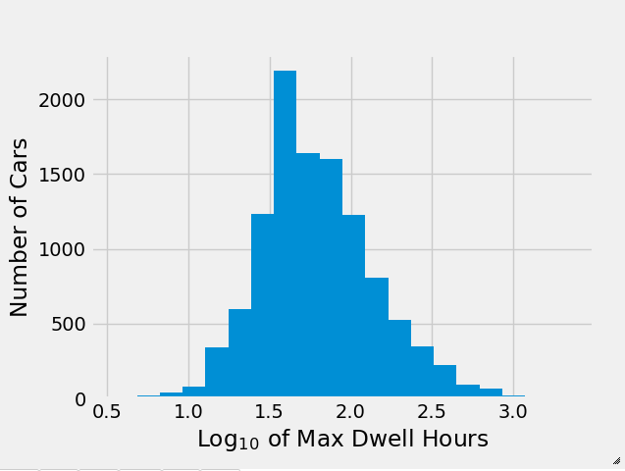
Metrics
An accurate prediction should be within 3 days of the actual dwell time
3 day cost accounts for 10% of average daily cost to the railroad to store a car at RUM (~$38.8k per month)
Assumptions:
Data available upon the car’s arrival is predictive of its future dwell time
Limitations:
Data is skewed: log normal in the value counts of almost all categorical features
2700 feature sparse dataset

Slide 4
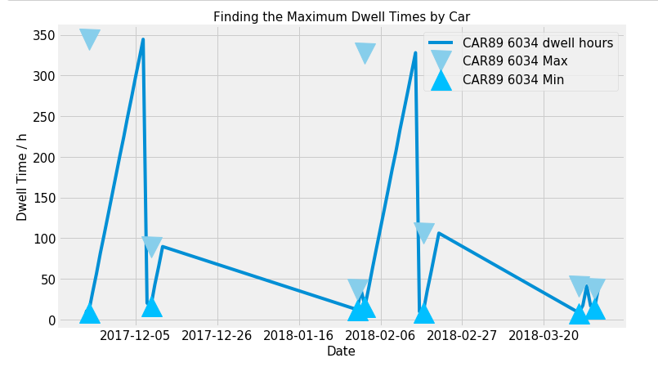
Approach
Data preparation:
Filtered all inventory down to dwelling cars only and matched the maximum dwell hours they achieved with their data available upon arrival
Analysis:
Model selection, fitting, optimization
Determine the most important features:
Best correlations (linear R² > 0.2)
Random forest importance (top 20 features)
Predictions:
The most accurate of the listed models was further optimized to generate a solution
Model | Mean Error ± std. / h | % In 3-day band
Trivial (mean) | 23 ± 113 | 58
Linear Regression | 21 ± 115 | 48
Decision Tree | 5.3 ± 116 | 63
Bagged Decision Tree | 23 ± 98 | 62
Random Forest | 20 ± 96 | 64

Slide 5
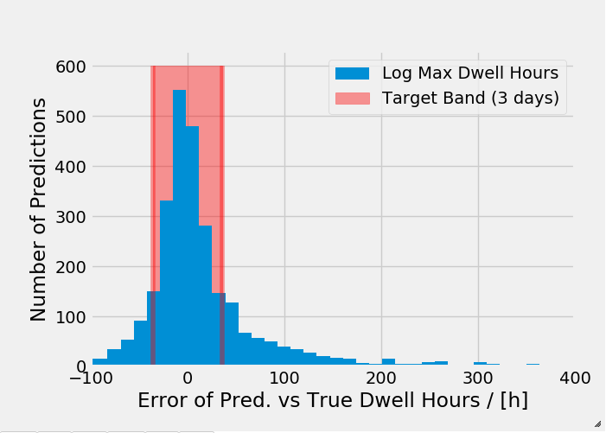
Model
A random forest model produced the narrowest range of errors of all the models tested (96 h).
64% of the predictions fall within the target 3 day accuracy band
Features most helpful for predicting dwell times are:
Hours since last move
Hours at Station
Tare Weight

Slide 6
Recommendations
More communication with Rumford Railyard employees to understand the manual decision making process for train loading, unloading and building.
Select features based on expert experience
Start collecting more relevant feature data
Railyard implementation of more regular protocols for train loading, unloading and building.
Model Impact:
The model falls short of the required target and is regularly only accurate to 24% of the monthly car hire spend (target = 10%)

