Slide 1
Network Security
Various Hacks and Exploits
by David J. Burger

Slide 2
Hacks and Exploits Outline
Shared Media and Packet Sniffing
Protocol Holes
  SYN flood
  DoS and DDoS
The Script Kiddie and his tools
  Legion
  Netbus
Resources

Slide 3

Shared Media -- Ethernet
H
I
G
A
E
E
E
HUB
E
E
E
E
E
E
F
B
E
C
D

Slide 4
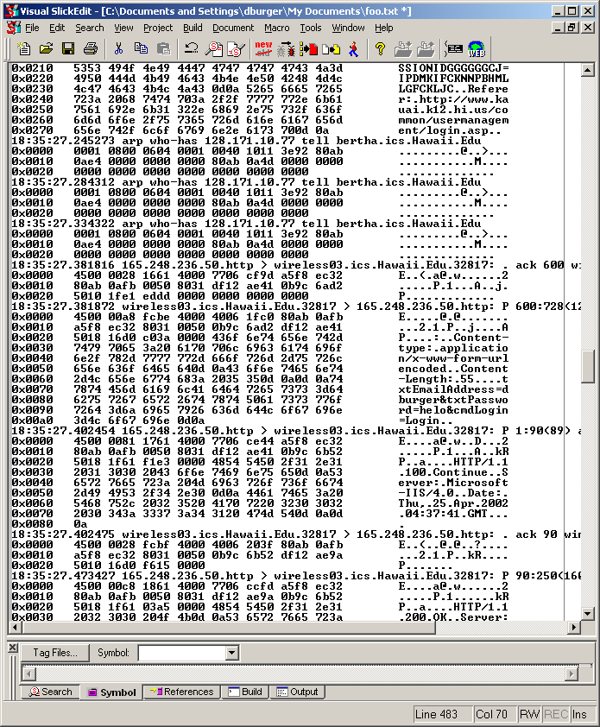
Promiscuous
Mode
Inspect ALL the packets going
across the network.
Attack the weakest link:
- telnet
- email
- web page logins

Slide 5
Defending Against Packet Sniffing
Avoid shared media
  Switches instead of hubs on Ethernet
  ADSL, not cable modems!
Use secure protocols
  Use SSH, not telnet
  SSL internet connections
Can you trust the people on your local network segment???

Slide 6
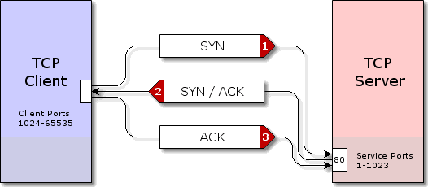
TCP Connection “Handshake”
(majority of TCP images taken from http://www.grc.com)

Slide 7
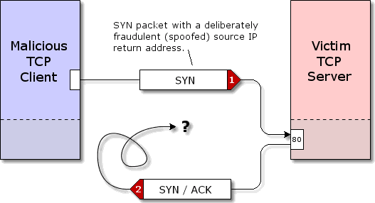
Traditional SYN Flood

Slide 8
Preventing the SYN Flood
SYN “Cookies”
  The server’s ISN is chosen with the time t, the MSS, and a secret function with inputs t, source IP, source port, destination IP, destination port
  No state information needs to be saved
  If an ACK comes in, the ACK number is checked using recent t values to see if it could be valid
  Available on most platforms, not necessarily turned on by default

Slide 9
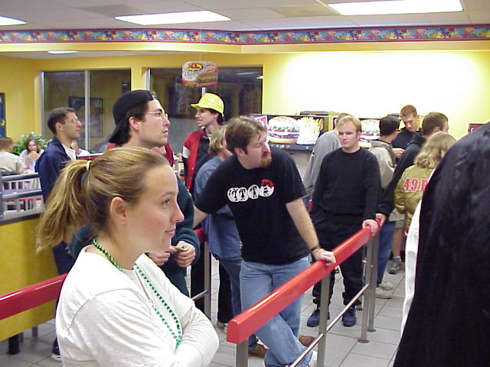
“Restaurant” Attack
Could I have a glass of water please?

Slide 10
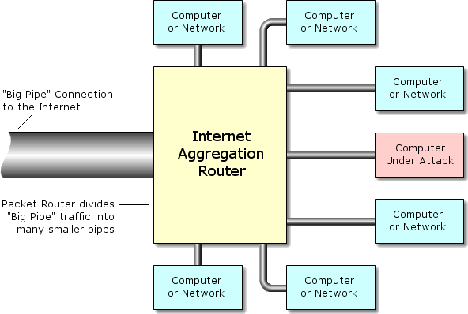
Bandwidth Attack

Slide 11
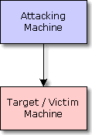
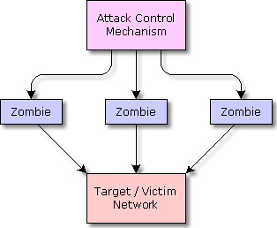
DoS vs DDoS
Attacking machine needs
to have a higher speed
connection than target.
Attacking machine uses aggregated
bandwidth of zombie machines.

Slide 12
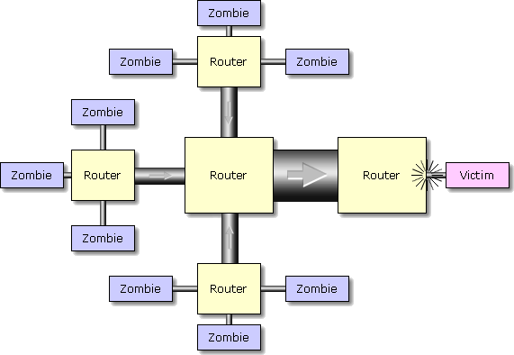
Aggregated Traffic

Slide 13
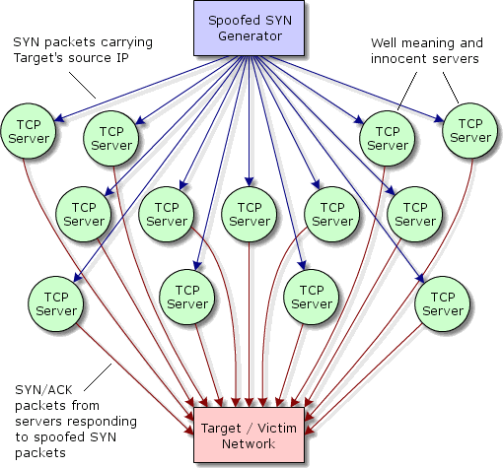
How DDoS Works
What TCP services/ports
can be exploited???
HTTP 80
SSH 22
telnet 23
DNS 53
BGP 179

Slide 14
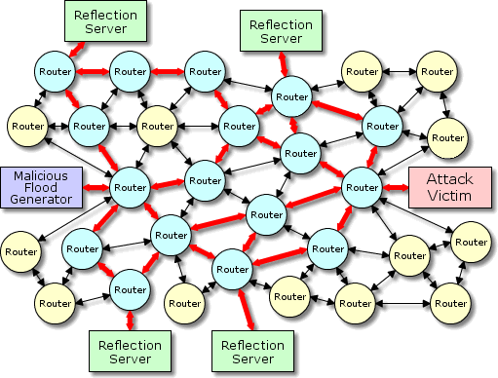
How DDoS Works, Part II
What happens when the reflection server doesn’t get an ACK for its SYN/ACK packet?
That’s right, current TCP implementations will do up to three retransmits, adding to the amplification of the attack.
Even worse…the reflection servers can be cycled so that they won’t even know they are being used in an attack.

Slide 15
Prevent DoS and DDoS
LAN
128.171.10.0/24
ROUTER
Internet
Routers should not let traffic out of the LAN that doesn’t have
128.171.10.0/24 as the source

Slide 16
Fear the “Script Kiddie”
Typically teenage boys
Limited computer expertise
Use tools developed by expert hackers
Target well known security flaws
Example:
  Legion
  Netbus
  Back Orfice

Slide 17
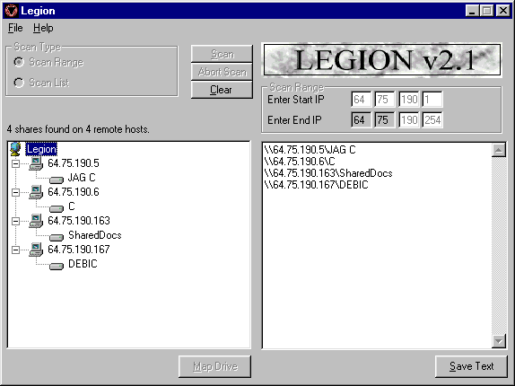
Legion

Slide 18
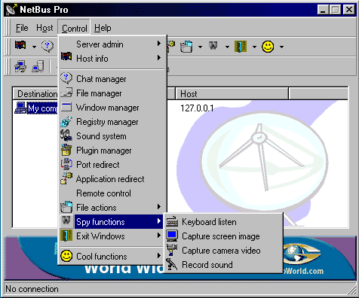
Backdoors - Netbus

Slide 19
Resources
“Hacking Exposed,” now in its Third Edition, McGraw Hill
http://www.hackingexposed.com
http://www.netbus.org
http://www.grc.com
http://cr.yp.to/syncookies.html

