Slide 1

Java Multimedia Programming
02/22/2002 * David J. Burger
History of java
The design of java
Comparison to C
Java Libraries
Multimedia programming
  Basic sound
  Moving graphics
  Java Media Framework
  Quicktime...
Summary

Slide 2
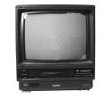






History of Java
What Is This Thing Called Java?
“The Green Project”
  13 members
  closed door
  Started in 1991
  Anticipating “next wave” in computing

Slide 3
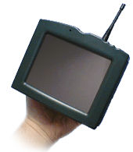
The First
Java Device
*7
The *7 was used to control a wide range
of entertainment platforms and appliances.
The target for the technology was the
television set-top-box and video-on-demand
Problem!!!

Slide 4
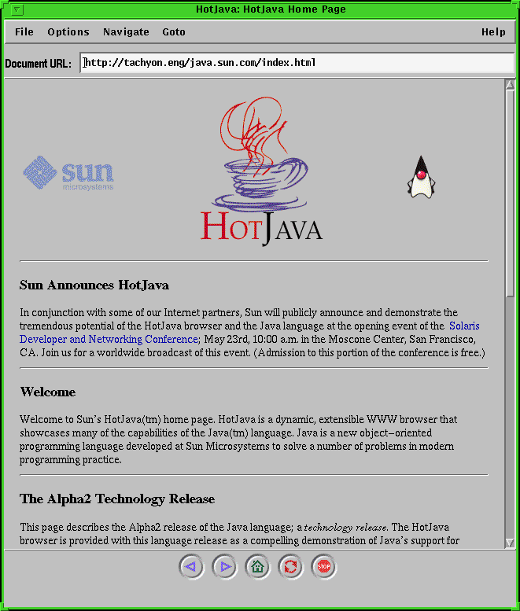
The Internet to the Rescue
Internet developing the type of services they had envisioned
The Hot Java browser...static pages only no more!

Slide 5





Java:
The Hype of 1995
Programs that ran on the web, not just static web pages.
Platform independence, any computer with a JVM can run a Java program.
Write once, run anywhere.
As long as your system has a JVM, the OS doesn’t matter...
Defeat Microsoft!

Slide 6
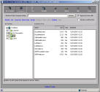
The Design of Java
Java was designed to be easy for C and C++
to learn.
Garbage collection
Multiple inheritance doesn’t work
Get rid of unsafe pointer operations
Exceptions
The Virtual Machine
File.java
Operating System
javac
jvm
bytecode

Slide 7
Java Is
Object Oriented,
Like C++
Encapsulation
Inheritance
Polymorphism
Encapsulation
public class Person {
private String name;
public void setName(String name) {
this.name = name;
}
public String getName() { return this.name; }
public void sayHi() {
System.out.println(“Hi “ + name);
}
}

Slide 8
Inheritance
public class Employee extends Person {
private int salary;
public void setSalary(int salary) {
this.salary = salary;
}
public int getSalary() { return this.salary; }
public void printStatus() {
System.out.println(name + “ is making “ salary);
}
}
Polymorphism
Shape
Circle
Square
public void processShape(Shape s) {
// the proper paint will be called
if (s.isVisible()) s.paint();
}

Slide 9
Java Libraries
Knowledge of the Libraries is Key
Basic data structures
  java.util.LinkedList
  java.util.HashMap
Extensive support libraries
  java.io.*
  java.net.*
  java.awt.*
Multimedia libraries...

Slide 10
Simple Library
Examples
To play a sound clip in an Applet:
AudioClip sound;
sound = getAudioClip(getDocumentBase(),"sound16.au");
sound.play();
sound.loop();
sound.stop();
Typical Rendering of an Image:
anImage = getImage("bart.jpg");
public void paint(Graphics screen) {
//clear the drawing surface
screen.setColor(Color.white);
screen.fillRect(0,0,width,height);
screen.drawImage(anImage,20,20);
}

Slide 11
More Examples...
Drawing shapes on the screen:
public void paint(Graphics g) {
Graphics2D g2D = (Graphics2D)g;
g2D.setStroke(borderStroke);
g2D.setColor(backColor);
g2D.fillRect(posX,posY,width,height);
//draw the background
g2D.setColor(borderColor);
g2D.drawRect(posX,posY,width,height);
//draw the border
g2D.setColor(textColor);
g2D.setFont(textFont);
int textPosX = posX + textInset;
int textPosY = posY + textAscent +
textInset;
g2D.drawString(displayText,textPosX,
textPosY);
}

Slide 12
Applet Example: http://www2.hawaii.edu/~dburger
import java.awt.*;
import java.applet.*;
import java.awt.event.*;
public class GraphicsDemo extends Applet implements KeyListener, Runnable {
private Image imgOffScreen;
private Graphics grpOffScreen;
private int screenWidth, screenHeight, xPos, yPos, xIncrement, yIncrement;
private static final int ufoWidth = 111;
private static final int ufoHeight = 70;
private Image ufoImage;
AudioClip sound;
private Thread runner;
public void init() {
ufoImage = getImage(getDocumentBase(),"ufo.jpg");
screenWidth = Integer.parseInt(this.getParameter("width"));
screenHeight = Integer.parseInt(this.getParameter("height"));
xPos = screenWidth / 2 - ufoWidth / 2;
yPos = screenHeight / 2 - ufoHeight / 2;
sound = getAudioClip(getDocumentBase(),"sound16.au");
this.addKeyListener(this);
repaint();
}

Slide 13
public void start() {
if (runner==null) {
runner = new Thread(this);
runner.start();
}
}
public void stop() {
runner = null;
}
public void run() {
Thread thisThread = Thread.currentThread();
while (runner==thisThread) {
int newxPos = xPos + xIncrement;
if ((newxPos>0) && (newxPos<screenWidth-ufoWidth))
xPos = newxPos;
else
sound.play();
int newyPos = yPos + yIncrement;
if ((newyPos>0) && (newyPos<screenHeight-ufoHeight))
yPos = newyPos;
else
sound.play();
repaint();
try {
Thread.sleep(1);
} catch (InterruptedException e) {
}
}
}

Slide 14
public void update(Graphics screen) {
paint(screen); //override to prevent flicker
}
public void paint(Graphics screen) {
if (imgOffScreen==null) {
imgOffScreen = createImage(getSize().width, getSize().height);
grpOffScreen = imgOffScreen.getGraphics();
}
grpOffScreen.fillRect(0,0,getSize().width,getSize().height);
grpOffScreen.drawImage(ufoImage,xPos,yPos,this);
screen.drawImage(imgOffScreen,0,0,this);
}
public void destroy () { grpOffScreen.dispose(); }
public void keyReleased (KeyEvent e) { xIncrement = 0; yIncrement = 0; }
public void keyTyped (KeyEvent e) {}

Slide 15
public void keyPressed (KeyEvent e) {
System.out.println(e.getKeyCode());
switch (e.getKeyCode()) {
case KeyEvent.VK_LEFT:
xIncrement = -5;
yIncrement = 0;
break;
case KeyEvent.VK_RIGHT:
xIncrement = 5;
yIncrement = 0;
break;
case KeyEvent.VK_UP:
xIncrement = 0;
yIncrement = -5;
break;
case KeyEvent.VK_DOWN:
xIncrement = 0;
yIncrement = 5;
break;
}
repaint();
}
}

Slide 16
More Libraries...
Quicktime in Java
Quicktime is an extremely popular media format and
playback device developed at Apple.
Movie m = makeMovie( new QTFile(
QTFactory.findAbsolutePath(
"data/zebra/Zebra.mov" )));
md = new MoviePresenter( m );
compositor.addMember( md, 1 );
compositor.getTimer().setRate(1);
md.setRate(1);
For extensive code examples and demonstrations see:
http://developer.apple.com/quicktime/qtjava

Slide 17
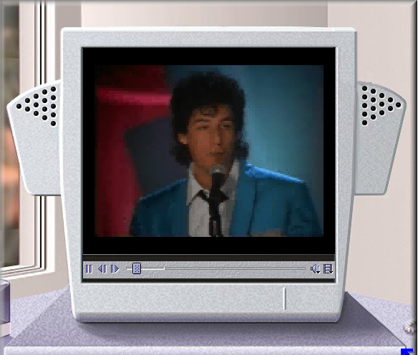
JMF
Java Media Framework http://java.sun.com/products/java-media/jmf/
Java SDK 1.4
url = new URL(getDocumentBase(), mediaFile);
mediaFile = url.toExternalForm();
player = Manager.createPlayer(mrl);
player.addControllerListener(this);
player.start();
Supports:
QuickTime
MPEG-1
MPEG-2
AVI
H.261
MIDI
AU
WAV
AIFF

Slide 18
Summary
02/22/2002 * David J. Burger
Java was developed by Sun in the early 90’s
Designed to be easy to be easy for C and C++ programmers
Being a good Java programmer means learning the libraries
  networking
  windowing
  multimedia
    sound
    graphics
    streaming

