Slide 1
Jini Technology
David J. Burger
EE 665
04/05/2002
What is Jini?
  The Sun Hype Machine
  OK, forget the hype, what is it really?
The Competition
How it works
  The process described
  Graphical flow model
  What is the proxy?
  Where layer does Jini operate in?
Why do we need it?
Are people really using this?
  A list of companies employing JINI technology
  Company examples and what they are doing
    MHPCC
    eko, systems inc.
The future of Jini
Summary and Conclusion

Slide 2
What is Jini?
The Sun Hype Machine
From the SUN web site:
“Jini network technology is an open architecture that enables developers to create network-centric services - whether implemented in hardware or software - that are highly adaptive to change. Jini technology can be used to build adaptive networks that are scalable, evolvable and flexible as typically required in dynamic computing environments.”
???

Slide 3
What is Jini?
What is it really?
Provides a means for using Java objects across a network by facilitating:
a way for finding and connecting to services on a network
creating reliable services out of unreliable parts
dealing with networks that are very large
enabling components of a service to change without interrupting the service

Slide 4
Competition
The Heavyweights:
  DCOM, Microsoft’s Distributed Component Object Model
  CORBA, Common Object Request Broker Architecture
Several other attempts:
  DOME, CMU’s Distributed Object Migration Project
  Object Oriented RPC at Stanford
  many, many more research groups are participating in the field

Slide 5
How it works
The process described
Discover – network service locates lookup service (LUS)
Join – network service sends service proxy to LUS
Discover – network client discovers LUS
Lookup – network client sends request to LUS for services
Receive – LUS sends registered service proxy to client
Use – network client uses proxy to interact directly with network service via proxy

Slide 6
How it works
Graphical flow model
Computer offering
LUS.
4
1
2
3
5
6
Computer offering
network service.
Discover
Join (proxy)
Discover
Lookup
5. Receive
6. Use
Client wishing to
use the network
service.

Slide 7
How it works
What is the proxy?
The proxy is the information that the client needs to instantiate the provided object and to call its methods
Like a stub in RPC
Efficiency is improved as only the necessary signature and parameters are transferred on the network, not the entire class file
Object
C
L
I
E
N
T
Proxy

Slide 8
Example Object:
public class Employee {
private String name;
private double salary;
private Employee boss;
public Employee( String empName) {
name = empName;
}
/** constructor to set name **/
public String getName() {
return name;
}
/** a method to set an Employee object's salary field **/
public void setSalary( double value ) {
salary = value;
}
/** a method to get an Employee object's current salary field value **/
public double getSalary( ) {
return salary;
}
/** a method to set an Employee object's field referencing another
Employee object **/
public void setBoss ( Employee boss ) {
this.boss = boss;
}
/** a method to return a String identifying the field contents of an
Employee **/
public String toString() {
return name + " salary:" + salary;
}
}

Slide 9
Associated Proxy:
server: 10.0.0.100
public class Employee {
public Employee( String empName);
public String getName();
public void setSalary( double value );
public double getSalary( );
public void setBoss ( Employee boss );
public String toString();
}

Slide 10
Where layer does Jini operate in?
Application
Jini Technology
Java Technology
Operating System
Network Transport

Slide 11
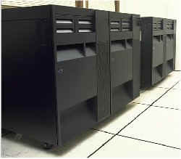
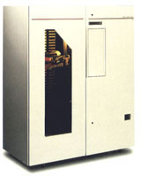

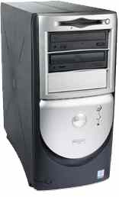
Why do we need it?
Jini
specialized hardware
access to specific data
ties together different technologies that are java capable

Slide 12
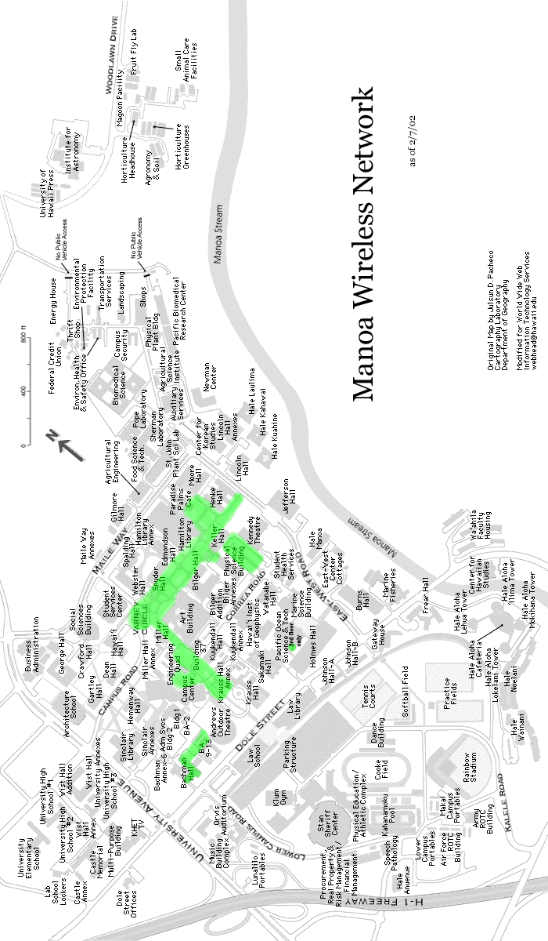

Off to Magoo’s

Slide 13
Are people really using this?
Company list
4D Networks
Appropria
Echelon
Entegrity Solutions
Eko
FETISH Federation
Lightflow
MHPCC
Procoma
Raytheon
U.S. Army
LOOX Software
OKI Electric
Perceptual Robotics
ProSyst Software
Zucotto Systems
Austrian Research Centers

Slide 14




Company Example
MHPCC – U.S. Navy
“The U.S. Navy had been using local area networks to support simulations it conducted with the supercomputing capabilities at the MHPCC – but that meant participating ships had to travel to the local exercise site,”
Jini
Over
WAN

Slide 15
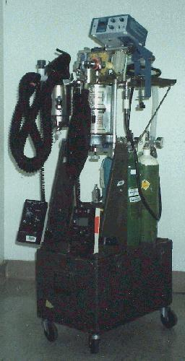

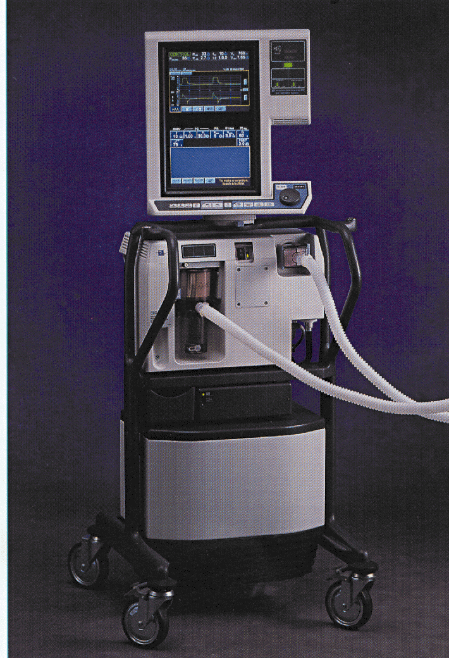
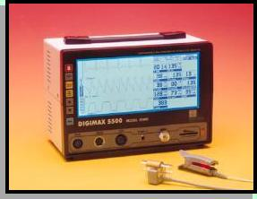

Company Example eko systems, inc.
“Jini technology gave the system, called Frontiers, the capability to connect to any type of medical equipment – including physiologic monitors, ventilators, and anesthesia machines – without requiring clinicians to even think about configuration data or software drivers.”
Jini

Slide 16
JINI – The future
Sun – “Early growth phase with early adopters.”
Others – “Luke warm reception to Jini technology.”

Slide 17
JINI – Summary and Conclusion
Provides a way to find and connect to services on a network
Provides reliability
Works over large networks
Flexible and adaptable
Gaining momentum or fizzling out???
For more information:
http://www.sun.com/jini/
http://www.jini.org

