Slide 1
Writing a network app?
TCP/IP vs UDP/IP
(or write your own???)
TCP | UDP
Communication over IP | Communication over IP
Connection oriented | Connectionless
Reliable | Unreliable
Stream oriented | Datagram oriented
Reliable startup
Reliable shutdown

Slide 2
Examples of Services that run on TCP/IP and UDP
FTP
HTTP
SNMP
DNS
TCP
UDP
IP
NET₁
NET₂
…
NET₃

Slide 3
Department of Defense
Four Layer Model
“Internet Architecture”
Process Layer
(HTTP, FTP, DNS)
Process Layer
(HTTP, FTP, DNS)
Transport Layer
(TCP, UDP)
Transport Layer
(TCP, UDP)
Network Layer
(IP)
Network Layer
(IP)
Data Link Layer
(ETHERNET, FDDI)
Data Link Layer
(ETHERNET, FDDI)
internet

Slide 4
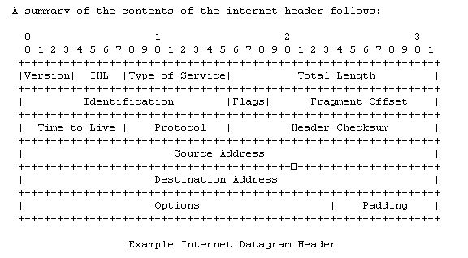
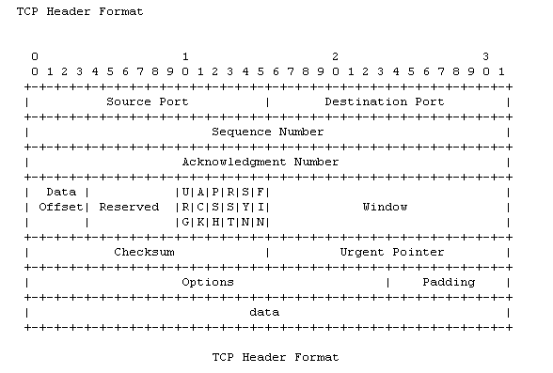
IP HDR
TCP HDR
PAYLOAD

Slide 5
From the programmer’s perspective:
OS TCP/IP
INTERFACE
OS TCP/IP
INTERFACE
INTERNET

Slide 6
On to programming…where to start???
Application Programming Interface (API):
The designed interface that applications use to
implement a particular feature. API usually
refers to services provided by the operating
system.
Examples:
Windowing systems
File systems
Database systems
Networking systems – Berkeley Sockets
The Berkeley Socket interface has been ported to virtually all popular operating systems!
Linux
Unix
Windows
BEOS

Slide 7
Berkeley Socket API: Based on the idea of a
socket being the endpoint of communications.
A socket is characterized by its protocol, IP
address, and port number.
Sockets API – Managing Connections
int socket(int domain, int type,
int protocol);
int bind(int sockfd, struct sockaddr *my_addr,
socklen_t addrlen);
int listen(int s, int backlog);
int accept(int s, struct sockaddr *addr,
socklen_t *addrlen);
int connect(int sockfd,
struct sockaddr *serv_addr,
socklen_t addrlen);
int shutdown(int s, int how);
int close(int fd);
int gethostname(char *name, int len);
struct hostent *gethostbyname(const char *n);
struct protoent *getprotobyname(const char *n);

Slide 8
Sockets API – Sending / Receiving
int send(int s, const void *msg, int len,
int flags);
int sendto(int s, const void *msg, int len,
unsigned int flags,
const struct sockaddr *to,
socklen_t tolen);
int write(int fd, const void *buf, int count); int recv(int s, void *buf, int len, int flags); int recvfrom(int s, void *buf, int len,
unsigned int flags,
struct sockaddr *from,
socklen_t *fromlen);
int read(int fd, void *buf, int count);
Sockets API – Windows Specific
int WSAStartup(int version,
WSADATA *implementation);
int WSACleanup();

Slide 9
Typical Call Sequence:
Server
Client
getprotobyname
gethostbyname
socket
getprotobyname
bind
socket
listen
connect
accept
close
close
= connection established...send and recv

Slide 10
Example Client:
int main(int argc, char *argv[]) {
struct hostentry *he;
struct sockaddr_in sin;
char buf[80];
int s, n;
he = gethostbyname(“comp.hawaii.edu”)
if (!he) {
printf(“Unable to resolve host.\n”);
exit(1);
}
memset((char *)&sin,0,sizeof(sin));
sin.sin_famliy = AF_INET;
sin.sin_addr.in_addr = htonl(he->h_addr);
sin.sin_port = htons(5432);
s = socket(PF_INET, SOCK_STREAM,0);
if (s<0) {
printf(“Unable to create socket.\n”);
exit(1);
}
n = connect(s, (struct sockaddr *)&sin,
sizeof(sin));
if (n<0) {
printf(“Unable to connect.\n”);
exit(1);
}
while (fgets(buf, sizeof(buf), stdin)) {
send(s, buf, strlen(buf), 0);
}
}

Slide 11
Example Server:
int main(int argc, char *argv[]) {
struct sockaddr_in sin; char buf[80]; int s, new_s, n;
memset((char *)&sin,0,sizeof(sin));
sin.sin_famliy = AF_INET;
sin.sin_addr.in_addr = INADDR_ANY;
sin.sin_port = htons(5432);
s = socket(PF_INET, SOCK_STREAM,0);
if (s<0) {
printf(“Unable to create socket.\n”);
exit(1);
}
n = bind(s, (struct sockaddr *)&sin,
sizeof(sin));
if (n<0) {
printf(“Unable to bind to port %d.\n”,n);
exit(1);
}
n = listen(s,1);
if (n<0) {
printf(“Unable to create backlog.\n”);
exit(1);
}
while(1) {
new_s = accept(s, (struct sockaddr *)&sin,&n);
if (new_s<0)
printf(“Error on accept.\n”);
else {
while(recv(new_s, buf, sizeof(buf), 0))
fputs(buf, stdout);
close(new_s);
}
}
}

