Slide 1
Homology Analysis by David Burger
Design Process
My Solution - Example
Proof of Correctness
Pseudo Code
  time complexity
  space complexity

Slide 2
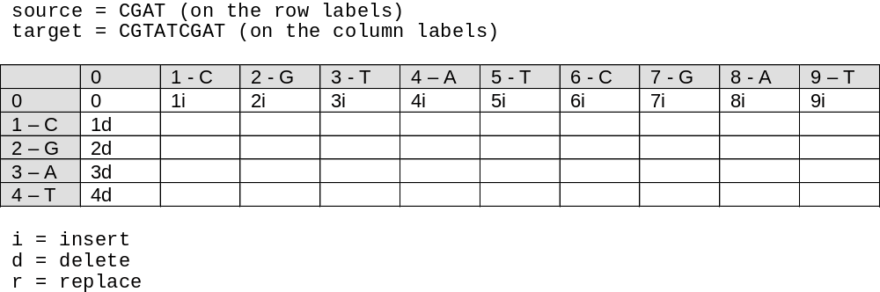
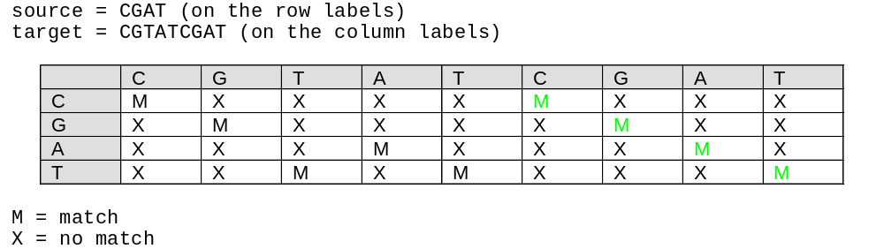
Prefix Technique???
Looking at Pattern Matching

Slide 3
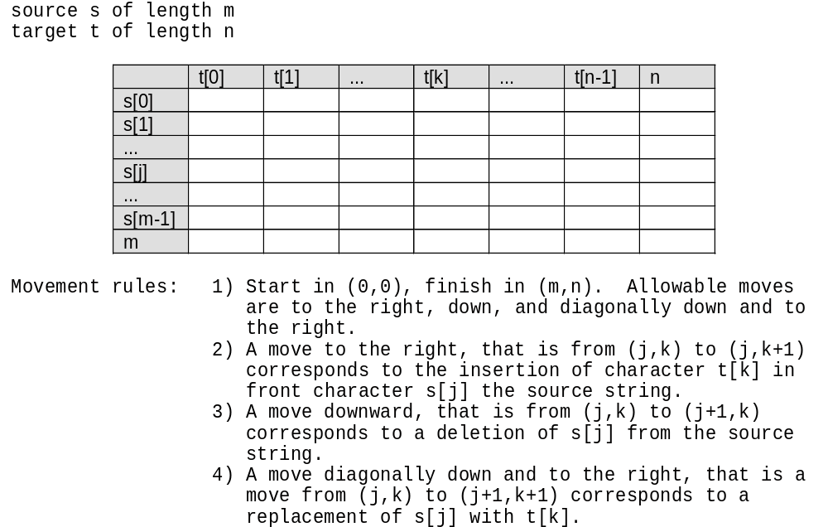
“The Movement Rules”

Slide 4
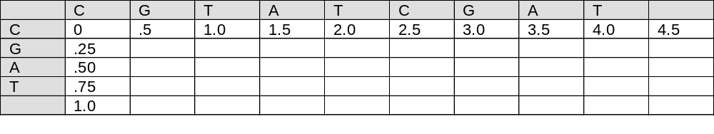
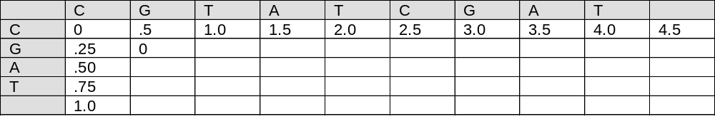
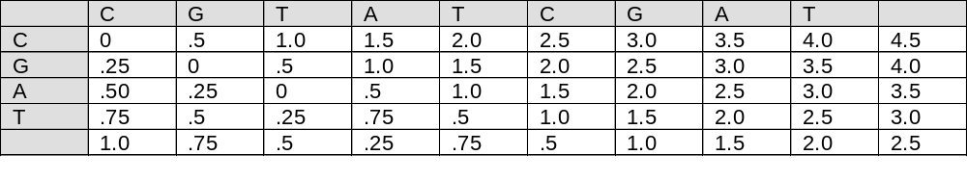
Example:
In this example we assume simplified probabilities of: insert .2 cost: 0.50
deletion .1 cost: 0.25
replacement .4 cost: 1.00

Slide 5
Theorem 1.0: The algorithm produces the minimal length needed for the homology analysis transformation.
Proof: Let d, i, and r represent the number of deletions, insertions, and replacements in an optimum transformation from a
source sequence s of length m to a target sequence t of length n. For simplification we will consider using base x in the source
to arrive at base x in the target as a replacement (of course with cost 0). There exists an optimum solution such that:
d + r = m
This is because each individual character of the source must be either deleted or replaced. Clearly any more
deletions and replacements would not lead to a better solution as it would involve:
- deleting an inserted base
- replacing an inserted base
- replacing the same base twice
i + r = n
This is because each individual character of the target must be arrived at by either insertion or replacement.
Clearly any more insertions and replacements would not result in a better solution as it would involve:
- inserting more characters than necessary, only to delete them
- replacing an inserted base
- replacing the same base twice
The movements in the algorithm’s table can represent all combinations of these m deletions and replacements and n
insertions and replacements. Furthermore, the number of vertical moves v and horizontal moves h from such an
optimal solution would be:
v = d + r = m
h = i + r = n
Therefore this optimal solution terminates in cell (m,n). Lastly, by the principal of optimality and through the cell
labeling process, the label placed in cell (m,n) is the optimal length of the homology analysis.

Slide 6
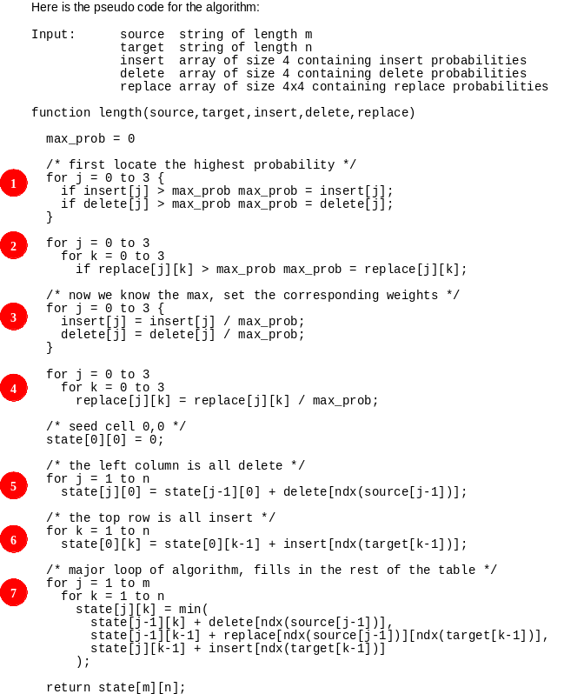

Slide 7
