Slide 1
MobiTrans
ICS 691 Project
by
Bruce Harris and David Burger

Slide 2

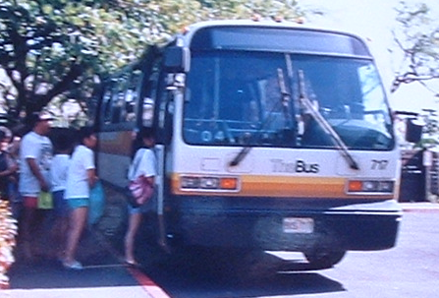
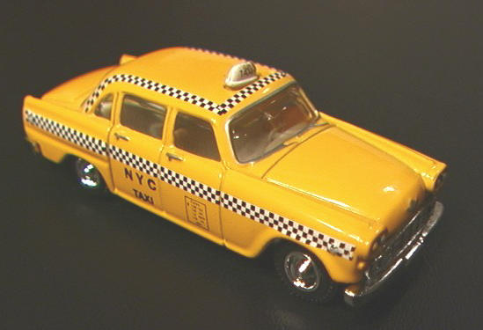
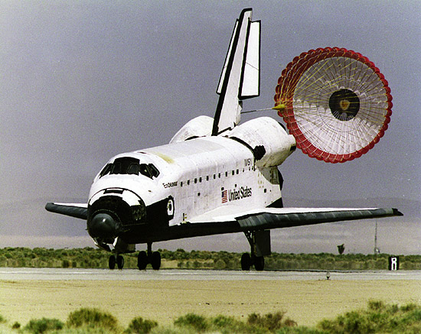
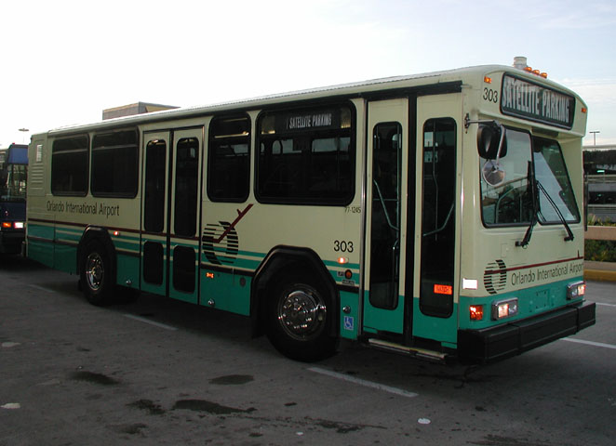
What is MobiTrans?
a floor wax
a dessert topping
a web presence reachable from mobile devices that connects people needing transportation to those that provide it

Slide 3

MobiTrans Backend
Linux (but could run on Windows, etc.)
Apache (but could run on any PHP enabled http server)
MySQL
PHP

Slide 4
Making money
Free for consumers
Subscription fees for transportation companies
Potential carrier provided service

Slide 5
Target Clients
Consumers
  Anyone who needs transportation alternatives and has a WAP-enabled device.
Suppliers
  Any organization wanting to advertise its transportation services via mobile devices (ex. TheBUS, taxis, shuttles)

Slide 6
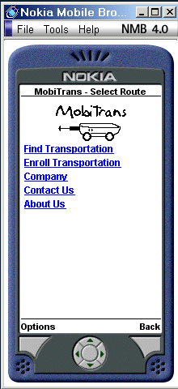
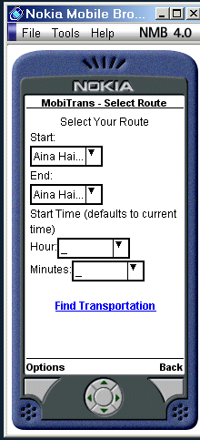
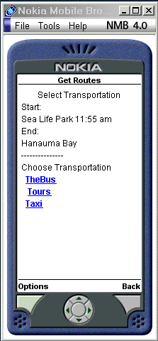
Consumer Usage Scenario

Slide 7
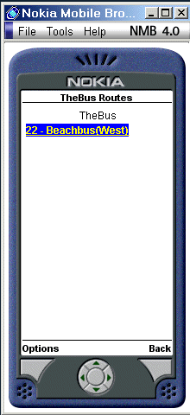
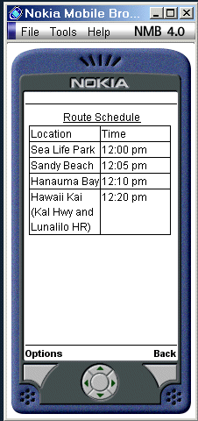
Consumer Usage Scenario

Slide 8
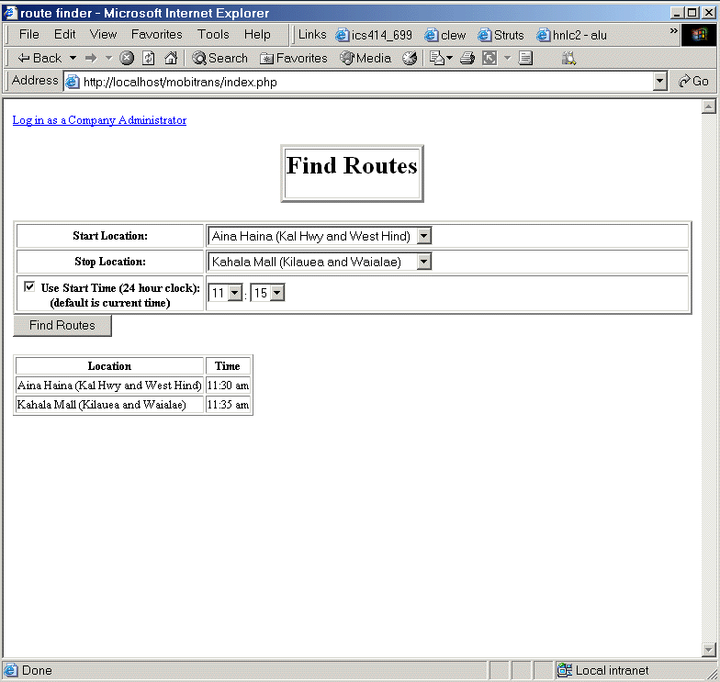
Consumer Usage Scenario

Slide 9
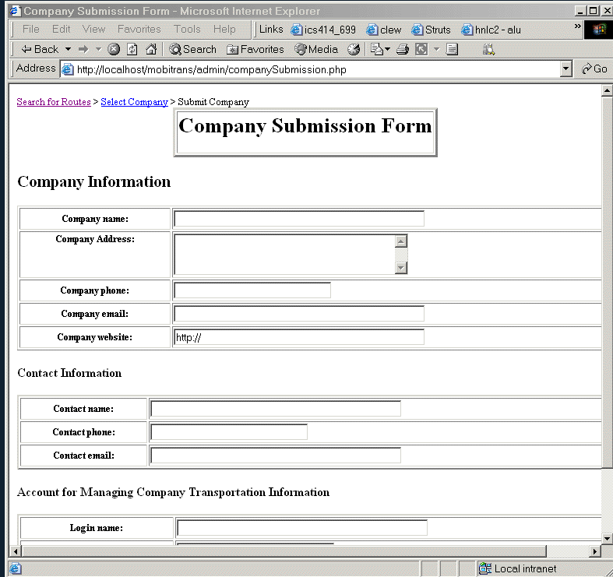
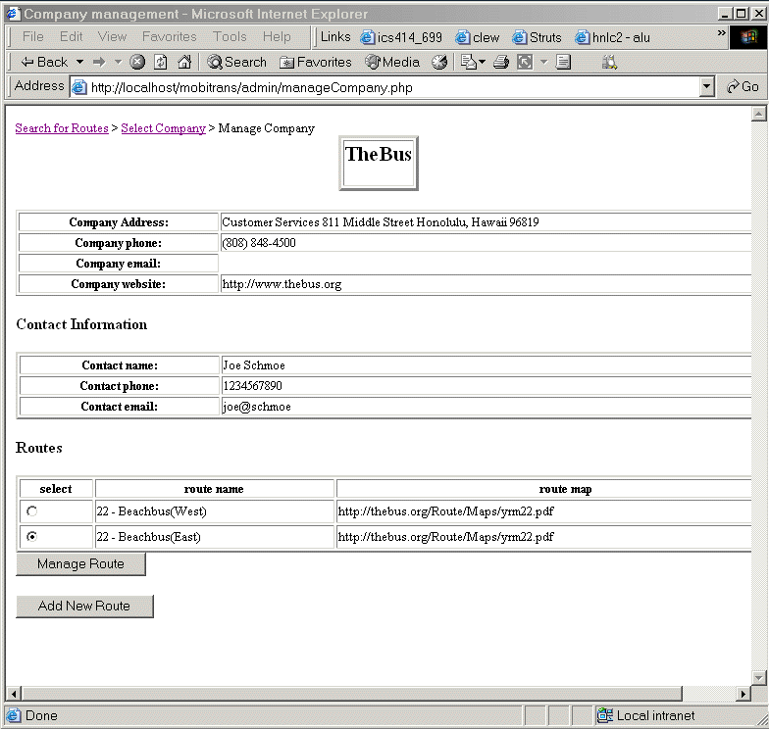
Provider Usage Scenario

Slide 10
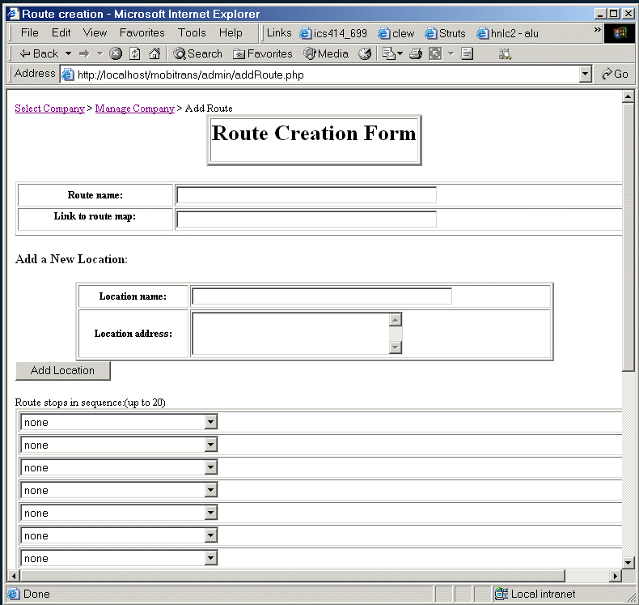
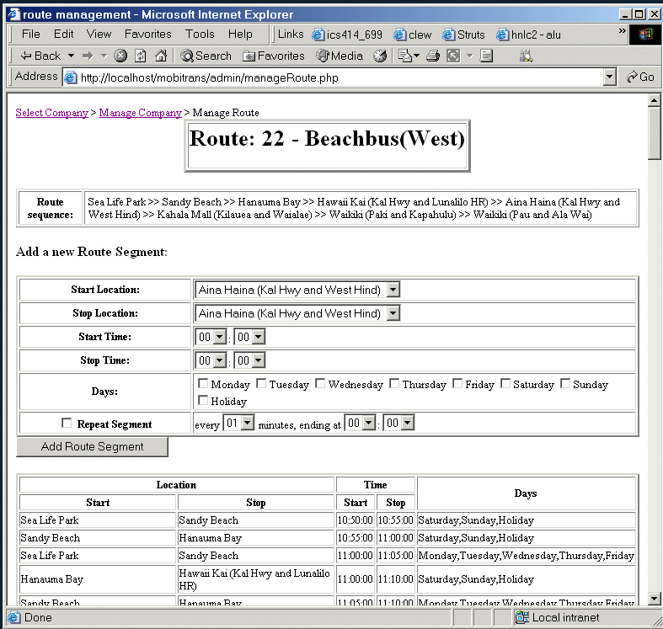
Provider Usage Scenario

Slide 11
The Future of MobiTrans
Advertising tie-ins
GPS
Maps
Universal standards

Slide 12
?
Sorry, no more questions, we’re out of time.

