Slide 1

Identifying Disinformation
Authors: David Burrus, Ginna Woo, Jianci Zhai (Angela)
Notes:
Hi Everyone, Welcome to our project – our topic is centered on Identifying Disinformation. Our Team lead is David Burrus, and we have two additional members – Ginna Woo and Jianci (Angela) Zhai.
Now, lets jump into our topic.

Slide 2

Table of Contents
What is Disinformation?
Design & Concept
Team Contribution
Diving into the Code
Challenges
Prerequisites: Packages and Language
Notes:
Here is a quick overview of our main topics – we’ll start off introducing our project and our ideas. We'll then jump into exploring our code and provide an explanation on our analysis development. We'll highlight our challenges and end our presentation with improvements to consider.

Slide 3
What is disinformation
Dissemination of information that is deliberately misleading (disinformation) or simply inaccurate (misinformation) has been recognized as a threat to society.
Disinformation that elicits emotional response from users tend to receive more click-throughs and is therefore favored by search engines.
It has become more and more difficult for individuals to determine which content is based on facts because of the unlimited sources of information available today.
By providing a “disinformation score” for each search result, our “search result markup” browser extension will influence user click-through by navigating the users towards more reliable sources.
We use COVID-related content as an example to elaborate how we can add the extra score to help users identify misinformation.
Notes:
The spread of misinformation and disinformation has affected our ability to improve many aspects of our lives – and this can be health related (COVID19) or even climate change for example. With so many information around us, it is extremely difficult to differentiate what is true information. Our goal here is to develop a tool to provide valuable insight on the information we received to help users identify disinformation. Our analysis program will produce disinformation scores for the end users to inform them of the level of disinformation allowing the user to make more inform decisions on content they are consuming. In the next few slides we will explore our goals and dive deeper into our code.

Slide 4
Project Objectives (as proposed)
Screen scrape search results from user query, focusing on organic rather than sponsored or paid results.
Visit each URL in the search results to scrape relevant text data, including headings, body, out-links, and author.
Analyze the content returned with topic mining and sentiment analysis.
The URL provides direct context by indicating an affiliation, so incorporate judgments from "authorities" who provide reliable, transparent assessments of the trustworthiness of websites.
Display search engine results to the user with an additional icon indicating level of accuracy or disinformation, so that users can make a more informed judgement.
Notes:
Here are our original project objectives. [Read them.]

Slide 5

DESIGN & Concept
Design & CONCEPT
The original concept involved developing an extension (plug-in) to modify search engine results by injecting our disinformation analysis directly onto the search result page (see below).
However, due to limitations (issues with integrating Python and JavaScript codes) the team opted to create an interface to allow our users to input values for the program to run its analysis.
Figure 0.1 - Original concept involves projecting misinformation/disinformation scores.
Figure 0.2 - Revised concept captures user inputs and projects analysis.
Notes:
We attempted to follow through our original concept which involves developing an web extension to directly modify the search engine results by integrating our model and injecting our disinformation analysis directly onto the search result page as seen in Figure 1.0. However, we came across several issues with compiling two different languages as web extensions are written in JavaScript – our model code was developed using Python. Given our time constraints as well – we opted to create an alternative solution that involves creating a user interface that take in user inputs instead (see Figure 1.1). The inputs will be used to kick-off the analysis. In the next section, we will talk more about the code and how the analysis is performed.

Slide 6
Project Submission
Our project submission includes four files in total – two data files and two code files:
covid_search_results_summary.xls : Excel file containing over 240 search engine results for various COVID-related queries. These data are used to train and test the analytical models.
url_accuracy.xls : Excel file containing over 3,400 judgments of website factual accuracy, based on assessments from organizations like MediaBiasFactCheck, NewsGuard, HON, and others. These data are used by the models.
CS410_COVID_Notebook_A.ipynb : Python notebook that scrapes results from three search engines, builds a model, and assesses its accuracy. This program requires the two data files above. Of the five project objectives, Notebook A achieves 1 through 4. However, it does not provide an interactive way for a user to enter his or her own choice of websites to analyze.
CS410_COVID_Notebook_B.ipynb : Python notebook that provides an interactive assessment of user input. This program also requires the two data files above. Of the five project objectives, Notebook B achieves 2 through 4 and provides a way for users to enter a website for analysis. Finally, Notebook B uses a different modeling technique, so the reviewer can see the performance of different methods.
All files may be downloaded from the GitHub repository containing the project proposal and progress report.
Notes:
Our submission includes four files, listed here and submitted through teh GitHub repository used for the team's prior submissions. There are two code files that address different parts of the project and that explore modeling in different ways. And there are two data files used by the two code files.

Slide 7
Notebook A – Overview & Implementation
Notebook A has six sections:
Scrape search results – This code section demonstrates that is possible to scrape search engines such as Bing, Google, and Yahoo. However, this task proved much more complex than expected. We found that some search engines block attempts at scraping or crawling. Such blocks can be circumvented sometimes, but not always, by continuously changing USER_AGENT and other parameters.
Collect “search engine result” text data as well as context and judgment data – This section:
Loads ‘covid_search_results_summary.xls’ is lieu of scraped search engine results. To minimize running time, the Excel file already contains website text and URL.
Visits each URL in the “search results” to collect additional context such as heading text and out-links. (Attempts to collect author were not successful, because different website indicate author in different ways or not at all.) This operation can take two or three minutes. Websites that ‘time out’ or refuse the request are bypassed and an error is reported.
Loads ‘url_accuracy.xls’ and incorporate the judgments of these authorities into the data set.
Adds top-level domain (e.g., edu, gov, com, net) to the data set as a possible feature for the model. This is based on the supposition that certain TLDs such as edu and gov tend to be very reliable.
Plots some exploratory data analysis. Please note that all program output is displayed within the Jupyter notebook.
Perform sentiment analysis using the NLTK package
Pre-process text data – This code cleans, tokenizes, and stems the text data in preparation for modeling, then plots word frequencies.
Process text data – This code builds features that will be used to train and test the model.
Build classifier – This final section creates a Support Vector Machine model, trains and tests it, then displays the model’s accuracy, precision, recall, and F1 score.
Notes:
The first code file, Notebook A, is a Jupyter notebook that illustrates the difficulty of scraping search engine results. Once it became clear that our original vision could not be achieved in the available time, we created a set of COVID-related search results that could be loaded from an Excel file. The reviewer can imagine, with a little more time, it might be possible to obtain such data directly from one or more search engines.
For each "search engine result", our data set combines the URL and text content with additional context including heading text and outlinks on that URL, a single-user judgment, an expert judgment (where available) and domain information.
The data set is analyzed using techniques discussed in class: removing stopwords and punctuation, tokenizing and stemming words, sentiment analysis, and so on. Both code files perform similar text transformations and processing.
However, Notebook A tries a discriminative modeling approach, while Notebook B tries a more generative approach. It has been interesting to compare the results.

Slide 8
Note book A – Usage
Notebook A requires the following packages to be installed prior to use: tldextract, requests, bs4, urllib, requests_html, nltk, and sklearn as well as standard packages numpy, pandas, matplotlib, os, string, and collections.
Notebook A can be run cell by cell. This allows the user to see the output of each section and to read code comments that are more detailed than the overview on the previous page.
Alternatively, Notebook A can be run all at once by selecting “Run All” from the Jupyter “Cell” menu. The two most time-consuming operations are (a) collecting context data from every URL and (b) tokenizing the text. Both should finish in about three minutes or less, but users who do not wish to wait may select “Run All” then review the output at their leisure.
Notebook A has been tested with Anaconda running Python 3.7 and higher.
Notes:
Here is a list of Python packages that must be installed prior to running Notebook A. Please note that Notebook B also uses many of these packages, and a few others as well.
Notebook A requires no user input. It can be run either cell-by-cell, or all at once, as the reviewer prefers. All of this program's output, including plots and performance statistics, are displayed within Jupyter.

Slide 9
Notebook B – Overview & Implementation
Notebook B has three parts:
Part I – Implements an interactive user interface in lieu of the proposed browser extension. A full browser extension proved impossible to implement within the time constraints of a class project. When this cell is run, a dialog box will prompt the user to enter (a) a COVID-related web site address and (b) the text contents of that address. LDA clustering and Logistic Regression in this notebook then will try to determine if the web site is more likely to contain accurate information or disinformation. The program's output will be displayed below, in this notebook -- not in the dialog box.
Part II – This code is substantially similar to Part I, except that (a) it is divided into many cells for the reviewer's convenience with detailed explanations and remarks and (b) the web address and contents to evaluate appear as two variables that the reviewer may fill in. This allows the reviewer to see the program's operation, step by step.
Part III – This code, which requires Part II to have been run first, helped the team choose an optimal number of clusters/topics for modeling. Results from this analysis already have been fed back into part I as a constant (n_cnt).
Notes:
The second code file, Notebook B, provides an interactive user experience. The team's original vision was to provide feedback to users directly on the search results page, but this was not possible within the allotted time. So, this program allows a user (or reviewer) to enter a URL and its text content, and then to receive an information accuracy score from 1 (disinformation) to 5 (accurate information).
Parts II and III of this notebook are for those who want to run the code step by step and see more details.

Slide 10
Notebook B – Usage
Notebook B requires the following packages to be installed prior to use: openpyxl, tkinter, tldextract, nltk, gensim, sklearn, and seaborn as well as standard packages numpy, pandas, string, matplotlib, pyplot, and plotly. Packages pyplot, plotly, and seaborn are not required by Part 1, because they are used to generate charts of the data and will help you understand the methodology better. Python 3.7 is strongly recommended.
To run the GUI program (Part I), open the notebook in Jupyter and run the first code cell (immediately under the heading "Part I"). When this cell is run, a dialog box will appear with fields for the user to enter (a) a COVID-related web site address and (b) the text contents of that address.
Example inputs (URL and text content) are on the next page, for the reviewer to try.
Results of the program’s analysis will be displayed in the Jupyter notebook (not the dialog box).
Notebook B will work with PyCharm, Anaconda, or Visual Studio Code. If the notebook doesn't work, you can always try to convert it into a simpler .py file and run using python directly.
Notes:
Here are the packages required to run all three parts of Notebook B. For the interactive user experience, only Part I should be executed. In other words, do not start by choosing "Run All". Please note that user input goes in the dialog box, but model output appears in Jupyter.

Slide 11
Notebook B – Example Inputs
URL | Text Content
https://www.who.int/westernpacific/emergencies/covid-19/information/asymptomatic-covid-19 | Asymptomatic COVID-19 - A person infected with COVID-19 also may not experience any symptoms and, without knowing, can transmit the virus to others. Get vaccinated and keep up all the protective measures to protect yourself, your loved ones and your community. Quarantine is the separation of contacts from others after exposure to a probable or confirmed COVID-19 case – you may or may not be infected. Quarantine is important in helping to limit the spread of COVID-19. If you have had exposure to a probable or confirmed COVID-19 case, your national health authority may ask you to stay home or at a designated centre for a certain period of time to help break the chain of COVID-19 transmission. Self-monitor your health and watch for any coronavirus symptoms. Always follow the advice of your national health authority on when and how to seek medical attention.
https://www.bloomberg.com/news/articles/2021-08-27/previous-covid-prevents-delta-infection-better-than-pfizer-shot | People who recovered from a bout of Covid-19 during one of the earlier waves of the pandemic appear to have a lower risk of contracting the delta variant than those who got two doses of the vaccine from Pfizer Inc. and BioNTech SE. The largest real-world analysis comparing natural immunity -- gained from an earlier infection -- to the protection provided by one of the most potent vaccines currently in use showed that reinfections were much less common. The paper from researchers in Israel contrasts with earlier studies, which showed that immunizations offered better protection than an earlier infection, though those studies were not of the delta variant.
https://www.niaid.nih.gov/news-events/nih-clinical-trial-investigational-vaccine-covid-19-begins | A Phase 1 clinical trial evaluating an investigational vaccine designed to protect against coronavirus disease 2019 (COVID-19) has begun at Kaiser Permanente Washington Health Research Institute (KPWHRI) in Seattle. The National Institute of Allergy and Infectious Diseases (NIAID), part of the National Institutes of Health, is funding the trial. KPWHRI is part of NIAID’s Infectious Diseases Clinical Research Consortium. The open-label trial will enroll 45 healthy adult volunteers ages 18 to 55 years over approximately 6 weeks. The first participant received the investigational vaccine today. The study is evaluating different doses of the experimental vaccine for safety and its ability to induce an immune response in participants. This is the first of multiple steps in the clinical trial process for evaluating the potential benefit of the vaccine. The vaccine is called mRNA-1273 and was developed by NIAID scientists and their collaborators at the biotechnology company Moderna, Inc., based in Cambridge, Massachusetts. The Coalition for Epidemic Preparedness Innovations (CEPI) supported the manufacturing of the vaccine candidate for the Phase 1 clinical trial. “Finding a safe and effective vaccine to prevent infection with SARS-CoV-2 is an urgent public health priority,” said NIAID Director Anthony S. Fauci, M.D. “This Phase 1 study, launched in record speed, is an important first step toward achieving that goal.”
https://weeksmd.com/2020/03/5g-worsens-coronavirus/ | Did 5G’s Neurotoxic and Immunotoxic Electromagnetic Radiation Make Wuhan’s Coronavirus Epidemic Deadlier? A Discussion of Some of the Un-mentioned/Censored-out Co-Factors in the Coronavirus Pandemic. The unwanted truths about the connections between 1) our immune systems’ resistance to infectious organisms and 2) the immunotoxic electromagnetic radiation of 5G networks have been intentionally kept out of the breathless 24/7 media coverage by our “Bought-and-Sold” Politicians, Medical “Experts”, Public Health Bureaucrats and the Obedient Mainstream Media’s Talking Heads – each of whom appear to be controlled by the ruling class’s multibillionaire 1% that profits from every crisis, whether designed/man-made or accidental (except for their occasional irritating losses in stock market crashes (that the most of the savvy ones manage by short-selling maneuvers before the crashes occur). One could ask the logical question: Is what is happening in the world of mandatory over-vaccinating everybody who will stand still the Zombie Apocalypse or is it just another false flag Swine Flu, SARS, MERS or Zika “Pseudo-epidemic”?
https://twitter.com/CristianTerhes/status/1589262808084250624 | The new COVID bivalent boosters aren’t better than the old injections, a study finds. But these bivalent boosters were not tested in humans before they were approved in USA. So how really "safe and effective" are they? We need to demand answers to these questions. #TheyAllLied Doc Mc - fringe minority Replying to @CristianTerhes Thank you for exposing this. Canada is still in a coma where this is concerned. Our leaders are a big fail!
https://www.bitchute.com/video/pyczBzMfOnuo/ | WARNING FOR HUMANITY / COVID-19 VACCINE & TRANSHUMANISM / BY DR CARRIE MADEJ – StopWorldControl Dr Carrie Madej explains how the proposed vaccine for COVID-19 can change humanity forever. Human 2.0, transhumanism, AI artificial intelligence.
Notes:
Here are some example inputs for the reviewer to try. The first three examples are highly reliable. The last three examples are pretty suspicious. The reviewer can see what scores are produced by the model.

Slide 12
Notebook B: Diving into the code
1. Initialize GUI
2. Request user inputs
3. Return user inputs to the algorithm module
4. Begin data processing and modeling
5. Return the prediction results to IDE
Notes:
As noted before, in this section we will dive deeper into the code to understand how our team developed our user interface, data processes involved, and implementation of the model.

Slide 13


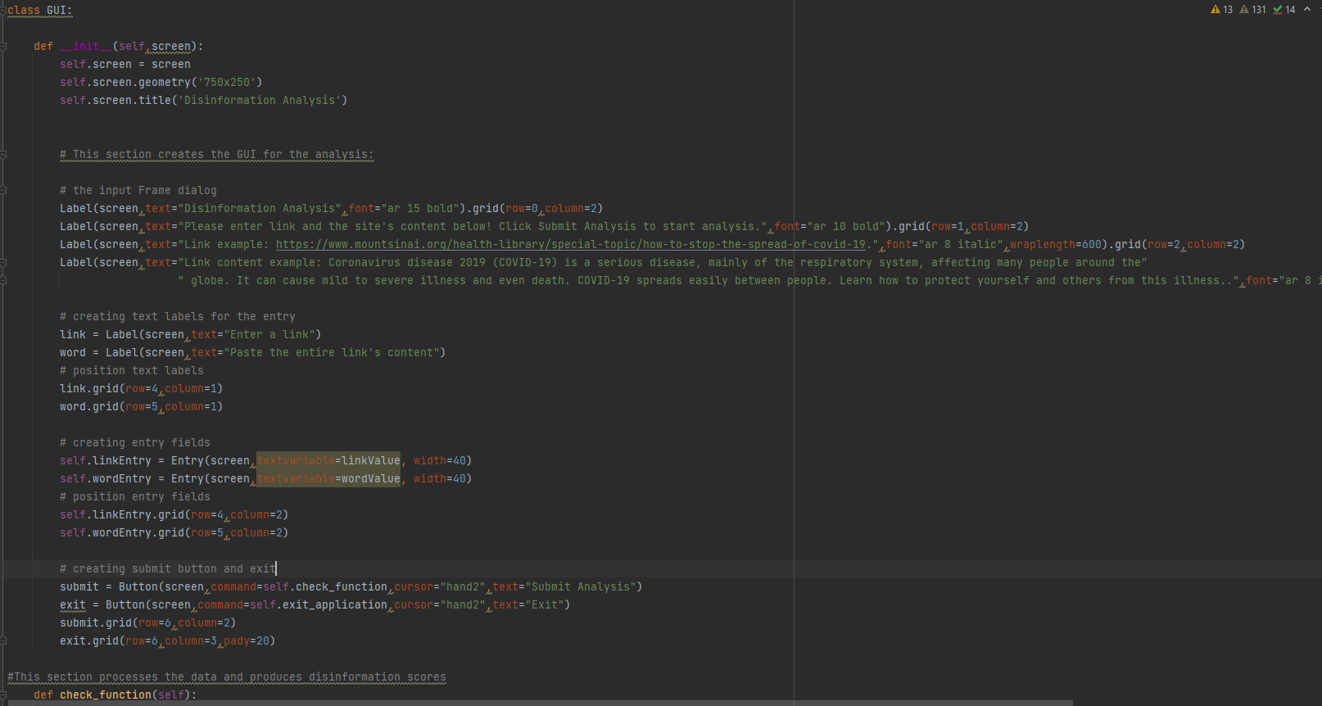


1. INITIALIZE User Interface
User interface requires Tkinter package.
The code begins with a function that creates the user interface.
The code initializes two variables to capture two of the main user inputs: link and the site's content.
Two button actions are created to allow the user to kick-off the program analysis.
Figure 1.0 - User interface code
Notes:
To create the GUI, we utilize a well-known python package called Tkinter (or TK interface) to develop our frontend. Tkinter provides custom commands to create and manipulate GUI widgets – such as creating buttons, text labels, the interface window, and more. For our example, we created a very simple GUI to allow the user to interact with our model. This image shows our entire front end – we created several text labels to provide instructions and examples to the end user. We initialized two variables to capture user inputs, in our case: link and the site's content. We also created buttons for users to initiate the analysis.

Slide 14
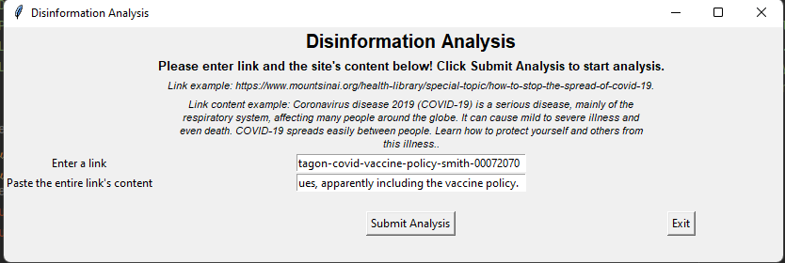
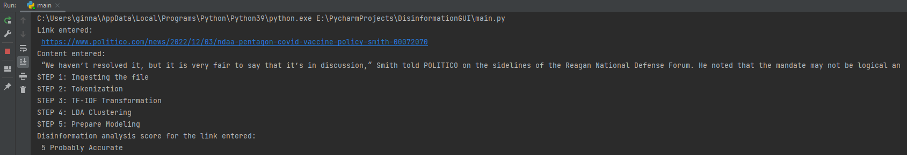
2. REQUEST USER INPUTS
The interface requests user to provide two (2) inputs: link and the site's content. User can provide any link related to COVID19 research or articles and can simply copy and paste the site's content into the text box to evaluate the level of disinformation in the article. When the user clicks "Submit Analysis" the application will process the analysis on the backend from the IDE and project running processes. The application will then produce the final analysis results.
Figure 2.0 - Graphic User Interface for running Disinformation Analysis.
Figure 2.1 - Process status of the running analysis in IDE.
Note: The analysis may take some time to ingest the input and produce results - Please be patient.
Notes:
As noted previously, the interface captures the user's input for a link and the link's content. When a user submits the analysis, this kicks off our analysis piece which we will dive further shortly. Figure 2.1 shows the user the processes running on the backend. This is projected from the IDE that is running the code. The IDE will produce a final analysis - as you can see above, the example shown is indicating a trustworthy with a Misinformation Score of 1 which is a high level of disinformation site based on the content that was entered by the user. Our hope is to allow users to quickly identify misinformation.

Slide 15
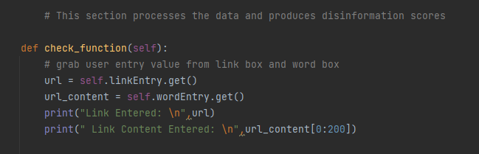
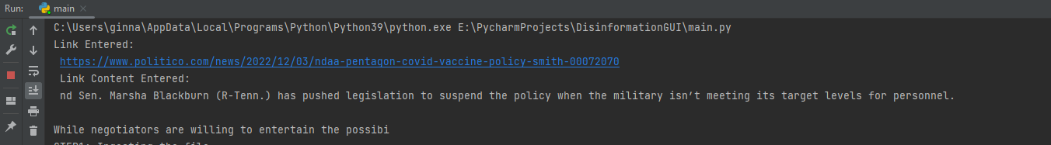
3. Return user inputs to the algorithm module
Program will retrieve the user inputs from the textbox in the GUI and return the values in the IDE to the user before beginning the data processing stage.
Figure 3.0 - code that grabs user inputs and project out the values entered in the IDE (image below)
Notes:
Stage 3 is fairly simple – it is the first step in retrieving the user inputs and projecting the inputs right back out to the user on the IDE before starting the next steps which is the data processing piece. This is so that the user can see the processes happening based on the information that was entered into the GUI.

Slide 16

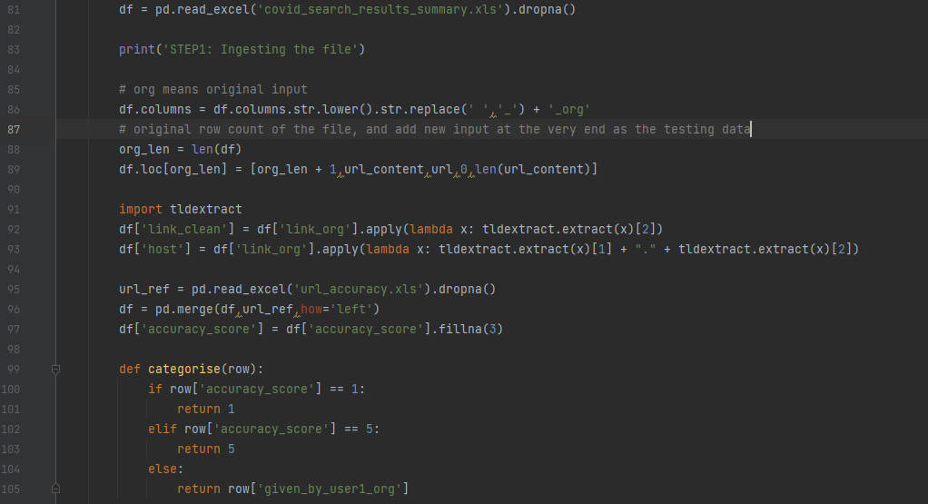

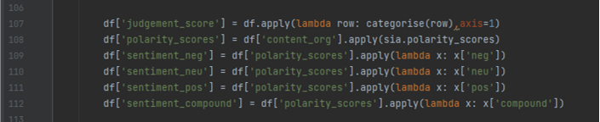
4. Begin data processing and modeling – Cleaning
In this stage, the model begins by processing a file called covid_search_results_summary.xls (training dataset) with about 250 samples of link and link's content. The user's input will be added the last of the list as the training dataset.
The model begins to stem and tokenize the content and transfer it into a matrix of doc * word. Then the model will normalize the value by tf-idf method and filter out words with very low tf-idf weighted values.
The word matrix then merge with url_accuracy.xls. The file carries the consolidated list of ranking of site accuracy from different websites that are specialized in evaluating the transparency and reliability of website.
Finally, we created the sentiment score for negative, positive, and neutral sentiment.
Figure 4.0 - Importing file to ingest test data to generate disinformation scoring after data cleaning along with generating sentiment analysis.
Notes:
The url_accuracy.xls file contains scoring (accuracy_score) for the host on a scale of 1 to 5 with 1 indicating very low levels of trust:
- the accuracy score will be introduced into the final modeling set as a predictor. If the accuracy score is missed for one url, a score 3 will be provided (neutral)
- if the score is 1 or 5, this score will overwrite the human judgement. By doing so, we combine judgment from human and list of authority websites and make sure in our algorithm the reliability of source will be an important predictor, if not the most powerful predictor.

Slide 17
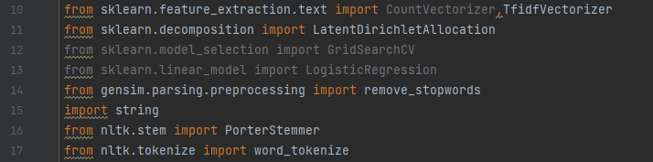
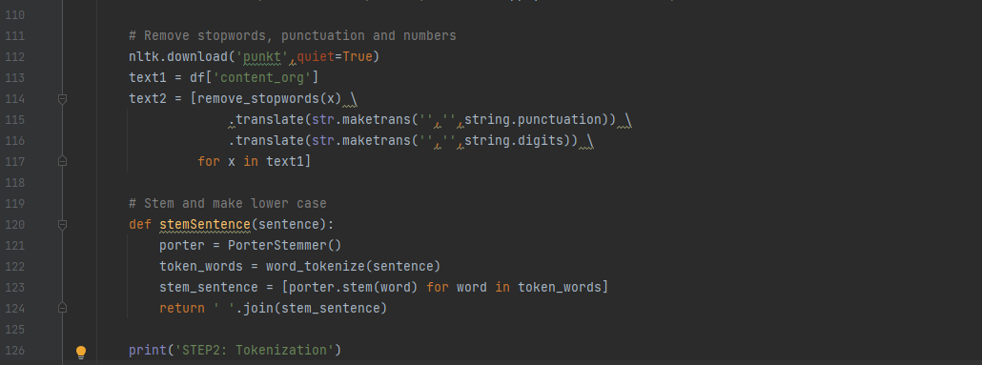
4. BEGIN DATA PROCESSING AND MODELING - tokenization
The code at a high level consists of tokenizing the data to remove punctuation, stop words, non-English and numbers. The analysis is carried out using Natural Language Toolkit (NLTK), which is a popular API (application programming interfaces) for Natural Language Processing (NLP) in Python. NLTK is used for stemming (reduces the number of unique words by analyzing just the stem of a word), and lemmatization (uses context to determine the meaning of a word). See lines 120.
The Python package genism.parsing.preprocessing will help remove stop words in our data to give focus to important words (see lines 112 above).
Figure 4.1 - Performing tokenization using NLTK and additional preprocessing packages from Python.
Notes:
In the second part of our data processing, we used a popular toolkit called Natural Language Toolkit (NLTK) to performed Tokenization to remove any punctuation, non-English and numbers. We also used genism.parsing.preprocessing to remove stop words.

Slide 18
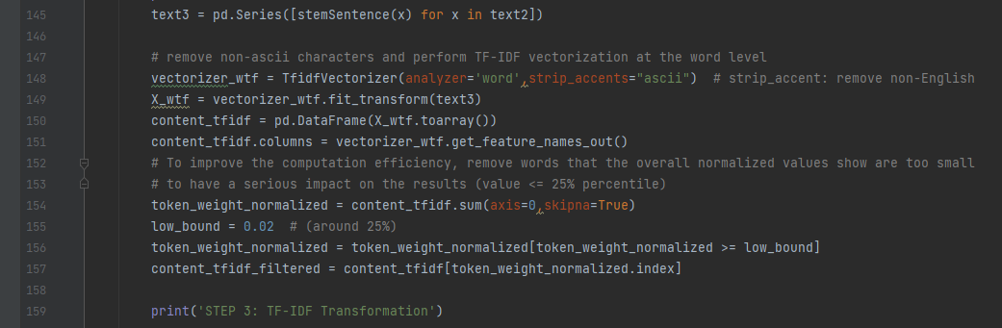


4. BEGIN DATA PROCESSING AND MODELING - TF-IDF TRANSFORMATION
We also remove non-English words from the results, and then perform a normalization of the datasets using TF-IDF methods.
To improve the computation efficiency, we removed words (see lines 155) that the overall normalized values prove to be too small to have a serious impact in results (value <= 25% percentile).
Figure 4.1 - Generating normalized data using TF-IDF.
Notes:
To normalize our data we leverage TF-IDF to evaluate how relevant a word is to a data in our overall collection of data. In order to improve computation efficiency we removed any words with a normalized value that is less than or equal to the 25 percentile since those words have weights that are too small to make an impact in our prediction.

Slide 19
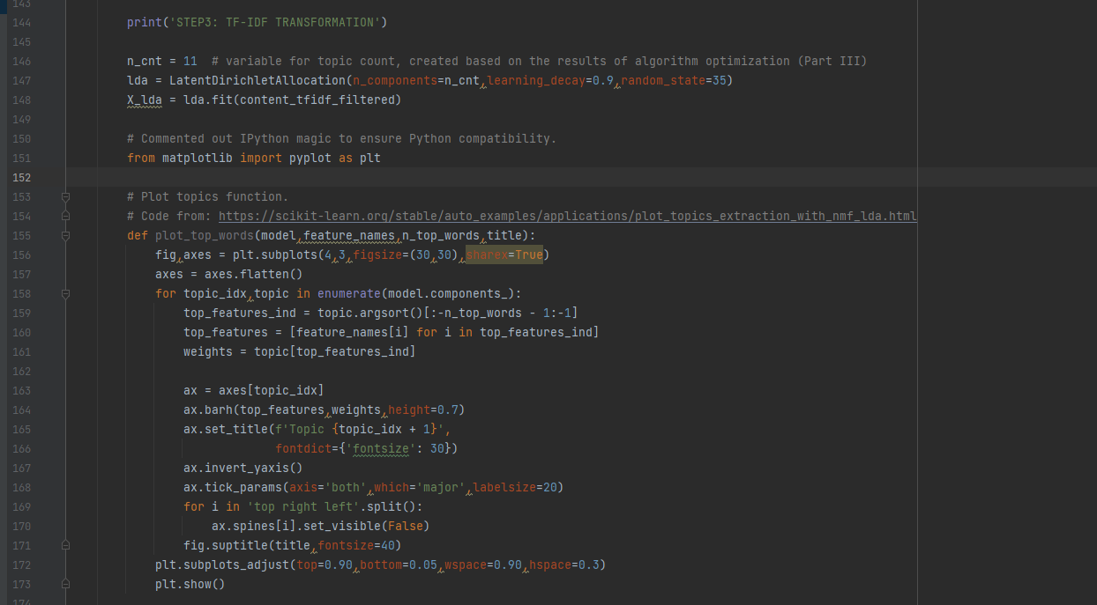
4. BEGIN DATA PROCESSING AND MODELING - LDA Clustering
There are many ways to vectorize or combine features (normalized word weight). Based on our course, there is no absolute method that proves to be the best. We choose Latent Dirichlet Allocation (LDA) which is a generative statistical model that explains a set of observations through unobserved groups, to discover document topics. We choose to use LDA because:
1) we never use it before among the programming assignments; and
2) unlike k-means/tree-based algorithm, LDA is specifically used in natural language processing (NLP).
The function plot_top_words plots the topics obtained from the data set. Each topic is represented as a bar plot using top few words based on weights. This function serves to provide our users a better understanding of our data only (see slide 20 for more details if interested) – please note that this function is not needed to run the program!
Figure 4.2 - Leveraging LDA to vectorize the data
Notes:
Here we are performing LDA clustering to vectorize features – we choose to use LDA as a challenge for our team to increase our general understanding of the modeling methods. It is also one of the most popular topic modeling methods in NLP. The goal of leveraging LDA is to find topics a document belongs to based on the words in it. Essentially, we want to figure out what are the words in each different topics in our dataset. In our example we are using LDA to identify representative words for a topic. We created a function called plot_top_words to project the topics identified along with a set of representative words. Though this function is NOT needed for the model – provided the code here for informational purposes (anyone who is interested in exploring our dataset further can see slide 20 for more explanation)

Slide 20
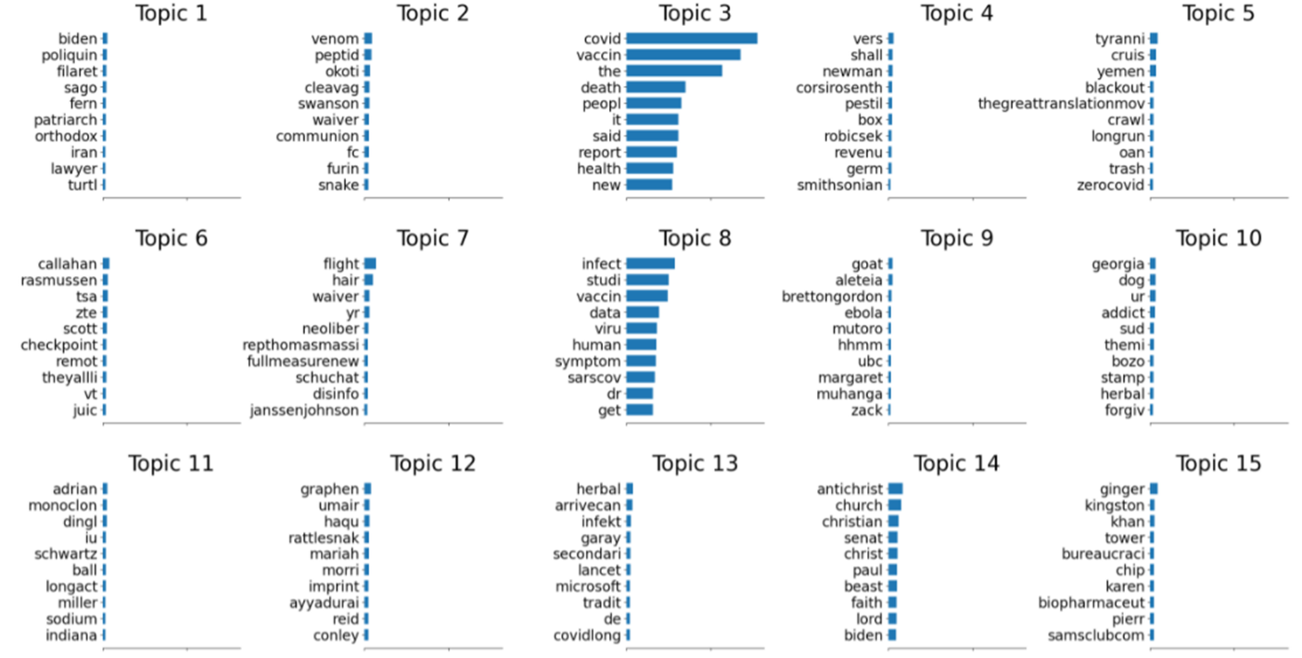
Topics Identified
A representation of the topics identified from the algorithm – COVID related terms are weighted much larger and is represented in the blue bar graph below (larger weight indicates higher chances that the topic is focused on COVID). Based on the charts, we found: Topic-2 is the most dominant one, which covers the general background and most popular topics around COVID (almost like a COVID specific background). Topic10 seem to related to disinformation that tried to falsely claim certain products can prevent covid. Topic 7 and 9 posts COVID related religious content. Finally, Topic 8 focuses on conspiracy theories around COVID. Topic 3 focuses on cruise related/TSA.
Different from the final chosen one in the model, but we want to leave it here so you can compare and see what topics are consistent in both versions.

Slide 21
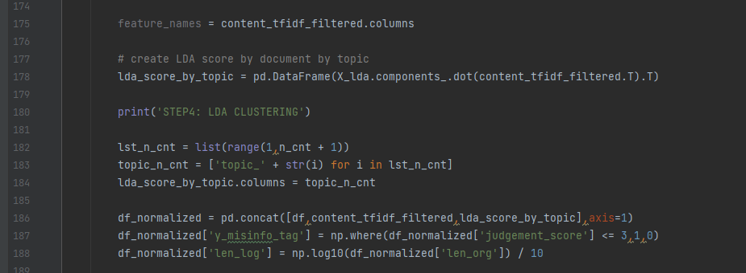
4. BEGIN DATA PROCESSING AND MODELING - LDA CLUSTERING Continue
In this section, we are creating the LDA scores based on document topics obtained from the previous step while normalizing the data using TF-IDF Transformation. We are combining the df data with the topic weights obtained previously. By doing so we are creating the weights of topics as our dependent variables.
Then, we converted the dependent variable into a dummy variable for the logistic regression.
The length of the content is much bigger than the other variables, so we use log-transformation and then divide the number by 10 to make sure it falls within a range comparable to other variables (mostly below 1).
Figure 4.3 - Generating LDA scores.
Notes:
In this section we combined LDA scores with the dataframe data generated from our collection of data to generate topic weights. We applied log-transformation and divided the number by 10 to ensure that the value falls within a comparable range with other variables.

Slide 22
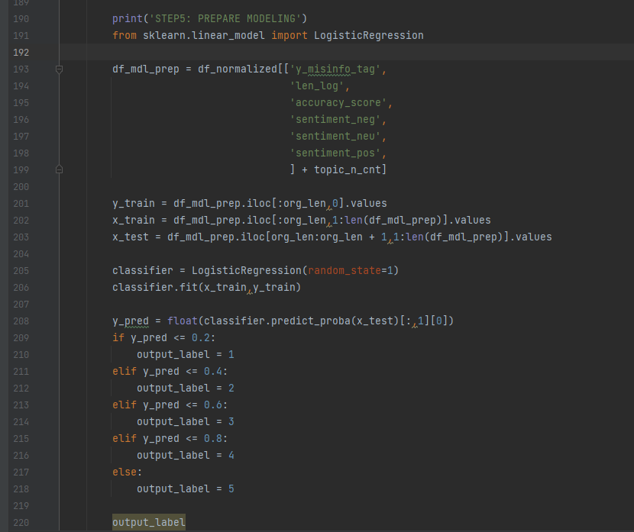
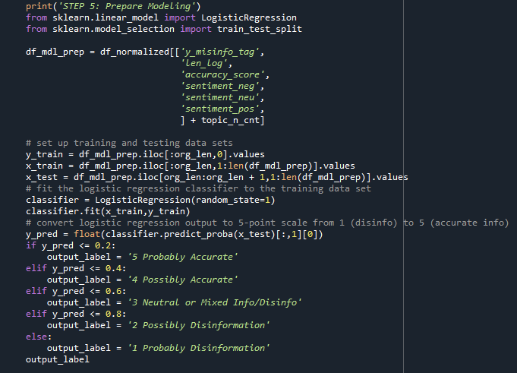
4. BEGIN DATA PROCESSING AND MODELING - Prepare Modeling
In this final piece of the algorithm, we are using sklearn.linear_model for running the logistic regression to train the model.
The original data inputs from the user will serve as the training data: x_train. The y_train will serve as the outputs generated from the model. We incorporated a x_test variable as a testing input data for our model (generated from the user's input).
The y_pred stores the prediction generated from the model as a probability for our implementation to create our scoring for levels of disinformation.
The result produces an output_label variable.
Figure 4.4 - Training the model using logistic regression and assigning scores based on the probabilities produced from the regression model.
Notes:
To prepare for the modeling we used sklearn to run our logistic regression to train the model. Variables generated earlier from the user input will server as our x_train variable. Y_train will serve as our outputs generated from the model. Finally this will generate a y_pred which holds the prediction value generated from the model as a probability for our implementation. We converted the logistic regression output to a 5-point scale from 1 (indicates high level of disinformation) to 5 (accurate information). The result is outputted in the output_label variable.

Slide 23
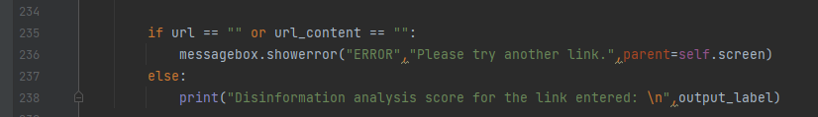
5. Return the prediction results to IDE
Finally, the prediction (the output_label variable) will be printed out on the IDE to show the user the disinformation score (i.e, 2 Probably Disinformation )
Figure 5.0 - print statement for the final analysis.
Figure 5.1 - outputs from the model in the IDE.
Notes:
With the results captured by the variable "output_label", the code will print out the final analysis as a disinformation score. The example shown above indicates the link and link's content entered by the user has a disinformation score of 5 which indicates accurate information is provided by the specific link that user ran the analysis on.

Slide 24
Final outcome
Notes:
Take a pause here to watch the entire application process from start to finish.

Slide 25



challenges
TECHNICAL
TIME
SKILLSETS
Browser extensions are written in JavaScript while the algorithm is written in Python code. This created difficulties integrating the extension and Python codes to process the data.
We can’t normalize the testing text content independently because it will rely on the whole corpus, so for each iteration of prediction, we had to ingest and process all testing dataset, which will decrease the efficiencies of our program.
Search engines incorporate defensive measures to make scraping difficult.
Google recently added countermeasures that remove most disinformation from search results related to COVID. This made it difficult to collect a balanced data set as originally planned for training.
Search engines typically return approximately ten organic results per page. Collecting data from multiple search engine pages (e.g., 200 results from the first 20 search result pages) proved much more complex than expected
The design of the websites are different, so it proves to be very hard to scrape text into organized forms, and impossible within the time available.
As we had to manually collect training data, the dataset is still comparatively small for our purposes. With a much bigger training dataset, our algorithm should be able to provide more accurate results.
Notes:
There were unforeseen challenges in our project that changed our scope. Our initial scraping attempts on Google and Twitter were unsuccessful because the websites blocked our crawlers. In addition, many of the large search engines implemented ways to remove any disinformation content from the search results which made it difficult for our team to collect sufficient data (disinformation and non-disinformation content) for our training sample. Our team had to resort to manual data collection which was extremely time consuming which caused our data set to be relatively small. In order to effectively train a model – we need a much larger set of training data to provide accurate results. Furthermore, our original proposal suggest building an extension from scratch to project the disinformation analysis to our user directly onto a search result page. Extensions are built using JavaScript however, our model was written in Python. This created difficulties integrating the codes to process the data therefore we opted to create an user interface as a workaround. Due to the difficulties of relying of the whole corpus when normalizing the test data, we had to ingest and process the test data at each iteration of prediction which drastically lowers the efficiency of our program.

Slide 26
WORKAROUND FOR THE CHALLENGES
User Interface
Modeling
We ask users to manually input the URL and content of search result
We manually collect a set of search results to provide diverse scores and topics
Web Scraping
We use the most popular UI package for Python, tkinter, to eliminate the problem to connect different languages (e.g.: Python and Java)
We overwrite the judgment from one user with judgments provided by "authorities" websites when the source is identified as highly trustworthy or confirmed source of disinformation
We adjust our testing datasets to teach the algorithm some additional features – for example, the resource of the content is more useful than the length of the content
Notes:
As noted previously as a workaround for the web scrape issue – we manually collected the test data set. Our original idea was to collect as many sample data as possible so that we can project the disinformation scores directly onto a search result. As mentioned earlier we created an user interface to capture user input (this allows us to manually collect some data (not a lot due to effort limitation – we would need more time and individuals to collect a large sample) and seek user input to run the analysis instead of generating millions of disinformation scores against search engine results) and opted away from building an extension.
For our modeling the we overwrite human's judgement with the ones confirmed by "authorities" websites because...
- with so much information available online, we believe it’s becoming harder and harder for ordinary users without expertise in certain domain to be able to tell whether a search result is real or not
- the websites that are dedicated to help evaluate the reliabilities and transparency of websites can be a cure for such information overdose
- by blending the human judgement and "authorities" websites judgement together, we believe we will make our algorithm more efficient and accurate
Given the challenges mentioned and our workaround for resolving the problems we encountered we were still able to produce a working proof-of-concept and we truly hope you enjoy using it.

Slide 27
Team contribution
Overall, we've evenly contributed to this project. We are glad everyone stretched their muscle and really applied what we learned into this project. Yet, everyone had a slightly different focus:
David: Proposed the initial concept, researched what has been done in the field of disinformation detection., and tried to apply class concepts to the project. Diligently kept track of the team’s progress, and vetted both code and data to confirm it worked as intended. Created and incorporated the list of authorities to tag the accuracy of 3400+ websites.
Ginna: had created the initial plug-in in Java, and then heroically crashed a course to learn how to use tkinter within a day to re-write everything. The logistic-master to keep our files in check and organized. She also shot the amazing demo and design the template of our presentation. Last but not least, Ginna is the glue of the team and a great cheerleader.
Angela: thanks to her background as data scientist, she was able to help the project on track and drove it to completion. She has manually created the testing dataset after our initial crawler didn't work out. She also helped to write most of the analytics module and figured out how to incorporate everyone's work together.
~~~~~~~~~~~~~~ Remember: it's always the journey, not the destination ~~~~~~~~~~~~~~~~~~
Notes:
[Read the slide]

Slide 28

Thank You
Please reach out to our team for further inquiries.
Emails:
David Burris - (DBURRUS3@ILLINOIS.EDU)
Jianci (ANGELA) zHAI - (jianciz2@illinois.edu)
GINNA wOO - (GINNAW2@ILLINOIS.EDU)

