Slide 1

Brad Harbans Rathish Parayil Sasidharan Vic Chan Dmitriy Burtsev
Team One
CUNY SPS 607 Project 3

Slide 2
2020 Kaggle Machine Learning & Data Science Survey
We set out to conduct an industry-wide survey that presents a truly comprehensive view of the state of data science and machine learning. The survey was live for 3.5 weeks in October, and after cleaning the data we finished with 20,036 responses!
In the survey 39 questions were asked. Many of the survey questions are relevant to answering, “What is the most valued data science skills.”
The challenge objective: tell a data story about a subset of the data science community represented in this survey, through a combination of both narrative text and data exploration.

Slide 3
What is GitHub?
GitHub is a code hosting platform for version control and collaboration. It lets you and others work together on projects from anywhere.
A repository is usually used to organize a single project. Repositories can contain folders and files, images, videos, spreadsheets, and data sets – anything your project needs.
On GitHub, saved changes are called commits. Each commit has an associated commit message, which is a description explaining why a particular change was made.
Pull Requests are the heart of collaboration on GitHub. When you open a pull request, you’re proposing your changes and requesting that someone review and pull in your contribution and merge them into their branch.

Slide 4
Amazon Relational Database Service (RDS)
Amazon Relational Database Service (Amazon RDS) makes it easy to set up, operate, and scale a relational database in the cloud. It provides cost-efficient and resizable capacity while automating time-consuming administration tasks such as hardware provisioning, database setup, patching and backups. It frees you to focus on your applications.
Amazon RDS is available on several database instance types - optimized for memory, performance or I/O - and provides you with six familiar database engines to choose from, including Amazon Aurora, PostgreSQL, MySQL, MariaDB, Oracle Database, and SQL Server.

Slide 5
MySQL Database
MySQL is an open-source relational database management system (RDBMS).
Its name is a combination of "My", the name of co-founder Michael Widenius's daughter, and "SQL", the abbreviation for Structured Query Language.
MySQL is free and open-source software under the terms of the GNU General Public License, and is also available under a variety of proprietary licenses.
MySQL is used by many database-driven web applications, including Drupal, Joomla, phpBB, and WordPress. MySQL is also used by many popular websites, including Facebook, Flickr, MediaWiki, Twitter, and YouTube.

Slide 6
Slack communication platform
"Searchable Log of All Conversation and Knowledge" is a backronym for "Slack"
Slack offers many Internet Relay Chat(IRC)-style features, including persistent chat rooms (channels) organized by topic, private groups, and direct messaging. Content, including files, conversations, and people, is all searchable within Slack. Users can add emoji buttons to their messages, on which other users can then click to express their reactions to messages.
8,000 customers signed up for the service within 24 hours of its launch in August 2013. At the time of its S-1 filing for IPO, dated April 26, 2019, Slack reported more than 10 million daily active users from more than 600,000 organizations, located in more than 150 countries.
Slack has been criticized for a retroactive 2018 change to their privacy policy, allowing access to all public and private chat messages by workspace administrators, without the need of consent from any parties using the app.

Slide 7
RStudio
RStudio is an integrated development environment (IDE) for R, a programming language for statistical computing and graphics. It is available in two formats: RStudio Desktop is a regular desktop application while RStudio Server runs on a remote server and allows accessing RStudio using a web browser.
CUNY School of Professional Studies provide RStudio Server at rstudio.sps.cuny.edu/
The RStudio IDE is available with the GNU Affero General Public License version 3. The AGPL v3 is an open source license that guarantees the freedom to share the code.
RStudio Desktop and RStudio Server are both available in free and fee-based (commercial) editions. OS support depends on the format/edition of the IDE. Prepackaged distributions of RStudio Desktop are available for Windows, macOS, and Linux.

Slide 8
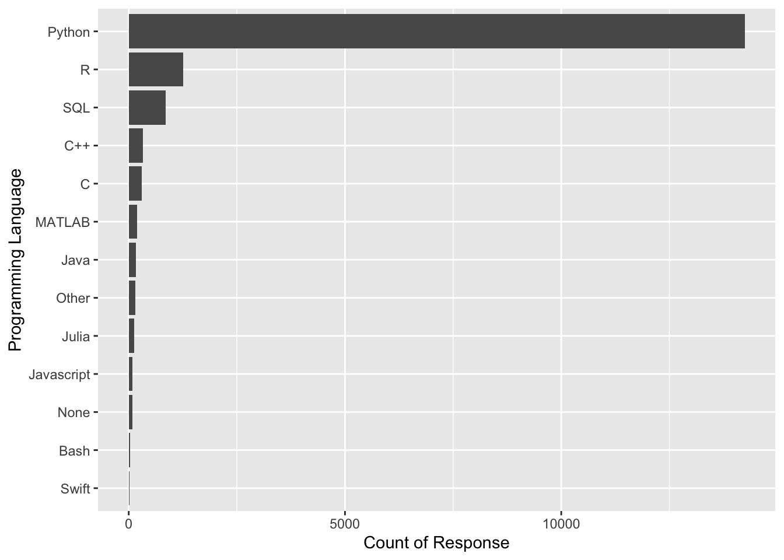
Analysis 1 Programming Languages
In the survey it asked Data Scientist “what programming language do you use on a daily basis,” and “what programming language would you recommend an aspiring data scientist to learn.” We will be looking at the responses and seeing what are the top programming languages data scientist should learn.
We can see that Python is what Data Scientist would recommend by a long margin following by R. One interesting thing to look at is the trend overtime and if python is becoming the default standard in Data Science.

Slide 9
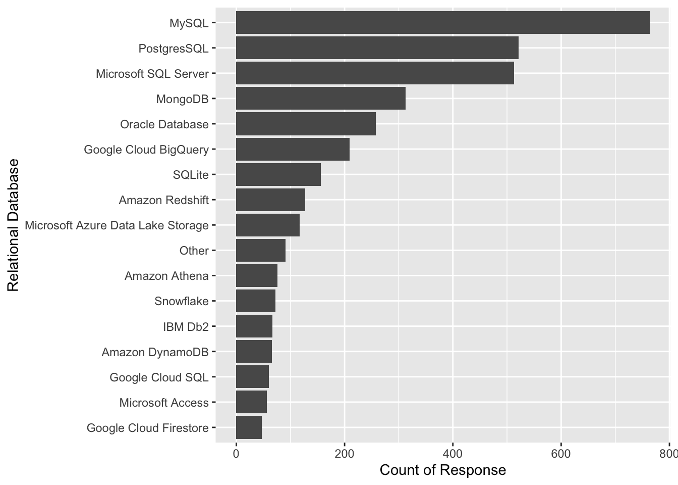
Analysis 2: Database
Another skill that is used a lot by Data Scientist is management and querying of relational databases. It is important to be able to quickly and efficiently get the data that is stored in the server for models and analysis.
We can see that MySQL is the post popular followed by Postgres and Microsoft SQL. While a lot of SQL is very similar to one another they all have their own variations and functions which can make it difficult if someone is looking to switch to another SQL variant.

Slide 10
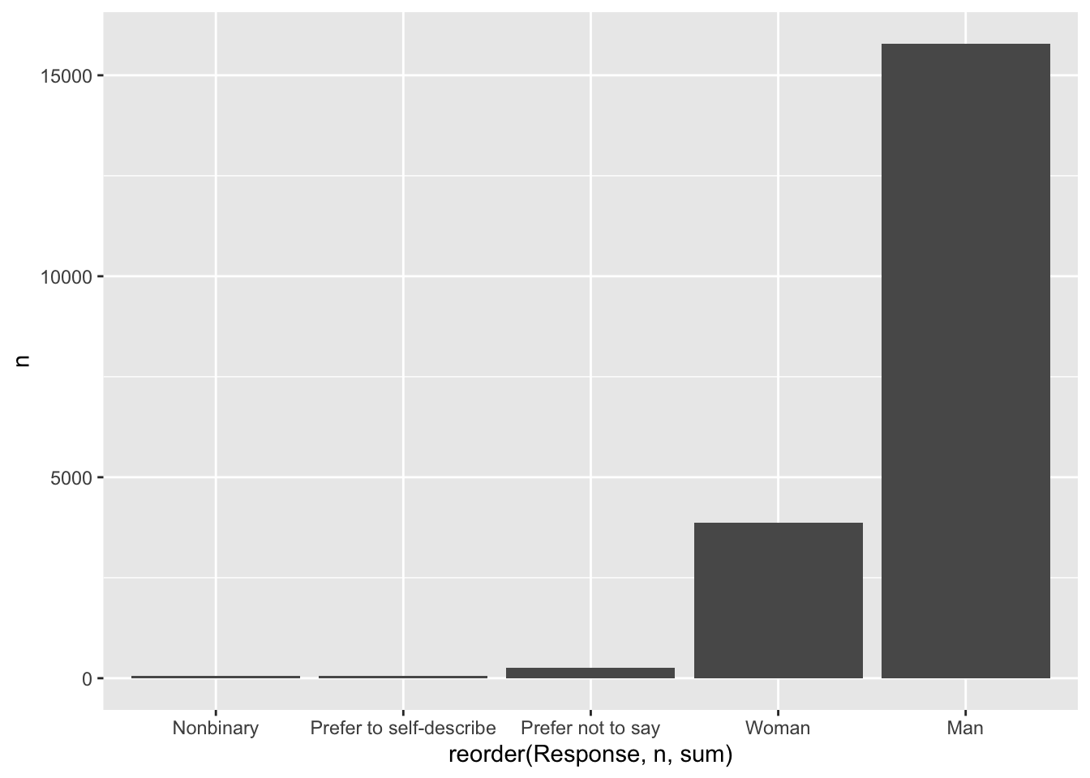
Analysis 3: Age and Gender
Question 1 asked what is the respondent age. I would like so see what is the age distribution of Data Scientist since this is a very new field that has only recently emerged.
We can see that most Data Scientist are between 18 - 39 in this Kaggle Survey. I would like to know if this sample of data truly represents the population or if this data set has bias with only younger people participating in this survey.

Slide 11
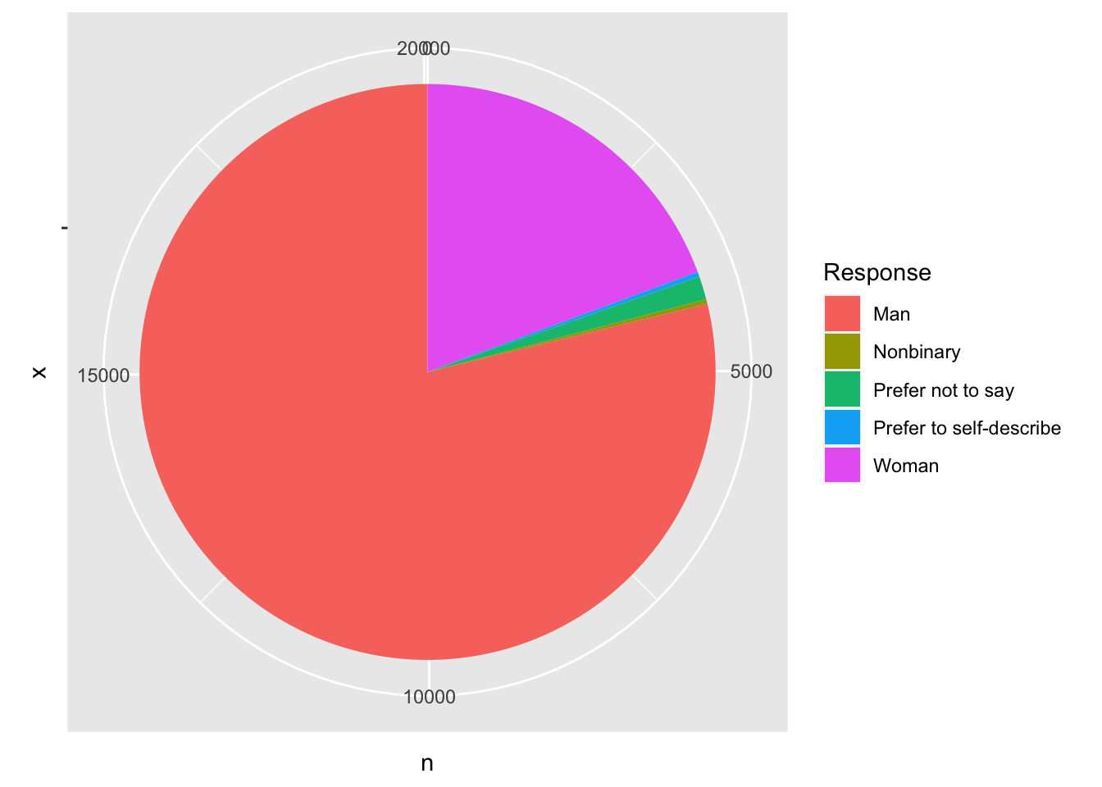
Analysis 3: Age and Gender
We can also see that Men are dominating the field of data science with only women making up less than 25% of data scientists.

Slide 12
Conclusion
The field of data science is a rapidly growing field and the tools that data scientist are using are constantly evolving. We can see the growth in popularity of data scientist using python now instead of R with almost 80% of data scientist saying that they use or would recommend people to use python. On the other hand for relational databases we can see that MySQL is still the most popular relational database used. But for SQL based languages they are all very similar using the same base syntax. One thing that was not surprising though was that the age group for data scientist is very young with a majority of it being male. It would be interesting to see how this changes over time and if more females will join the field of data science

