Slide 1
DevOps Final Project
Chatter
Ravi Kumar Pilla
Dinakara Sai Santosh Burugupalli
Priyam Mukund Modi

Slide 2
Introduction
· Token based authentication for user Sign in and Sign up
· Web application where user can tweet and see the recent tweet from all other users.
· User can comment and like the tweet and view tweets posted by others.
· Ability to delete offensive tweets before any user can see them.
· Ability to deploy front-end as a PWA so that it can run on devices

Slide 3
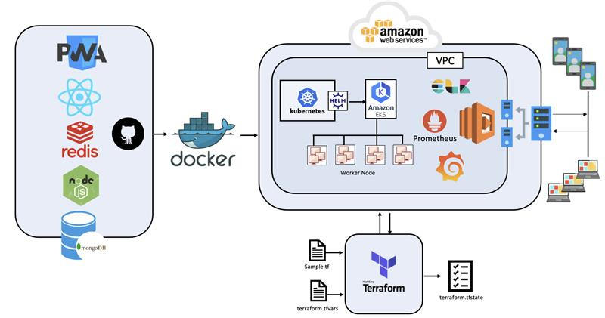
Project Architecture
Frontend - React, PWS
Middleware - Redis
Backend - Nodejs, MongoDB
Docker
Kubernetes
Helm Chart
Prometheus
Grafana
ELK
Terraform
ELB

Slide 4
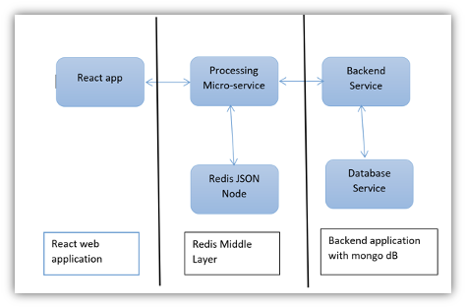
Application Architecture
React Application Process to the Middleware i.e Redis JSON
All the request are clustered in the Middleware
After every interval it is transferred to the Backend Server
The Redis JSON is connected to the backend Node JS server
Node JS Relates to MongoDB
User information is stored to the MongoDB for future interacations

Slide 5

Front End
The frontend application is created in React, which enables the application to run on both Mobile and Web App.
Login page
Sign Up page for new user
Home page
Comment and Like functionality
Token Based Authentication

Slide 6
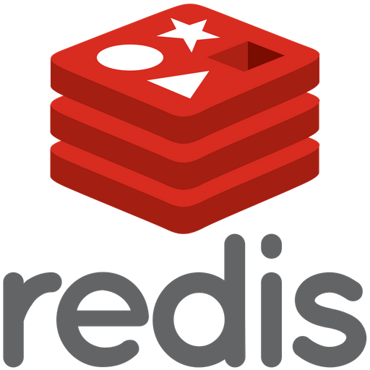
Middleware
The Redis server will act as the middleware for the application.
All the request from the frontend will be forwarded to the Redis server
The Set interval method is used to queue the api calls
All the call will be forwarded to the Node Server at the fixed Interval

Slide 7

Back End
All the requests from the Redis JSON is forwarded to the Node JS Servers
The Server Controllers API contains the Tweet methods for creating and displaying tweets, adding comments to the tweet, adding like to the tweet
The Server Model API contains the Schema of the tweet and user data.
The Route services API contains the routes through which the data will be communicated between frontend and backend.

Slide 8
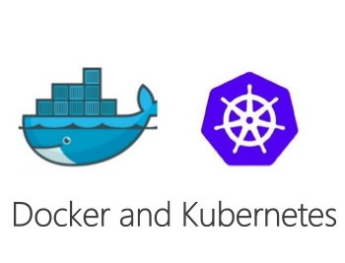
Infrastructure
Docker
All the layers are separately containerized in the Docker Container.
The Docker containers are further deployed as the Kubernetes pods.
Kubernetes
The Kubernetes pods are deployed on the AWS EKS using the Terraform.

Slide 9
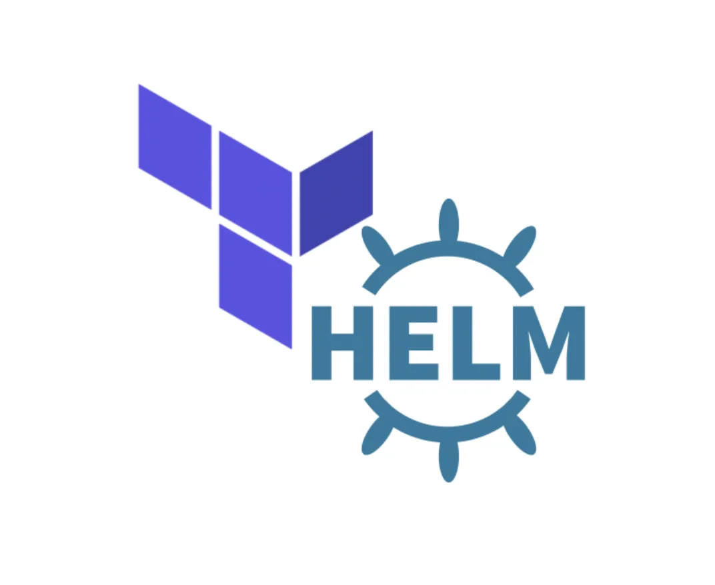
Infrastructure
Helm Chart
Helm is a package Manager for Kubernetes.
They provide a standard, opinionated way to install, configure, upgrade, and run an application in a matter of minutes
Terraform
Terraform is a tool for building, changing, and versioning infrastructure safely and efficiently.
Terraform can manage existing and popular service providers as well as custom in-house solutions.

Slide 10

Infrastructure
Ingress
Kubernetes ingress is a collection of routing rules that govern how external users access services running in a Kubernetes cluster
Implemented Ingress resource configuration for external users service
Prometheus
The Prometheus server is connected to the AWS to track down the request load on the server

Slide 11
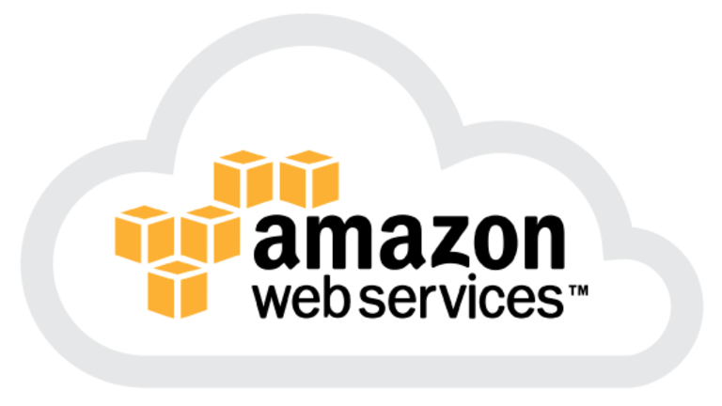

Infrastructure
AWS ELB
All the incoming requests from the client are load balanced on the AWS using the ELB service of the AWS.
Grafana
Metrics are displayed using Grafana dashboard
Pod autoscaling based on number of client requests.
Custom metrics using service monitor and Prometheus client.

Slide 12


