Slide 1

Leadership Under Pressure: Making Decisions When It’s Not Clean

Slide 2
Core idea: Leadership isn’t about perfect situations—it’s about acting when things are messy.
Real examples (missed deadlines, poor performance, conflict)
How do you separate facts vs emotion?
When to act vs when to wait?
Owning decisions even when unpopular? Schedules
Leadership is not about being liked—it’s about being responsible.

Slide 3
A Situation I Had to Lead Through
Missed deadlines / resistance / conflict
What was at risk (mission, team, reputation)
Why it wasn’t straightforward
There is no perfect answer—only a decision.

Slide 4
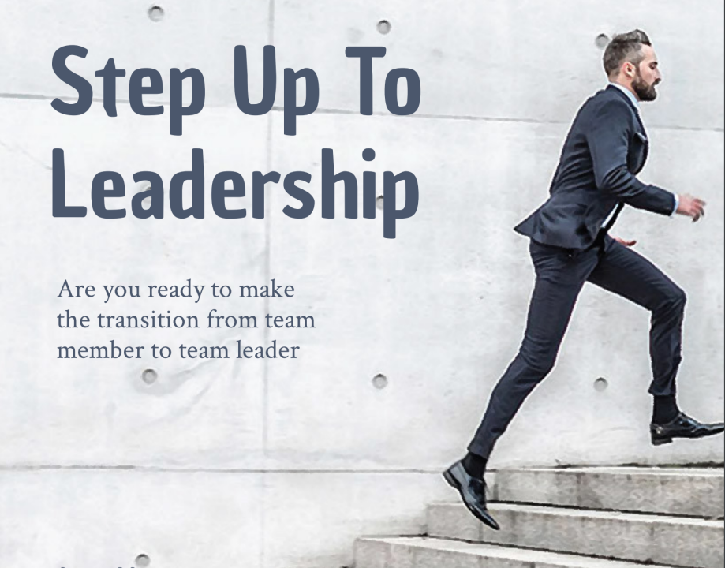
From Individual Contributor to Leader: The Shift That Most People Miss

Slide 5
Core idea: What got you promoted will NOT make you a good leader.
What you cover:
Doing the work vs getting work done through others
Letting go of control
Delegation vs micromanagement
Trust and accountability
If you’re still doing everything yourself, you’re not leading—you’re bottlenecking.

Slide 6
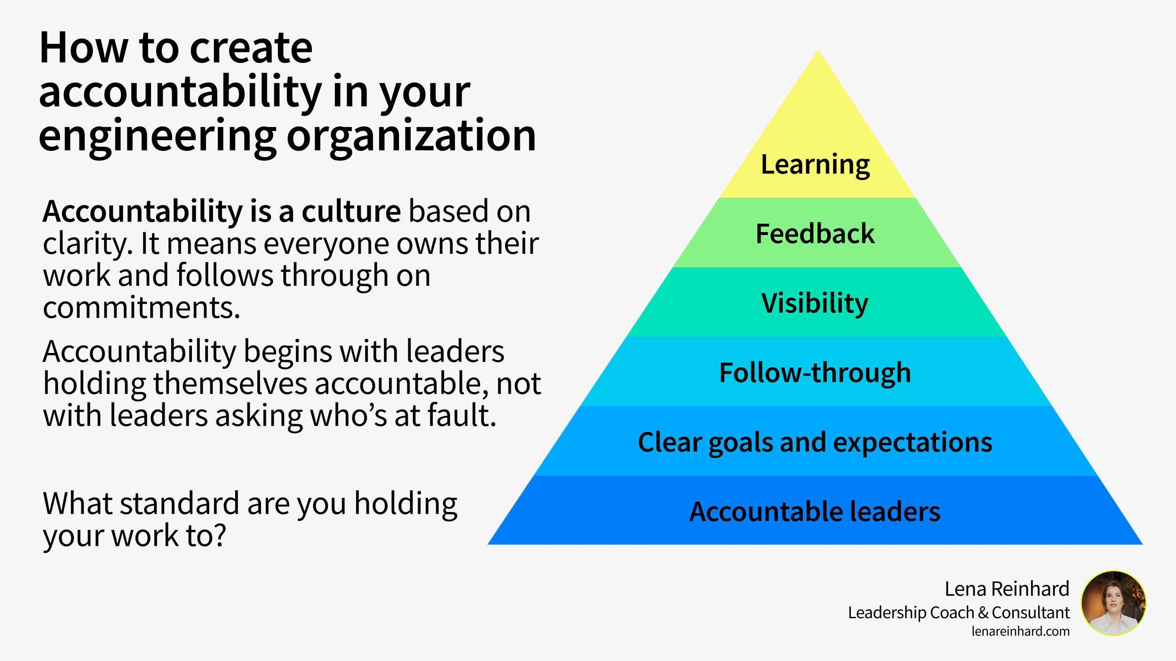
Accountability: The One Trait That Separates Leaders from Everyone Else”

Slide 7
Most people avoid accountability—leaders don’t.
Setting clear expectations
Following through (even when uncomfortable)
Difference between coaching vs discipline
Why inconsistency destroys teams
What you tolerate becomes your standard.

Slide 8
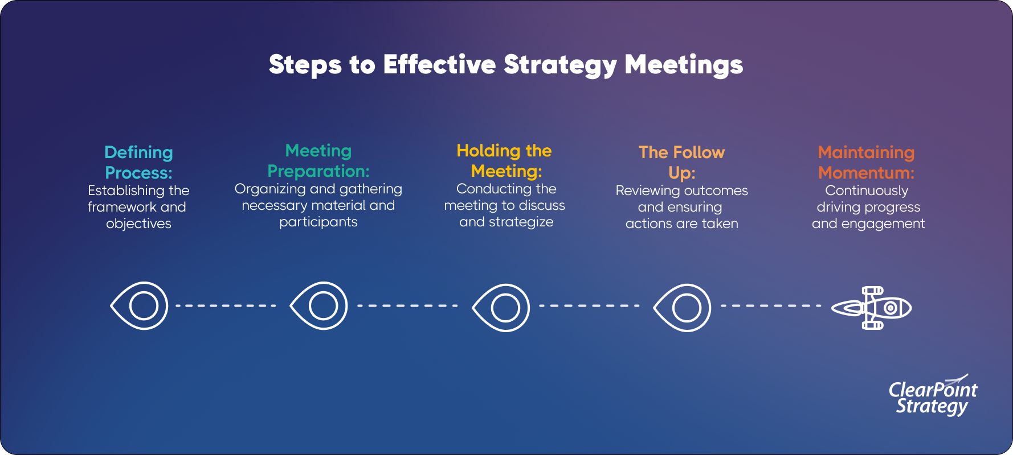
Building a High-Performance Team (Even When You Don’t Have Enough People)

Slide 9
You don’t need perfect resources to lead effectively.
Prioritization when understaffed
Protecting your best people
Eliminating low-value work
Creating momentum despite constraints
You don’t rise to the level of your resources—you rise to the level of your leadership.

Slide 10

Career Strategy: How to Position Yourself for Leadership Roles Early

Slide 11
What Happens When You Don’t Enforce Standards
One missed expectation → becomes a pattern
Others notice immediately
Your credibility drops—not theirs

Slide 12
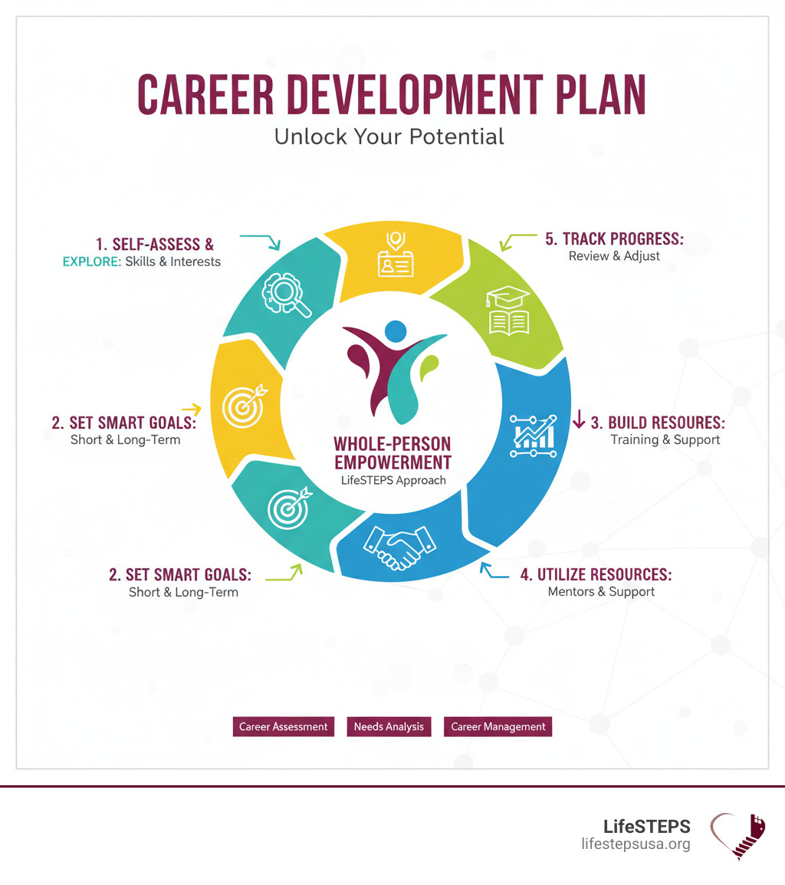

Slide 13
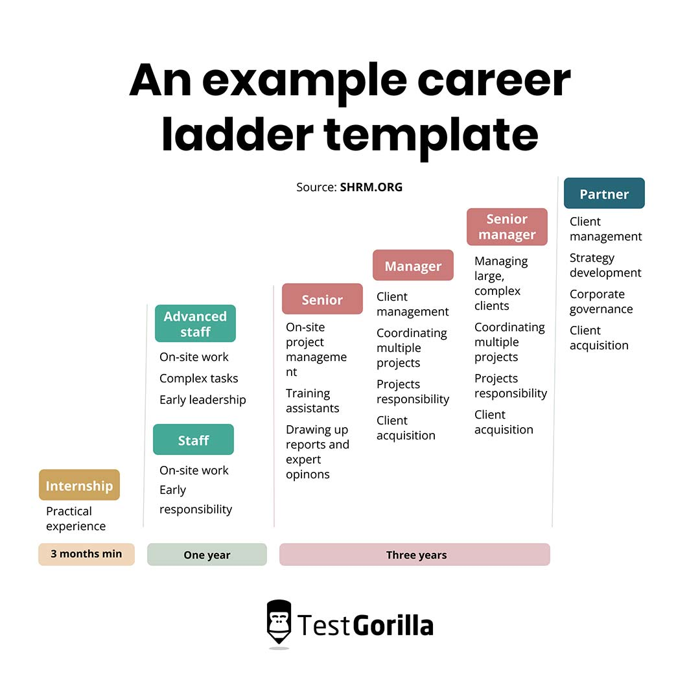

Slide 14
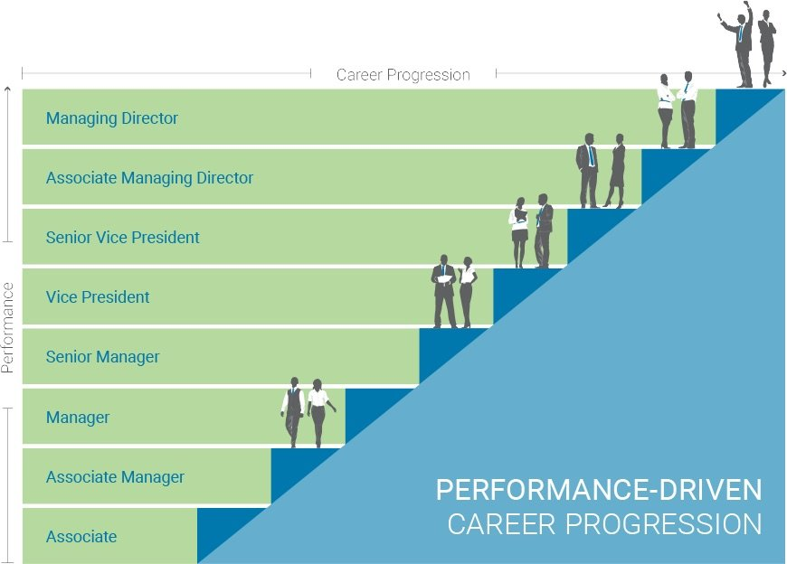

Slide 15
Leadership starts long before the title.
Visibility vs just doing your job
Taking ownership early
Building relationships strategically
Saying yes to the right opportunities
Your career doesn’t move because you work hard—it moves because you position yourself.

Slide 16
How I Make Decisions When It’s Not Clean
Facts vs narratives
Mission vs personality
Short-term discomfort vs long-term standard
Act vs delay (what happens if I do nothing?)

Slide 17
What Weak Leadership Looks Like
Avoids hard conversations
Changes standards depending on the person
Let’s deadlines slide
Tries to be liked instead of respected
Most leadership failure isn’t lack of knowledge—it’s avoidance.

Slide 18
Your First Leadership Test Will Look Like This
A peer not pulling their weight
A group project going sideways
A boss avoiding decisions
Being asked to step up when no one else will
Leadership doesn’t start when you get a title—it starts when you act.

Slide 19
Reality of Leadership Roles
Most leaders are promoted too early
Most avoid conflict
Most teams fail due to people issues—not technical ones

Slide 20
Final Thoughts
You will be tested as a leader long before you’re ready.
In those moments, people won’t remember what you said they’ll remember what you allowed.

