Slide 1
Feasibility Study Opinion
Group 1

Slide 2

Good Idea … In Theory
Pros:
More gym and aquatic space
Tourist attraction
Athletic tournaments
Jobs
Cons:
Cost
Constant losses
Tax increase
Time for construction
Location uncertainty
Maintenance
Competition between other gyms

Slide 3
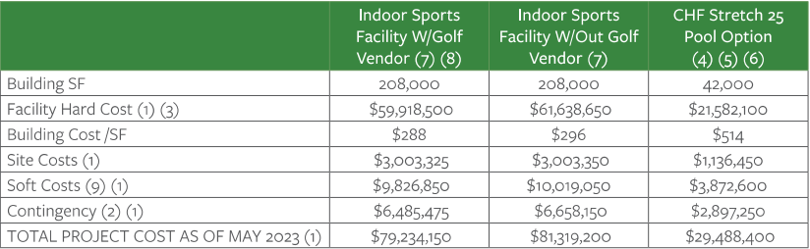
Facility Options

Slide 4
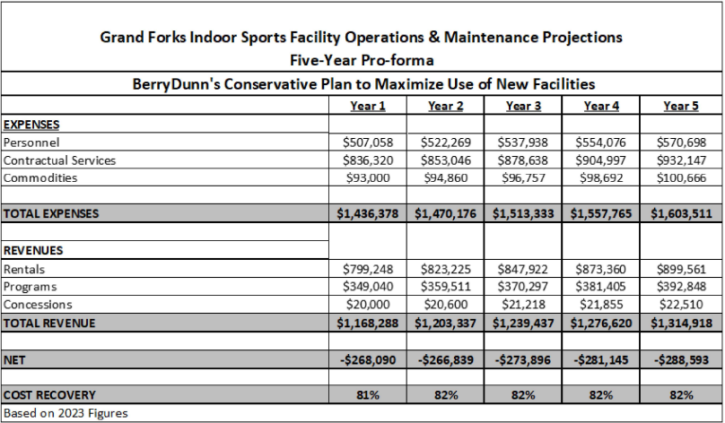

Slide 5
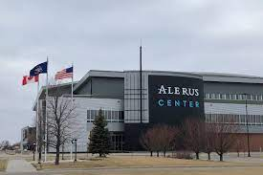
Funding
Alerus Center 0.75% sales tax extension for the next 30 years
Increase property tax
Regional and athletic events
Grant funding

Slide 6
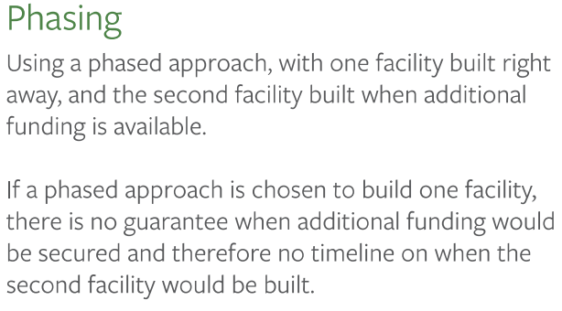
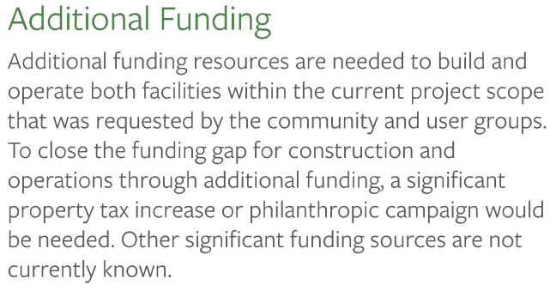
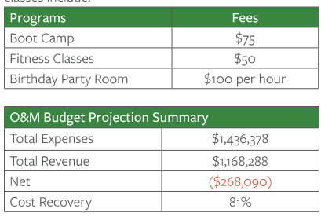
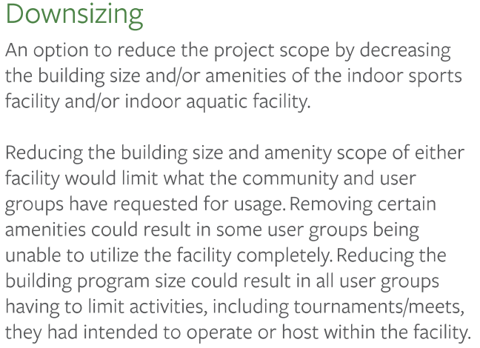
Funding Uncertainty???

Slide 7
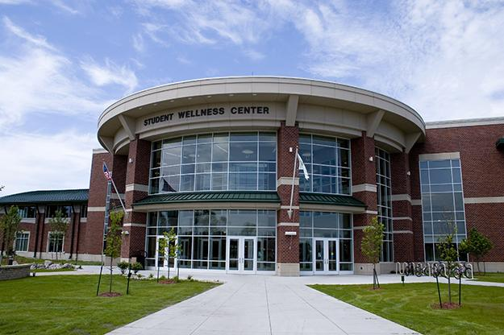
Existing Facilities
Choice Health & Fitness
Grand Forks YMCA
Anytime Fitness
Planet Fitness
Ironworks Gym
Orangetheory Fitness
CrossFit Tundra
MAP Fitness
University of North Dakota's Wellness Center
**Total of 19 Gyms**

Slide 8

Demographics
– UND Student Population = 13,876
23.6 % of total population
– Grand Forks Population aged 1-18 = 14,907
25.4 % of total population
Total Student Population = 28,783
Grand Forks Population = 58,692
49 % of total population
(Neilsburg.com)

Slide 9
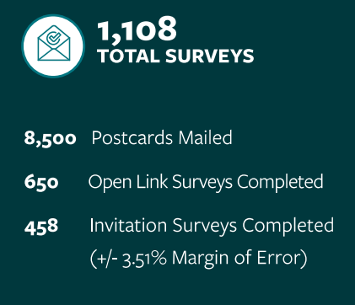
Is There a Demand For This?
1.9 % of Grand Forks Total Population Voted
87 % of people that were invited to the survey did not complete it

