Slide 1
Market Research

Slide 2
What is Market Research?
Market research is the process of gathering, analyzing, and interpreting information about a market, including its potential customers, competitors, and overall industry. The goal of market research is to provide businesses with insights and data that can help them make informed decisions about their products, services, marketing strategies, and overall business operations.

Slide 3
Why am I talking about Market Research
In many communication scenarios you will have to conduct market research to know the product/customer/client etc. ¡! ¡

Slide 4
Two Main types of Market Research
Primary Research: This involves collecting new data directly from potential customers, competitors, or other relevant sources. Primary research methods include surveys, interviews, observations, and focus groups. It provides specific and tailored information that is directly related to the research objectives.

Slide 5
Two Main types of Market Research
Secondary Research: This involves analyzing existing data that has been collected by someone else, such as government agencies, industry associations, market reports, and academic research. Secondary research helps to gain a broader understanding of the market landscape and can be a cost-effective way to gather information.

Slide 6
What purpose does market research have?
1) Identify opportunities
2) Assessing demand
3) Understanding Competition
4) Making informed decisions
5) Minimizing risks
6) Evaluating marketing effectiveness

Slide 7
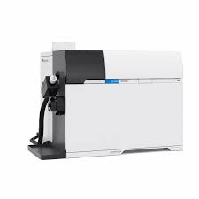
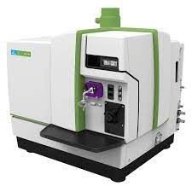
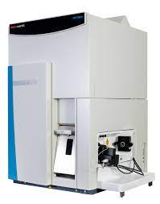
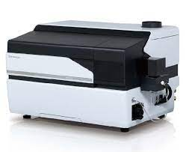
We could talk about ICP-MS manufacturers

Slide 8
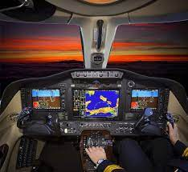

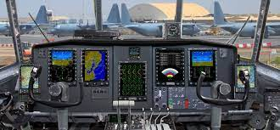
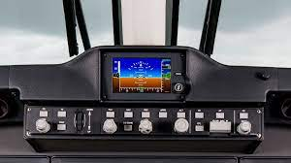
We could talk about market research as it pertains to aircraft navigation systems

Slide 9





This could be applied to salaries

Slide 10

I am thinking outside the box here!!

Slide 11
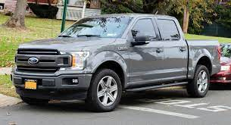
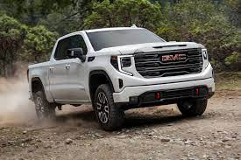
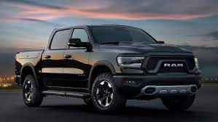
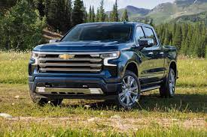
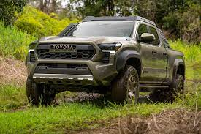
So, what I think could be relatable to everyone would be a vehicle

Slide 12
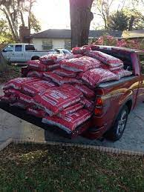
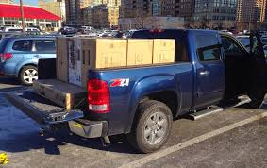
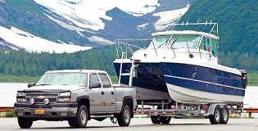
Let’s say we are in the market to purchase a vehicle for the organization we either own or work for.
Let’s imagine that we need to purchase a truck
.

Slide 13
Some stipulations
Brand new vehicle
Crew cab – think about hauling around 3-4 people at a time
Towing capacity 15,000 lbs.
Fictitious incentive if the truck is at least 70% manufactured in America. Incentive is 15k.
Truck to get at least 20 mpg /city/highway to keep the incentive
Budget of $90,000
Please think about safety features!

Slide 14
Where to conduct market research
Some examples:
Manufacturers website:
Cars.com
Cargurus.com
Caredge.com

Slide 15
What to include
Charts
Graphs
MSRP stickers
Screenshots
Tables
ETC.

Slide 16
The end!
The assignment details along with student examples can be found in Blackboard.

