Slide 1

ContractOS
AI-Powered Contract & Payroll Intelligence
for Oracle Game Studio
Daria Bystrova & Julian Granados · SilverTrust · Pitch to Review Board
01 Client & Problem
02 The Solution
03 Compliance
04 Monitoring
05 The Ask
ih

Slide 2
Our Recommendation
OVERVIEW
Oracle's burn crisis is a cost visibility problem — ContractOS solves it with five AI agents that read every contract, catch every invoice error, and show exactly where the money is going.
Three supporting arguments
01
02
03
The problem is real
The solution is defensible
The system is observable
9 pain points discovered blind. Revenue side cannot be fixed. Only lever is cost.
5 AI agents, one per capability. Human-in-the-loop technically enforced. EU AI Act minimal/limited risk.
LangSmith live — 6 runs complete, all 5 agents traced, PII redacted, full audit trail for regulators.
2

Slide 3
Oracle has no visibility over where the money goes
Discovered blind — 10 indirect questions, 0 direct pain-point asks
01 CLIENT & PROBLEM
900 people · 5 jurisdictions · high burn · no contract register · no single cost view.
CEO / CTO: Eugen
Pain points uncovered
CFO: Thibaud
No contract visibility — 900 contracts unread
Wrong invoicing — amounts not matching contracts
Size: ~900 FTEs, part-time, contractors, interns
Lost contractors — duplicate or inactive payments
Countries: Russia · India · Pakistan · Bangladesh · Philippines
Paying twice — contractor = internal role scope
Revenue: B2C games, one-time purchase, no subscriptions
No cost visibility — burn untraceable by category
Lever: Revenue side is structurally fixed — only cost can move
Multi-country payroll bottleneck + intermediaries
Compliance unknown — asked unprompted
IP at risk — ambiguous contractor IP clauses
ih

Slide 4
Every pain point was earned through indirect questioning
01 DISCOVERY EVIDENCE
No direct asks. These verbatim quotes from the transcript confirm the problem is real.
Eugen "I cannot really tell you what kind of tools we're using... people just want a tool and then we give it to them." → Zero cost visibility
Thibaud "The stack is absolutely a mess. Wrong invoicing, pay cycles. There are a lot of problems." → Core pain confirmed
Thibaud "We kind of lost track of all the subcontractors we have and we're working with." → Duplicate payments likely
Both "Are we actually compliant by doing what we are doing?" — asked unprompted. → Compliance anxiety real
ih

Slide 5
ContractOS — five agents, one per capability, zero automated decisions
02 THE SOLUTION
One interface. Five AI agents orchestrated by LangGraph. Every output goes to a human before any action.
1
2
3
4
5
Contract
Intelligence
Invoice
Validation
Overlap
Detection
Compliance
Flagging
Cost
Categorisation
Agent 1
Agent 2
Agent 3
Agent 4
Agent 5
LLM ingests contract documents.
Structured extraction prompt returns JSON: name, role, rate, currency, jurisdiction, notice period, IP clause status, GDPR clause status, working arrangement description.
Output stored in Contract Register DB.
LLM reads incoming invoice text and compares it against extracted contract terms.
Flags discrepancies in amount, currency, scope, and billing period.
Output: validated / flagged + specific mismatch detail.
LLM compares contractor working arrangement descriptions against internal job role descriptions using semantic similarity.
Flags pairs where scope overlap exceeds threshold.
Output: overlap alert with contractor name, internal role, estimated duplicate cost.
LLM checks extracted contract data against jurisdiction-specific rule sets: GDPR clause presence, IP assignment clarity, misclassification indicators, notice period minimums. Output: Red / Amber / Green status + specific flags per contract.
LLM normalises ambiguous spend descriptions and categorises all payments by country, contract type, team, and intermediary.
Plain software aggregates and renders the dashboard.
Output: categorised cost register + burn trend.
h
⚠ Human approves every flag before any payment is sent or any contractor is reclassified — this is technically enforced, not just policy.

Slide 6
AI only where language understanding is required — everything else is plain software
02 AI vs SOFTWARE
This boundary is what keeps the system auditable, maintainable, and cost-efficient.
Needs LLM reasoning
Plain software sufficient
◆ Extracting data from unstructured multilingual contract templates
○ Structured database storage of extracted fields
◆ Semantic overlap: contractor scope vs internal job role descriptions
○ Cost dashboard charts and aggregation
◆ Misclassification risk from natural language working arrangements
○ Payment routing via Wise API or local rails
◆ Missing clause detection using jurisdiction-specific legal knowledge
○ Role-based access control
◆ Invoice anomaly detection across inconsistent multilingual formats
○ Audit trail logging and notifications
ih

Slide 7
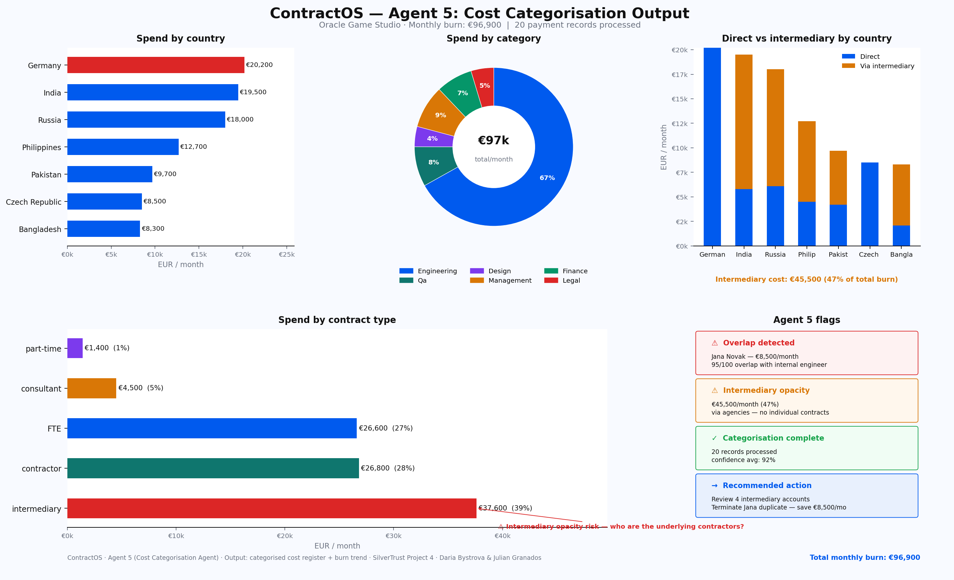
Sample Dashboard by Plain Software Integration (Demo Only!)
02 AI vs SOFTWARE

Slide 8
Technical Infrastructure Architecture
04 SOLUTION DESIGN
EU-hosted, privacy-first AI intelligence layer — n8n · LangChain · LangGraph · LangSmith — all data stays in EU infrastructure.
Tech Stack
Human Review Layer — Non-Negotiable
n8n
Workflow & Integration Connects all data sources: contracts, invoices, payroll exports, HR records, payment confirmations
⚠ All agent outputs → human approval queue → only then action
Finance Team: Approve / reject invoice payments
LangChain
Document Processing Document loading, text extraction, chunking, retrieval, structured extraction
Legal / Compliance: Escalate compliance risks, review misclassification flags
LangGraph
Agent Orchestration Coordinates 5 AI agents, manages state, routes outputs to human review
HR: Investigate duplicate work, update contractor register
LangSmith
Observability Traces every LLM call, audit trail, error analysis, model behaviour, prompt versioning
CEO / CTO (Eugen): Review cost dashboard, approve strategic decisions
EU Infra
Hosting Role-based access, encrypted storage, minimal data retention, human approval gates
CFO (Thibaud): Approve payment holds, review cost reduction flags

Slide 9
ContractOS is minimal/limited risk — justified, not asserted
03 COMPLIANCE — EU AI ACT
No agent executes a decision. Every output goes to a named human before action. This is what keeps the classification defensible.
MINIMAL RISK
LIMITED RISK
Contract extraction · Cost dashboard · Payment tracking
Overlap detection · Misclassification flagging
Surfaces information only. No decisions affecting individuals.
Touches Annex III pt.4 territory — human legal review required before any reclassification.
Roles & Obligations
SilverTrust = PROVIDER
Oracle Game Studio = DEPLOYER
· Maintain technical documentation
· Maintain human review for all flags before action
· Implement quality management + logging
· Inform workers AI analyses their contracts (transparency obligation)
· Ensure human oversight is technically enforced — not just policy
· Conduct own DPIA before deployment
ih

Slide 10
Every data use has a named lawful basis — three LIAs completed
03 GDPR & OTHER LAW
No personal data leaves EU infrastructure. LLM processing runs under documented legitimate interest.
Personal data use
Lawful basis
Article
Constraint / Action
Employment contracts
Contract performance
6(1)(b)
No consent needed
Payroll records & invoices
Legal obligation
6(1)(c)
Tax + labour law retention
LLM contract processing
Legitimate interest
6(1)(f)
LIA completed · EU infra only · DPA signed
LangSmith traces
Legitimate interest
6(1)(f)
PII redacted · 90-day retention max
Other Applicable Law
NL DBA Act (2025): Agent 4 flags misclassification — human + legal review before reclassification
German BetrVG: Works council consulted before go-live — SilverTrust provides technical documentation
India DPDP / Philippines DPA: Data stays EU-side — local counsel for processing obligations
ih
Russia: Out of scope v1 — sanctions + data localisation require specialist legal advice

Slide 11
The black box has windows — every AI decision is logged and auditable
04 MONITORING
If a regulator asks what happened with a specific contractor's data, we show the complete chain in under five minutes.
Extraction confidence Alert < 0.80 on rate, jurisdiction, IP
Failed extractions Zero tolerance — immediate alert
Human override rate Alert > 20% in 7-day window
Compliance flag trend Alert if Red > 10% of new contracts
Latency per agent Alert p95 > 30 seconds
PII redaction audit Weekly — zero tolerance for PII in traces
✓ Live — contractos-oracle-prod
6 runs complete · All 5 agents traced · EU endpoint: eu.api.smith.langchain.com · PII redacted
"Here is where you can see everything the AI did, catch a mistake before it costs you money, and prove to an auditor exactly what happened — in under five minutes."
ih

Slide 12
05 The Ask
05 THE ASK
✓
Problem discovered blind — 9 pain points confirmed by verbatim transcript evidence
✓
Solution addresses all 9 pain points with 5 dedicated AI agents — each maps to exactly one capability
✓
EU AI Act: Minimal / Limited risk — justified, not asserted — human-in-the-loop technically enforced
✓
GDPR: 3 lawful bases documented, 3 LIAs completed, subject rights handled, data stays EU-side
✓
LangSmith: 6 runs live, all 5 agents traced, PII redacted, complete audit trail
✓
ContractOS gets Oracle back to black numbers — cost reduction measurable from day one
Do you approve ContractOS for Oracle Game Studio — or what needs to change?
ih

Slide 13
ContractOS v1.1
Revised Proposal — Based on Client Feedback
Oracle approved ContractOS v1.0 — seven change requests incorporated below.
CR-01 EOR coverage
CR-02 Social registration
CR-03 Contract generation
CR-04 PO matching
CR-05 Accounting rules
CR-06 Intermediary costs
CR-07 Multilingual QA
ih
Daria Bystrova & Julian Granados · SilverTrust · ContractOS v1.1

Slide 14
Oracle approved — with seven change requests
06 REVISED PROPOSAL
ContractOS v1.0 architecture, compliance position, and LangSmith monitoring approved without objection. Seven enhancements requested during Q&A.
Approved unchanged ✓
Change requests → v1.1
Five-agent architecture (Agents 1–5)
CR-01 EOR coverage per country Phase 1
Human-in-the-loop — technically enforced
CR-02 Social registration automation Phase 2
EU AI Act: Minimal / Limited risk
CR-03 Contract generation workflow Phase 2
CR-04 PO matching — Agent 2 Phase 1
GDPR: 3 lawful bases, 3 LIAs completed
CR-05 Local accounting rules — Agent 2 Phase 1
LangSmith observability live
CR-06 Intermediary cost tracking Phase 1
Auto-signing rejected — human signature always required
CR-07 Multilingual QA plan Phase 1
ih

Slide 15
Phase 1 — immediate enhancements to existing agents
06 REVISED PROPOSAL
Four change requests implemented as enhancements to Agent 2, 4, and 5. No new agents required. Ready for v1.1.
Agent 4
EOR Coverage
CR-01
Flags contracts in countries where Oracle has no legal entity (Russia, India, PK, BD, PH). Output: EOR required flag + estimated EOR cost range + recommended action. Agent 5 tracks EOR fees as a named cost category.
Agent 2
PO Matching + Local Accounting Rules
CR-04 + CR-05
Agent 2 now compares invoice against contract AND Purchase Order (three-way match). Also checks jurisdiction-specific accounting thresholds — Germany, India, Philippines in v1.1. Flags if invoice triggers different accounting treatment.
Agent 2 + 5
Intermediary Cost Tracking
CR-06
Intermediary fees (staffing agencies, EOR providers, government fees) tracked as adjacent costs per contract. New cost subcategories: staffing_agency · eor_provider · government_fee · legal_counsel. Alert if intermediary costs exceed 30% of country spend.
ih

Slide 16
Phase 2 — new capabilities after go-live stabilisation
06 REVISED PROPOSAL
Client explicitly requested full process automation up to the human signature step. Two Phase 2 capabilities scoped — compliance research required before commitment.
CR-02 Social Registration Automation
CR-03 Contract Generation Workflow
Trigger: New contract created in target country
Trigger: HR onboards a new worker
Pulls country-specific social security + insurance registration requirements
Collects: name, role, country, contract type, rate, start date
Pre-fills registration forms with contract data
LLM generates draft contract using jurisdiction-specific template
Routes to HR for review and official submission
Draft produced in local language + English
Human submits to government bodies — agent prepares only
Lawyer reviews first template per country — approved templates reused
⚠ Pre-condition: legal review per jurisdiction before automation
⚠ Auto-signing explicitly out of scope — human signature always required
ih

Slide 17
Multilingual QA plan + revised scope summary
06 REVISED PROPOSAL
CR-07: Formal three-phase QA plan for Agent 1 across all operating languages. Revised scope table with phases and priorities.
CR-07 — Multilingual QA Plan
Revised scope summary
Phase
Action
Acceptance
Capability
Phase
Priority
Phase 0
5 test contracts per language, manual verification
≥90% field accuracy
Five-agent core (v1.0)
Delivered
✅
Phase 1
Refine extraction prompts per language from errors
≥95% field accuracy
EOR flagging (Agent 4)
v1.1 — now
🔴
Intermediary tracking (A2+A5)
v1.1 — now
🔴
Phase 2
LangSmith monitors confidence scores in production
Alert if < 0.80
PO matching (Agent 2)
v1.1 — now
🔴
Languages: English · Russian · Hindi · Urdu · Filipino · Bengali · German
Local accounting (Agent 2)
v1.1
🟡
Multilingual QA plan
v1.1
🟡
Social registration auto
Phase 2
🟢
Contract generation workflow
Phase 2
🟢
Auto-signing
Out of scope
❌
ih

Slide 18
07 The Revised Ask
07 THE REVISED ASK
✓
ContractOS v1.0 approved — five agents, compliance position, LangSmith monitoring
✓
Seven change requests received and documented — all addressed in this revised proposal
✓
Phase 1 enhancements ready: EOR flagging · PO matching · intermediary cost tracking · accounting rules
✓
Phase 2 scoped: social registration automation + contract generation workflow (post go-live)
✓
Multilingual QA plan formalised: 3 phases, acceptance criteria per language, 7 languages covered
✓
Auto-signing out of scope — human signature always required — accepted by client
Do you approve ContractOS v1.1 for Oracle Game Studio?
ih

