Slide 1
A Physics-Based Basketball Shot Simulation
COMP1110 Computing and Data Science in Everyday Life, 2026/27 Semester 1
Progress report, week 6. He Runlong, Li Zhenyi, Shao Linjun, Liang Xuanshuo, Chen Yin

Slide 2
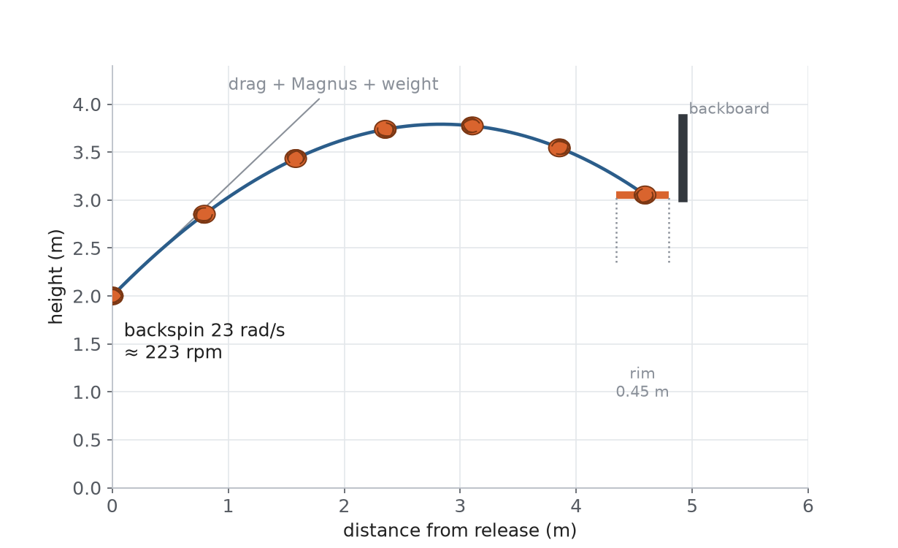
Project at a Glance
Three release numbers drive everything: point (x, y), velocity vector, backspin rate.
Gravity, quadratic air drag and Magnus lift shape the flight; the rigid board and rim decide every bounce.
Pure physics, no training.

Slide 3
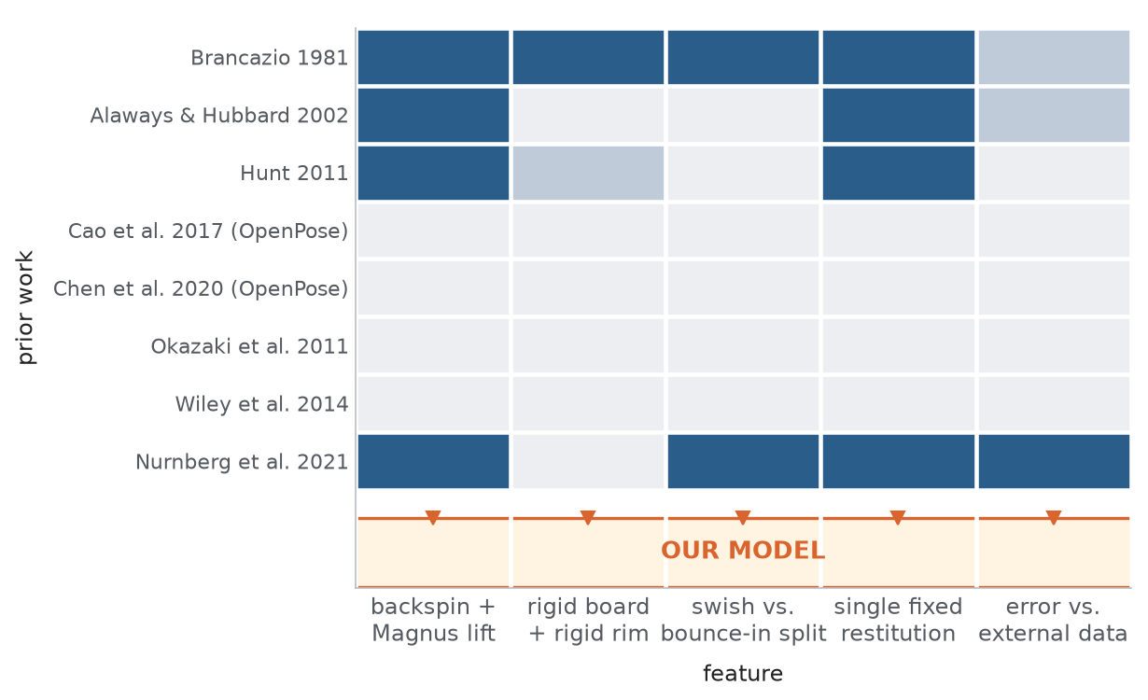
Why Ball Physics, Not Pose Estimation
OpenPose work (Cao 2017, Chen 2020) corrects the shooter's posture.
Classical models (Brancazio 1981, Alaways and Hubbard 2002) drop backspin or fuse the bounce outcomes.
No study fills all five columns. That gap is our benchmark.

Slide 4
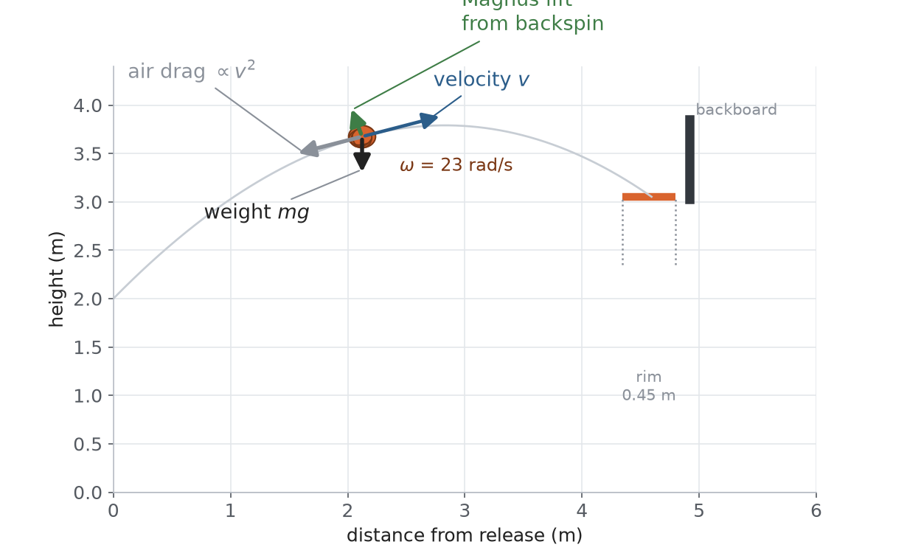
Model Concept and Research Question
Can a simulation with a rigid board, rigid rim and one restitution constant e = 0.7 reproduce swish, board-and-in and miss?
Weight, v-squared drag and spin-driven Magnus lift are the only forces modelled.

Slide 5
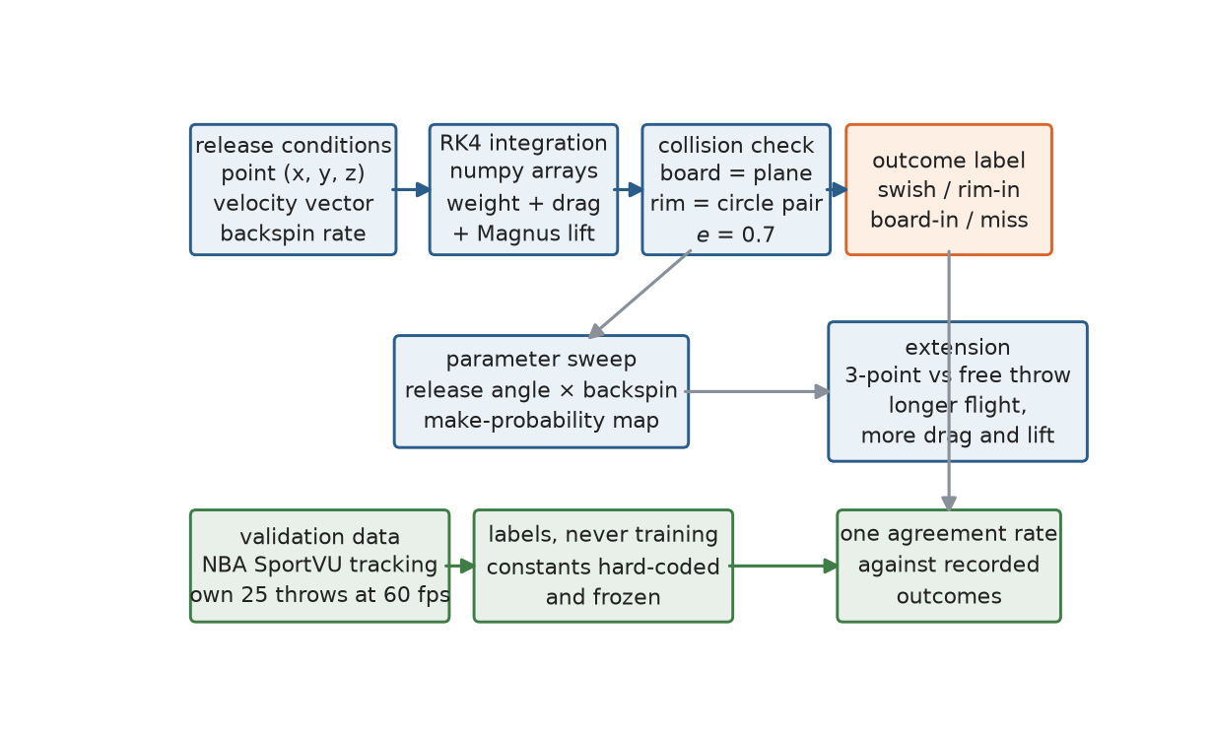
Method and Tools
RK4 integration in Python and numpy.
Plane-sphere and circle-pair contacts, four labelled outcomes, then a sweep over angle and spin.
SportVU plus our own filmed throws supply labels only; every constant stays frozen.

Slide 6
Trajectory Equations (Model Function)
State vector s = (x, y, vx, vy), released from (0, 2.00 m).
dv/dt = g_vec + a_drag + a_magnus, with g_vec = (0, -9.81).
Quadratic air drag, opposing velocity:
a_drag = -k |v| v, k = 0.5 rho C_D A / m = 0.0213 per metre.
Magnus force from backspin omega (spin axis out of plane):
a_magnus = C (omega x v), C = 0.5 rho C_L A R / m = 1.09e-3.
Components: ax = -C omega vy, ay = +C omega vx.
Vacuum closed form, used as a solver sanity check:
x(t) = v cos(theta) t, y(t) = 2.00 + v sin(theta) t - 4.905 t^2.
Reaching the rim plane x = d at height 3.05 fixes the no-air
minimum launch speed for that angle.
Contacts: board = rigid vertical plane, rim = two circles;
post-bounce normal velocity scaled by e = 0.70, tangent by 0.85.
Integrator: 4th-order Runge-Kutta, fixed 1 ms step, events checked
every step (plane crossing, distance to each rim edge).

Slide 7
Model Parameters (frozen, not tuned)
Symbol | Quantity | Value
m | ball mass | 0.60 kg
R | ball radius | 0.12 m
A | cross-sectional area | 4.52e-2 m^2
g | gravity | 9.81 m/s^2
C_D | drag coefficient | 0.47
C_L | Magnus (spin-lift) coefficient | 0.20
rho | air density (20 C, sea level) | 1.204 kg/m^3
e | restitution, board and rim | 0.70
rim r | rim inner radius / plane height | 0.229 m / 3.05 m
dist | release to rim plane | 4.60 m FT, 6.75 m 3PT
omega | backspin rate, swept | 0 to 40 rad/s
dt | RK4 integration step | 1.0 ms
k = 0.0213 per metre and rho C_L A R / 2m = 1.09e-3 are the
only two prefactors that enter dv/dt. All constants stay frozen.

Slide 8
Representative Flight Data (release height 2.0 m)
Shot | Angle | Spin | Speed window to score | Window | Rep speed | Hang time | Entry angle | Apex above rim
Free throw, no spin | 45 | 0 | 7.99-8.02 | 0.03 | 7.99 | 0.87 s | 31 deg | 0.49 m
Free throw, backspin | 45 | 23 | 8.02-8.05 | 0.03 | 8.02 | 0.87 s | 31 deg | 0.48 m
Free throw, peak region | 51 | 23 | 7.87-7.93 | 0.06 | 7.90 | 0.99 s | 41 deg | 0.75 m
Free throw, steep | 54 | 23 | 7.87-7.96 | 0.09 | 7.90 | 1.05 s | 45 deg | 0.89 m
Bank shot | 45 | 23 | 8.38-8.47 | 0.09 | 8.41 | 0.94 s | 40 deg | 0.63 m
Bank shot, steep | 57 | 23 | 8.38-8.56 | 0.18 | 8.47 | 1.22 s | 58 deg | 1.33 m
Three-point, flat | 45 | 23 | 9.43-9.49 | 0.06 | 9.46 | 1.10 s | 38 deg | 1.04 m
Three-point, peak | 51 | 23 | 9.37-9.46 | 0.09 | 9.40 | 1.24 s | 46 deg | 1.44 m
Window = the launch speeds that produce a clean swish or a clean bank-in,
found by a 0.03 m/s grid sweep of the RK4 model; wider window means more
tolerance to launch-speed error. The 57 deg steep bank has the widest
single band (0.18 m/s), but the combined Monte-Carlo make rate over angle
and spin still peaks near 51 deg at 23 rad/s, as reported in the
Early Result slide (peak P = 0.86).

Slide 9
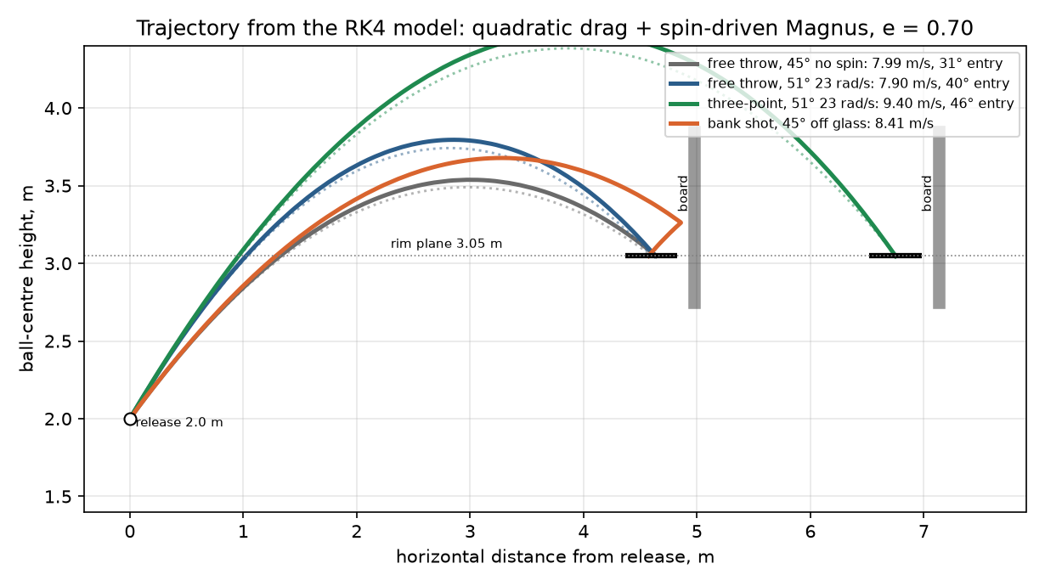
Simulated Trajectories
Solid curves are representative mid-window shots from the RK4
model; the dotted arcs repeat the same aim with air removed.
With no air the ball meets the rim-centre plane about 32 cm
below the rim on a free throw and 75 cm below from three-point
range, so aiming as if in a vacuum lands low - the basis of the
distance-extension result. Drag and spin scale with flight length.

Slide 10
Quantitative Air and Vacuum Comparison
Shot | Vacuum aim speed | Model launch speed | Air cost | Vacuum aim lands below rim by
Free throw, 45 deg | 7.65 m/s | 8.02 m/s | +4.9 % | 32 cm
Free throw, 51 deg | 7.52 m/s | 7.90 m/s | +5.0 % | 44 cm
Three-point, 45 deg | 8.86 m/s | 9.46 m/s | +6.8 % | 75 cm
Three-point, 51 deg | 8.80 m/s | 9.40 m/s | +6.8 % | 101 cm
Model launch speed (drag + Magnus) against the same-angle vacuum
aim. Air raises the required speed by roughly 5 % at the free throw
and 7 % at three-point range, and a vacuum-aimed shot reaches the
rim plane increasingly low with distance - supporting the extension.

Slide 11
Scope Boundaries
Release point, velocity vector, backspin
Quadratic air drag + Magnus lift
Rigid vertical board plane
Rigid rim, inelastic contact e = 0.7
Swish, rim-in, board-in, miss
Free-throw versus 3-point extension
Ball deformation, rim flex, board vibration
Player fatigue and psychology
Side-spin and wobble
Machine-learning correction of the physics
Real-time pose estimation
Claims about real players' performance

Slide 12
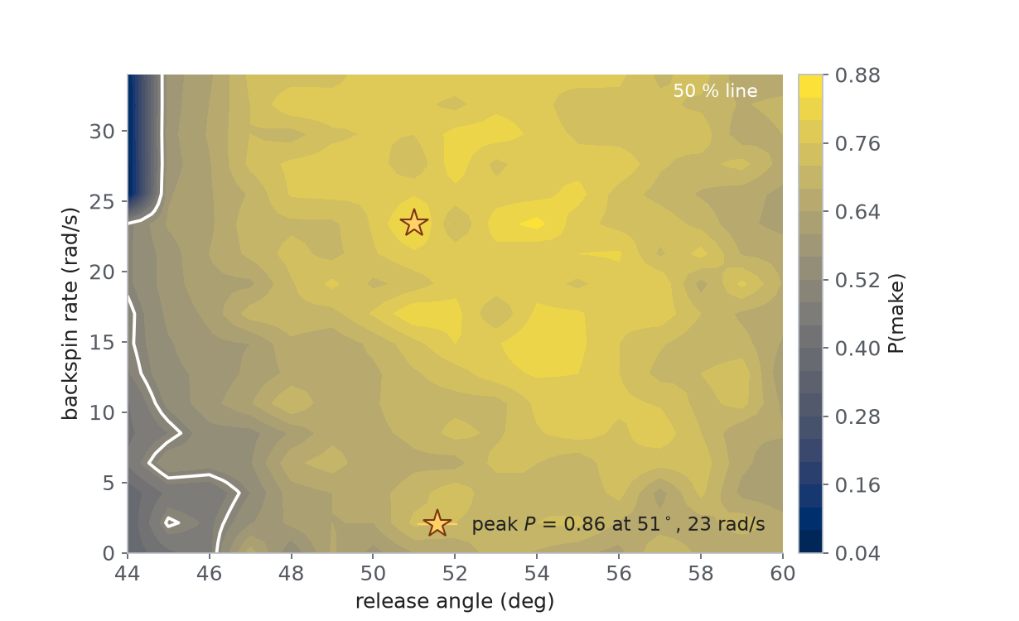
Early Result: Make-Probability Surface
Grid sweep: 17 angles x 17 spin rates, 200 jittered shots per cell.
Peak P(make) = 0.86 near 51 degrees with 23 rad/s of backspin, split into 0.67 swish and 0.14 bounce-in.
Mean P climbs from 0.61 without spin to 0.69 at the top of the range.

Slide 13
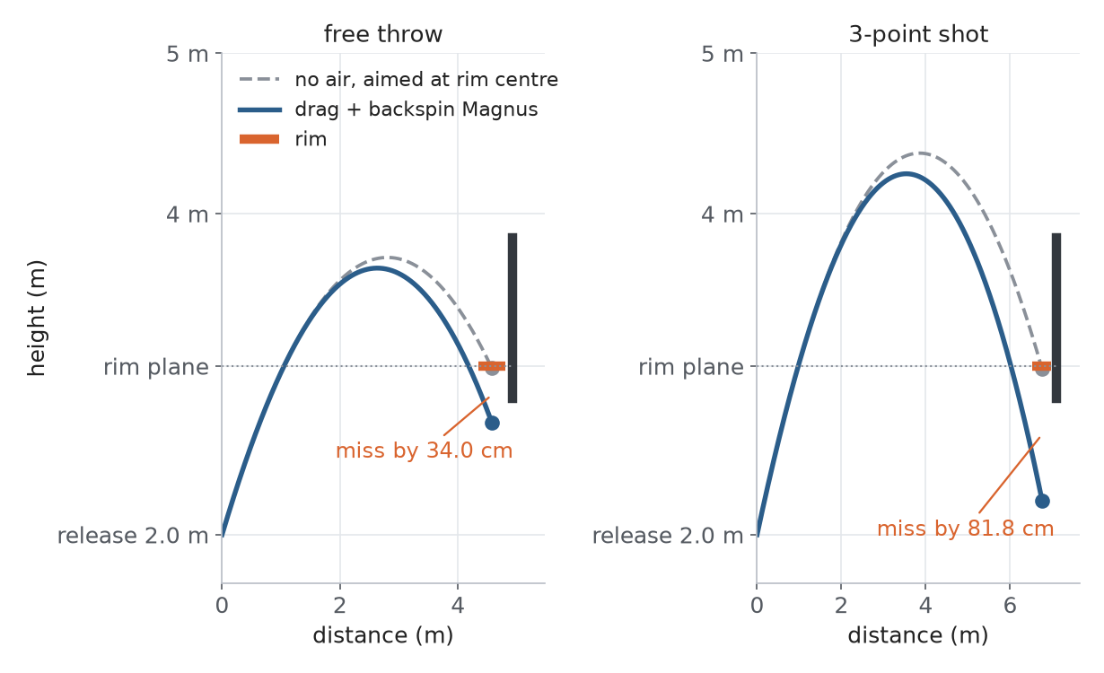
Extension: Free Throw versus 3-Point
Air raises the minimum launch speed by about 5 per cent at the free
throw and 7 per cent from three-point range, as tabulated on the
Quantitative Air and Vacuum Comparison slide earlier in this deck.
Aim the same angle as if in a vacuum and the ball meets the rim
plane low: about 32 cm on a free throw and 75 cm from three-point
range at 45 deg; 44 cm and 101 cm at 51 deg.
Drag and spin act for longer the farther the shot, so their effect
grows with distance.

Slide 14
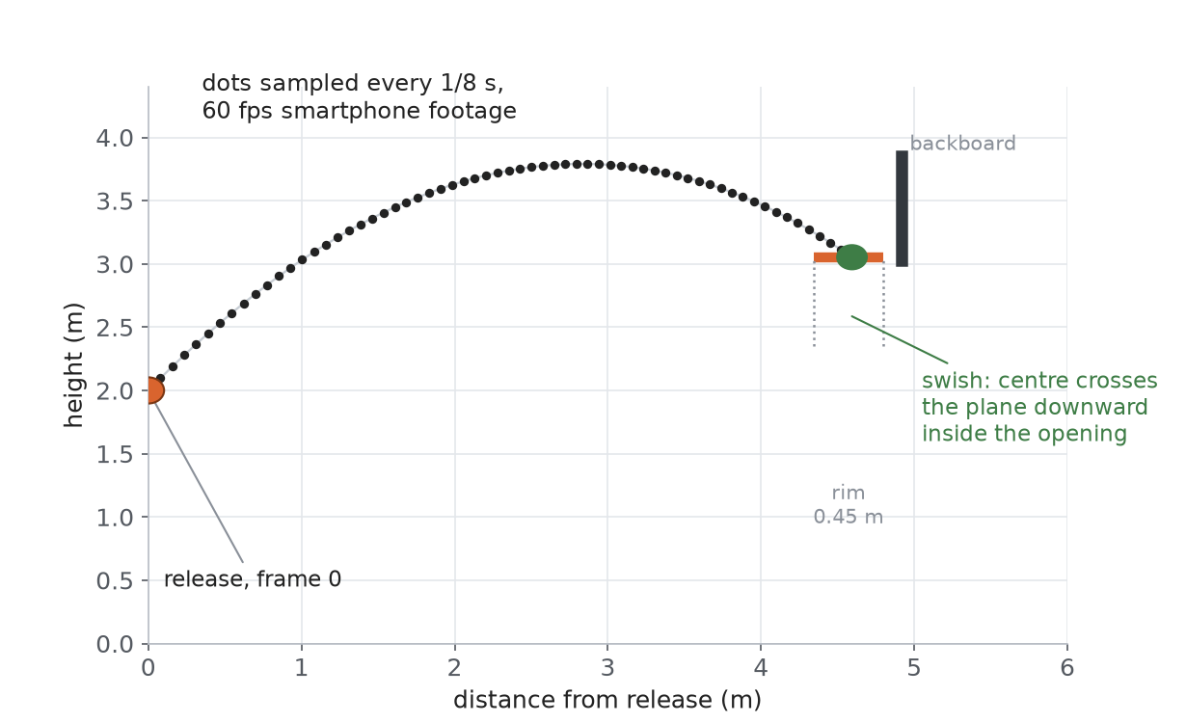
Validation Design
20 to 30 group-member free throws filmed at 60 fps, plus public NBA SportVU tracking.
Frame by frame tracking gives release geometry and the recorded outcome class.
We report a single disagreement rate, as a sanity check rather than a statistical claim.

Slide 15
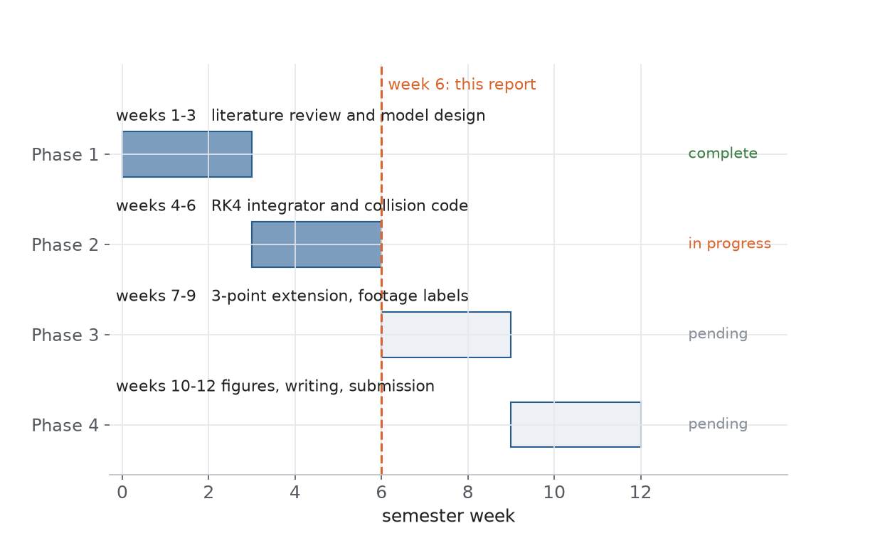
Timeline and Current Progress
Phase 1, literature review and model design, is complete.
Phase 2, the RK4 integrator and the collision code, is in progress this week.
Extension and footage labels follow in weeks 7 to 9; writing and figures in weeks 10 to 12.

Slide 16
Stated Limitations and Ethics
Real rims flex, real boards vibrate
One restitution constant for two contacts
Spin held constant, no decay in flight
Bounce-in outcomes less accurate than swish
Small empirical sample
Filmed participants are team members
Verbal consent, footage stays local
Outcomes labelled, no face data needed
Video deleted after the final report
SportVU data is public and anonymised

Slide 17
Deliverables and Next Steps
Working Python simulation of free-throw outcomes
Make-probability map over release angle and backspin
Disagreement rate against SportVU and our own footage
Free-throw versus 3-point comparison
Written note on an AI-based extension, kept out of scope
Next: finish the collision code, film 20 to 30 throws, widen the sweep

