Slide 1

International Institute of Professional Studies
Davv

Slide 2
Faculty Performance Based Appraisal System
Presented By-
Ritika Barethia
Shubham Neema
Sweta Rathore
Vikas Chouhan

Slide 3
Introduction
To design and develop a Computerized System, it is necessary to manage information of faculties more effectively using the concepts of database design and easy-to-use GUI interface which would help the user to save time and effort.

Slide 4
Objective
Computerization of present system which results in effective and efficient use of time and effort.
Integrating information at one place.
To provide security of information.
To increase efficiency of Information management.
Storing Academic ,Personal and Professional at a one place.
To generate reports at a single click.

Slide 5
Technologies Used
Git
Asynchronous Javascript And XML
Bootstrap
Hypertext Preprocessor

Slide 6
Git

Slide 7
Bootstrap

Slide 8
Ajax and Php

Slide 9
Other Technologies
Html
Css
Java Script
Sql (Backend)
Wamp Server

Slide 10
Gmail Login

Slide 11
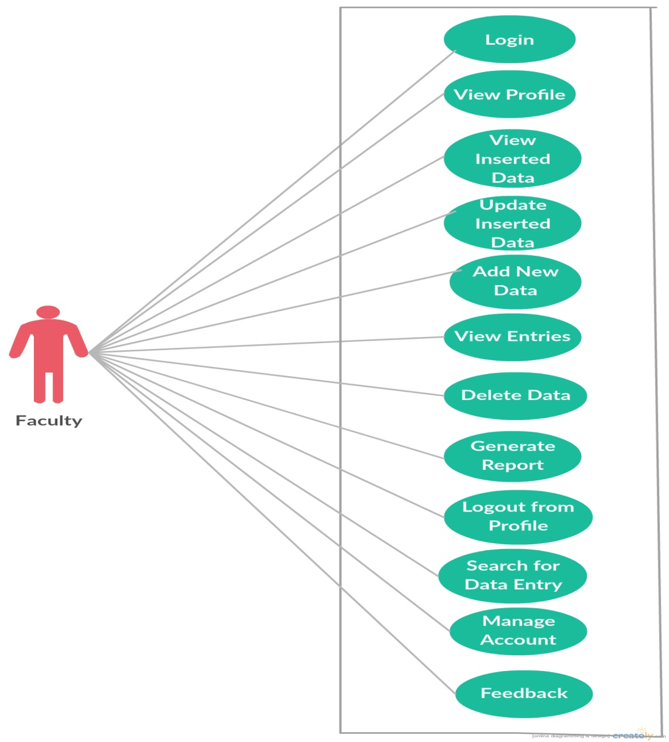
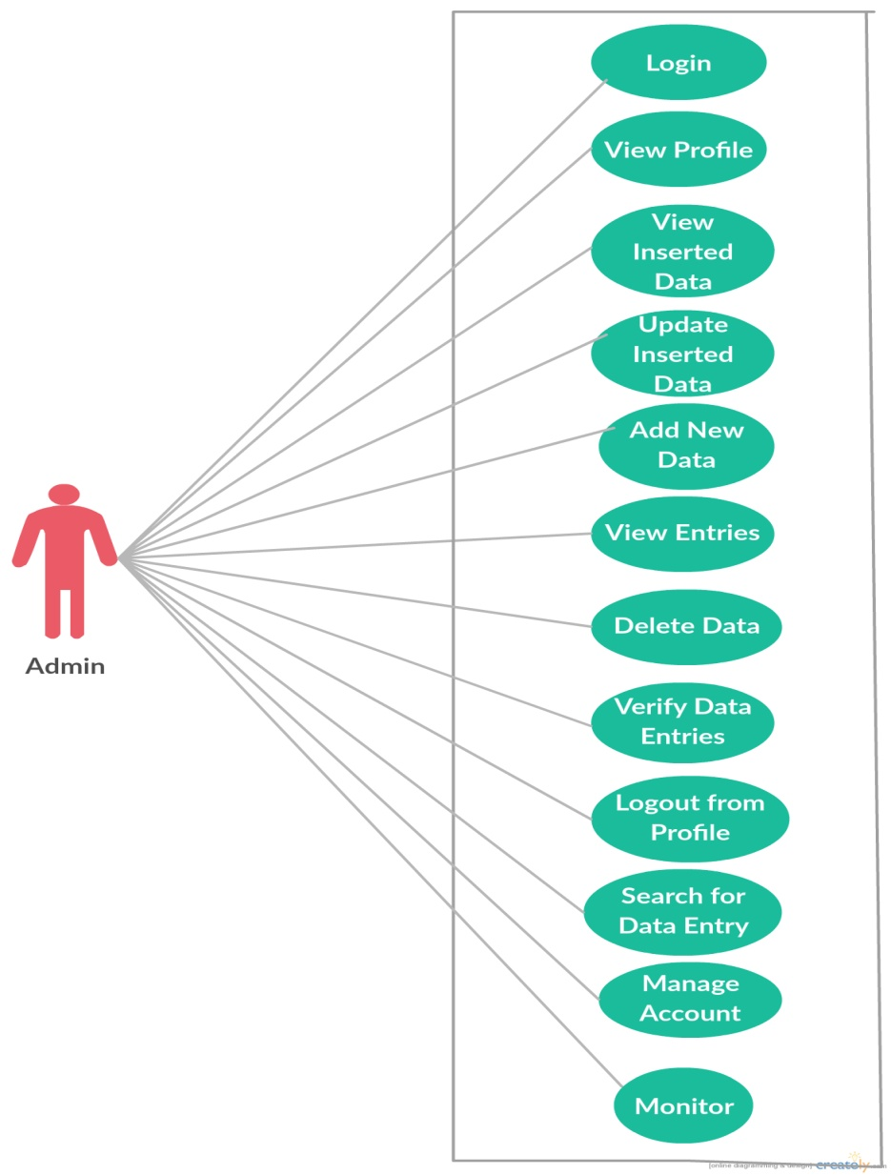
Use Case

Slide 12
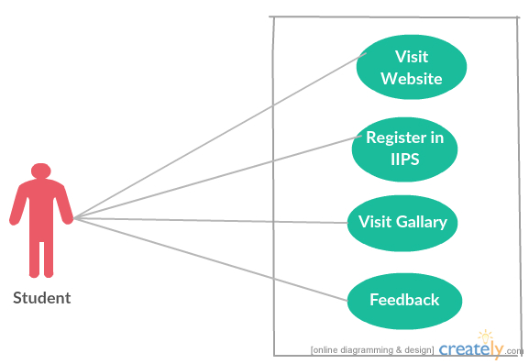
Use Case...conti..

Slide 13
Flow Chart
1. Google Login

Slide 14
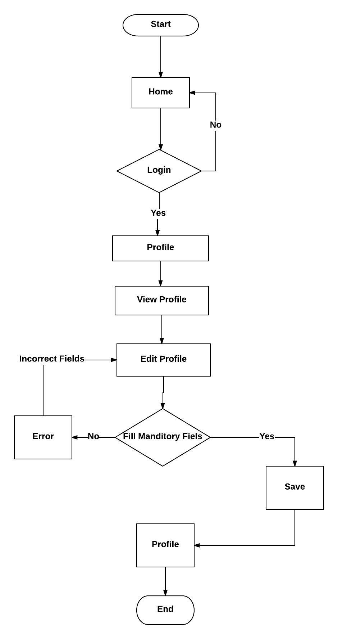
Flow Chart
2.. View Profile

Slide 15
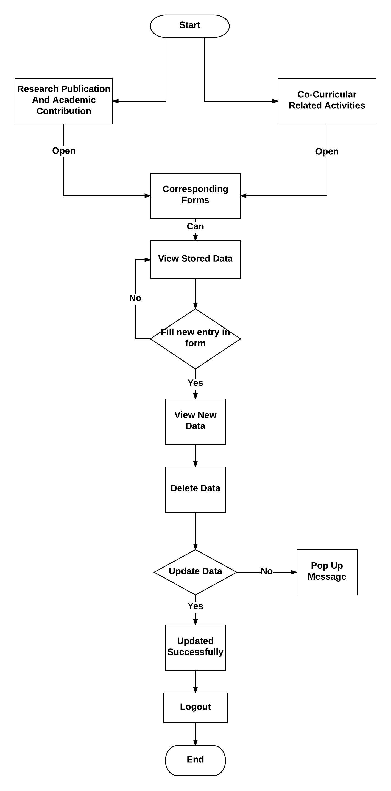
Flow Chart
3. Rearch Publication and Co- curicullar activities forms

Slide 16
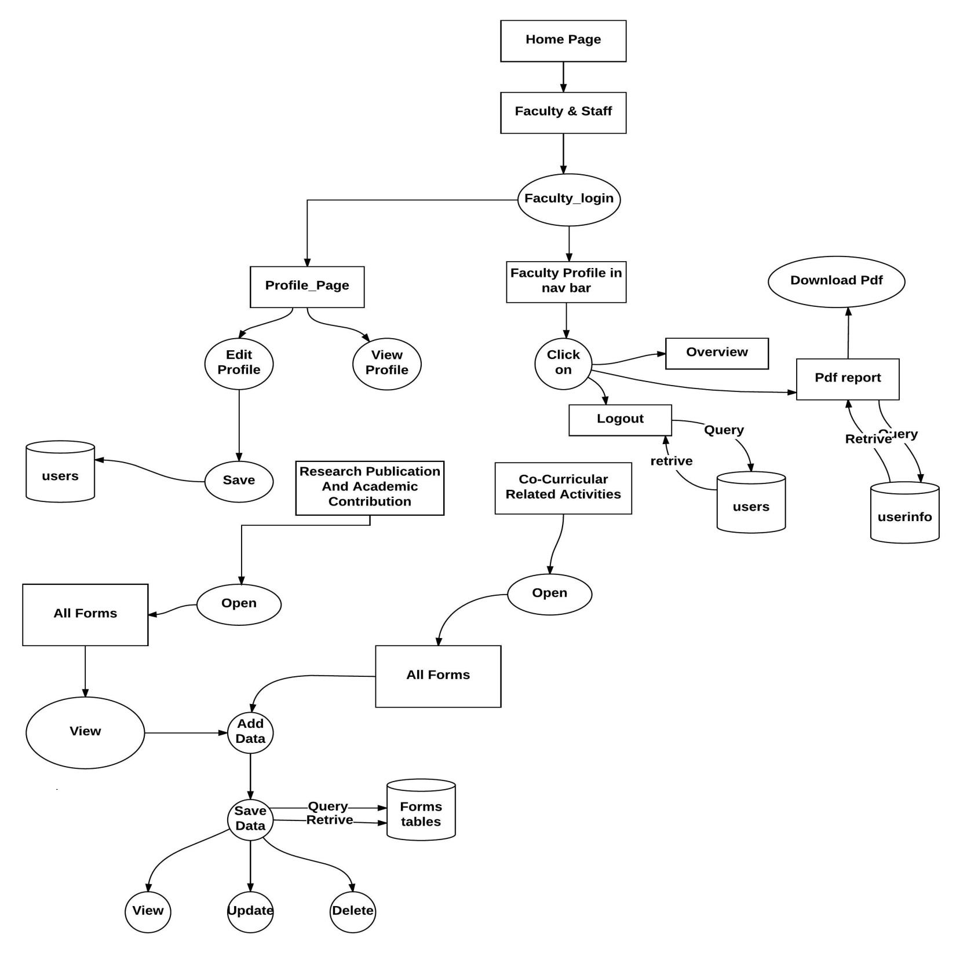
Data Flow Diagram

Slide 17
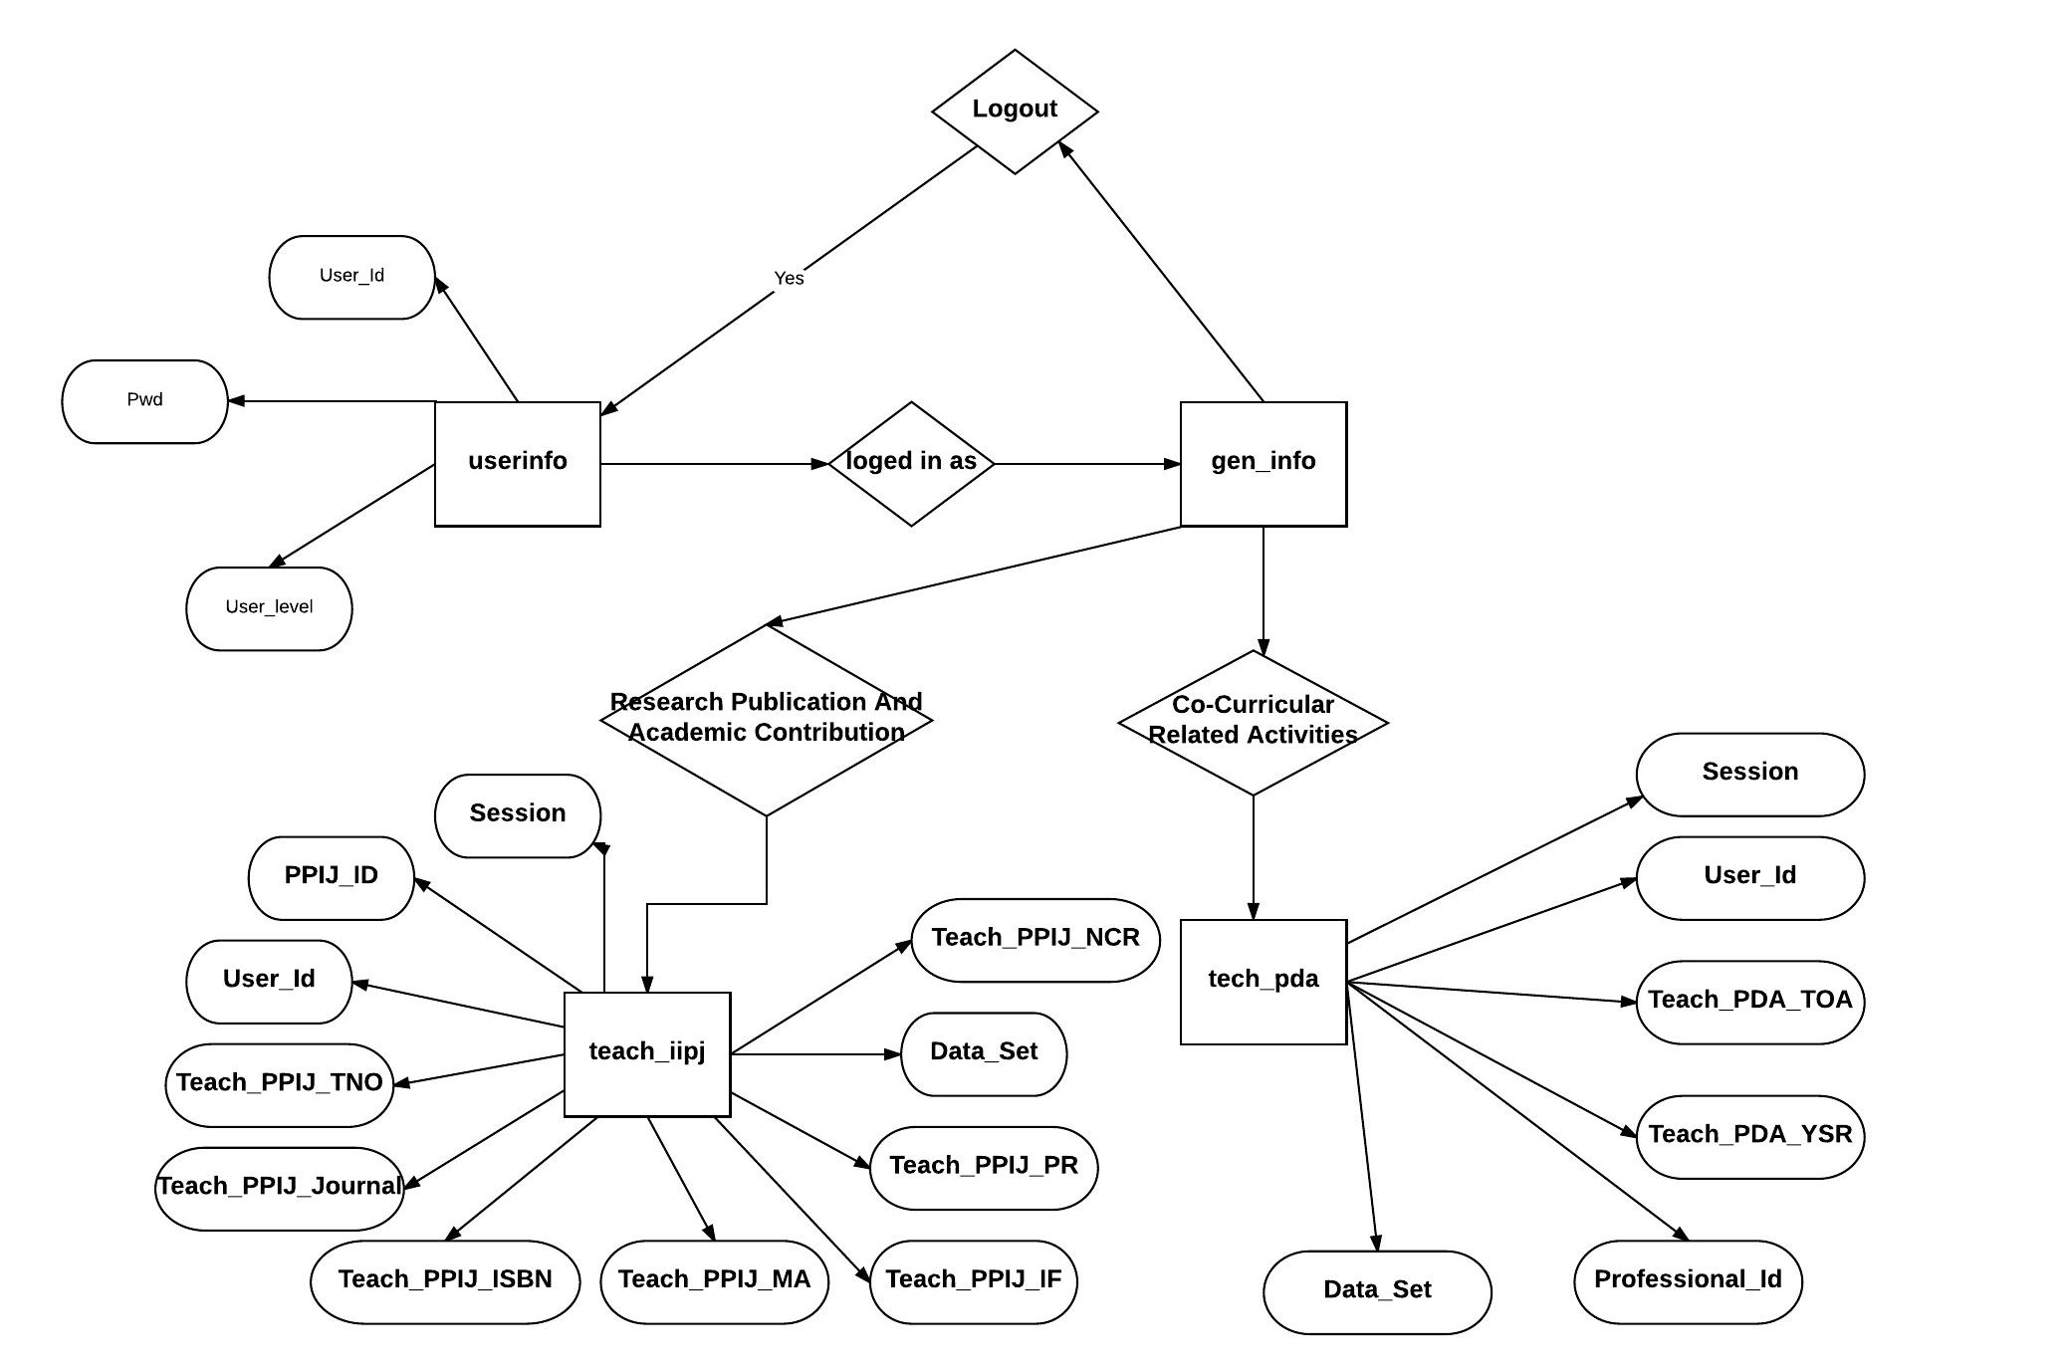
ER Diagram

Slide 18
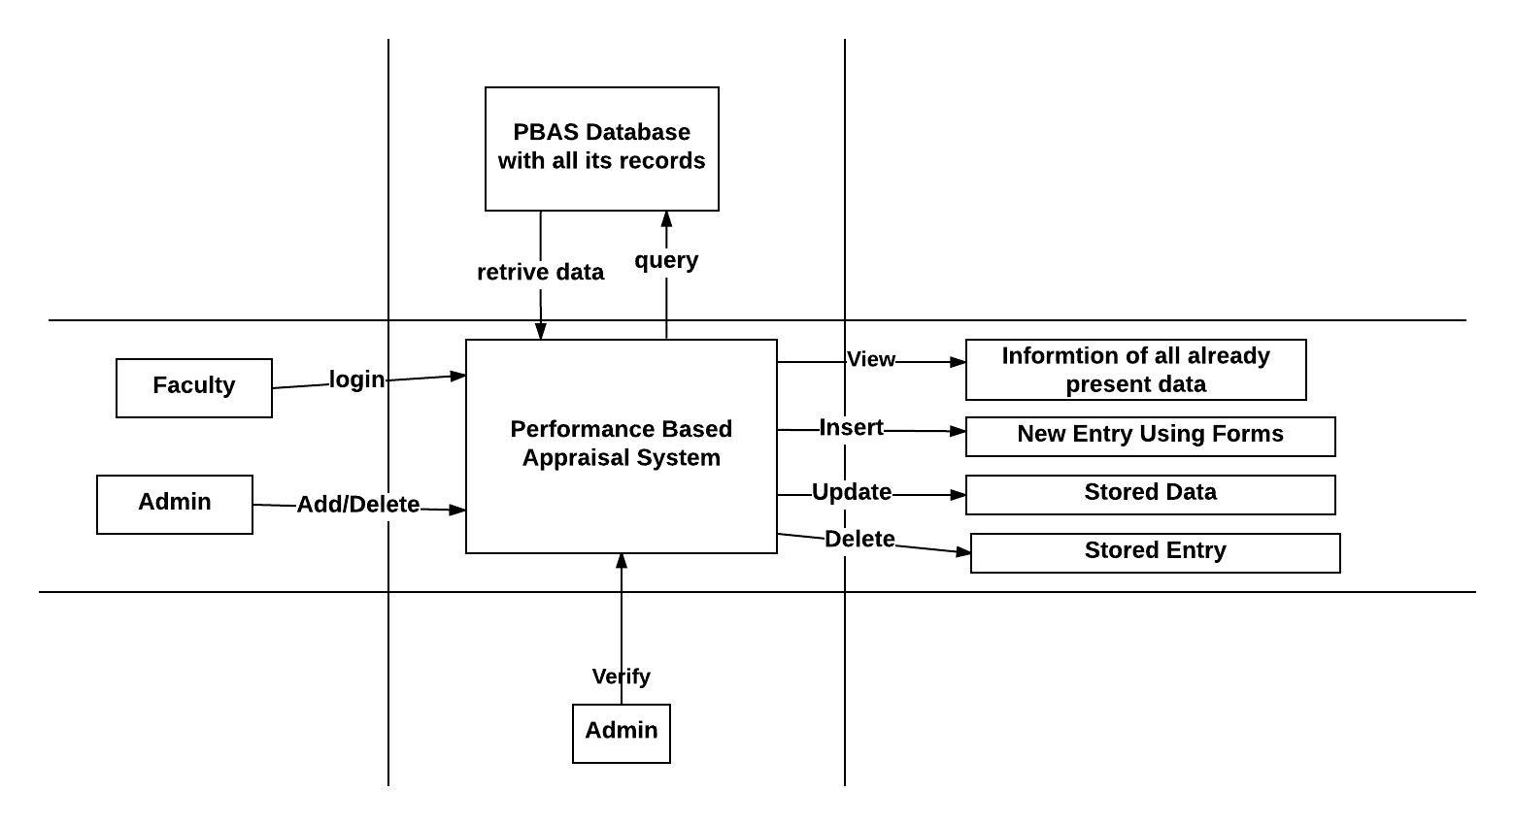
System Diagram

Slide 19
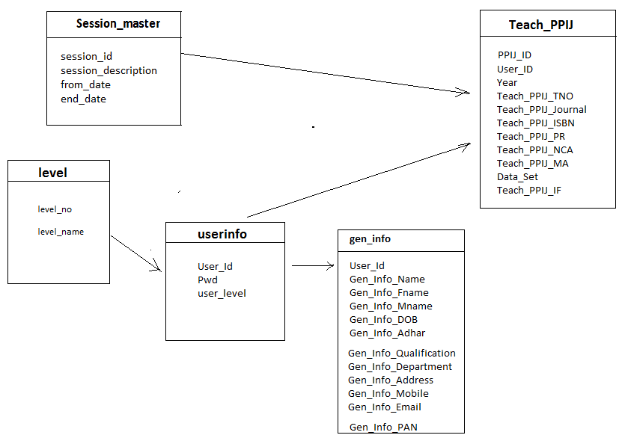
Class Diagram

Slide 20
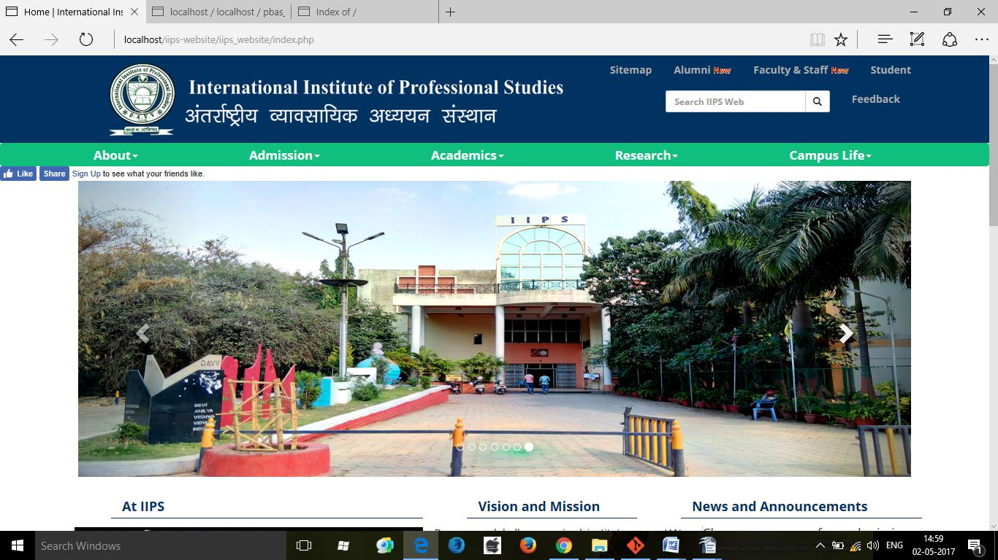
User Interfaces
IIPS College Website

Slide 21
User Interface
Login

Slide 22
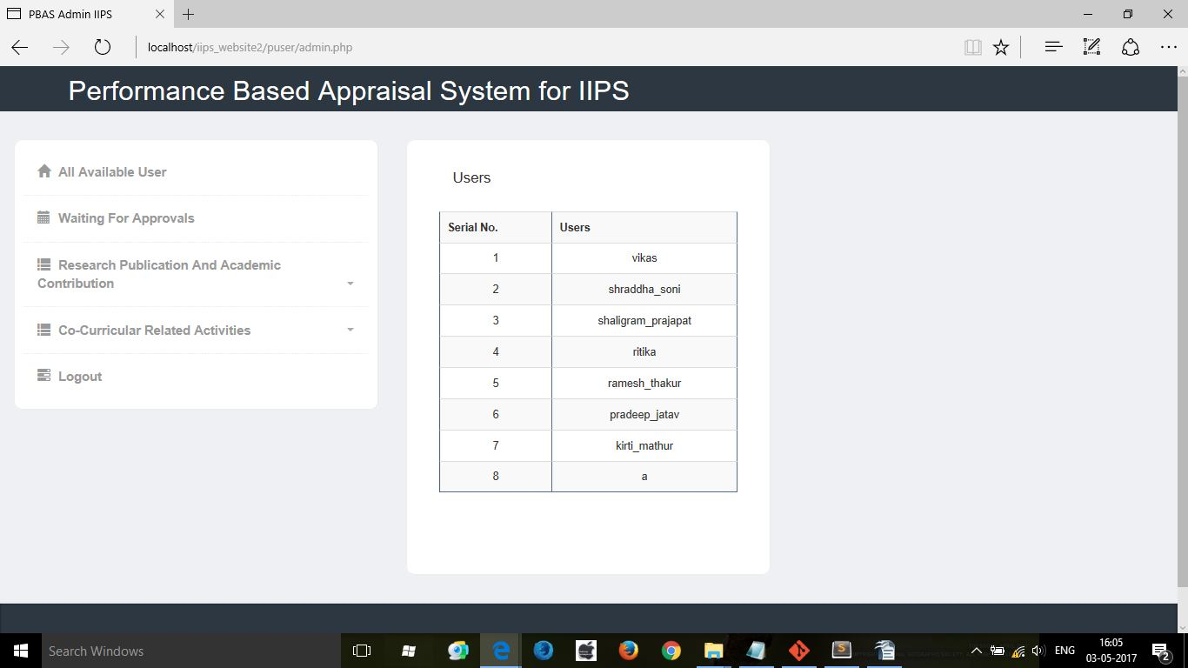
User Interface
Admin

Slide 23
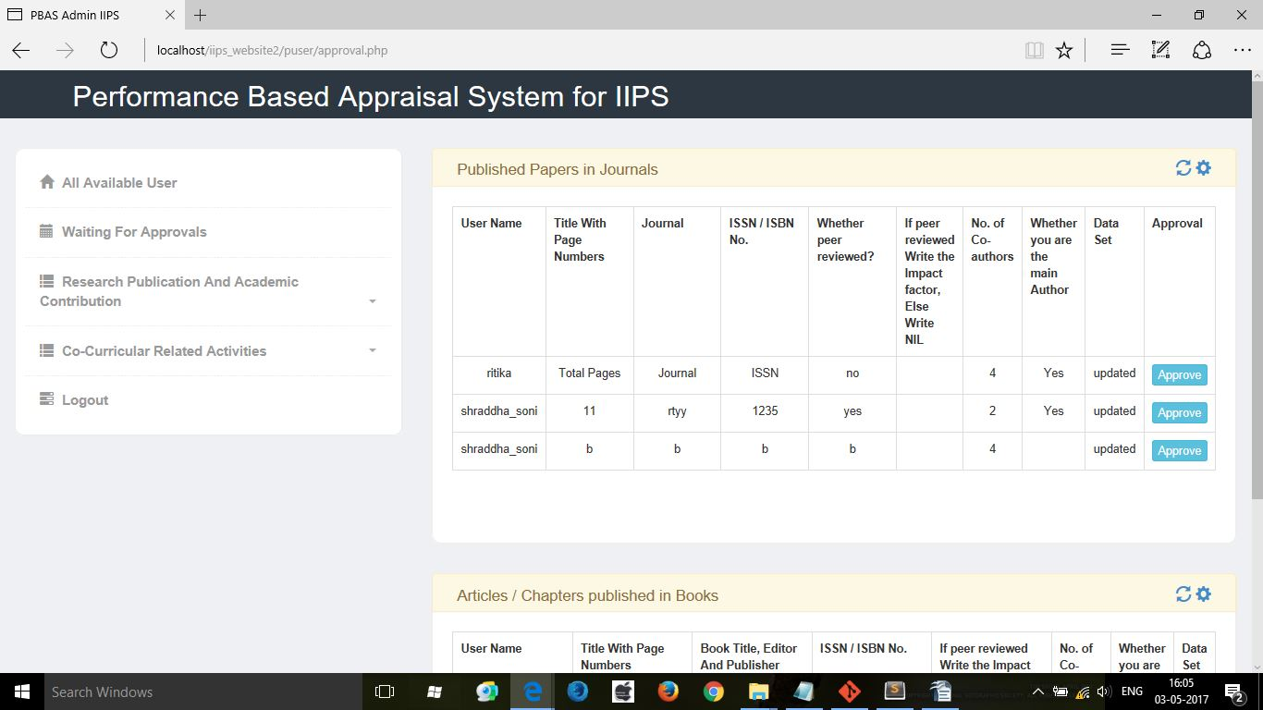
User Interface
Admin Approval System

Slide 24
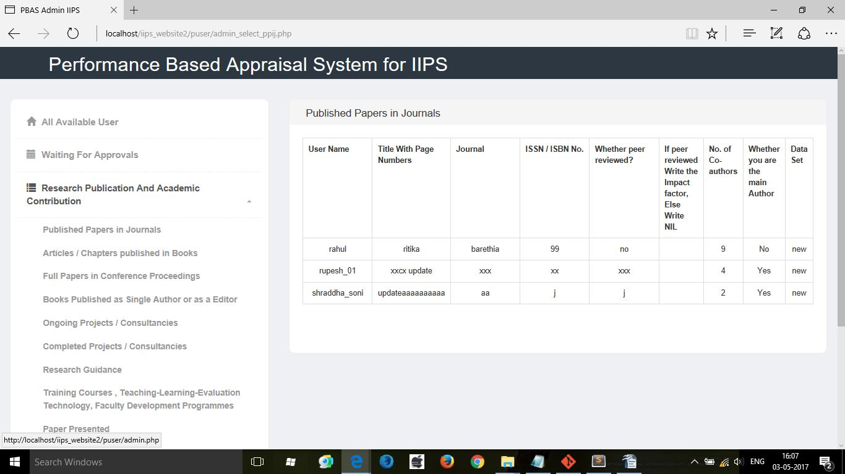
User Interface
Admin View All Entries

Slide 25
User Interface
Login

Slide 26
User Interface
Login

Slide 27
User Interface
Login

