Slide 1
Exploring the structure of Mathematical Theories using Graph Databases
Dhruv Makwana, Trinity College
Supervisor: Dr. Timothy G. Griffin

Slide 2
Understanding maths can be hard…
Textbooks are linear
A lot is implicit: notation, assumptions, types
Difficult to track dependencies mentally
Difficult to compare/consider alternative strategies

Slide 3
… and machine-checking often makes things worse
More verbose and explicit
to the point of adding too much noise
Clunky notation/vocabulary
designed for theorem-proving rather than understanding

Slide 4
Solution: marrying static proofs with dynamic graph databases
Unlike typical relational databases, can express more complex relationships
E.g. dependants and components

Slide 5
Basic strategy
Coq proof-scripts (*.v)
file-graph
Merge into model (CSV)
utilities
Neo4j
Database
library of queries
Glob files (*.glob)
dpdgraph++

Slide 6
Work done
Learning what doesn’t work: coqdoc was a dead-end ☹
Discovering I don’t need to parse Coq proof-scripts ☺
Figuring out precise versions of all components ☹
Lots of reading the (poorly documented) Coq project ☹
3 ASTs, 6 transformations, ~3000 types, ~9000 functions

Slide 7
Work done
Relating types and their constructors ☺
Inferring module hierarchies ☺
Labelling objects according to types & super-types ☺
Creating Neo4j databases from this information ☺
Running graph algorithm & visualisation libraries over this ☺
Starting Intro, Planning sections of final report ☺

Slide 8
Work remaining
Parsing glob files (~2 weeks) to
Add notation to the model
Accommodate Coq’s abstract modules
Streamline all these tools into a better package (~2 weeks)
Research and implement a sophisticated and useful/applicable metric (~4 weeks)
Bugs/reports/leeway (~2 weeks)

Slide 9
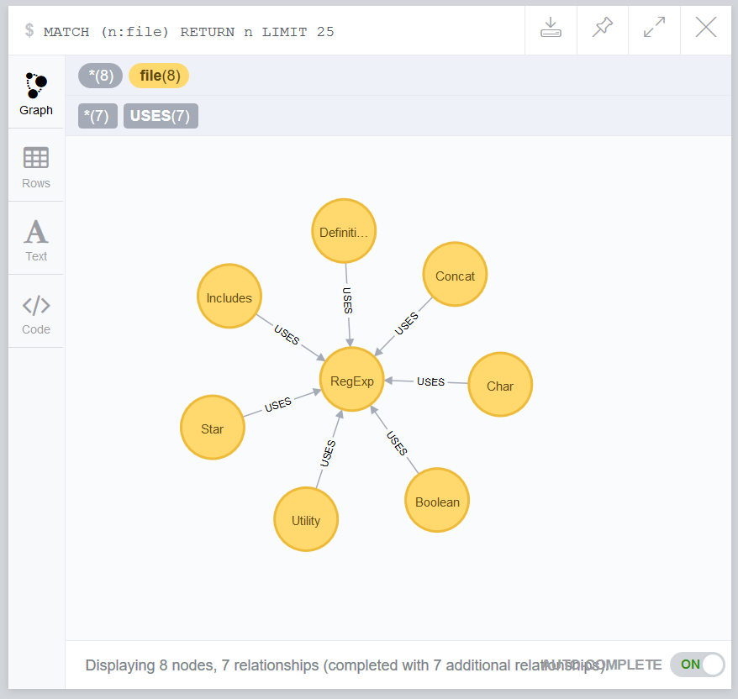
File structure in coqregexp
Simple, but you get the idea

Slide 10
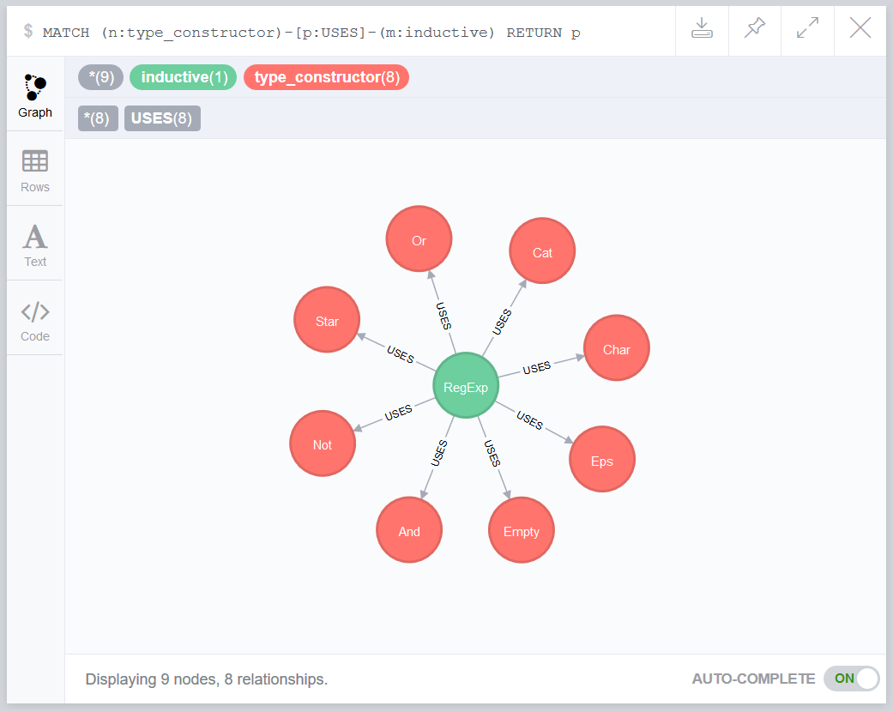
Types and constructors
(Un)fortunately only one inductive type is defined in this particular library.

Slide 11
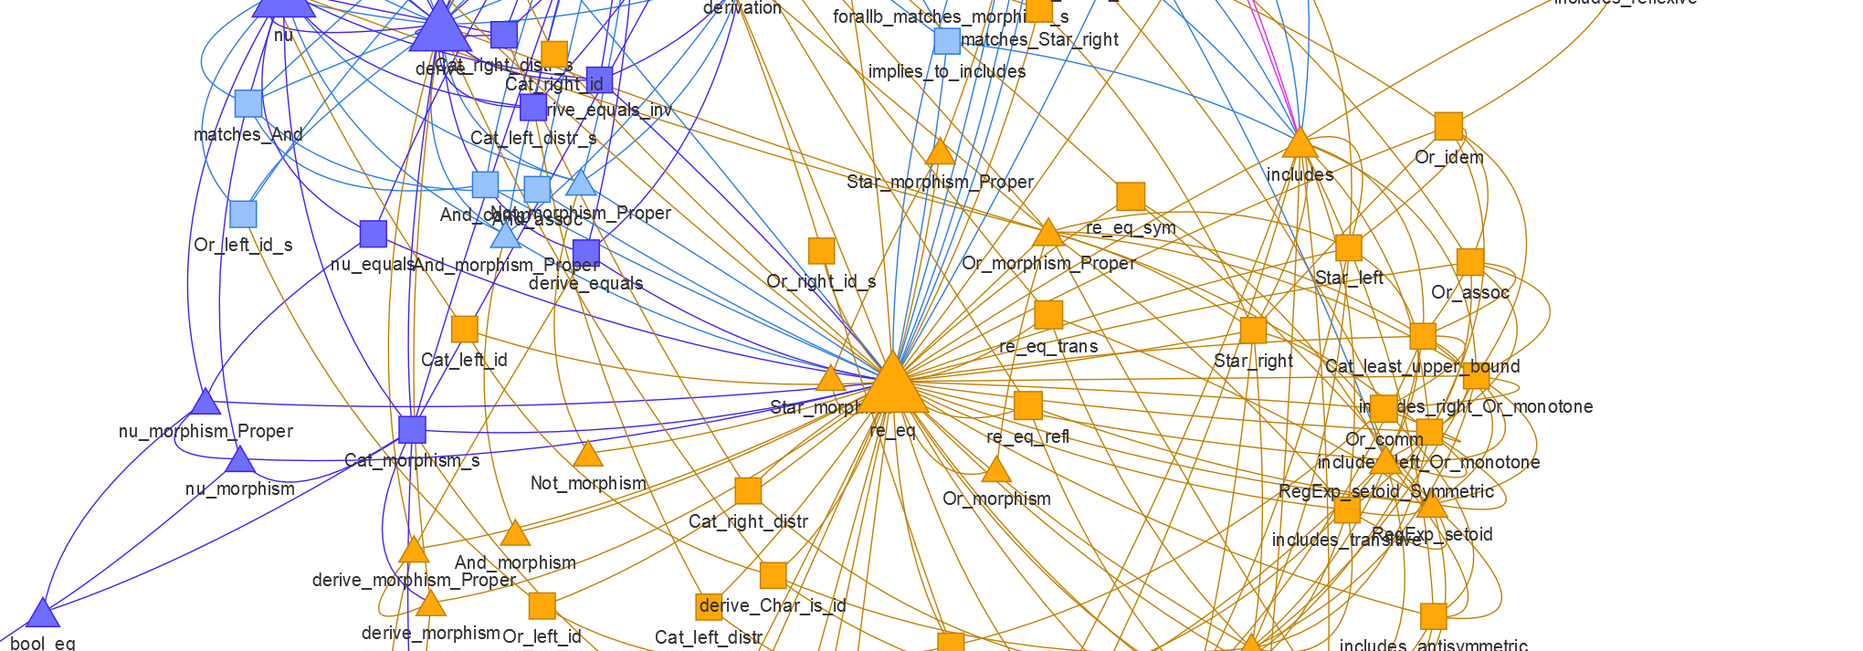
PageRank/Fast Modularity of coqregexp definitions (triangles) and proofs (squares)

Slide 12
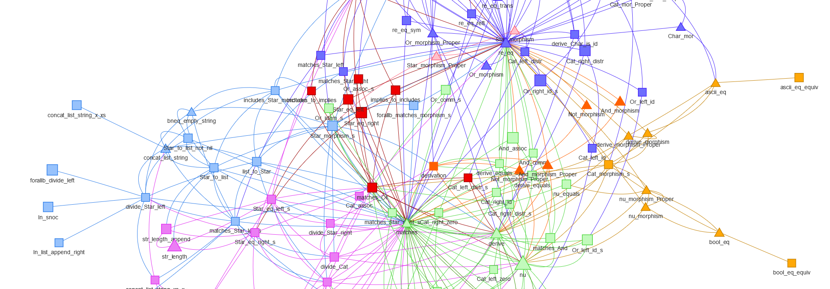
Betweenness of coqregexp definitions (triangles) and proofs (squares)

Slide 13
Thank you for listening
Project Domain Expert (suggestion): Peter Sewell
(or anyone else who works with Coq regularly)

