Slide 1

Trucking Company Management System (TCMS)
Software Development Plan

Slide 2
Overview
The objective of this project is to develop a system, which will maintain detailed information current and historical for a major trucking company.
Records must be maintained for a ten-year period.
To protect the privacy and security of company information users of the system will have access to information only on a “need to know” basis.

Slide 3
Personnel
Donal Cavanaugh
James Williamson
Zach Johnson
John Mullen

Slide 4
Development Environment
IDE - Visual Studio 2015
GUI Development - WPF (Windows Presentation Foundation)
Language - C#
Web Base - WCF Web Services
Database - MySQL

Slide 5
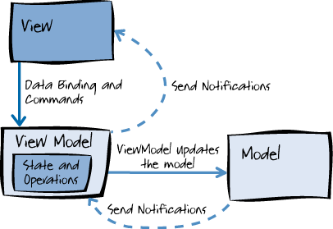
Design Pattern
MVVM (Model-View-ViewModel)
Utilizes the power of data binding

