Slide 1
打地鼠
17090704 丁成

Slide 2
设计方案
打地鼠是一款常见的小游戏，简单有趣，深受人们的喜爱，所以目标为设计一个简易打地鼠游戏
游戏介绍:LED灯代表三个地鼠，3个按键分别对应三个灯，共两关。两关每个灯亮灯时间分别为1s、0.5s。两关需全对为成功。
Groundhog is a common small game, simple and interesting, loved by people, so the goal is to design a simple groundhog game
Game introduction: two levels in total. LED lights represent three ground mice, and three buttons correspond to three lights respectively. The lighting time of each lamp is 1s and 0.5s respectively. Two passes need to be all right for success.

Slide 3
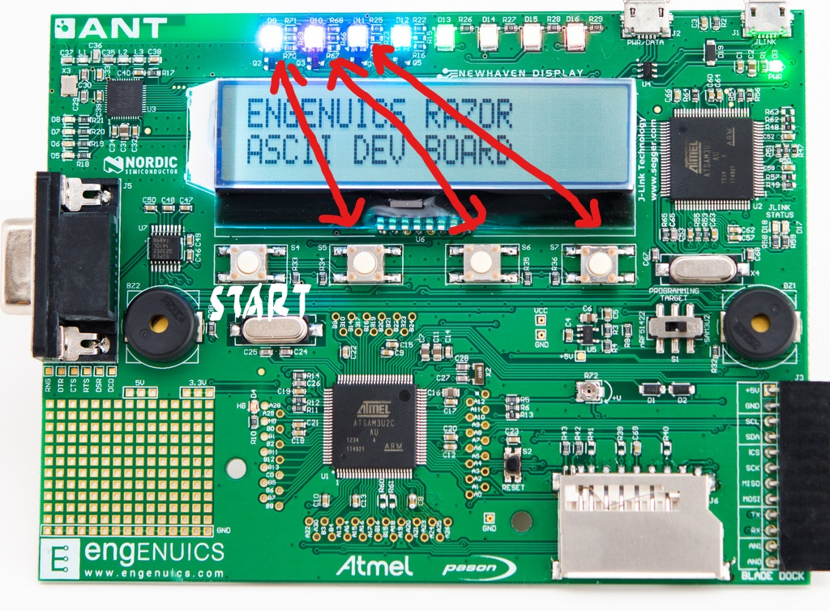
按键功能对应图

Slide 4
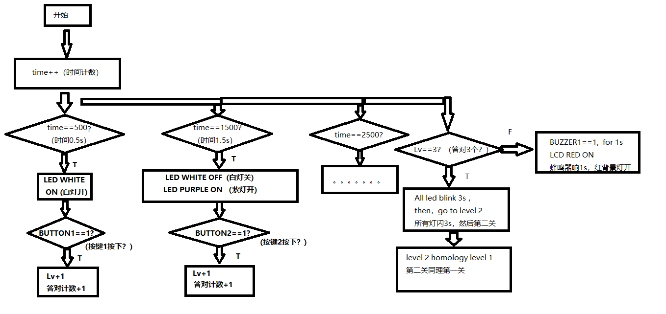
程序流程图

Slide 5
Thank you！

