Slide 1
If economists become unemployed, who reports it?
Team CryptoCurious

Slide 2

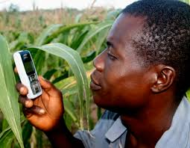

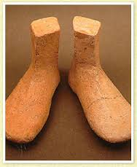
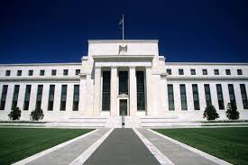

Slide 3
Problem
Volatility
Little Regulation
Illicit Uses
Prominent Thefts
Community Disagreement

Slide 4
Question
Can we use data to gain insight into what is driving these issues?
Can we understand how to make a better digital currency?

Slide 5
Problem
Volatility
Little Regulation
Illicit Uses
Prominent Thefts
Community Disagreement

Slide 6
Applications
Online Ecosystems
Mobile games
MMORPGs
EVE Online
Mega-corporations
Niche economies

Slide 7
Unique Data
We can see every tx in the whole network for it’s entire history, and it’s updated in real time
Pseuodo-anonymity
Many APIs

Slide 8
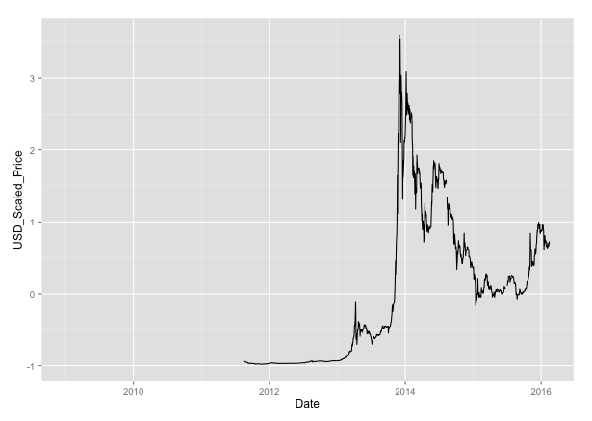
Goal
Attempt to find early signals of price volatility from aggregate transaction data and major exchange rates

Slide 9
Features
Aggregate bitcoin data
Financial Exchange Rates (in $US)
JPY
GBP
CHF
EUR
CNY
CAD
SEK
Abbreviation | Data
ATRCT | Bitcoin-Average-Transaction-Confirmation-Time
AVBLS | Bitcoin-Average-Block-Size
ETRAV | Bitcoin-Estimated-Transaction-Volume
NADDU | Bitcoin-Number-of-Unique-Bitcoin-Addresses-Used
NTRAN | Bitcoin-Number-of-Transactions
NTRBL | Bitcoin-Number-of-Transaction-per-Block
NTREP | Bitcoin-Number-of-Transactions-Excluding-Popular-Addresses
TOUTV | Bitcoin-Total-Output-Volume
TRFEE | Bitcoin-Total-Transaction-Fees
ATRCT | Bitcoin-Average-Transaction-Confirmation-Time
Source: quandl.com

Slide 10
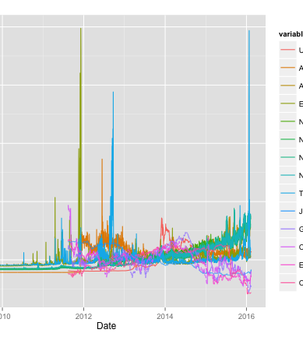
Target
(BTC in $US, normalized)
Input Features

Slide 12
Results

