Slide 1
If economists become unemployed, who reports it?
Team CryptoCurious

Slide 2

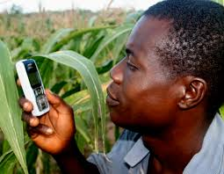

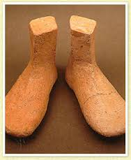
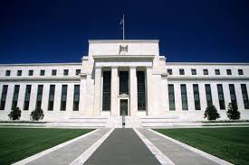

Slide 3
Problems
Volatility
Little Regulation
Illicit Uses
Prominent Thefts
Community Disagreement

Slide 4
Question
Can we use data to gain insight into what is driving some these issues?
Provide actionable analysis?
Can we understand how to design a better digital currency?

Slide 5
Problem
Volatility
Little Regulation
Illicit Uses
Prominent Thefts
Community Disagreement

Slide 6
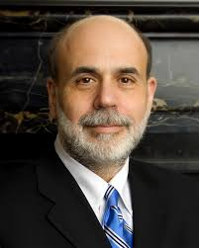
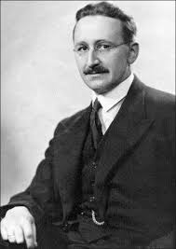
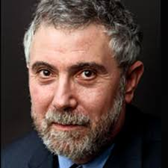
Applications

Slide 7
Applications
Enable Self-Regulating Ecosystems
Gaming
MMORPGs
EVE Online
World of Warcraft
Mega-corporations
Niche economies
Reduce Reputational and Operational Risk

Slide 8
Unique Data
We can see every tx in the whole network for it’s entire history, and it’s updated in real time
Pseuodo-anonymity
Many APIs and assembled datasets

Slide 9
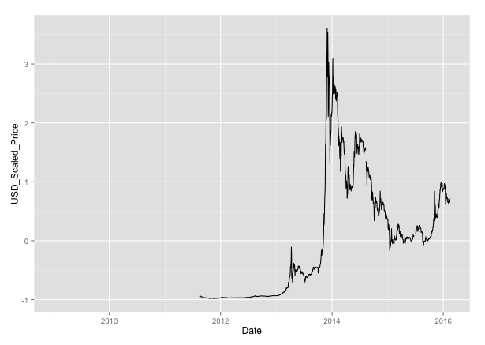
Goal
Attempt to find early signals of price or volatility from aggregate transaction data and major exchange rates

Slide 10
Features
Aggregate bitcoin data
Financial Exchange Rates (in $US)
Features
Bitcoin-Average-Transaction-Confirmation-Time
Bitcoin-Average-Block-Size
Bitcoin-Estimated-Transaction-Volume
Bitcoin-Number-of-Unique-Bitcoin-Addresses-Used
Bitcoin-Number-of-Transactions
Bitcoin-Number-of-Transaction-per-Block
Bitcoin-Number-of-Transactions-Excluding-Popular-Addresses
Bitcoin-Total-Output-Volume
Bitcoin-Total-Transaction-Fees
Bitcoin-Average-Transaction-Confirmation-Time
Currencies
JPY
GBP
CHF
EUR
CNY
CAD
SEK
JPY
GBP
Source: quandl.com

Slide 11
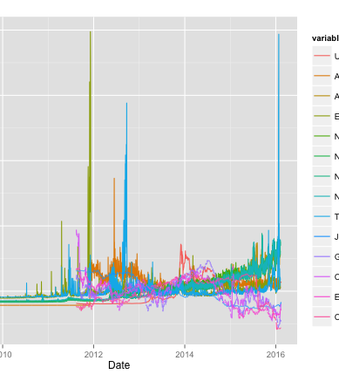
Target
(BTC in $US, normalized)
Input Features

Slide 12
Abbr. | Data
ATRCT | Bitcoin-Average-Transaction-Confirmation-Time
AVBLS | Bitcoin-Average-Block-Size
ETRAV | Bitcoin-Estimated-Transaction-Volume
NADDU | Bitcoin-Number-of-Unique-Bitcoin-Addresses-Used
NTRAN | Bitcoin-Number-of-Transactions
NTRBL | Bitcoin-Number-of-Transaction-per-Block
NTREP | Bitcoin-Number-of-Transactions-Excluding-Popular-Addresses
TOUTV | Bitcoin-Total-Output-Volume
TRFEE | Bitcoin-Total-Transaction-Fees
ATRCT | Bitcoin-Average-Transaction-Confirmation-Time

Slide 13
Attempted Approaches
Model | Pro | Con | Result
granger | Attempts to detect casaulity | Hypothesis test, poor validation framework | Casaulity expected in reverse direction
Linear Model, With Lag

Slide 14
Stray Observations

