Slide 1
Questing for Automatic Economics
Team CryptoCurious

Slide 2


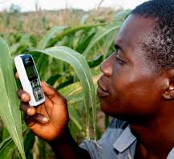
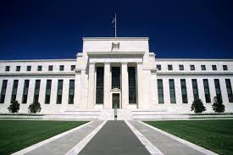
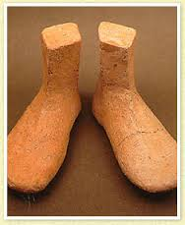

Slide 3
Problems
Volatility
Little Regulation
Illicit Uses
Prominent Thefts
Community Disagreement

Slide 4
Questions
Can we use data to gain insight into what is driving some these issues?
Can we provide actionable analysis?
Can we understand how to design a better digital currency?

Slide 5
Problem
Volatility
Little Regulation
Illicit Uses
Prominent Thefts
Community Disagreement

Slide 6
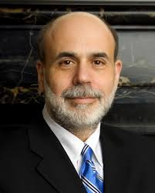
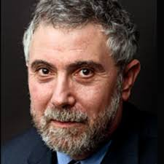
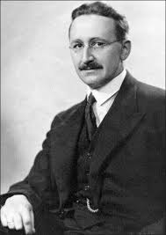
Applications

Slide 7

Applications
Enable Self-Regulating Ecosystems
Gaming
MMORPGs
EVE Online
World of Warcraft
Mega-corporations
Niche economies
Mitigate Reputational and Operational Risk

Slide 8
Unique Dataset
Pseudo-anonymity
We can see every transaction in the entire network for its entire history
There are many APIs and assembled datasets
Bitcoin can be exchanged to many currencies and cryptocurrencies

Slide 9
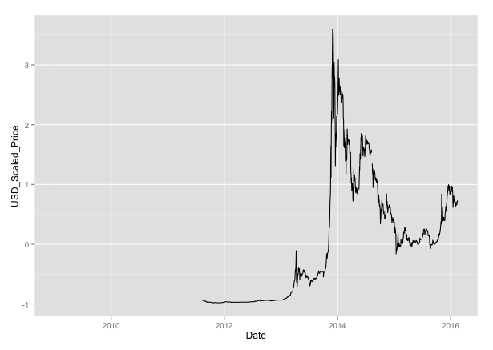
Actionable Goal
Attempt to find early signals of price or transaction volume volatility from aggregate transaction data and major exchange rates

Slide 10
Features
Aggregate Bitcoin data
Exchange Rates in USD
Features
Bitcoin-Average-Transaction-Confirmation-Time
Bitcoin-Average-Block-Size
Bitcoin-Estimated-Transaction-Volume
Bitcoin-Number-of-Unique-Bitcoin-Addresses-Used
Bitcoin-Number-of-Transactions
Bitcoin-Number-of-Transaction-per-Block
Bitcoin-Number-of-Transactions-Excluding-Popular-Addresses
Bitcoin-Total-Output-Volume
Bitcoin-Total-Transaction-Fees
Bitcoin-Average-Transaction-Confirmation-Time
Currencies
JPY
GBP
CHF
EUR
CNY
CAD
SEK
JPY
GBP
Source: quandl.com

Slide 11
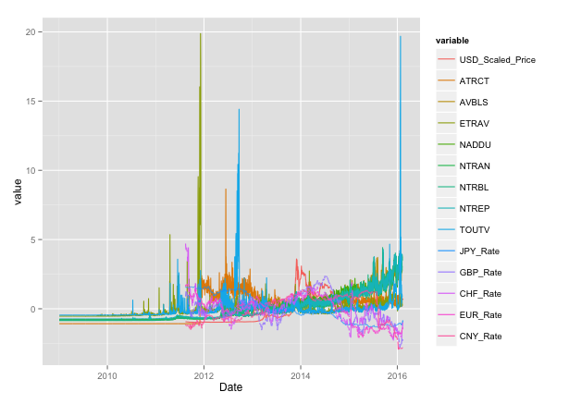
Target (BTC in USD, normalized)
Input Features

Slide 12
Abbr. | Data
ATRCT | Bitcoin-Average-Transaction-Confirmation-Time
AVBLS | Bitcoin-Average-Block-Size
ETRAV | Bitcoin-Estimated-Transaction-Volume
NADDU | Bitcoin-Number-of-Unique-Bitcoin-Addresses-Used
NTRAN | Bitcoin-Number-of-Transactions
NTRBL | Bitcoin-Number-of-Transaction-per-Block
NTREP | Bitcoin-Number-of-Transactions-Excluding-Popular-Addresses
TOUTV | Bitcoin-Total-Output-Volume
TRFEE | Bitcoin-Total-Transaction-Fees
ATRCT | Bitcoin-Average-Transaction-Confirmation-Time

Slide 13
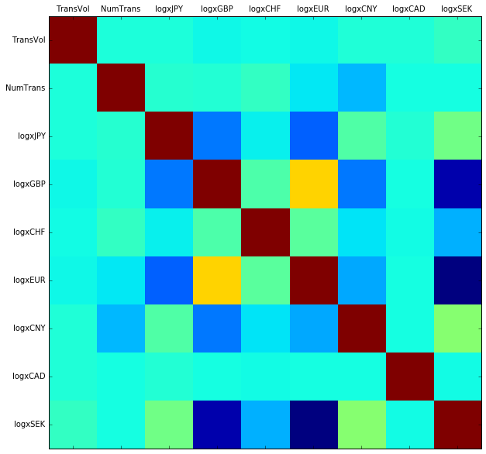
Correlations

Slide 14
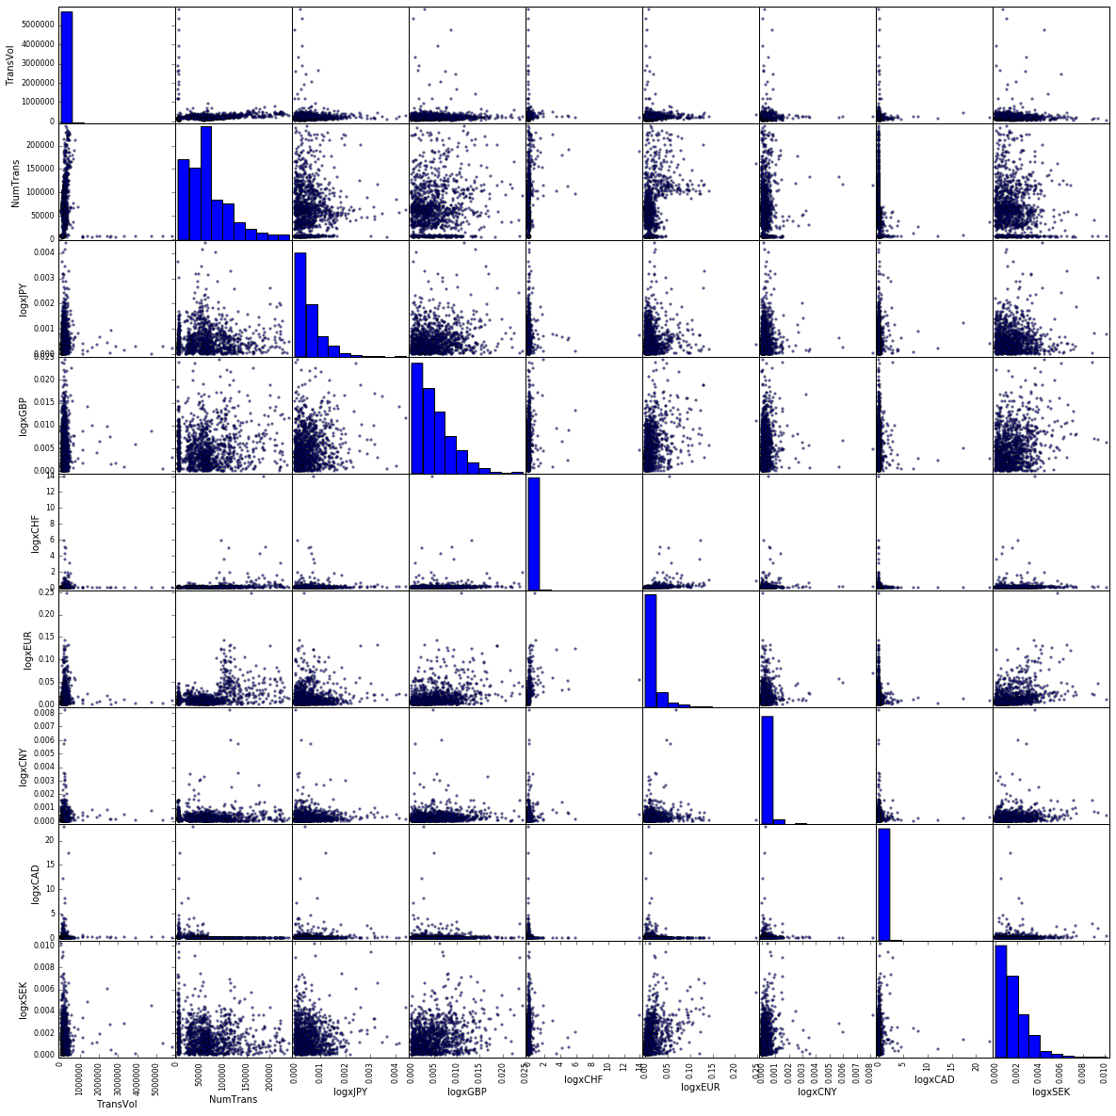
Scatterplots

Slide 15
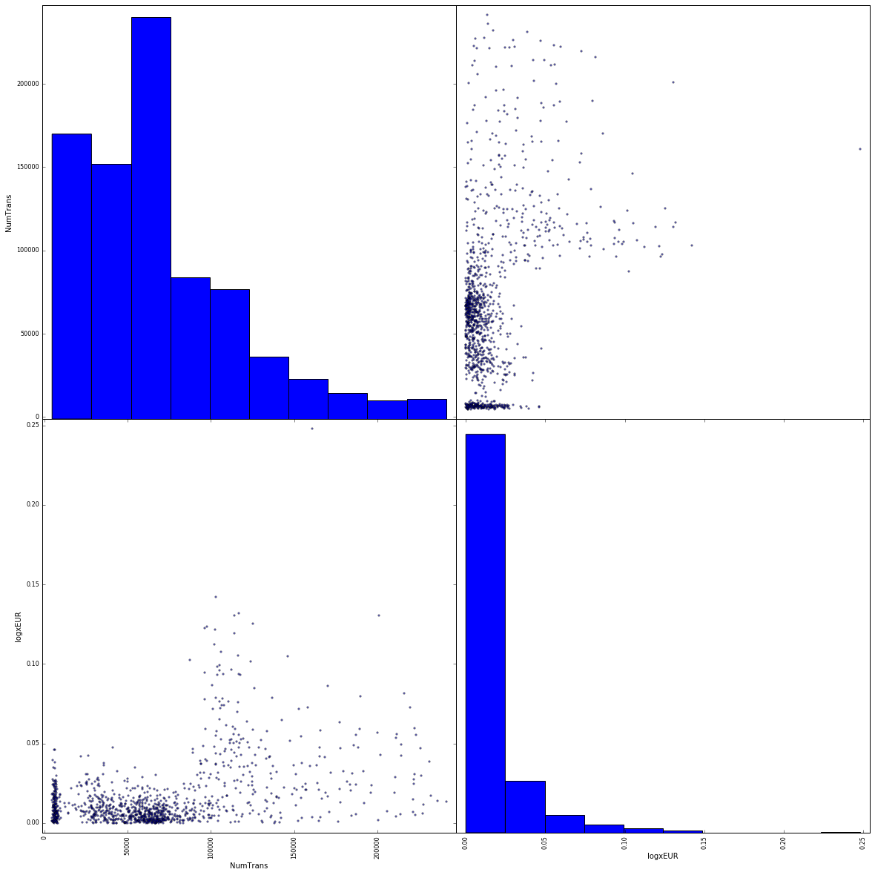
Number of Transactions vs. Log Difference in Euro Exchange Rate

Slide 16
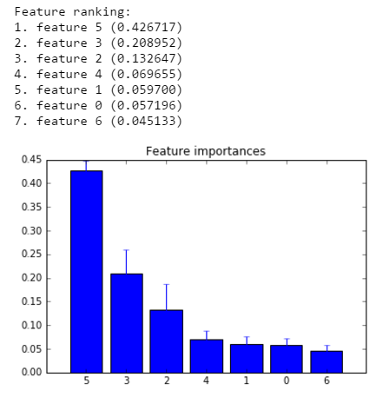
Random Forest
Feature 0: logxJPY
Feature 1: logxGBP
Feature 2: logxCHF
Feature 3: logxEUR
Feature 4: logxCNY
Feature 5: logxCAD
Feature 6: logxSEK

Slide 17
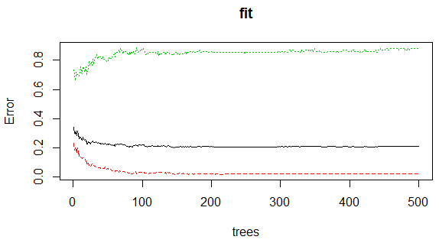
Random Forest
on 2-Step Lookback Log Differences in Price and BTC Aggregates

Slide 18
Granger test and Linear Models
Tests for causal connection (in either direction) within a variable lag
No features had significant granger-causation, with lag of up to 8 days
BTxs had significant granger-causation with several features:
Average-Block-Size-Estimated
Number-of-Unique-Bitcoin-Addresses-Used
Linear correlation had decent performances (R^2=, but failed to validate

Slide 19
Lessons Learned
Bitcoin Tx prices have weak signal with features and models we had time to explore
Approaches to and complexities within time series analysis
Shiny Platform for R Visualization

