Slide 1
Discover Advanced Threats With
Threat Intelligence
elknot@360corpsec
Qihoo 360 Enterprise Security Group

Slide 2
About Me
Jeremy Li (elknot@360corpsec)
Senior Security Researcher of Qihoo 360 Enterprise Security Group
Leader of Data-Driven Threat Analysis Services to Business Customers
Core Member of DEFCON Group 010
Speaker at ISC2017, DEFCON Group
Focus on Threat Intelligence and Advanced Threats Analysis
Found Plenty of Advanced Threat Cases from Financial Industry

Slide 3
Agenda
Attacker’s Profiling Research
Building Private Threat Intelligence Datasets
Building a Platform for Discovering Advanced Threats
Discover Advanced Threats with Private TI Platform
Case — Authentic DB Collision?

Slide 4
Attacker Profiling Research

Slide 5

What Attacker Do?
Fetching Sensitive/Privacy Data
Persistent Penetrating
Malicious Remote Access
Fetching Illegal Profits
Advanced Threats

Slide 6
Attackers Gonna ……
Intelligence-Driven
Response-Driven
Weaponi-zation
Exploitation
C&C
Recon-naissance
Delivery
Active on Objects
Installation
Lockheed Martin Kill-Chain

Slide 7
Profiling — Description of Attackers
Weapons (Exploits, Vulnerabilities, IPs, etc.)
Damages (Assets Infection, Business Impacts, etc.)
Motivation (Money, Political Factors, etc.)
Objectives (Remote Access, DoS, Data, etc.)
Identities (Virtual Profiles, Real Profiles)
Target (Business Property, System, Employees, etc.)

Slide 8
Building Private
Threat Intelligence Datasets

Slide 9
Life-Cycle Of Threat Intelligence
Investigate Your Business Services
Considering TTL of FINTEL
Create Objectives and Key Results of Your Threat Intelligence Datasets
Of Course Providing APIs
Verify your work
Collection
Planning & Direction
Plan
Pre-processing & Utilization
Transmission
Analysis & Production

Slide 10
Real Minority Report？
Inactive:
Delay — Not Real-Time!
Sources — Trusted or Not!
NO Quality Evaluation Standard!
Active:
Possible Set Alarms for the Same Industries
Reinforce Advanced Threat Analysis
CAN BUT WITH
HUGE LIMIT！！
Notes:
limitation

Slide 11
Threat Intelligence for Security Operation
Attacker-Based Intelligence
Intelligence Source About Attackers Which Attack Business Services Directly
Incident-Based Intelligence
Intelligence Sources About Public Security Incident Affect Business Services Directly
Threat Intelligence
Native-Based Intelligence
Use Honey pots & Sandboxes to Analysis Attackers Behavior
SIEM APIs
Using Intelligence to Detect Attack Behavior via Secure Log Sources and Net-Flows

Slide 12
Open Intelligence Collector & Notification
Spider Engine
Data Controller
Notification
Technical Blogs
Retrieve
Database
Mail-Push
SNS Site
SMS Push
Threat Exchange Collector
IOCs
Flows
Security News
Rating for Notification
TimeLine
Solution

Slide 13
Threat Intelligence in Research
Internal Infrastructures
Intelligence Data Collector
Con-troller
Internal & Internet Network
Net-flow
Honeypots/net
IT Infrastructures
(Servers, Clients, Secure Devices)
Logs
Botnet Research
Files
Sandboxes
Text Information

Slide 14
Building a Platform for Discovering
Advanced Threats

Slide 15
First things First
Threat Intelligence
Security Data Sources

Slide 16
Security Data Collection
Security Devices Log
Alarm & Notification
Network Activity
More Security Log Sources
Network Activities && DPI Data
Security Data Visualize
Security Information & Events Management (SIEM) Can Help Collecting Event Logs

Slide 17
Monitoring……
DashBoard
Secure Devices Log Sources
Account&
Authentication
Security Data Collector
Network Activities Log
Network Monitor
Alarms & Notifications
Security Monitoring
Open Threat Intelligence APIs
Attacker Profiling Intelligence
Security Incidents Intelligence
Threat Intelligence
Non-Data
Intelligence
Honey net Intelligence
Mail Push Service

Slide 18
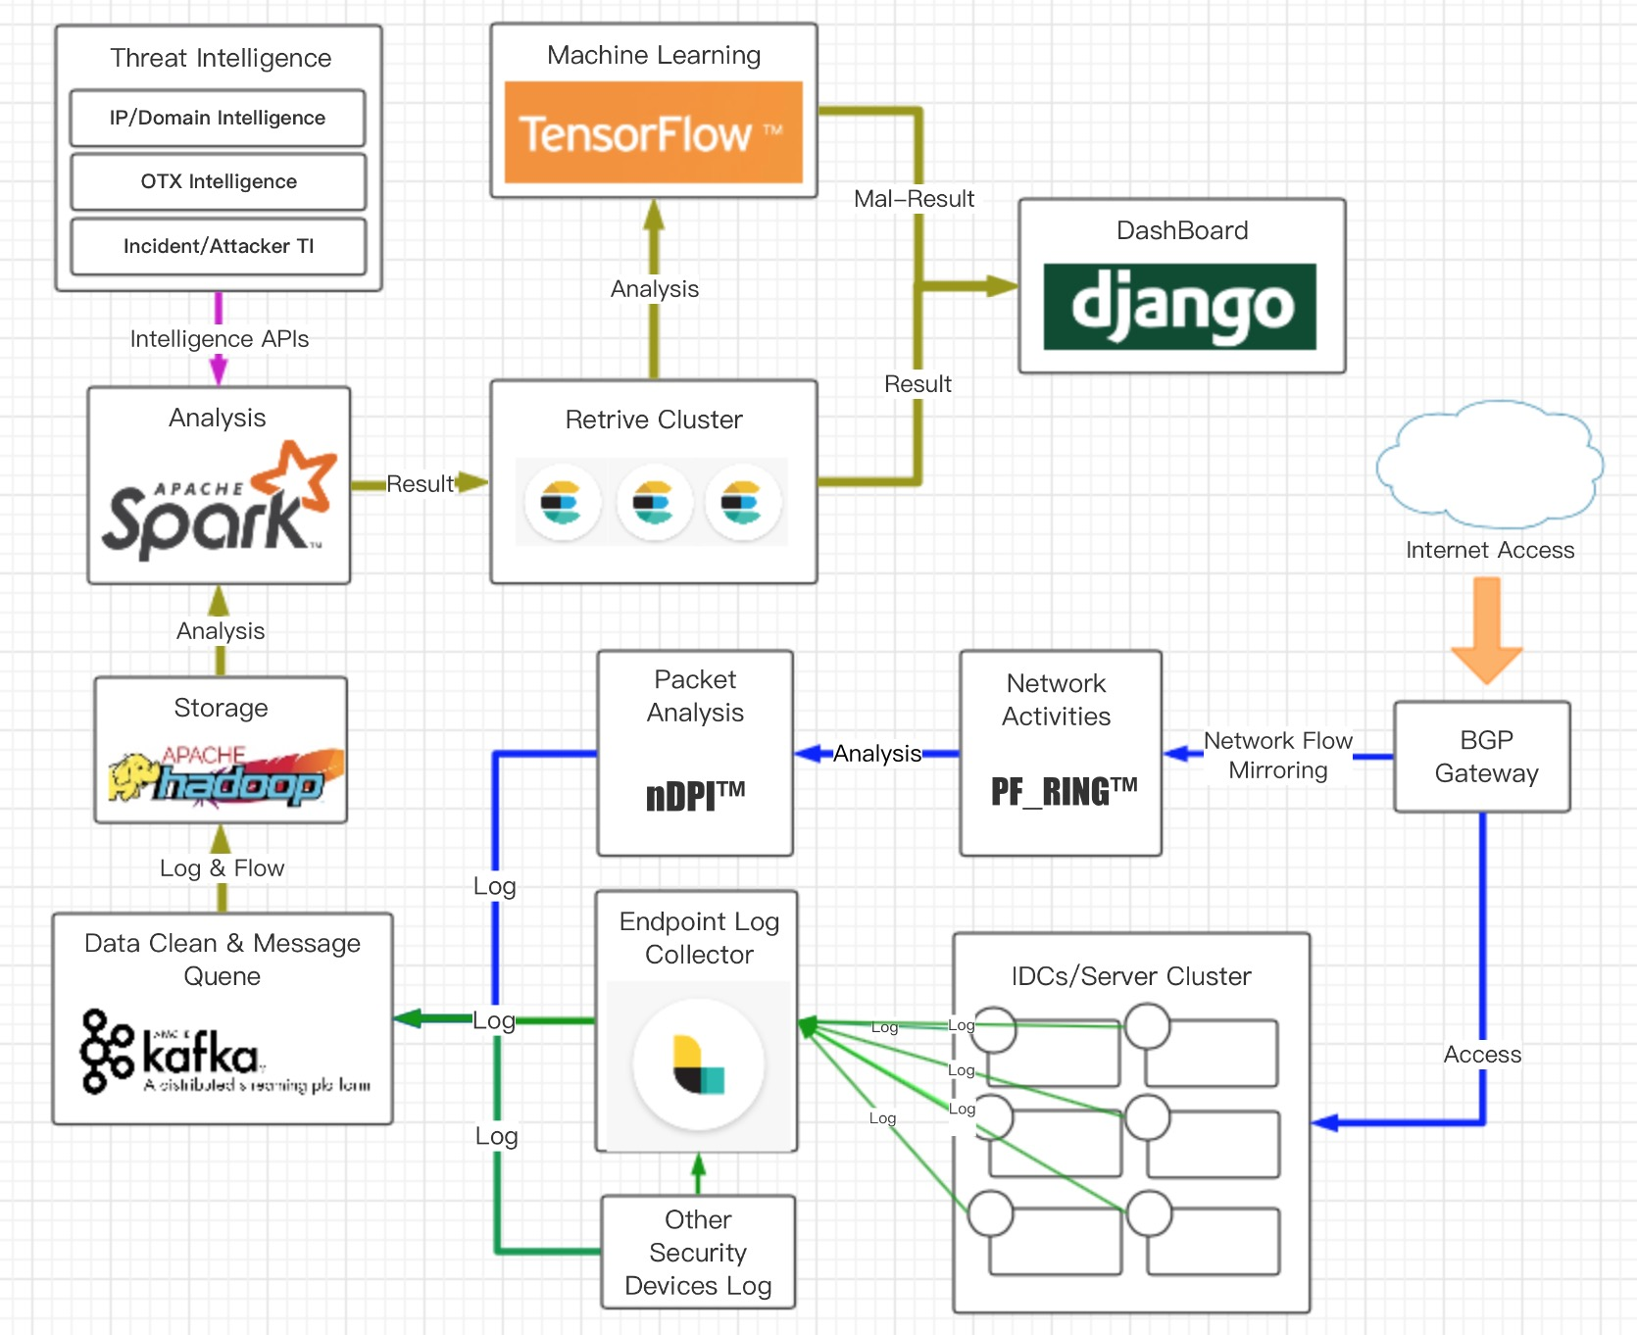
Build Private Threat Platform
Data Storage in HDFS
Retrieve Data by ES Cluster
Network in DPI
Monitor, Alarm, Notification
ML to Detect Abnormal Datasets

Slide 19
Discover Advanced Threats from
Private TI Platform

Slide 20
Workflow for Discover Advanced Threats
Native-Based Threat Datasets Analytic
Threat-Based Datasets Analytic
Techniques and Potential Targets Analytic
Attacker Profiling Datasets & Disposal Solution

Slide 21
Native-Based Data Analysis
Attack
Vectors
Device Log Sources
Internal Threat Datasets
Attack
Networks
Attacker Behaviors
Network DPI Data
Attack
Effects

Slide 22
Threat-Based Intelligence Analysis
Threat Intelligence Datasets & APIs
Sample Intelligence
Invasion History
Tools Collection
Aimed Targets
Compromised Servers
Attack Methods
Attacker Behaviors
IP/Domain
Intelligence
Behavior-Based
Intelligence

Slide 23
Threat Intelligence in Using
Research TI Datasets by SOC Team
Threat Intelligence in Research
OTX Datasets and Opening Threat Intelligence Sources
40%
20%
40%
Public Threat
Intelligence APIs
Native-Based Threat Intelligence
TI from Internal Security Datasets

Slide 24
Intelligence-Driven Entities Analysis
Attacker Objectives
Attacker Identities
Attacker Technique & Tactical
Attacker Kill-Chain
Data
Service
IT System
Target Industries
Network Identities
Commercial Interest
IP/Domain
Proxy/VPN
Tools & Abilities
Exploitation
Installation
Actives on Objects

Slide 25
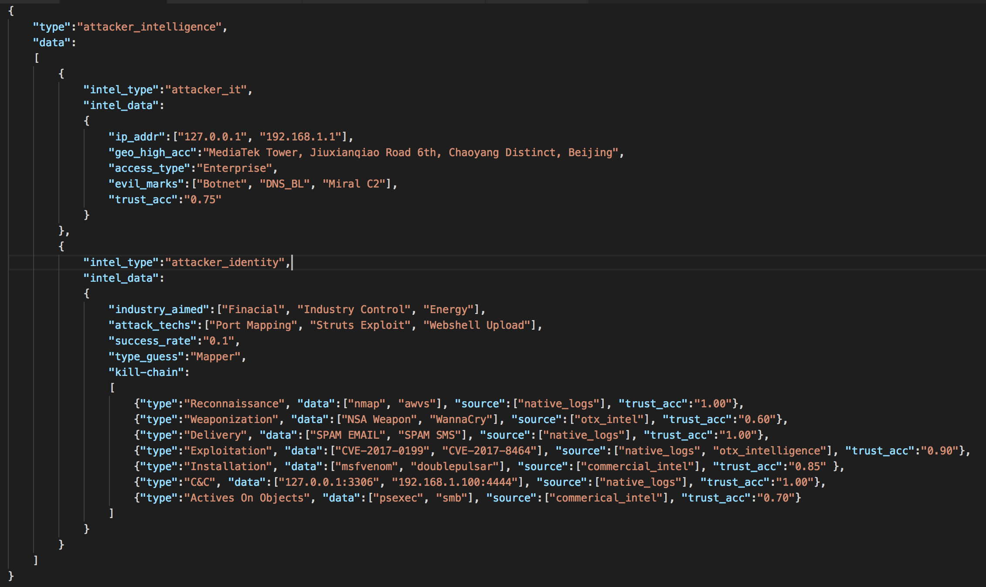
Collect Data From Attackers
Attacker Information
Attacker Techniques
Attacker Kill-Chain

Slide 26
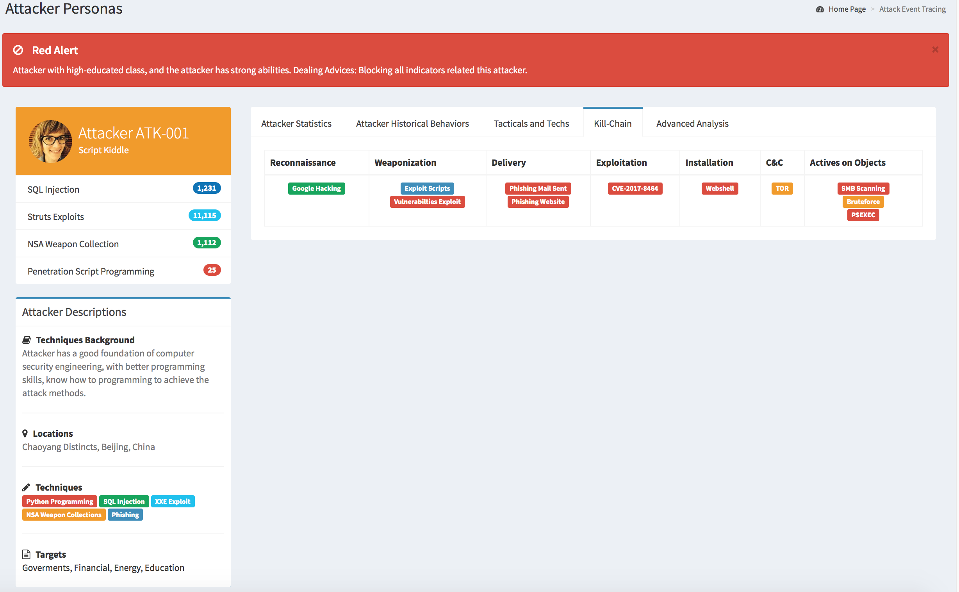
Visualization - Description of Attackers
Alert Method
Attacker Information
Attacker Profiles
Attacker Description

Slide 27
Current Stage of Result
Detected More Than 500+ Advanced Threat Cases
All Cases Have Been Made to Models for Security Ops
Identify Unknown Attackers with Existed Models
Introducing Machine Learning into Hybrid Platform
Open APIs and Datasets to Few Researchers

Slide 28
Authentic DB Collision ?

Slide 29
DB Collision ?
Log Terminal
X
CIRT:
Abnormal User Login
Accounts Brute-force
Too Many Failures!
Possible DB Collision
Success Rate Over 30%
19:00:01 > System Log: AUTH FAILED!!
19:00:01 > System Log: AUTH FAILED!!
19:00:01 > System Log: AUTH SUCCESS!!
19:00:01 > System Log: AUTH SUCCESS!!
19:00:01 > System Log: AUTH FAILED!!
19:00:01 > System Log: AUTH FAILED!!
19:00:01 > System Log: AUTH SUCCESS!!
19:00:01 > System Log: AUTH FAILED!!
19:00:02 > System Log: AUTH FAILED!!
19:00:02 > System Log: AUTH SUCCESS!!
19:00:02 > System Log: AUTH FAILED!!
19:00:02 > System Log: AUTH SUCCESS!!
19:00:02 > System Log: AUTH SUCCESS!!
19:00:02 > System Log: AUTH FAILED!!
19:00:02 > System Log: AUTH FAILED!!
19:00:03 > System Log: AUTH SUCCESS!!

Slide 30
DB Collision ?
Possible:
DB Thieves
Black Industry
Penetration Test
IP/URL From Foreign Countries
Attack Motivation？
Data Source of Collision?
Dangerous Success Rate
Any Sequelae？
Should I Ask Police for Help?
Attacker
Possible:
Leak DBs
Hydra
Scanner
Port Mapping
IP/Domain
URL
Infra-structures
Techs & Tools
Victim
Possible Employees

Slide 31
Possible Attack Roadmap
Possible Collect DBs
Prepare Brute Tools
Brute-Force Accounts
Planting RATs
Weaponi-zation
Exploitation
C&C
Recon-naissance
Delivery
Active on Objects
Installation
Google Hacking
Possible AWVS Scan
Illegal Login
More Possibilities

Slide 32
DB Collision ?
About 6 IPs, 3 in Blacklists
2 IPs With DDoS Tag
About 20 Domains Using in Phishing
Aim Financial Industry
IP TI DB
C&C IP
Attacker Leaks
PDNS Data
IP Address
Malware For Brute-Force Made In China
Fingerprint
Virus Total
Net-Flows
Attack TI
DDoS Attack Behaviors
With Short Time and Small Flows
Botnet Behaviors (From Honey Pot)
DDoS Mon
Net-Flow TI

Slide 33
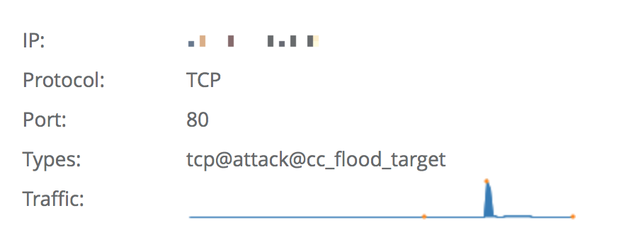
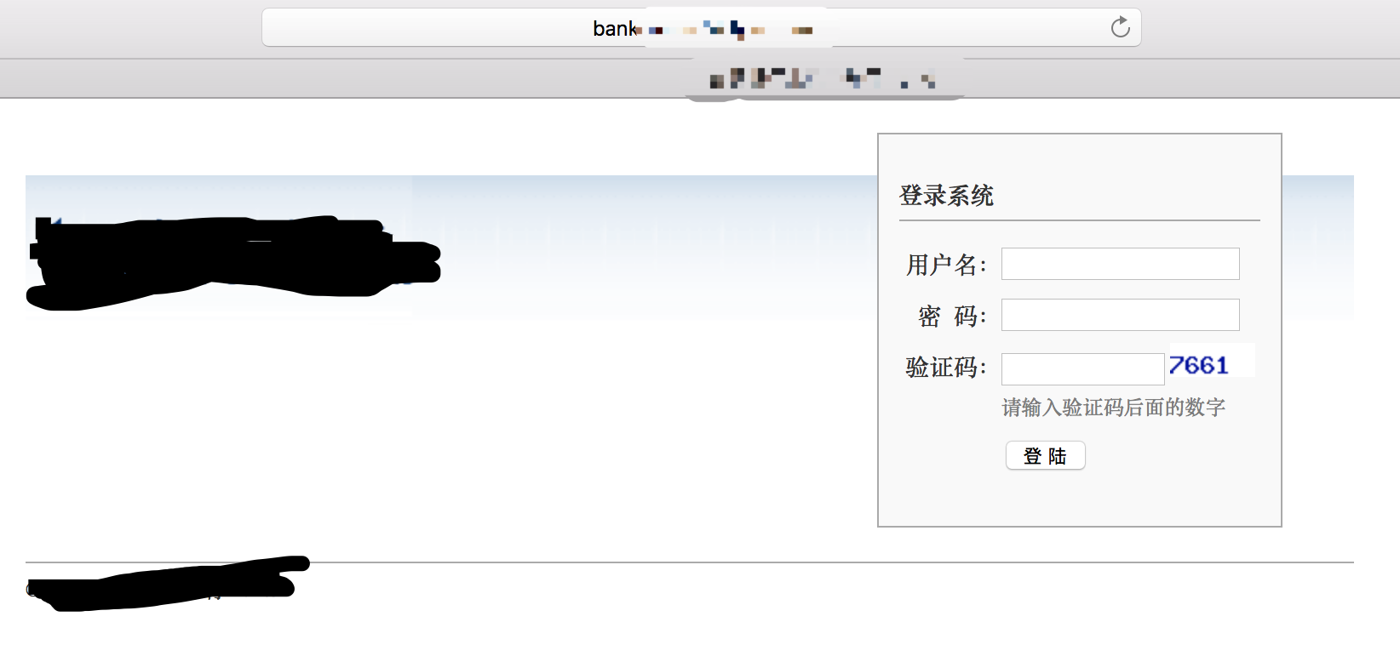
About Attack Processing
Using DDoS/SMS Spamming to Detect Victims
Preparing and Delivering Phishing Sites via SMS
Making DB with Leaking Accounts and Weak Password
DB Collision Attack

Slide 34
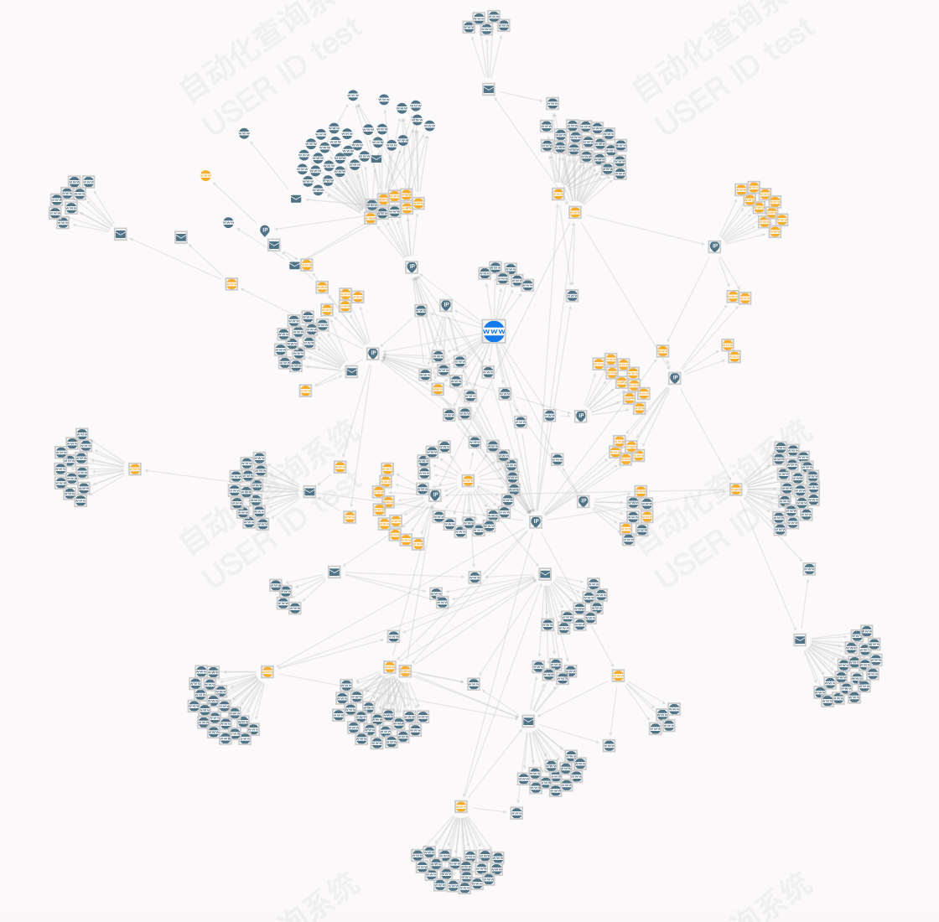
About Attacker
Medium-Scale Black Team
Mainly Focus on Financial Industry
Using DDoS, Phishing, SMS Spamming and DB Collision
Medium Threat Level

Slide 35
Real Attack Roadmap
Possible Collect DBs
Prepare Brute Tools
Prepare Phishing Site
Make Phishing DB for Brute-force Account
Weaponi-zation
Exploitation
C&C
Recon-naissance
Delivery
Active on Objects
Installation
Google Hacking
Possible AWVS Scan
Micro DDoS
Set Up Phishing Site
Illegal Login (Brute Force)

Slide 36
Summary
Understanding Attacker‘s Targets and Ambition
Building Private Threat Intelligence Datasets
Threat Analysis with Threat Intelligence Datasets
Discover Advanced Threat with Your Private TI Platform

Slide 37
Thank You!
Email: e1knot@oulook.com Twitter: elknot_jeremyli

